Slide 1
Applications of Depth First Search
Thomas Schwarz, SJ

Slide 2
Topological Sort
Recall topological sort
We are given a directed graph
Want to order all vertices such that no edge goes from a higher-numbered vertex to a lower-numbered vertex
If this is impossible, then we have a cycle
So, our algorithm also detects whether there is a cycle in a directed graph
We use DFS for an even better algorithm

Slide 3
Topological Sort
Run DFS on all nodes
Order nodes according to finish time in descending order

Slide 4
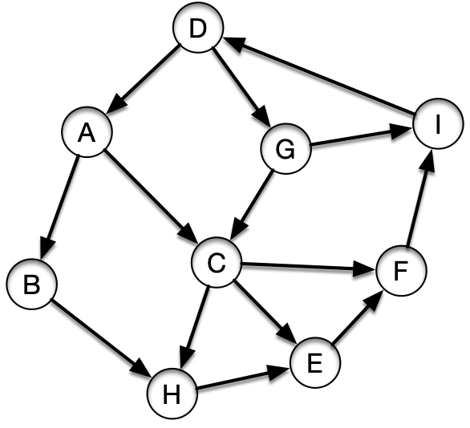
Topological Sort
Start in A
Order adjacency lists alphabetically
A: B,C
B: H
C: E,F,H
D: A,G
E: F
F: I
G: C
H:
I: D

Slide 5
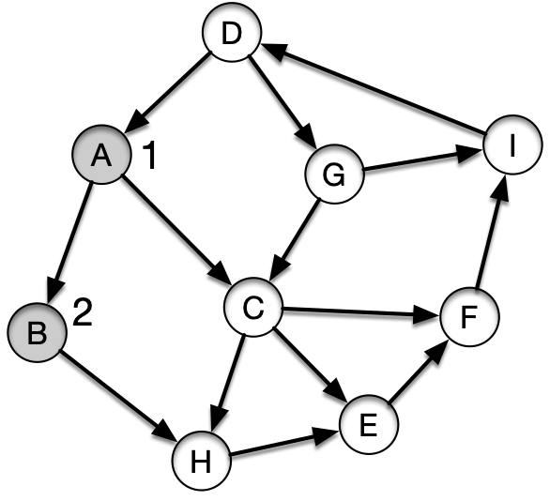
Topological Sort
Visit B
A: B,C
B: H
C: E,F,H
D: A,G
E: F
F: I
G: C
H:
I: D
visit(B)
visit(A)

Slide 6
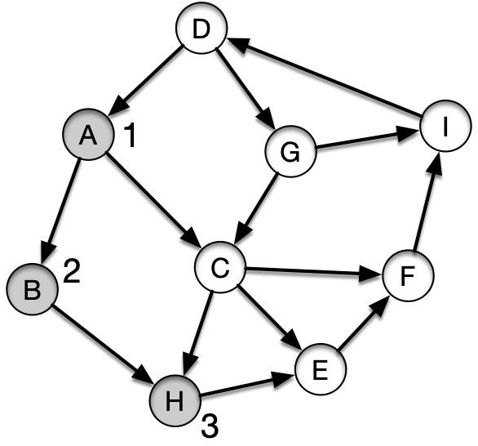
Topological Sort
Visit H
A: B,C
B: H
C: E,F,H
D: A,G
E: F
F: I
G: C
H:
I: D
visit(H)
visit(B)
visit(A)

Slide 7
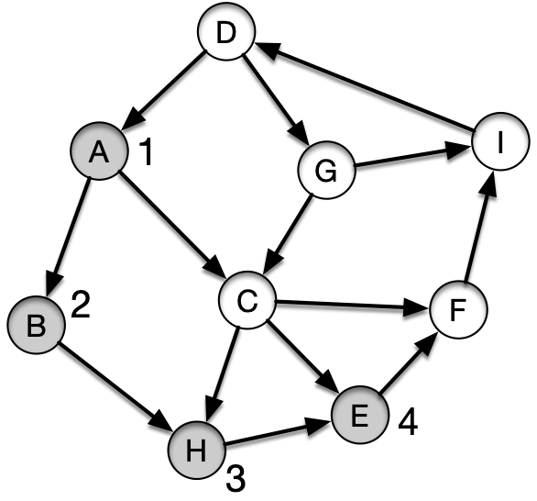
Topological Sort
Visit E
A: B,C
B: H
C: E,F,H
D: A,G
E: F
F: I
G: C
H:
I: D
visit(E)
visit(H)
visit(B)
visit(A)

Slide 8
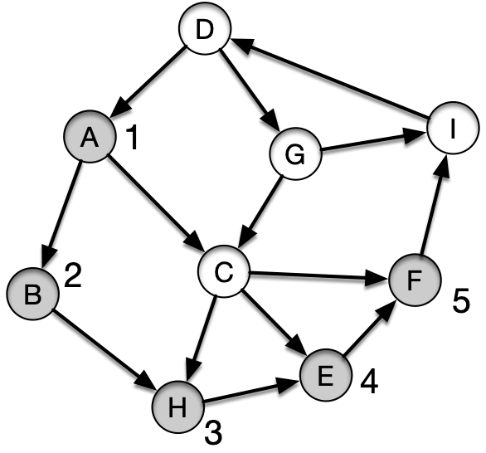
Topological Sort
Visit F
A: B,C
B: H
C: E,F,H
D: A,G
E: F
F: I
G: C
H:
I: D
visit(F)
visit(E)
visit(H)
visit(B)
visit(A)

Slide 9
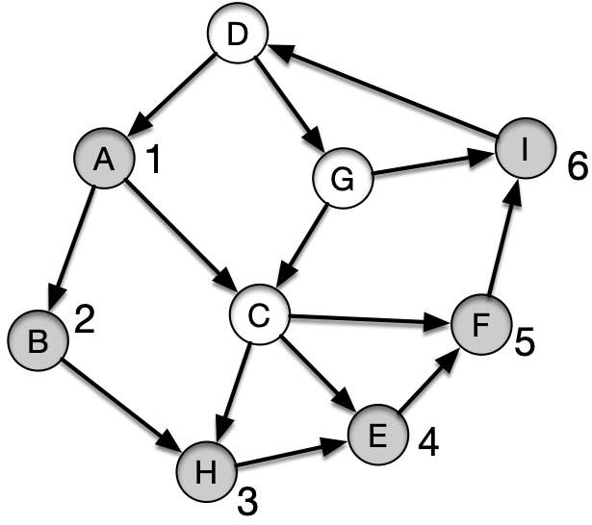
Topological Sort
Visit I
A: B,C
B: H
C: E,F,H
D: A,G
E: F
F: I
G: C
H:
I: D
visit(I)
visit(F)
visit(E)
visit(H)
visit(B)
visit(A)

Slide 10
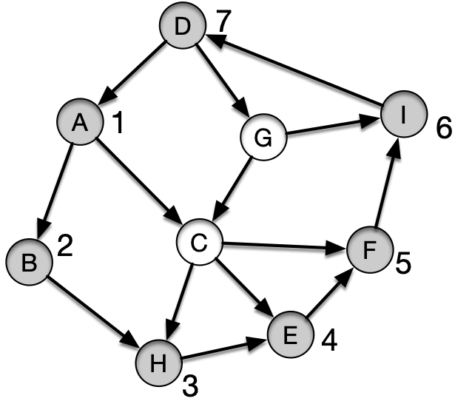
Topological Sort
Visit D
A: B,C
B: H
C: E,F,H
D: A,G
E: F
F: I
G: C
H:
I: D
visit(D)
visit(I)
visit(F)
visit(E)
visit(H)
visit(B)
visit(A)

Slide 11
Topological Sort
At this point:
The adjacency list of D starts with A
A is gray
This edge becomes a back edge!
And shows that there is a cycle
A: B,C
B: H
C: E,F,H
D: A,G
E: F
F: I
G: C
H:
I: D
visit(D)
visit(I)
visit(F)
visit(E)
visit(H)
visit(B)
visit(A)

Slide 12
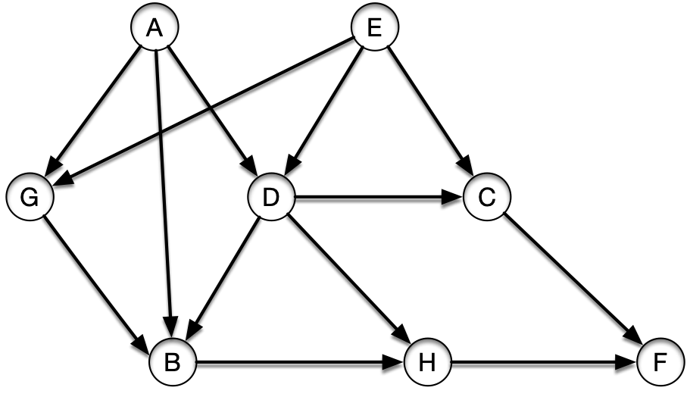
Topological Sort
A different example
Start in A
A: B,D,G
B: H
C: F
D: B,H
E: C,D,G
F:
G: B
H: F

Slide 13
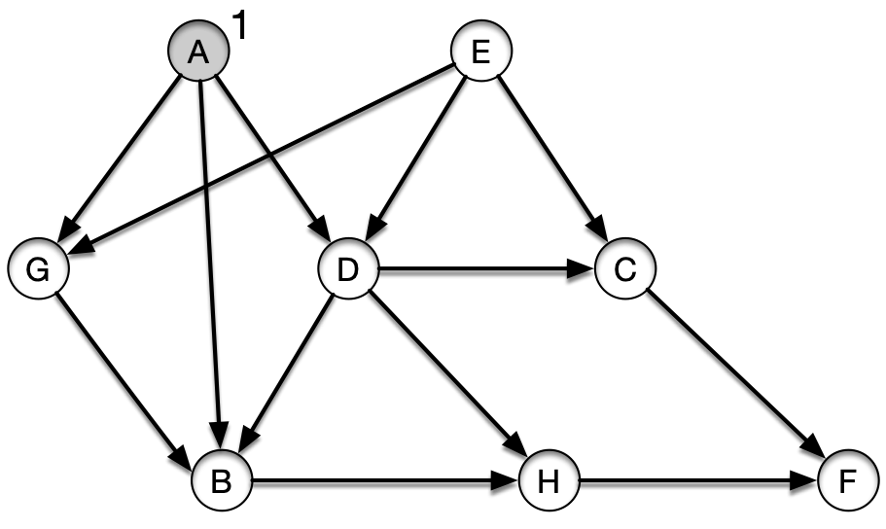
Topological Sort
A different example
Start in A
A: B,D,G
B: H
C: F
D: B,H
E: C,D,G
F:
G: B
H: F
visit(A)

Slide 14
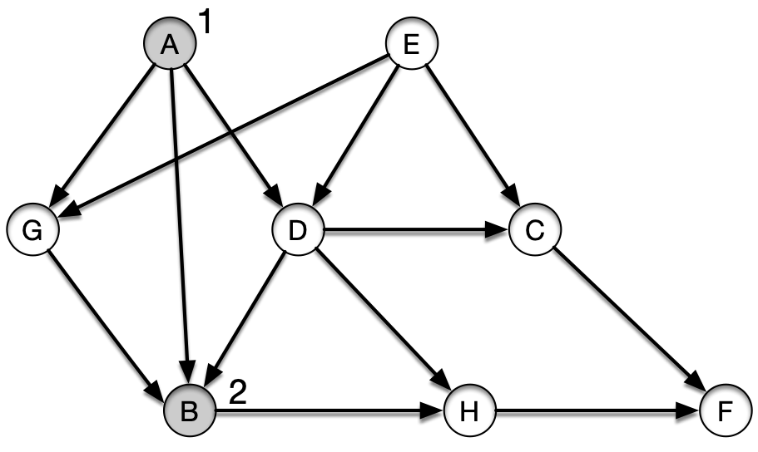
Topological Sort
Visit B
A: B,D,G
B: H
C: F
D: B,H
E: C,D,G
F:
G: B
H: F
visit(B)
visit(A)

Slide 15
Topological Sort
Visit H
A: B,D,G
B: H
C: F
D: B,H
E: C,D,G
F:
G: B
H: F
visit(H)
visit(B)
visit(A)

Slide 16
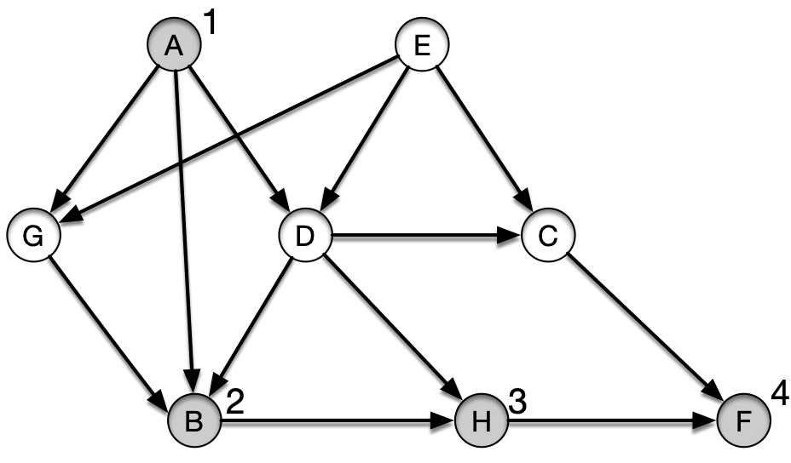
Topological Sort
Visit F
A: B,D,G
B: H
C: F
D: B,H
E: C,D,G
F:
G: B
H: F
visit(F)
visit(H)
visit(B)
visit(A)

Slide 17
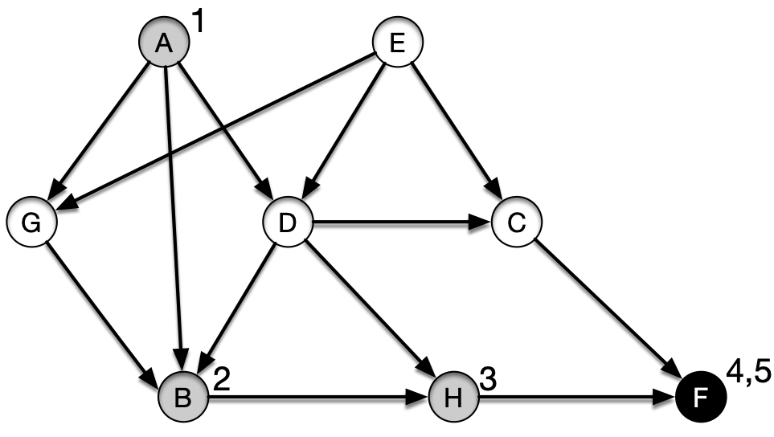
Topological Sort
Finish F
Push F at front: [F]
A: B,D,G
B: H
C: F
D: B,H
E: C,D,G
F:
G: B
H: F
visit(F)
visit(H)
visit(B)
visit(A)

Slide 18
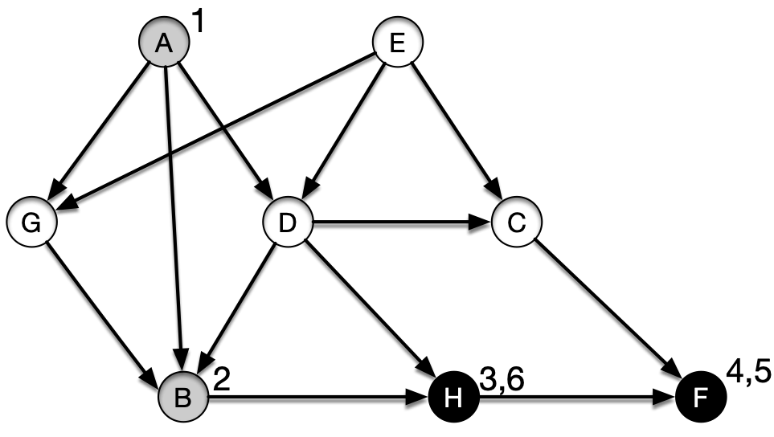
Topological Sort
Finish H
Push H at front: [H, F]
A: B,D,G
B: H
C: F
D: B,H
E: C,D,G
F:
G: B
H: F
visit(H)
visit(B)
visit(A)

Slide 19
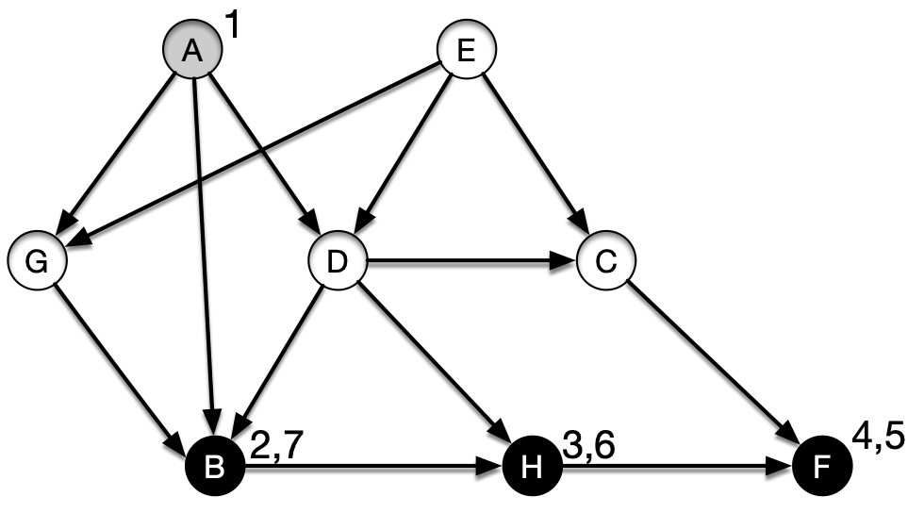
Topological Sort
Finish B
Push B at front: [B,H, F]
A: B,D,G
B: H
C: F
D: B,H
E: C,D,G
F:
G: B
H: F
visit(B)
visit(A)

Slide 20
Topological Sort
Go back to visit A
[B,H, F]
A: B,D,G
B: H
C: F
D: B,H
E: C,D,G
F:
G: B
H: F
visit(A)

Slide 21
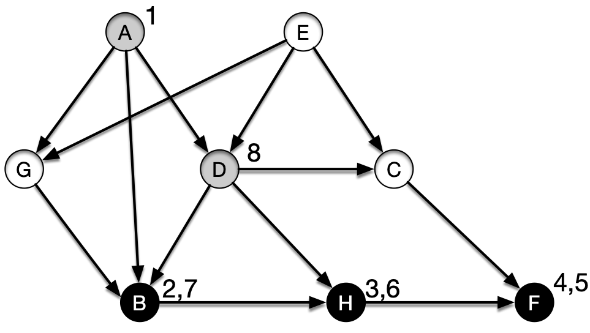
Topological Sort
Visit D
[B,H, F]
A: B,D,G
B: H
C: F
D: B,H
E: C,D,G
F:
G: B
H: F
visit(D)
visit(A)

Slide 22
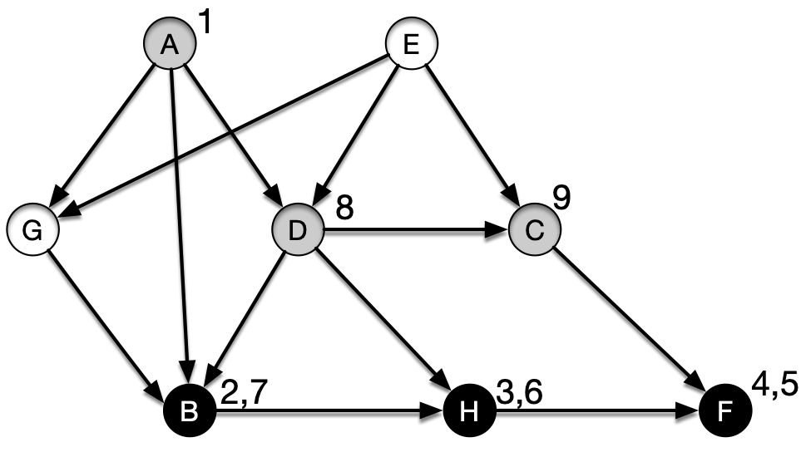
Topological Sort
Visit C
[B,H, F]
A: B,D,G
B: H
C: F
D: B,H
E: C,D,G
F:
G: B
H: F
visit(C)
visit(D)
visit(A)

Slide 23
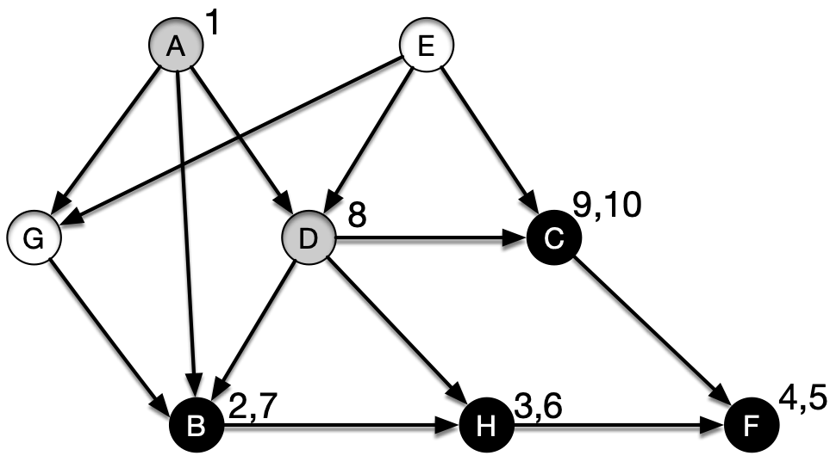
Topological Sort
Finish C
[C, B,H, F]
A: B,D,G
B: H
C: F
D: B,H
E: C,D,G
F:
G: B
H: F
visit(C)
visit(D)
visit(A)

Slide 24
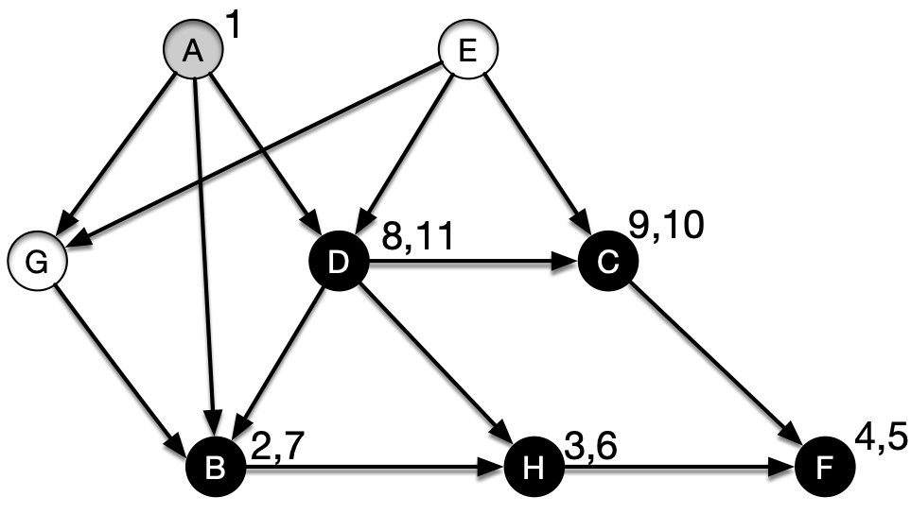
Topological Sort
Go back and finish D
[D, C, B, H, F]
A: B,D,G
B: H
C: F
D: B,H
E: C,D,G
F:
G: B
H: F
visit(D)
visit(A)

Slide 25
Topological Sort
We are back to visit A
Next node is G
[D, C, B, H, F]
A: B,D,G
B: H
C: F
D: B,H
E: C,D,G
F:
G: B
H: F
visit(A)

Slide 26
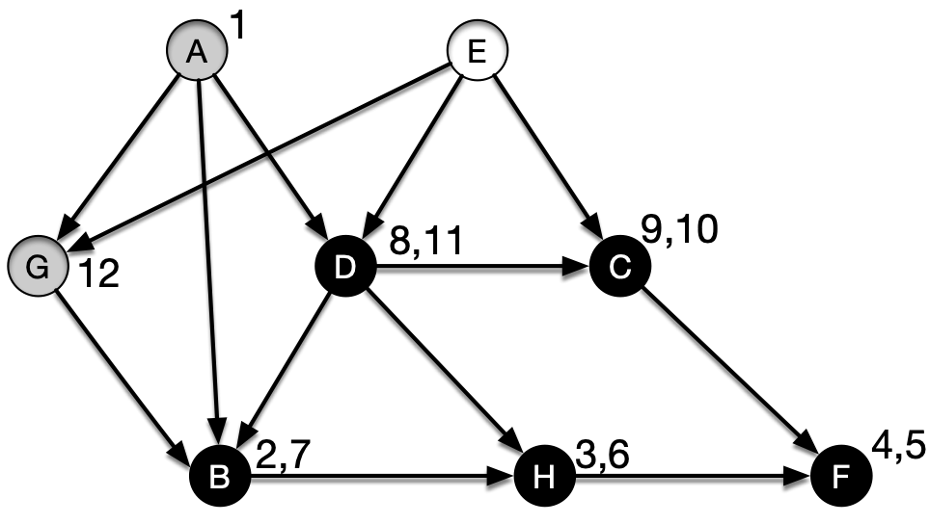
Topological Sort
Visit G
[D, C, B, H, F]
A: B,D,G
B: H
C: F
D: B,H
E: C,D,G
F:
G: B
H: F
visit(G)
visit(A)

Slide 27
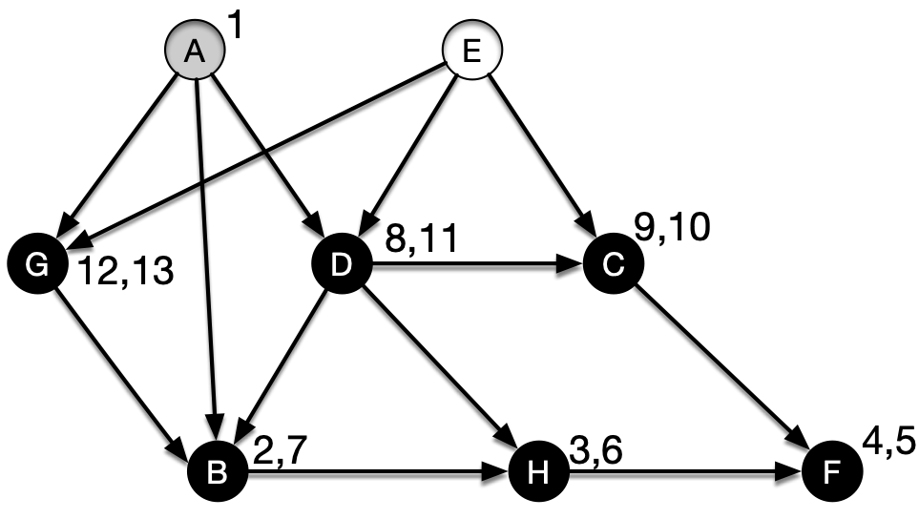
Topological Sort
Finish G
[G, D, C, B, H, F]
A: B,D,G
B: H
C: F
D: B,H
E: C,D,G
F:
G: B
H: F
visit(G)
visit(A)

Slide 28
Topological Sort
Go back to A
[G, D, C, B, H, F]
A: B,D,G
B: H
C: F
D: B,H
E: C,D,G
F:
G: B
H: F
visit(A)

Slide 29
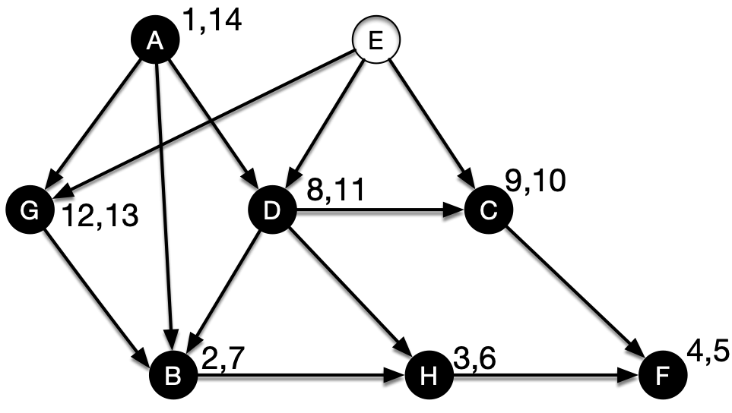
Topological Sort
Finish A
[A, G, D, C, B, H, F]
A: B,D,G
B: H
C: F
D: B,H
E: C,D,G
F:
G: B
H: F
$$∅$$

Slide 30
Topological Sort
Done with visit(A)
[A, G, D, C, B, H, F]
A: B,D,G
B: H
C: F
D: B,H
E: C,D,G
F:
G: B
H: F
$$∅$$

Slide 31
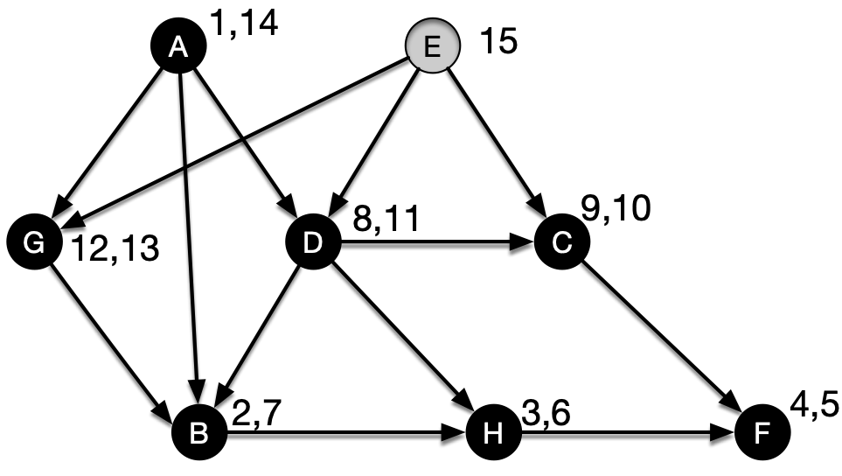
Topological Sort
One white node left: E
Visit E
[A, G, D, C, B, H, F]
A: B,D,G
B: H
C: F
D: B,H
E: C,D,G
F:
G: B
H: F
visit(E)

Slide 32
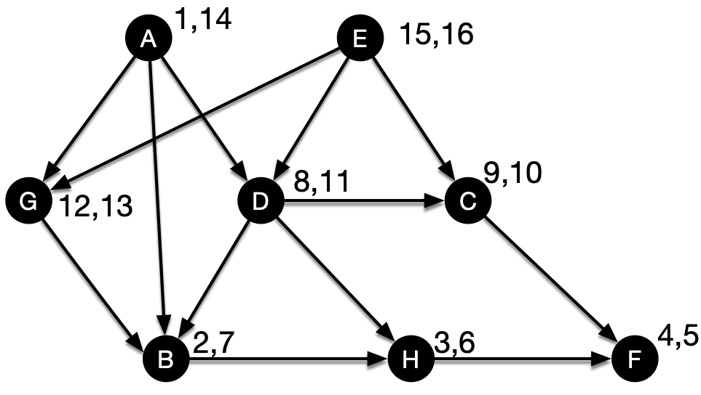
Topological Sort
Finish E
[E, A, G, D, C, B, H, F]
A: B,D,G
B: H
C: F
D: B,H
E: C,D,G
F:
G: B
H: F

Slide 33
Topological Sort
Key observation from the examples:
We have a cycle if we ever try to visit a gray node

Slide 34
Topological Sort
Lemma: A directed graph $G=(V,E)$ is acyclic if and only if a DFS of G yields no back edges

Slide 35
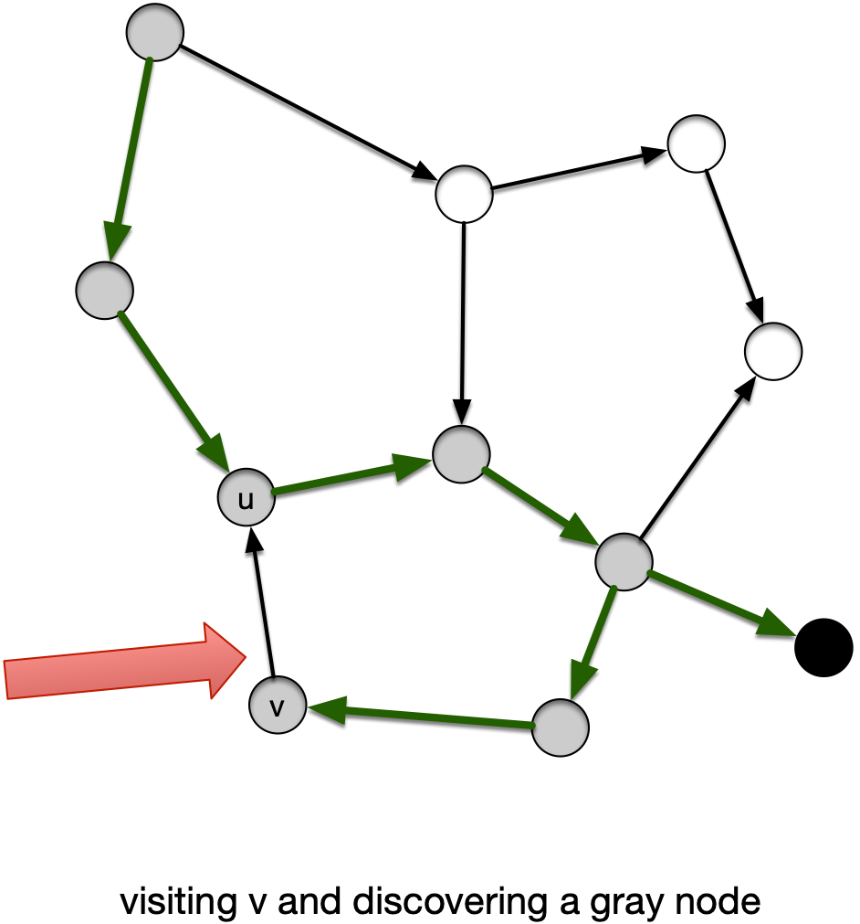
Topological Sort
Proof: "$⇒$"
If DFS produces a back-edge $(v,u)$ then $u$ is an ancestor of $v$
There is a path from $u$ to $v$ in the tree
The edge $(v,u)$ closes a cycle
from $u$ to $v$ back to $u$

Slide 36
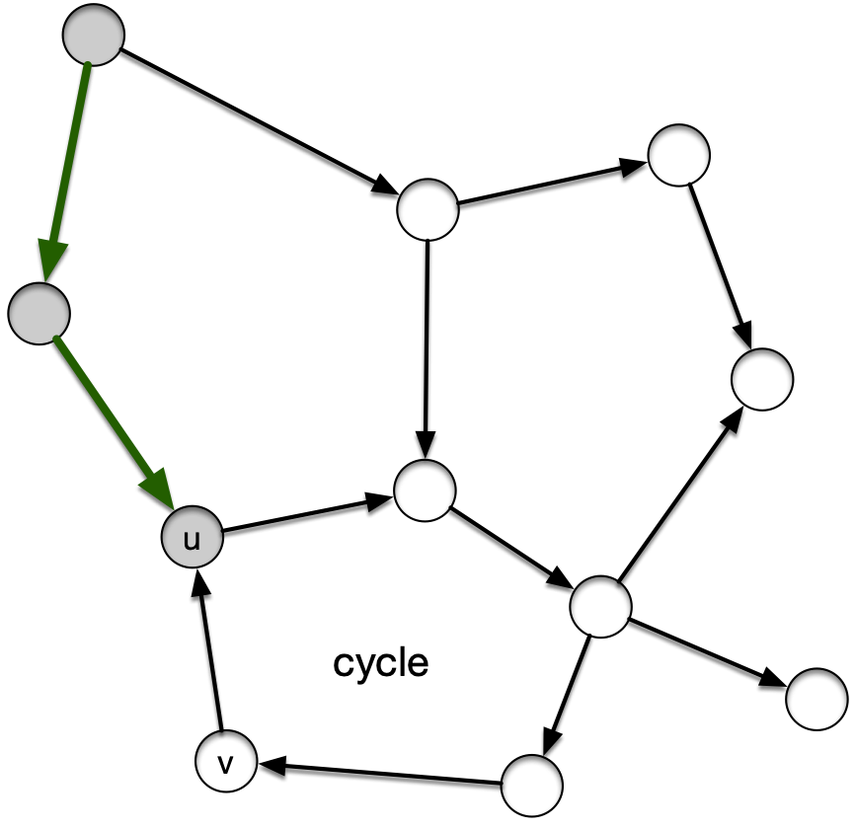
Topological Sort
Proof: "$⇐$"
Suppose $G$ has a cycle
Let $u$ be the first vertex in the cycle to be discovered

Slide 37
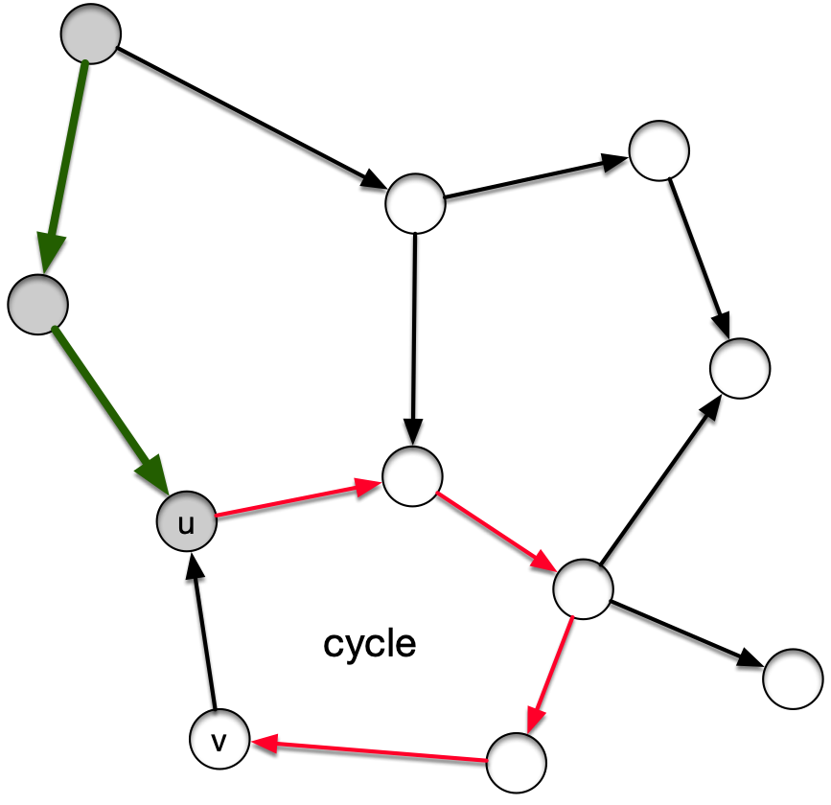
Topological Sort
All other vertices in the cycle are white and there is a white-path to the node $v$ just in front of $u$

Slide 38
Topological Sort
By the white-path theorem:
We will discover $v$ from $u$
(Though not necessarily through the cycle since there might be more cycles)
Thus, $(v,u)$ is a back edge

Slide 39
Topological Sort
Theorem: DFS gives a topological sort or discovers a cycle
Proof:
Need to show:
If DFS does not discover a cycle, then for each edge $(u,v)$, we have $u.f>v.f$

Slide 40
Topological Sort
Proof:
At the time that we are first looking at $(u,v)$:
$v$ cannot be gray, because then we would have a back-edge

Slide 41
Topological Sort
At the time that we are first looking at $(u,v)$:
If $v$ is white:
Then by the white path theorem, $u$ becomes an ancestor of $v$
By the parenthesis theorem $v.f<u.f$

Slide 42
Topological Sort
Proof:
At the time that we are first looking at $(u,v)$:
If $v$ is black, then $u$ is still be visited, so
$u$ is not yet black
so, $u.f>v.f$
qed

Slide 43
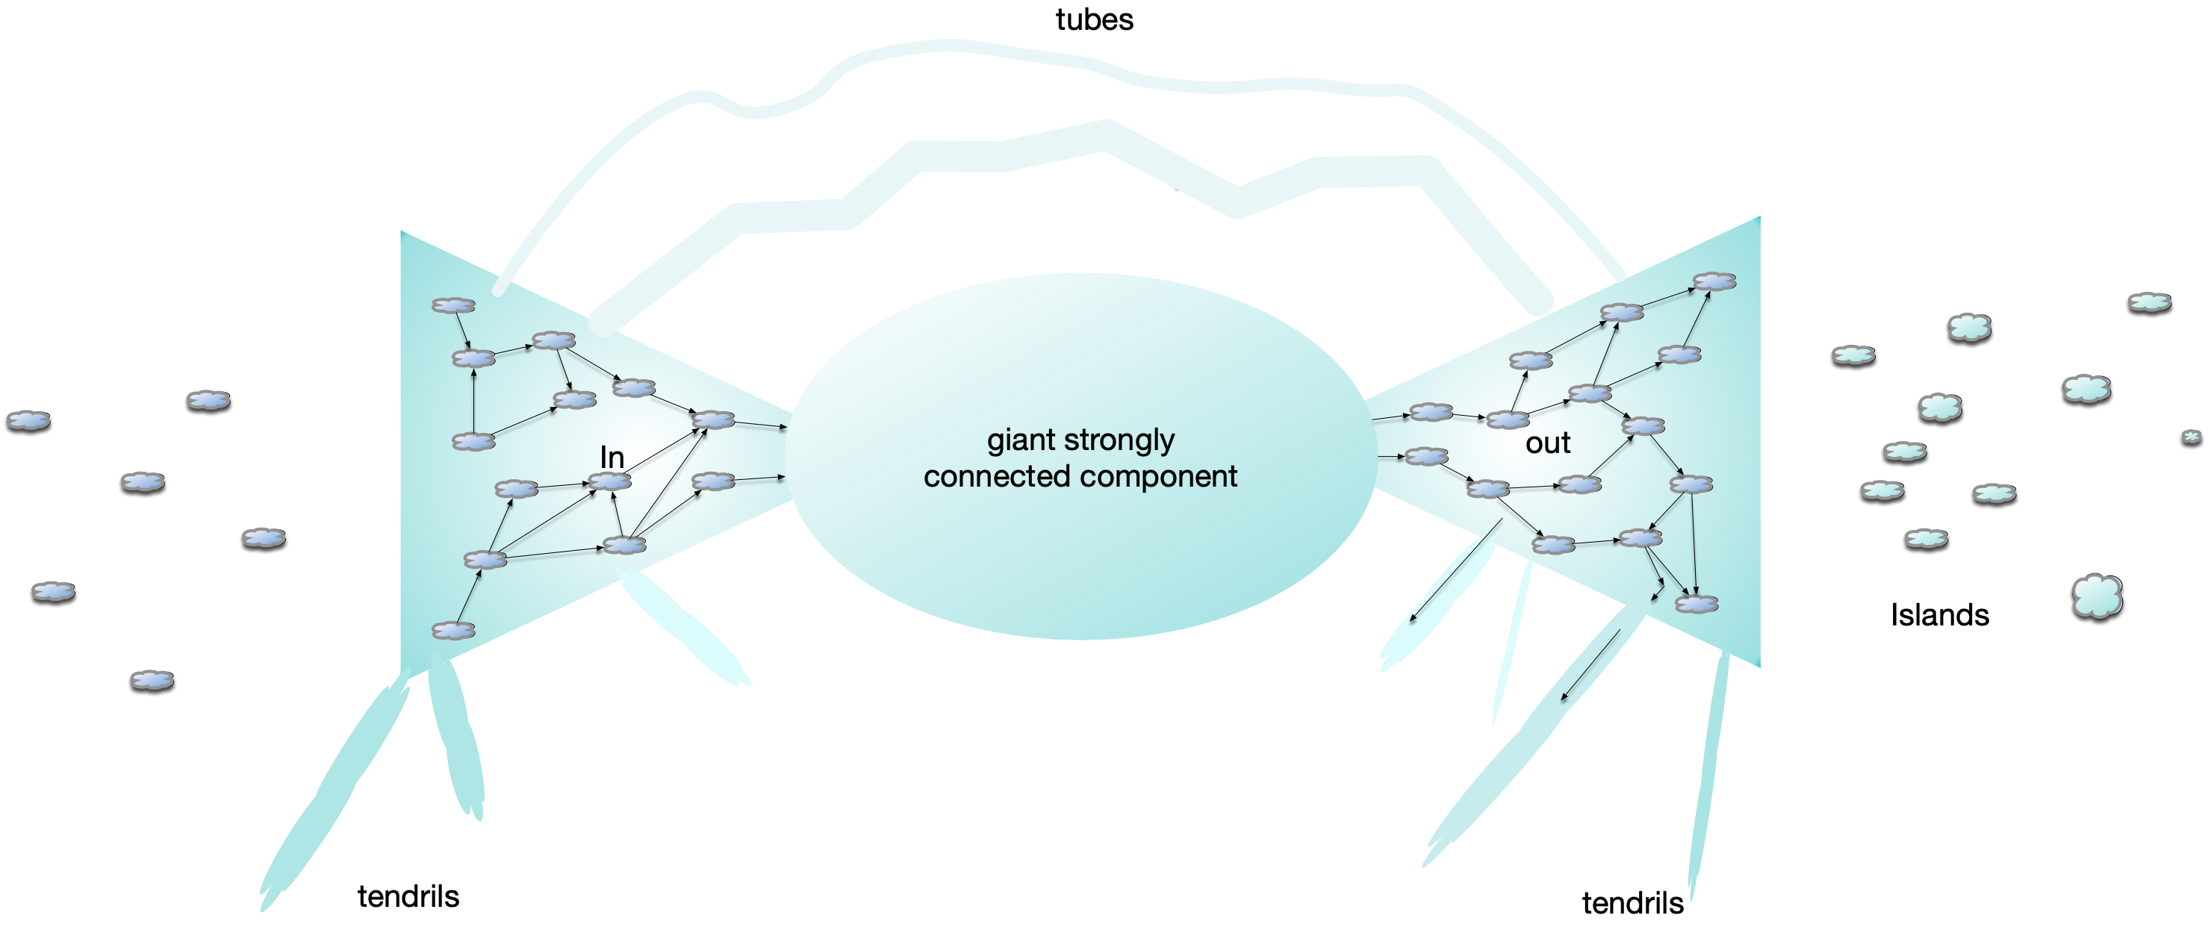
Strongly Connected Components
WWW graph:
Nodes: pages
Edges: links from one page to another page
Broder et al. study (2000): 200 million pages and 1.5 billion links

Slide 44
Strongly Connected Components
Bowtie:
Strongly connected component at the center of the WWW (28%) of all nodes

Slide 45
Strongly Connected Components
Islands: Isolated areas of the web

Slide 46
Strongly Connected Components
In: Possible to reach the giant
Out: Reachable from the giant

Slide 47
Strongly Connected Components
Weird stuff: Tubes that move from In to Out bypassing the giant

Slide 48
Strongly Connected Components
Weird stuff: Tendrils to In and tendrils to Out

Slide 49
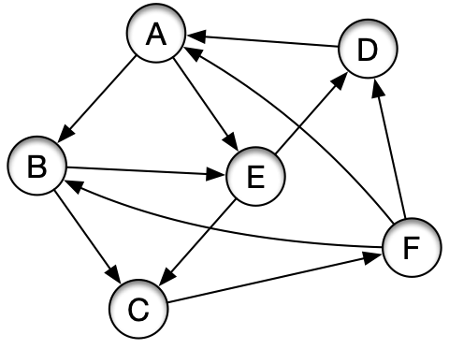
Strongly Connected Components
Strongly connected component:
Can reach any vertex from any other vertex

Slide 50
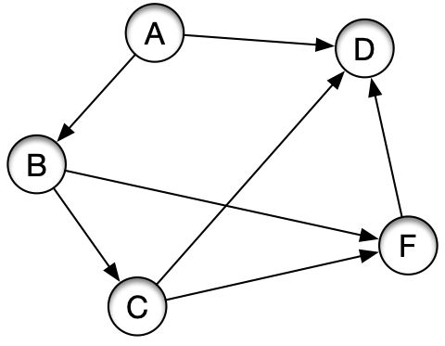
Strongly Connected Components
Strongly connected component
This is NOT strongly connected
There is no way to get from D to A

Slide 51
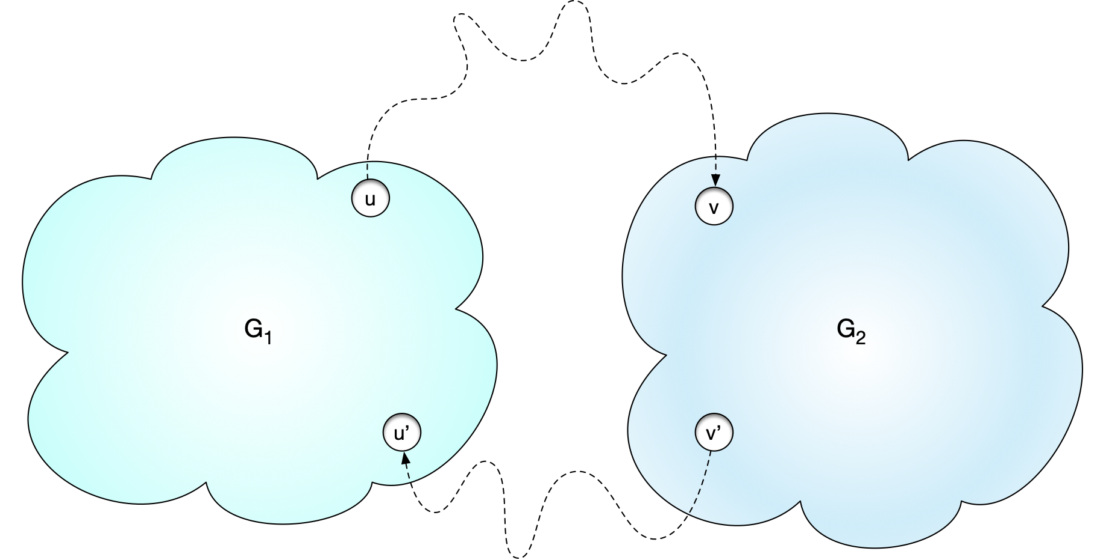
Strongly Connected Components
Lemma: Let $G_{1}$ and $G_{2}$ be two strongly connected subgraphs of a graph $G$ and assume that there is a path from a vertex in $G_{1}$ to a vertex in $G_{2}$ and also a path from a vertex of $G_{2}$ to $G_{1}$, then $G_{1}∪G_{2}$ is strongly connected

Slide 52
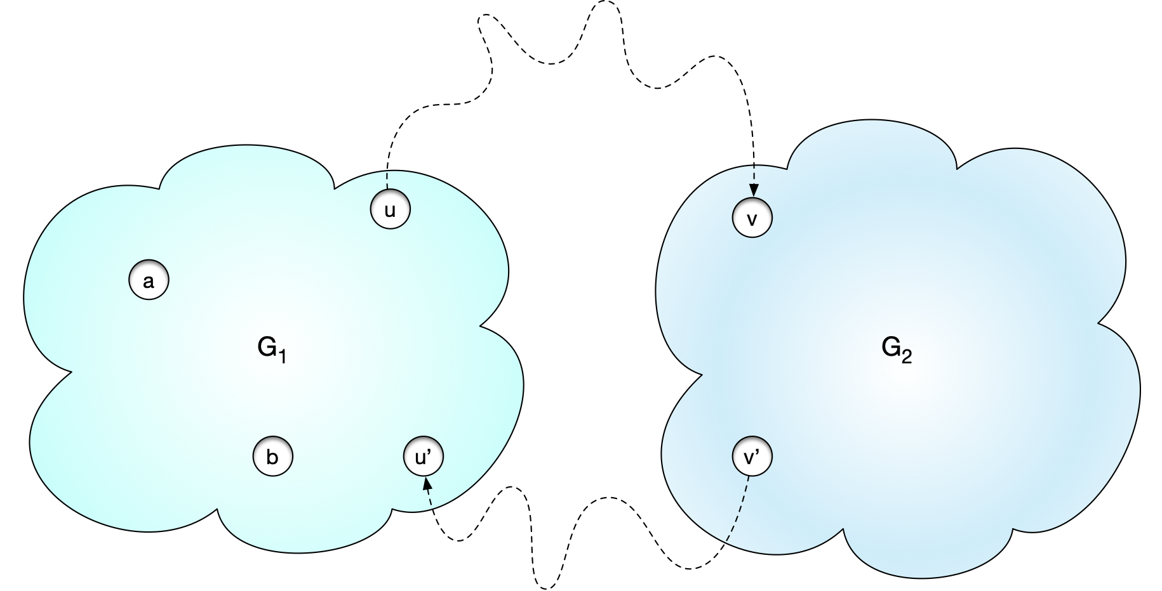
Strongly Connected Components
Proof: Take two nodes $a$ and $b$ in $G_{1}∪G_{2}$.
If both are in $G_{1}$ then there is a path between $a$ and $b$ because they are in $G_{1}$

Slide 53
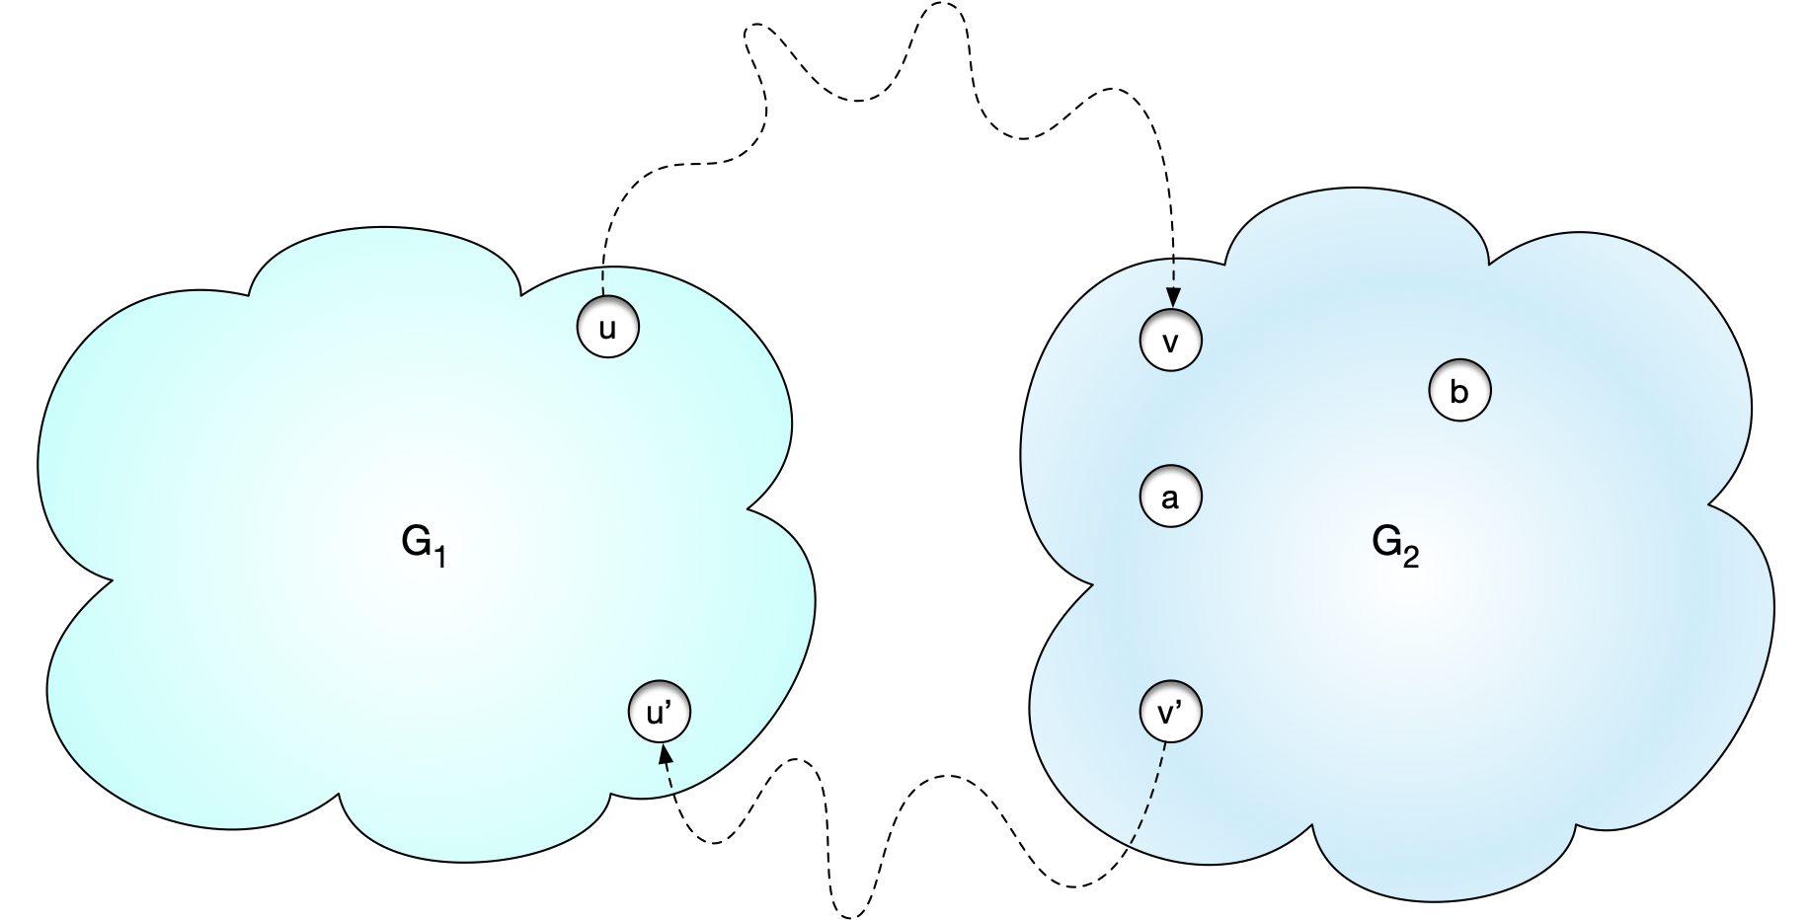
Strongly Connected Components
Proof: Take two nodes $a$ and $b$ in $G_{1}∪G_{2}$.
If both are in $G_{2}$ then there is a path between $a$ and $b$ because they are in $G_{2}$

Slide 54
Strongly Connected Components
If $a∈V(G_{1})$ and $b∈V(G_{2})$, then we can move from $a$ to $u$ and from $u$ to $v$ and then from $v$ to $b$.
After removing cycles, this is now a path from $a$ to $b$

Slide 55
Strongly Connected Components
Similarly, if $a∈V(G_{2})$ and $b∈V(G_{1})$, then we can move from $a$ to $v^{′}$ and from $v^{′}$ to $u^{′}$ and then from $u^{′}$ to $b$.
After removing cycles, this is now a path from $a$ to $b$

Slide 56
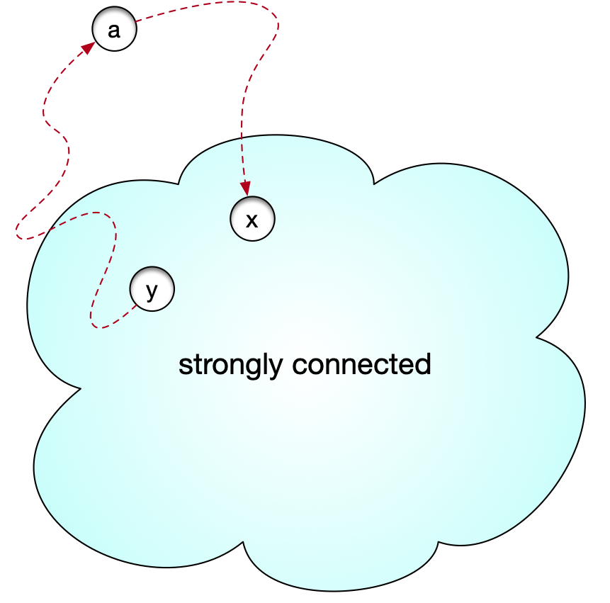
Strongly Connected Components
A single node is a strongly connected subgraph
For each strongly connected subgraph, we can try to grow by adding other nodes
If a node a has a path to and from a strongly connected subgraph, then by the lemma, we can add the node and get a bigger strongly connected subgraph

Slide 57
Strongly Connected Components
Strongly connected component : A maximal strongly connected subgraph
The nodes of any directed graph can be divided into strongly connected components

Slide 58
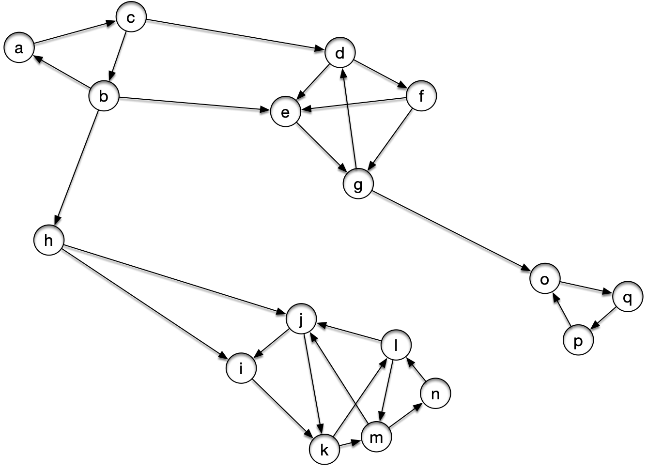
Strongly Connected Components
Example:

Slide 59
Strongly Connected Components
Try it out by growing from individual nodes

Slide 60
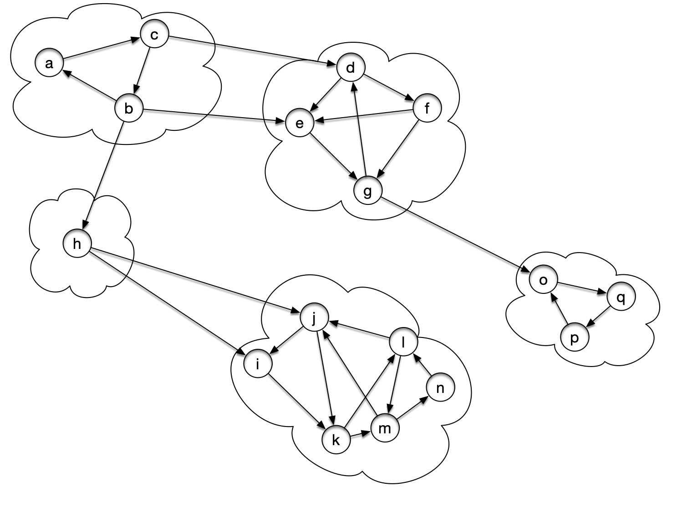
Strongly Connected Components
Result:

Slide 61
Strongly Connected Components
If we only look at the connected components we get the SCC metagraph
Nodes are the strongly connected components
Edges represent the existence of an edge from one component to the next

Slide 62
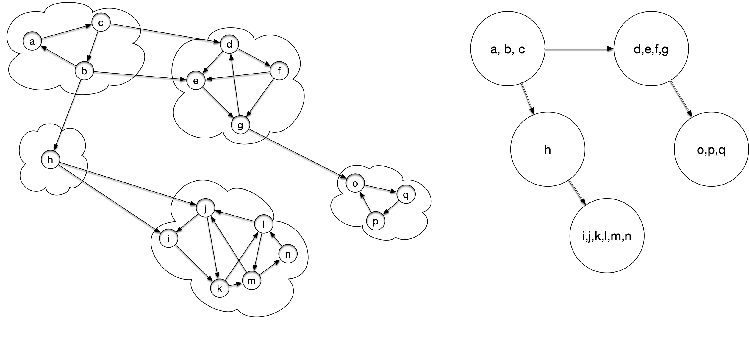
Strongly Connected Components

Slide 63
Strongly Connected Components
The resulting metagraph has to be acyclic
If there is a cycle in the metagraph, then by the lemma, the metanodes can be merged into bigger strongly connected subgraphs

Slide 64
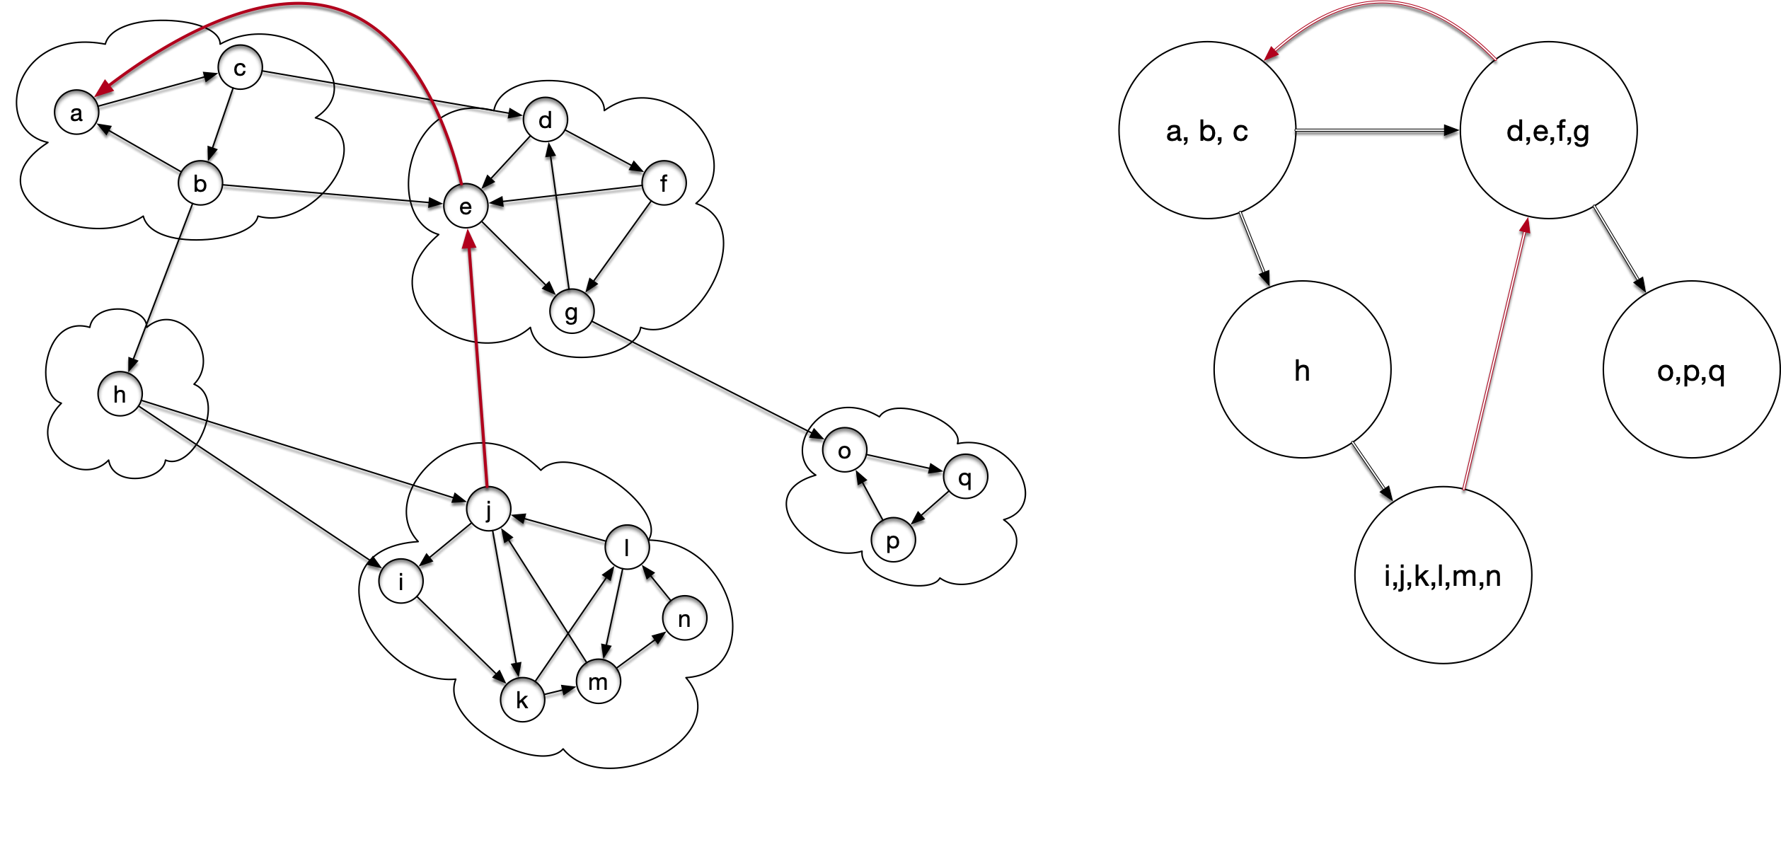
Strongly Connected Components
Example: Add two edges

Slide 65
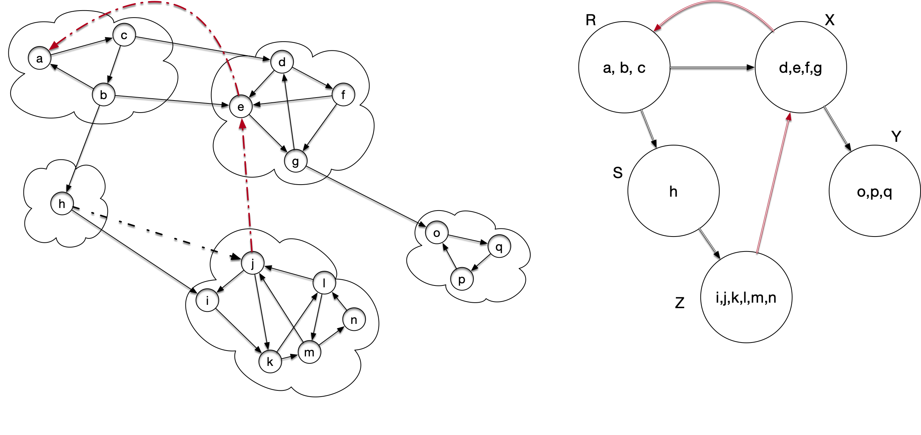
Strongly Connected Components
Now we can start merging via the Lemma
There is a path from components S to R and vice versa

Slide 66
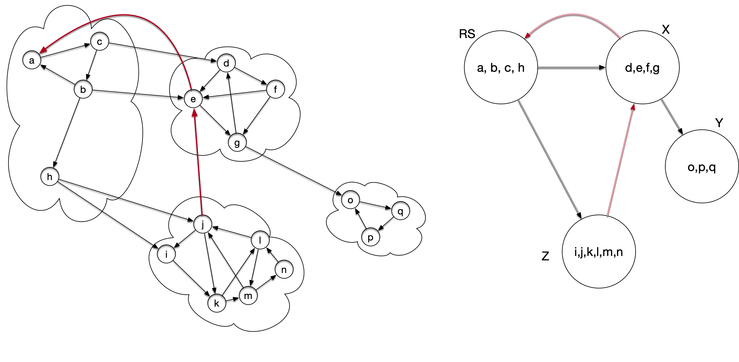
Strongly Connected Components
So we merge

Slide 67
Strongly Connected Components
There is a path from RS to X and vice versa:

Slide 68
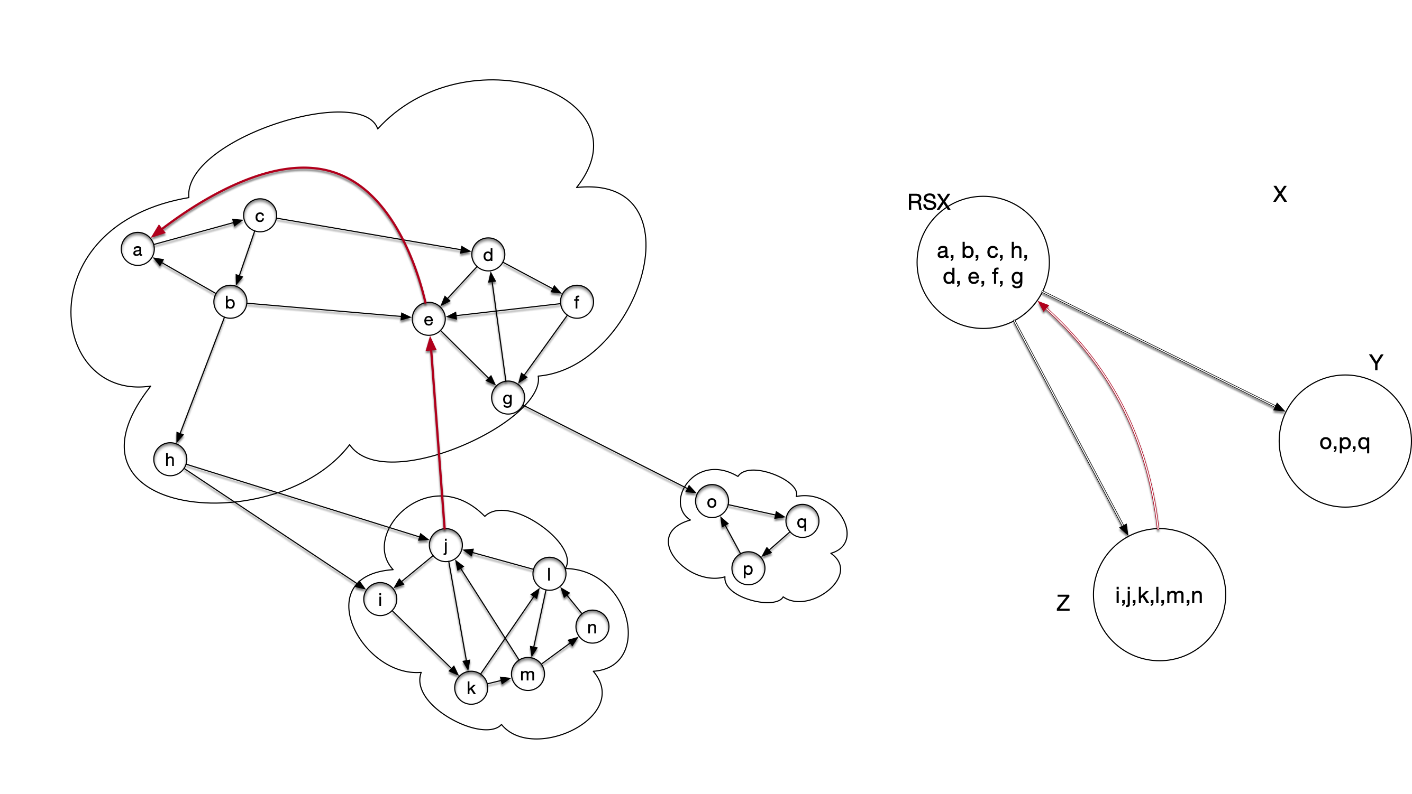
Strongly Connected Components
We can merge

Slide 69
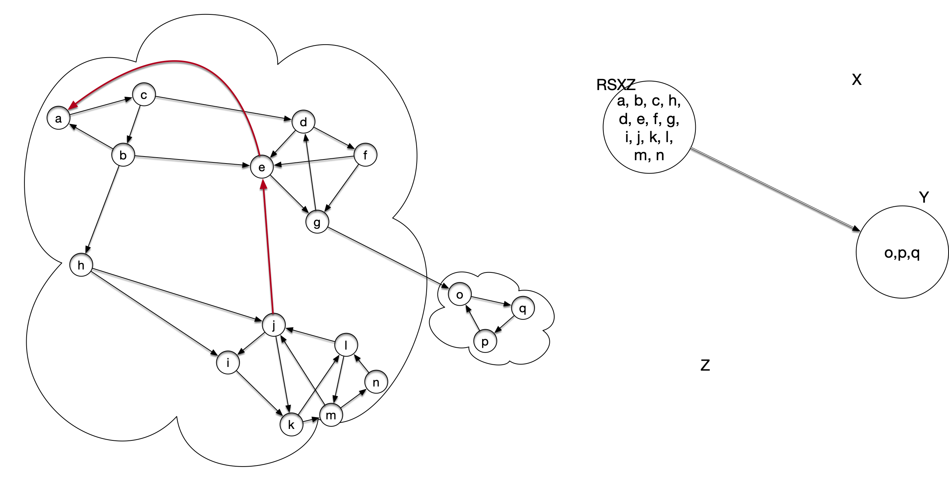
Strongly Connected Components
Finally, we can merge Z with the new supernode

Slide 70
Strongly Connected Components
This can be generalized:
Theorem: The metagraph is acyclic

Slide 71
Strongly Connected Components
How can we apply DFS to the problem of determining connected components?
The WWW graph in 2000 would have been to big for anything but linear time algorithms

Slide 72
Strongly Connected Components
Answer:
Use DFS several times
Including indirectly on the metagraph

Slide 73
Strongly Connected Components

Slide 74
Strongly Connected Components

