Slide 1
Graphs
Thomas Schwarz, SJ

Slide 2
Graph Definition
A graph has a set of vertices $V$ and a set of edges.
Directed edges are pairs $(u,v)$ with $u,v∈V$
Undirected edges are two-sets $\{u,v\}$ with $u,v∈V$
A graph with directed edges is called a directed graph
A graph with undirected edges is just called a graph

Slide 3
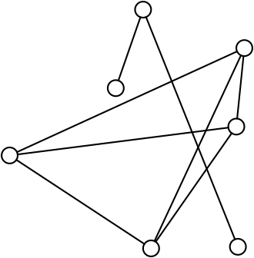
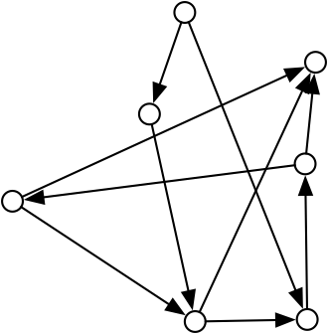
Graph Definition
Graphs are represented by:
drawing the vertices as small circles
drawing the edges as edges
Directed edges are drawn as arrows
An undirected graph with 7
vertices and 7 edges
A directed graph

Slide 4
Graph Definition
Computer scientist sometimes differ from mathematicians in what is called a graph
In Mathematics, a(n undirected) graph can
Have only one edge at most between two vertices
Cannot have an edge to the same vertex

Slide 5
Graph Definition
Computer scientist sometimes differ from mathematicians in what is called a graph
In Mathematics, a directed graph can
Have only one edge at most between two vertices
Cannot have an edge to the same vertex

Slide 6
Graph Definition
Mathematicians call a graph that allows multiple edges between the same pair of vertices
a multigraph

Slide 7
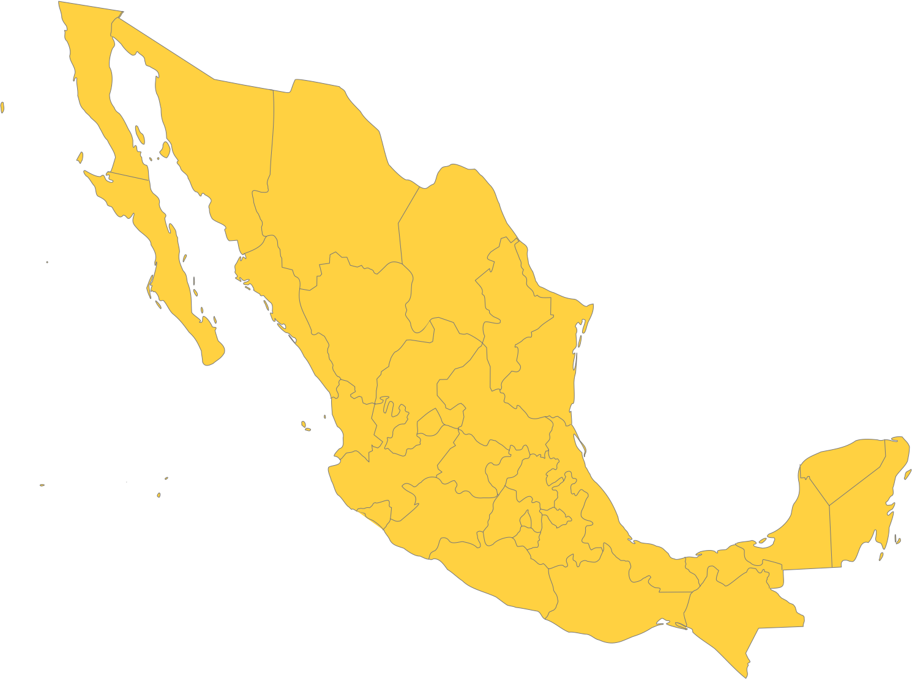
Graph Representations
To understand graphs, we can use:
The visual representation
E.g. The neighbor graph
Take a political map

Slide 8
Graph Representations
Examples:
Place a vertex in every entity (state, not DDFF)
Connect vertices if the entities have a common border

Slide 9
Graph Representations
Vertices are stations
Edges represent a connection via underground or light rail
This is multi-graph because several edges can connect a station

Slide 10
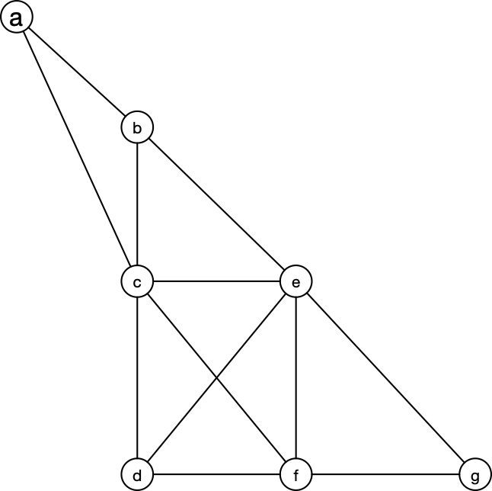
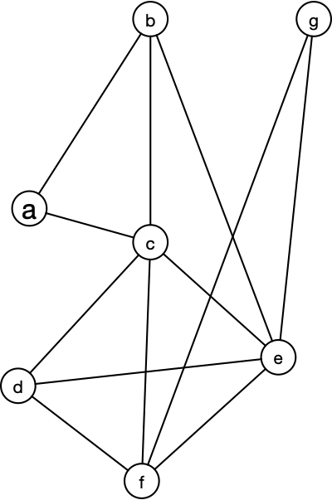
Graph Definition
Different visualizations can still give you the same graph, as you can see from the examples below
ab, ac, bc, ce
cd, cf, de, df
ef, eg, fg

Slide 11
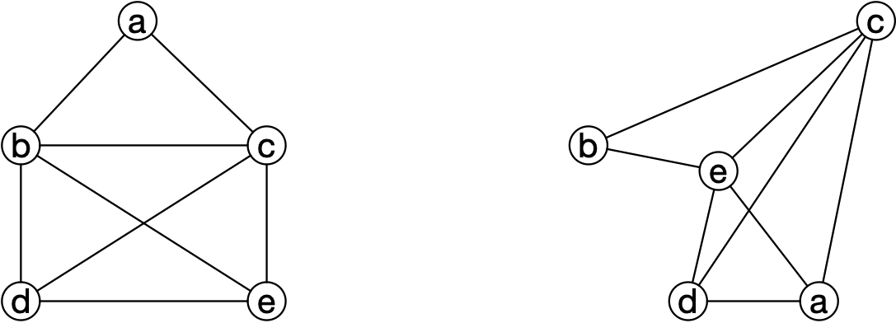
Graph Definition
Two graphs are isomorphic, if there is a renaming of the vertices that converts one into the other and vice versa
Mathematically, a renaming is a bijection
These two do not look the same, but they are isomorphic: $a→b,b→c,c→e,d→d,e→a$

Slide 12
Graph Definition
Two graphs are isomorphic, if there is a renaming of the vertices that converts one into the other and vice versa
$G=(V,E)$ is isomorphic to $G^{′}=(V^{′},E^{′})$
$⇔$
$$∃f:V→V^{′}\text{bijection}:∀v_{1},v_{2}∈V:(f(v_{1}),f(v_{2}))∈E^{′}⇔(v_{1},v_{2})∈E$$

Slide 13
Graph Definition
Determining whether two graphs are isomorphic is a known, difficult question
Some results are easy, e.g. vertices of the same rank (the number of edges adjacent to a vertex) need to be mapped to vertices of the same rank
So, these two graphs cannot be isomorphic

Slide 14
Graph Definition
These two graphs cannot be isomorphic
The left graph has two vertices of degree 2
The right graph has no vertices of degree 2
But the number of vertices and edges is equal

Slide 15
Graph Definitions
There are a number of important properties of graphs
No need to learn them by heart, the ones used in CS will get repeated over and over again
A path between two vertices $u,w∈V$ of a graph $G=(V,E)$ is a list of vertices $u=v_{0},v_{1},…,v_{n-1},v_{n}=w$ such that there is an edge between all $v_{i}$ and $v_{i+1}$
Furthermore, no vertices can be repeated

Slide 16
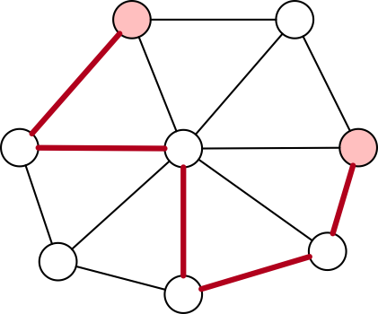
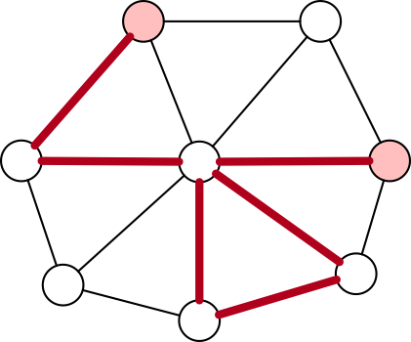
Graph Definitions
Example for a path:
Has length 5 (number of edges)
Example for a walk that is not a path
We visit the center vertex twice

Slide 17
Graph Definitions
For directed graphs, the paths need to follow the arrow

Slide 18
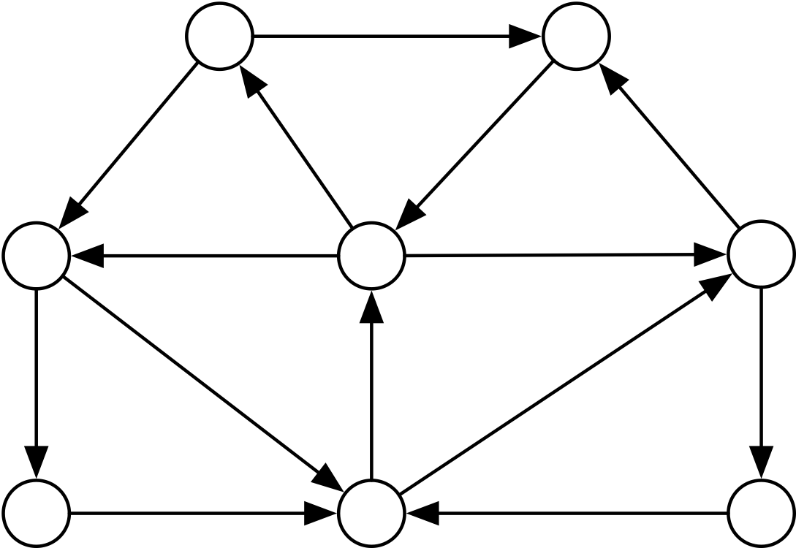
Graph Definitions
A directed graph (digraph) is strongly connected if there is a path from every vertex to every other vertex

Slide 19
Graph Definitions
An undirected graph is connected if there is a path from every vertex to every other vertex
This is not a connected graph
But it consists of two connected components

Slide 20
Graph Definitions
Interesting question
Is the friends graph on facebook connected
The "friend" relation is mutual, so all users are vertices and there is an edge if two users are in a friends-relation
Probably not, because we signed up my mom on facebook and she did not like it, so she is no longer friends with anyone
But how about "active users"
Could there be a republican and a democratic facebook
No, but maybe there are isolated groups

Slide 21
Euler Tours
An Euler tour is a closed tour that traverses each edge of the graph only once.
Graphs with an Euler tour are called Eulerian
Theorem: An undirected, connected graph is Eulerian if each vertex has even degree.
Recall: Degree is the number of edges of the vertex

Slide 22
Euler Tours
Königsberg bridge problem
Königsberg had seven bridges over the river Pregel
Is it possible to have an afternoon walk crossing all bridges exactly once

Slide 23
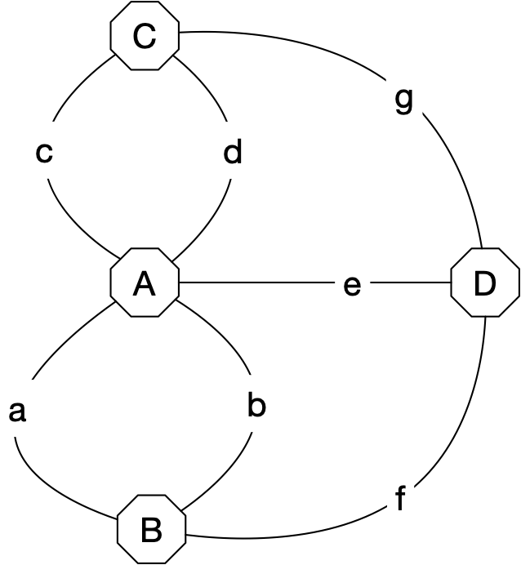
Euler Tours
Solved by Euler
Translate into a multi-graph (multiple edges allowed)

Slide 24
Euler Tours
Actually, all edges have odd degree, so such a tour is not possible
To show that the theorem is correct:
Euler tour exists implies all vertex degrees are even
Because an Euler tour visits all edges and every time it visits an edge, it needs to come and to go.

Slide 25
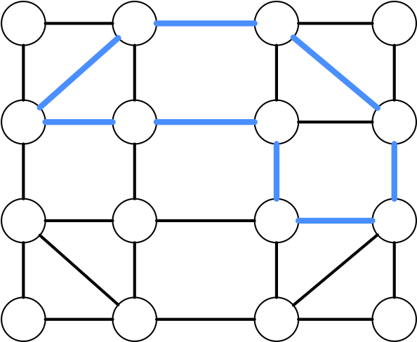
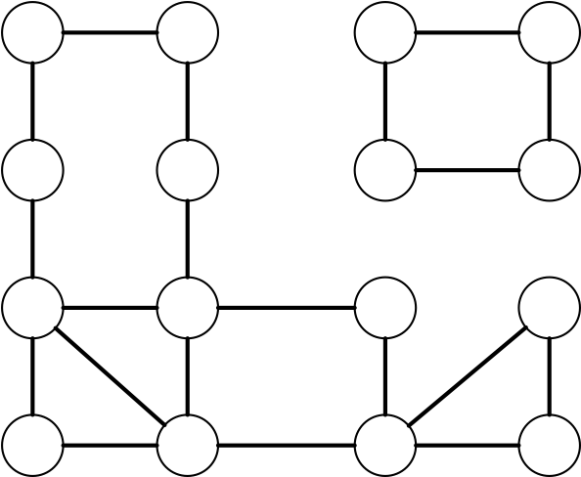
Euler Tours
Other direction can be shown using Fleury's algorithm
Key observation:
If we remove the edges from a closed tour
(starts and ends at the same vertex)
then in the remaining graph all vertices have still even degree

Slide 26
Euler Tours
Fleury's algorithm:
Start at a node and walk anywhere, marking the edge
Leave the node that you arrived at
Continue until you can no longer find an unused edge
At this point, you are back in the starting vertex
If any of the vertices visited has a unused edges, start with that edge until you are back at that edge.
Splice the new circuit into the old one

Slide 27
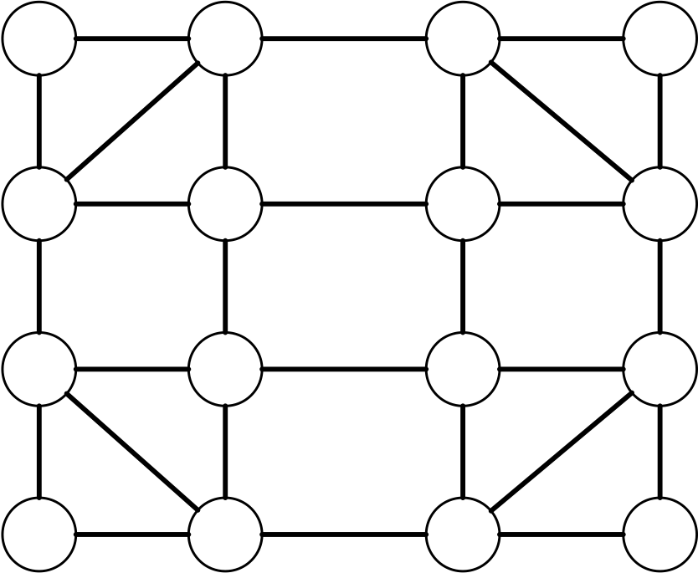
Euler Tours
Example

Slide 28
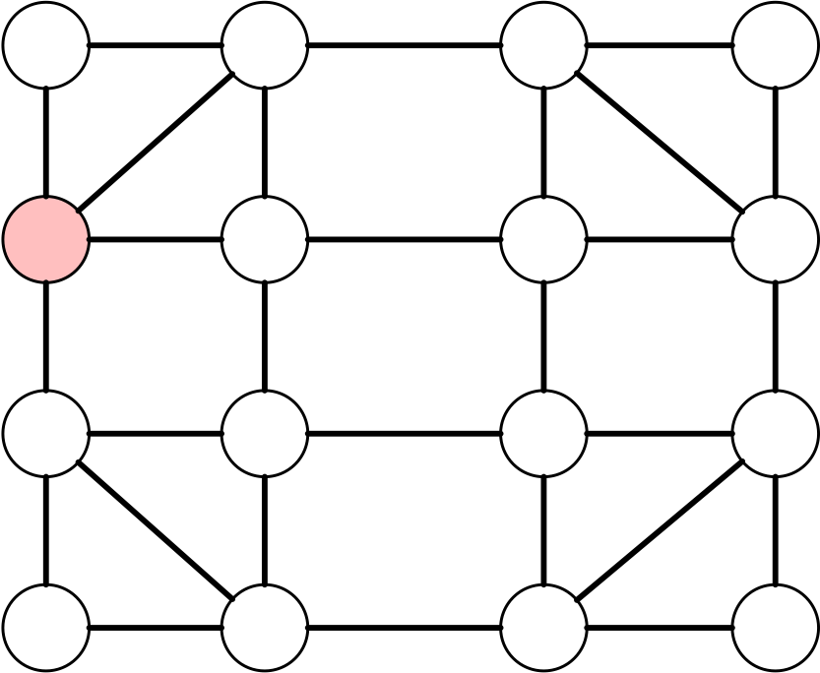
Euler Tours
Start at a random vertex

Slide 29
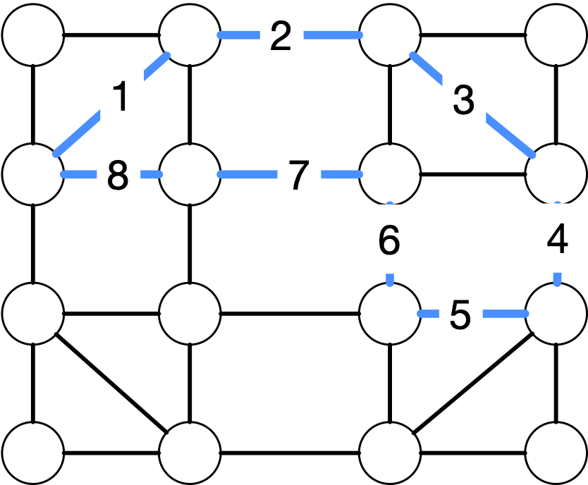
Euler Tours
Make a tour

Slide 30
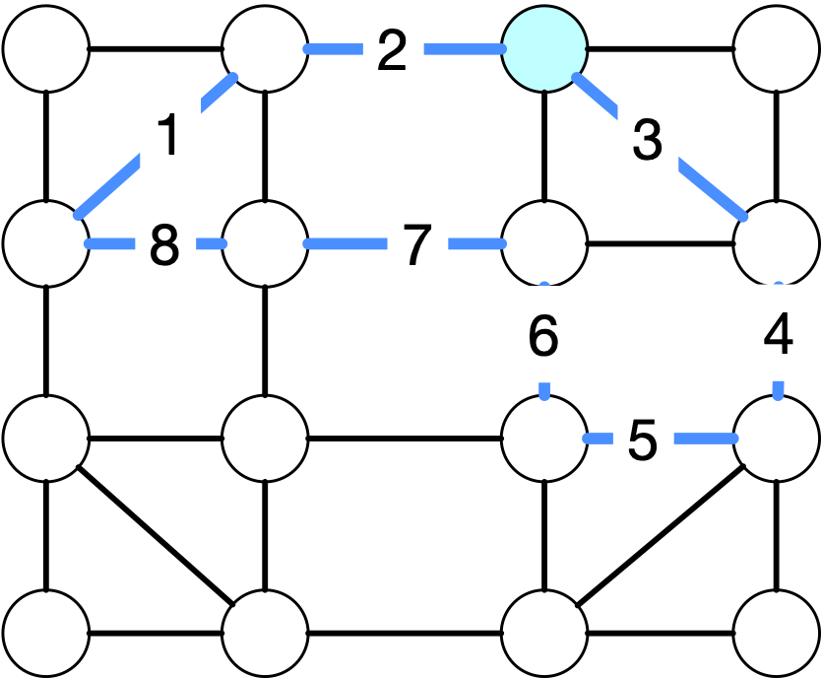
Euler Tours
Check for vertices with unused edges and pick a random one

Slide 31
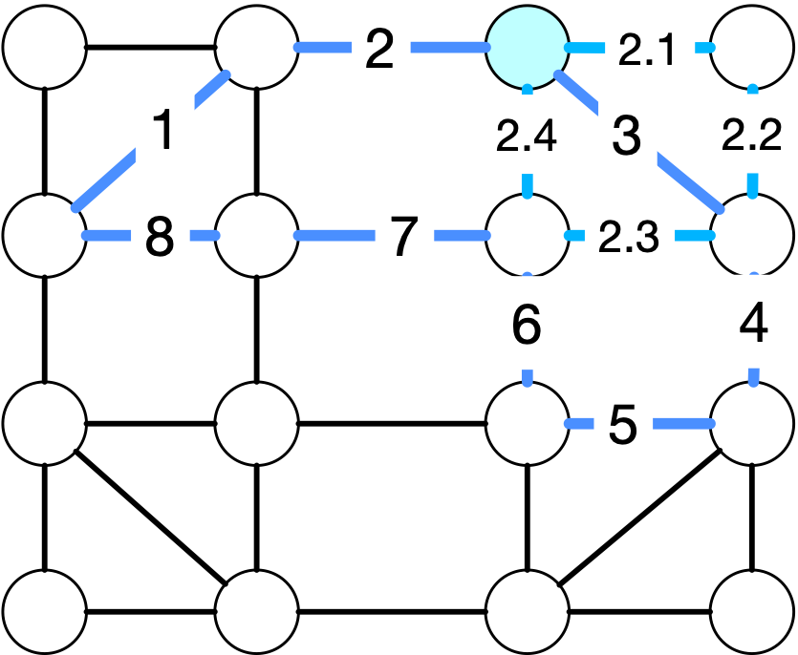
Euler Tours
Start out creating a random circuit of unused edges

Slide 32
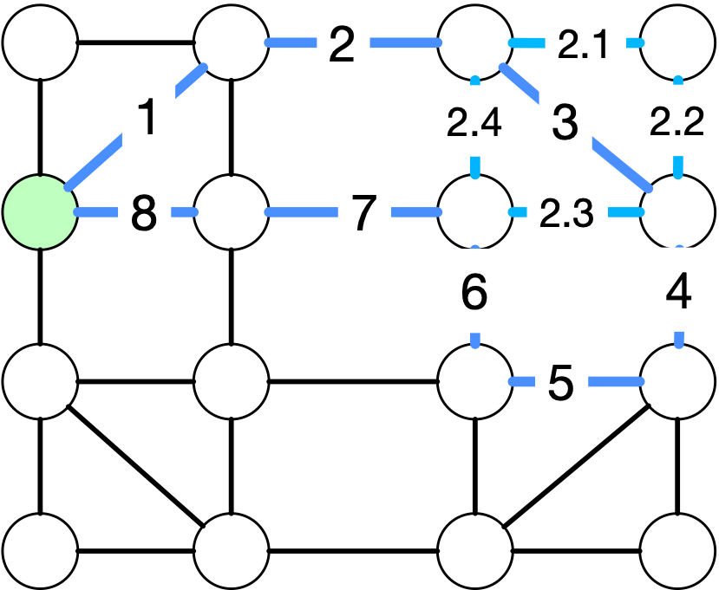
Euler Tours
Pick another vertex with unused edges

Slide 33
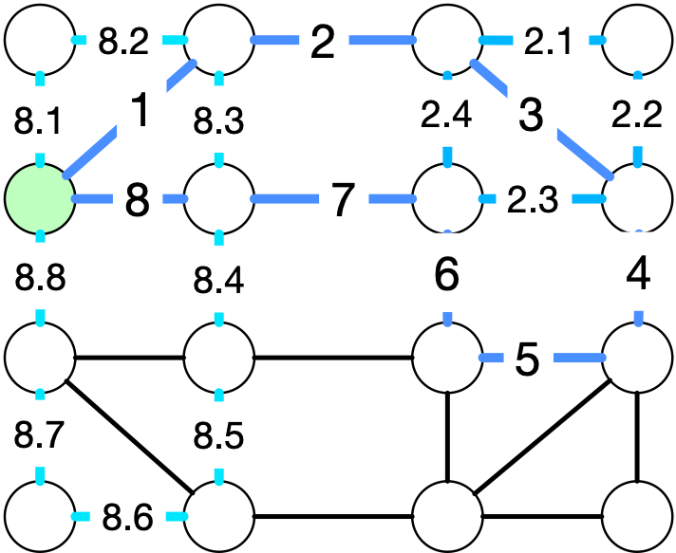
Euler Tours
Start a new part of the circuit
Circuit so far: 1, 2, 2.1, 2.2, 2.3, 2.4, 3, 4, 5, 6, 7, 8, 8.1, 8.2, 8.3, 8.4, 8.5, 8.6, 8.7, 8.8

Slide 34
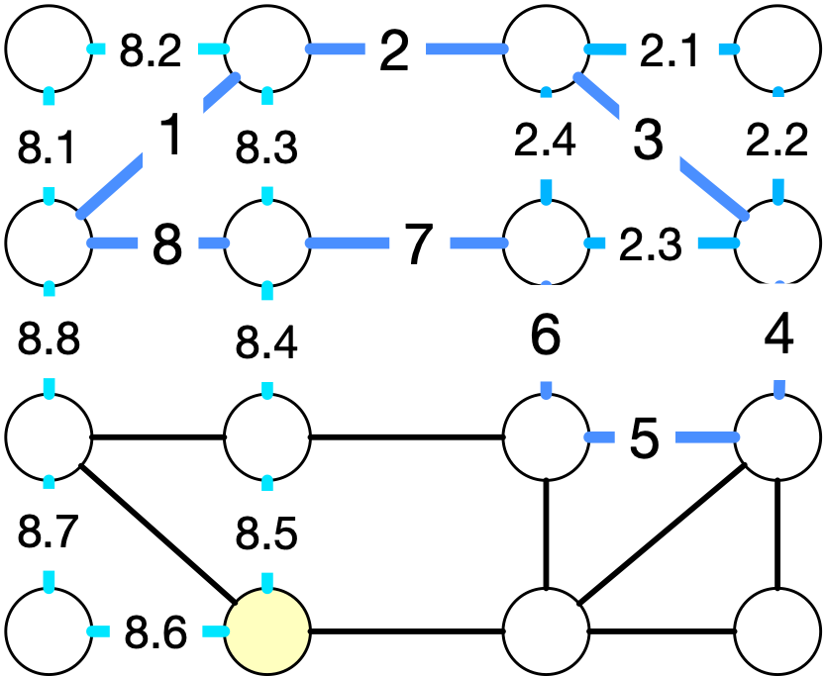
Euler Tours
In the new circuit, there are still vertices without all edges used.
Pick one
Circuit so far: 1, 2, 2.1, 2.2, 2.3, 2.4, 3, 4, 5, 6, 7, 8, 8.1, 8.2, 8.3, 8.4, 8.5, 8.6, 8.7, 8.8

Slide 35
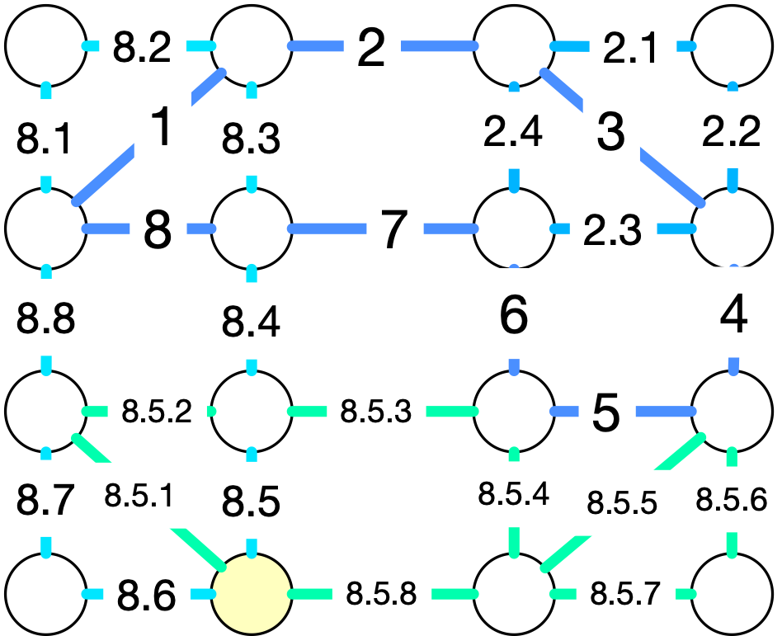
Euler Tours
And after this, we are done
Circuit is: 1, 2, 2.1, 2.2, 2.3, 2.4, 3, 4, 5, 6, 7, 8, 8.1, 8.2, 8.3, 8.4, 8.5, 8.5.1, 8.5.2, 8.5.3, 8.5.4, 8.5.5, 8.5.6, 8.5.7, 8.5.8 8.6, 8.7, 8.8

Slide 36
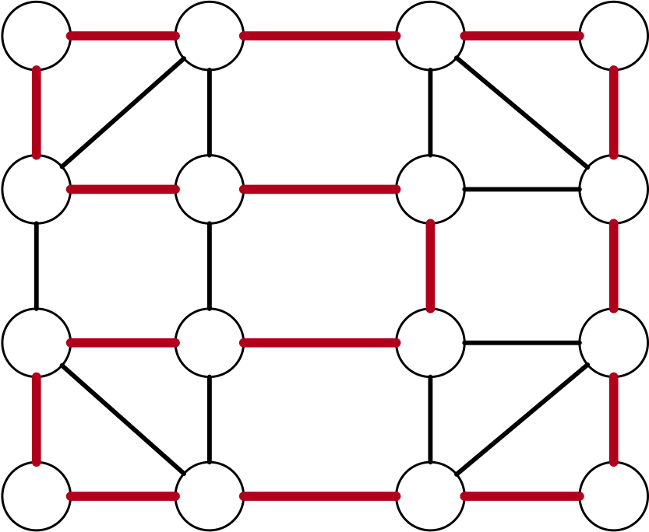
Hamiltonian Circuit
Similar question: Is there a circuit that goes through all vertices

Slide 37
Hamiltonian Circuit
Turns out to be very difficult
Can be shown to not be decidable with a polynomial time algorithm

Slide 38
Graph Definitions
Distance in a graph:
Length of the shortest path between two vertices
$$δ(u,w)=min\{n|∃v_{0}=u,v_{1},…v_{n}=w\text{such that}(v_{i},v_{i+1}∈E∀i∈\{0,...,n-1\}\}$$

Slide 39
Dijkstra's Algorithm
Want to determine the distance between a vertex $s$ and all other vertices in an undirected graph
Dynamic programming algorithm
Add intermediate vertices one by one
Start: Every vertex not $s$ gets distance infinity
$s$ gets distance 0
Put all vertices into a priority heap ordered by distance
We can quickly extract a vertex with minimum distance

Slide 40
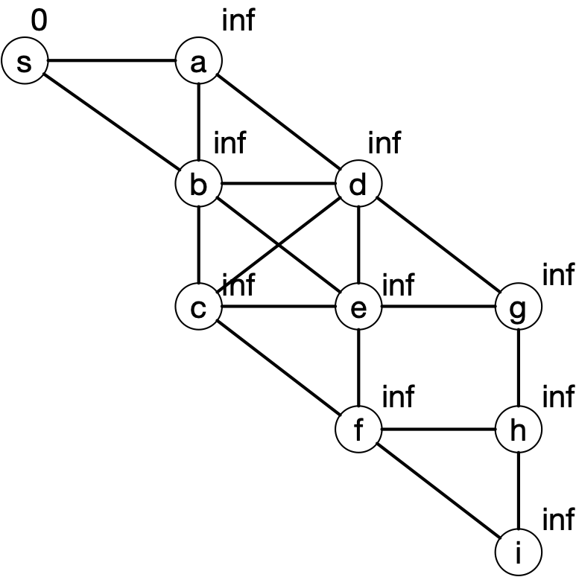
Dijkstra's Algorithm
Example:

Slide 41
Dijkstra's Algorithm
Update $s$:
Give all neighbors of $s$ distance 1

Slide 42
Dijkstra's Algorithm
The heap gives us one of $\{a,b\}$ as a minimum distance node.
Pick $a$.
Update all its neighbors by giving them an updated distance
Minimum of current value
Value of a plus 1
a is connected to b, c, and s

Slide 43
Dijkstra's Algorithm
b gets min(1, 1+1)
s gets min(0, 1+1)
d gets min(inf, 1+1)

Slide 44
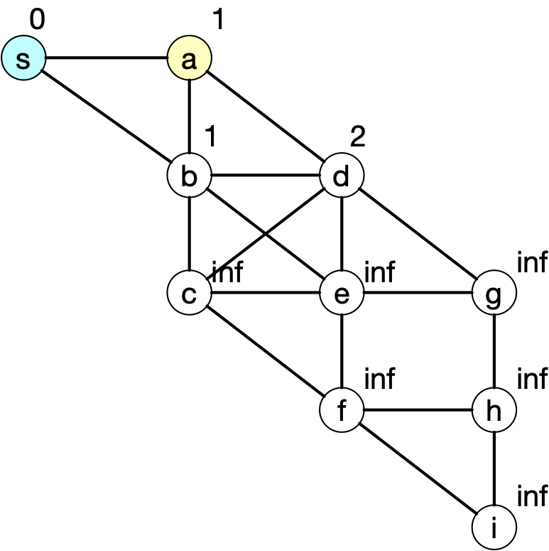
Dijkstra's Algorithm
b gets min(1, 1+1)
s gets min(0, 1+1)
d gets min(inf, 1+1)
After update, mark a as used by removing it from the priority queue

Slide 45
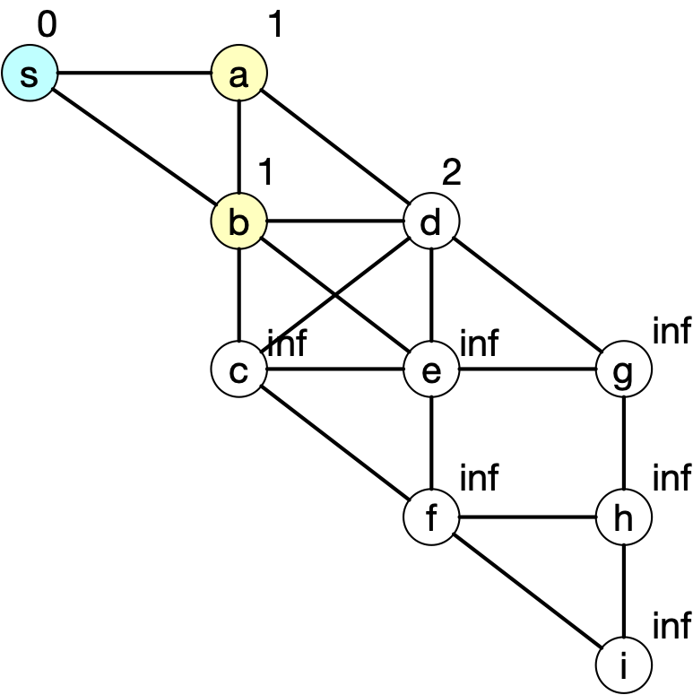
Dijkstra's Algorithm
Pick the node with minimum distance that is not marked
Which would be b
Update its neighbors

Slide 46
Dijkstra's Algorithm
d gets min(2,1+1)
c gets min(inf, 1+1)
e gets min(inf, 1+1)
s gets min(0, 1+1)

Slide 47
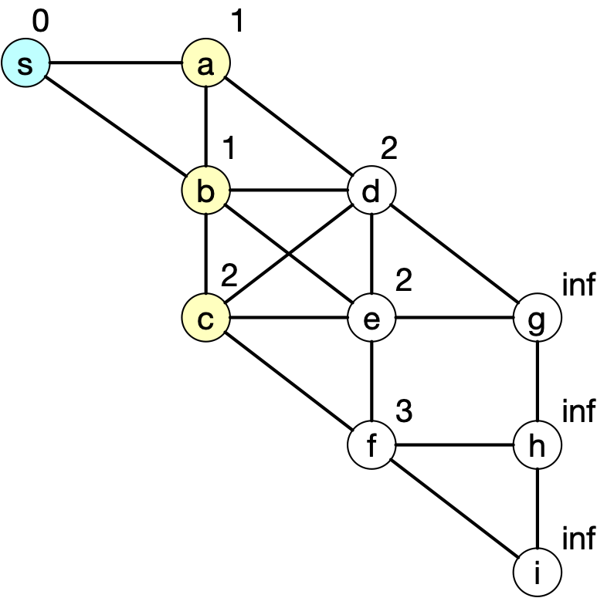
Dijkstra's Algorithm
Select one of the vertices with minimum distance:
Either c, d, or e
Pick c
b gets min(1,2+1)
d gets min(2, 2+1)
e gets min(2, 2+1)
f gets min(inf, 2+1)
Remove c from the priority heap

Slide 48
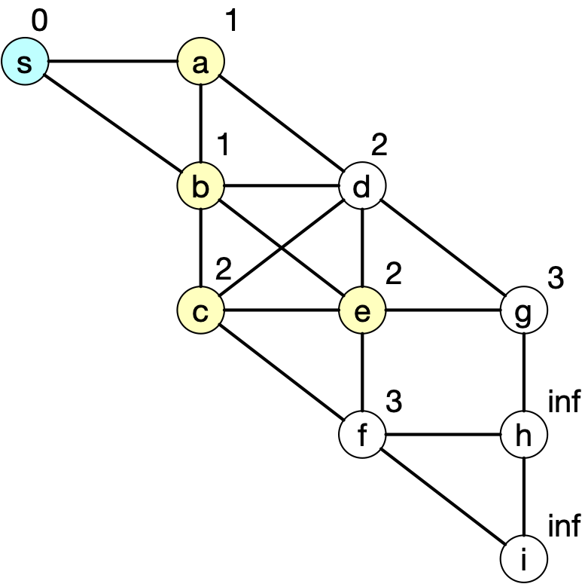
Dijkstra's Algorithm
Select e
Update b with min(1,2+1)
Update c with min(2,2+1)
Update d with min(2, 2+1)
Update f with min(3,2+1
Remove e from priority heap

Slide 49
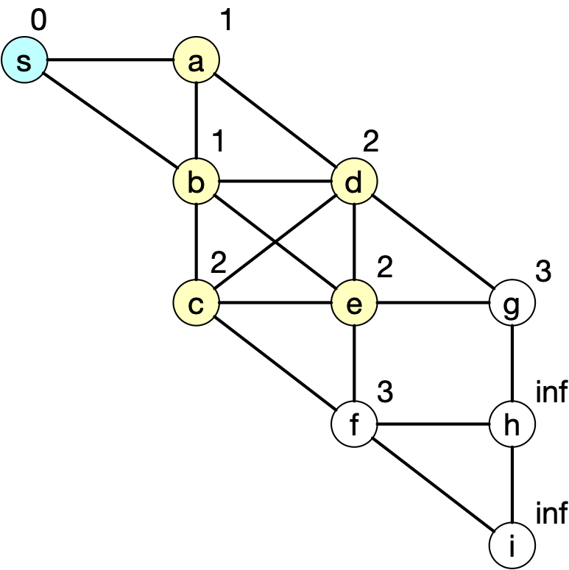
Dijkstra's Algorithm
Select d
Updates have no effect
Remove d from heap

Slide 50
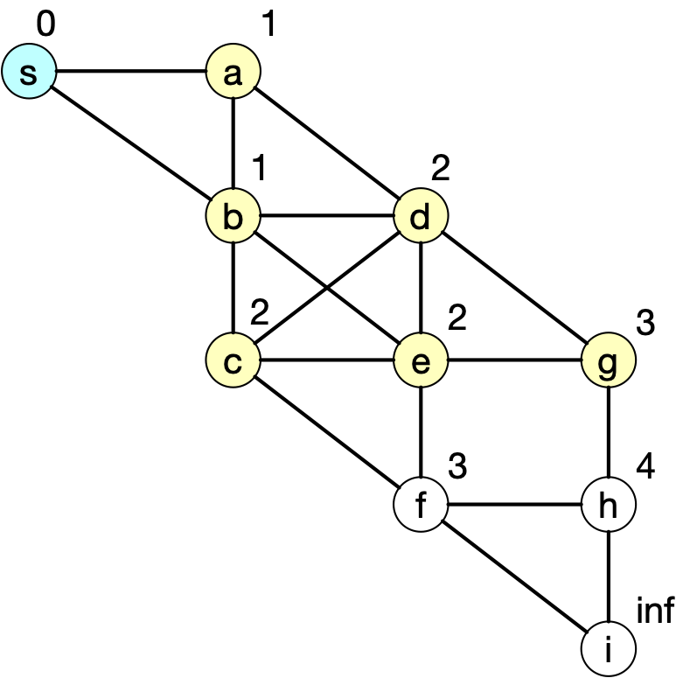
Dijkstra's Algorithm
Select g
Only change is h gets 4
Remove g from priority heap

Slide 51
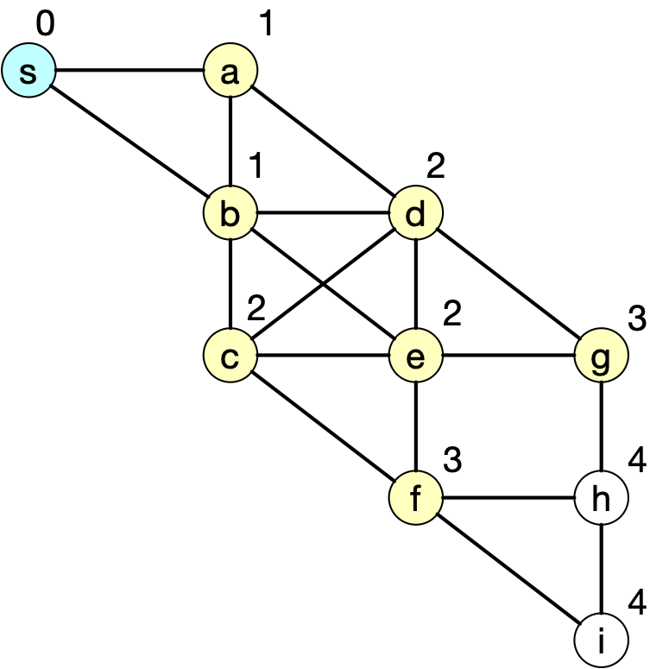
Dijkstra's Algorithm
Need to select f
Update only changes h

Slide 52
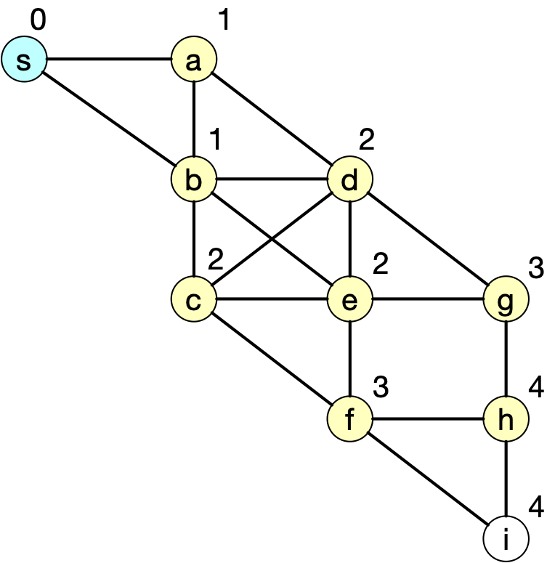
Dijkstra's Algorithm
Need to select h
Does not change any value

Slide 53
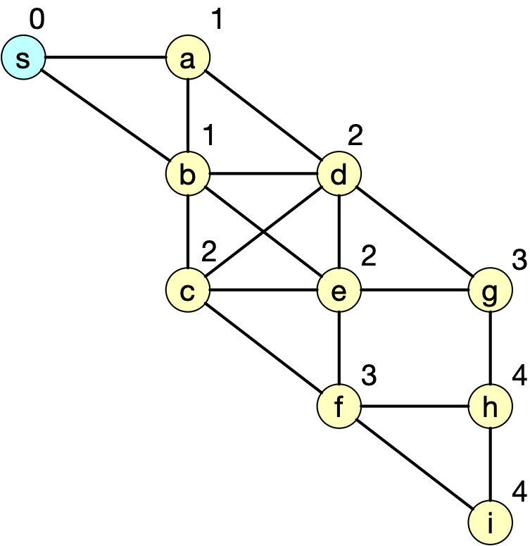
Dijkstra's Algorithm
Need to select i as the only node left
But that does not change any values

Slide 54
Dijkstra's Algorithm
Dijkstra's algorithm can be generalized to weighted graphs

Slide 55
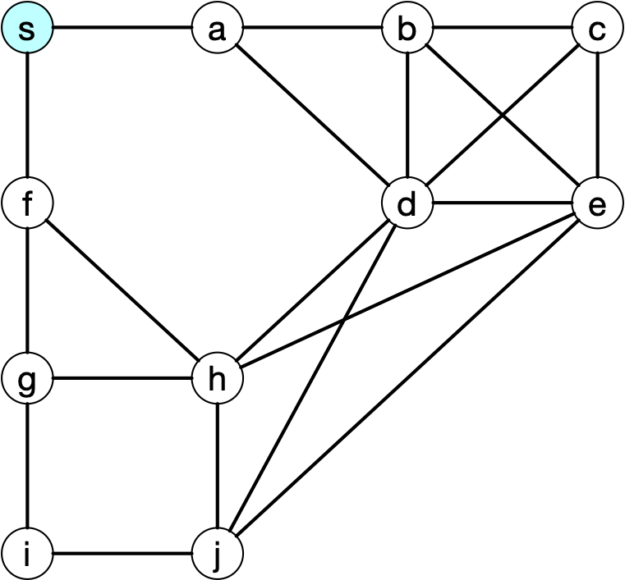
Dijkstra's algorithm
Your turn
Rule:
Of course you choose smallest distance first, but you break ties in order of the alphabet, e.g. select a over f

Slide 56
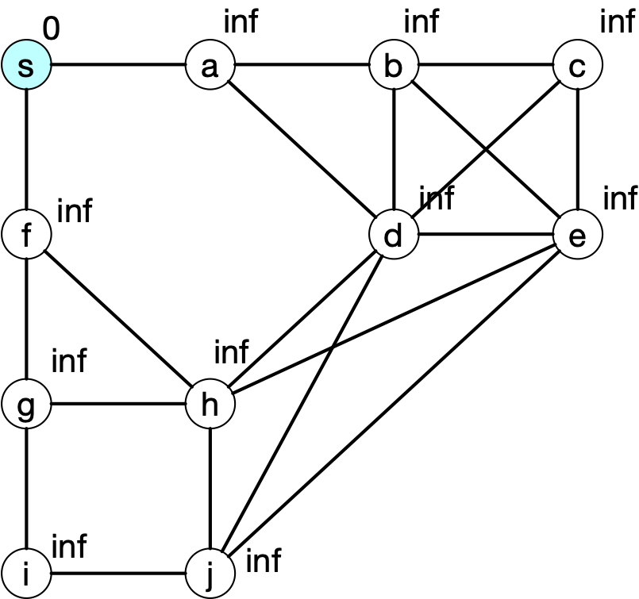
Dijkstra's algorithm
Select s

Slide 57
Dijkstra's algorithm
Update a and f

Slide 58
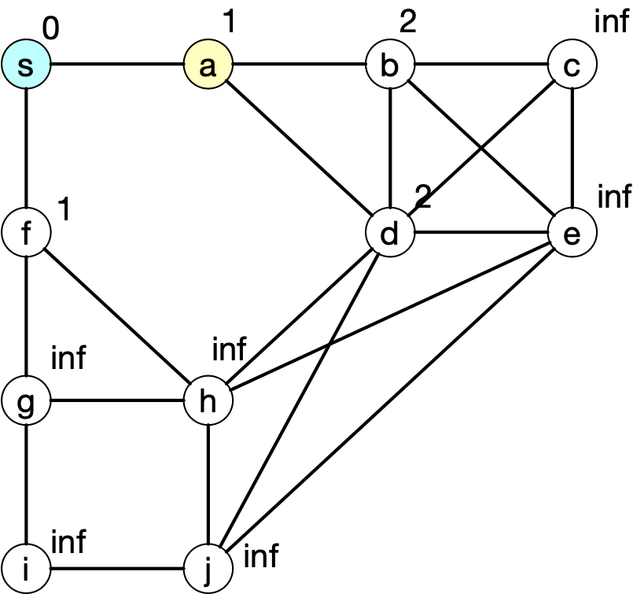
Dijkstra's algorithm
Select a
Update b and d
s stays the same

Slide 59
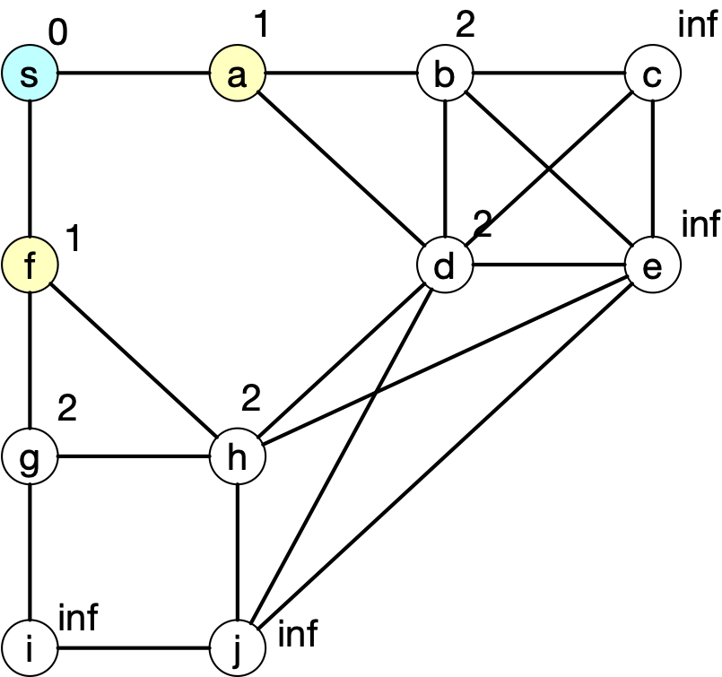
Dijkstra's algorithm
Select f (no choice here)

Slide 60
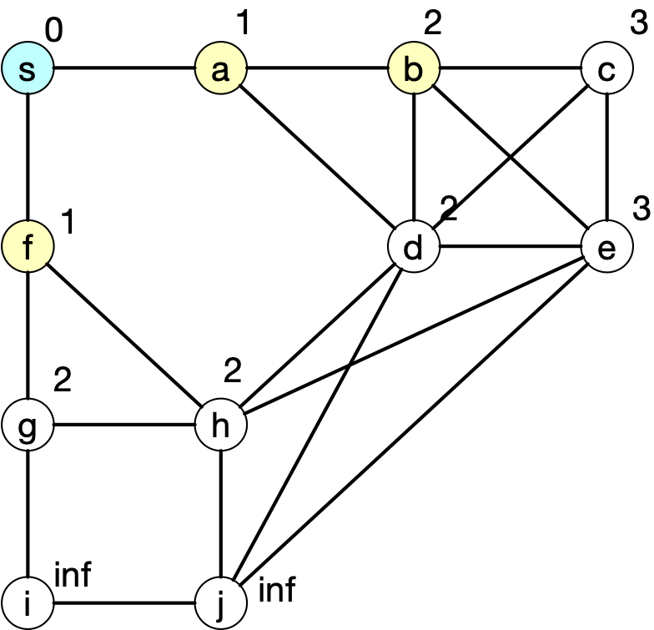
Dijkstra's algorithm
Select b

Slide 61
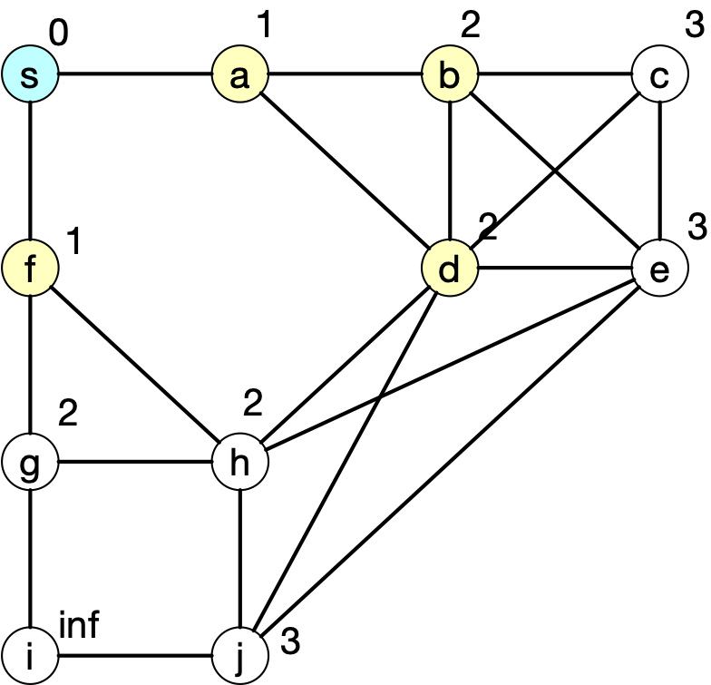
Dijkstra's algorithm
Select d

Slide 62
Dijkstra's algorithm

Slide 63
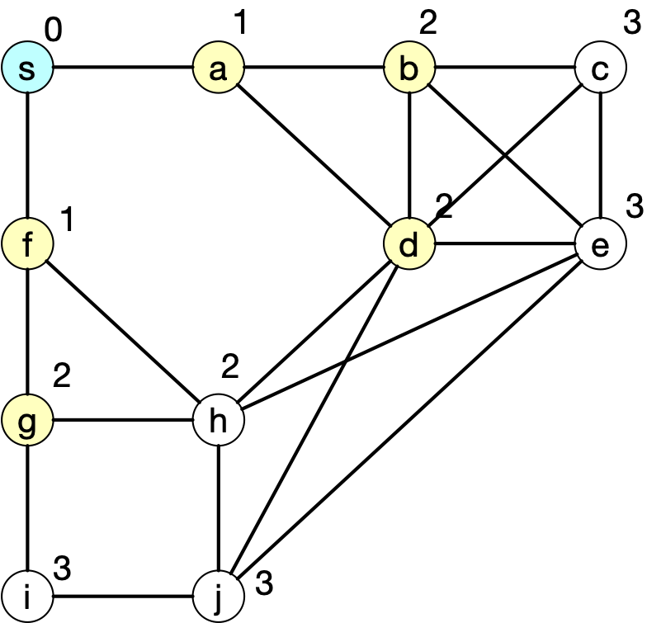
Dijkstra's algorithm
Select g

Slide 64
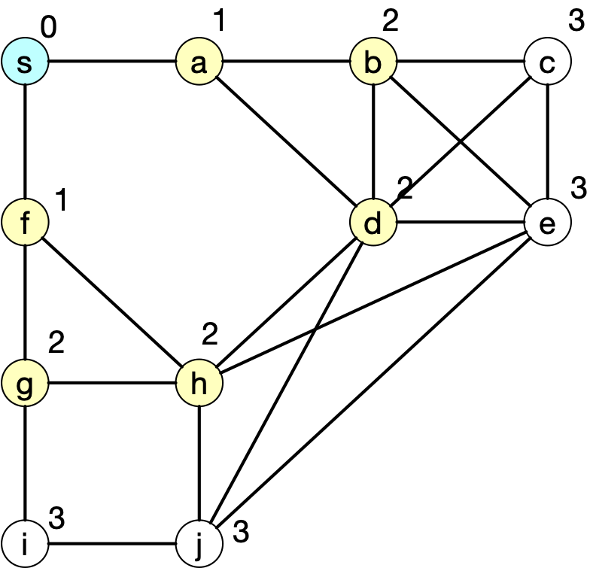
Dijkstra's algorithm
Select h

Slide 65
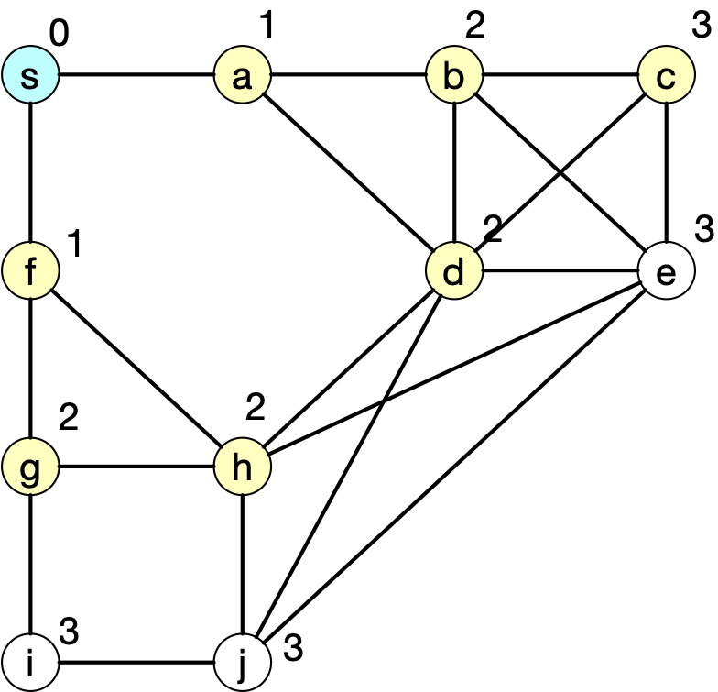
Dijkstra's algorithm
Select c
We might as well stop here
All updated values will be 4 or more, and every node has already a 3

Slide 66
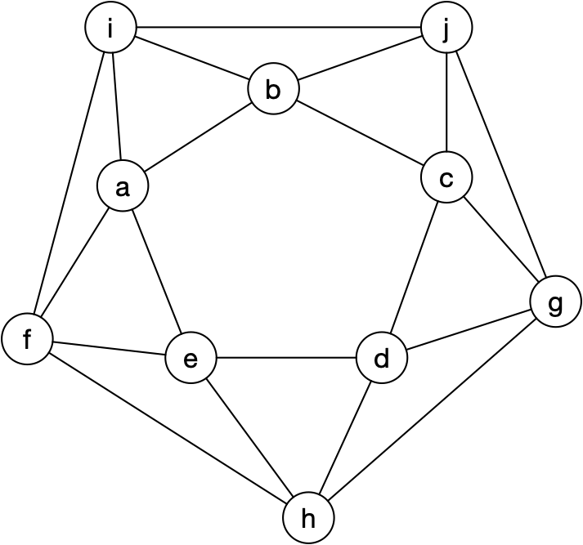
Graph Representations
For computational purposes, we can use:
List of vertices and list of edges as pairs
$$V=\{a,b,c,d,e,f,g,h,i,j\}$$
$$E=\{(a,b),(a,e),(a,f),(a,i),(b,c),$$
$$(b,i),(b,j),(c,d),(c,g),(c,j),(d,e),$$$$(d,h),(d,g),(e,f),(e,h),(f,h),(f,i),$$
$$(g,h),(g,j),(i,j)\}$$

Slide 67
Dijkstra's Algorithm
Need to maintain a priority heap
Otherwise
Look at every node
And every edge twice

Slide 68
Graph Representations
An adjacency list
For every vertex the list of vertices to which there is an edge
a: b,e,f,i
b: a,c,i,j
c: b,d,g,j
d: c,e,g,h
e: a,f,d,h
f: a,e,h,i
g: c,d,h,j
h: d,e,f,g
i: a,b,f,j
j: b,c,g,i

Slide 69
Graph Representations
An adjacency matrix
square matrix conceptually labeled with vertices
coefficient $a_{i,j}=\{\begin{aligned}1\text{edge between}v_{i}\text{and}v_{j} \\ 0\text{otherwise}\end{aligned}$
 | a | b | c | d | e | f | g | h | i | j
a | 0 | 1 | 0 | 0 | 1 | 1 | 0 | 0 | 1 | 0
b | 1 | 0 | 1 | 0 | 0 | 0 | 0 | 0 | 1 | 1
c | 0 | 1 | 0 | 1 | 0 | 0 | 1 | 0 | 0 | 1
d | 0 | 0 | 1 | 0 | 1 | 0 | 1 | 1 | 0 | 0
e | 1 | 0 | 0 | 1 | 0 | 1 | 0 | 1 | 0 | 0
f | 1 | 0 | 0 | 0 | 1 | 0 | 0 | 1 | 1 | 0
g | 0 | 0 | 1 | 1 | 0 | 0 | 0 | 1 | 0 | 1
h | 0 | 0 | 0 | 1 | 1 | 1 | 1 | 0 | 0 | 0
i | 1 | 1 | 0 | 0 | 0 | 1 | 0 | 0 | 0 | 1
j | 0 | 1 | 1 | 0 | 0 | 0 | 1 | 0 | 1 | 0

Slide 70
Number of Vertices and Edges
Graph $G=(V,E)$ with vertices $V$ and edges $E$
Whether directed or undirected, graph can have as many edges as there are pairs of vertices
The latter is $\left({|V| \atop 2}\right)=\frac{|V|(|V|-1)}{2}$
Number of edges is at most $O(|V|^{2})$

Slide 71
Number of Vertices and Edges
Graph $G=(V,E)$ with vertices $V$ and edges $E$
Graph algorithms usually need to look at each edge at least once
there are some idiosyncratic exceptions
They usually run in time at least $Θ(|V|^{2})$
However, many important graphs are sparse:
No edge between most pairs of vertices

Slide 72
Topological Sort
We can use a directed graph in order to represent a precedence relation
Topological sort:
Given a directed graph:
Order all vertices in an order such that an edge always goes from a preceding to a succeeding vertex
Or show that this is impossible because there is a cycle

Slide 73
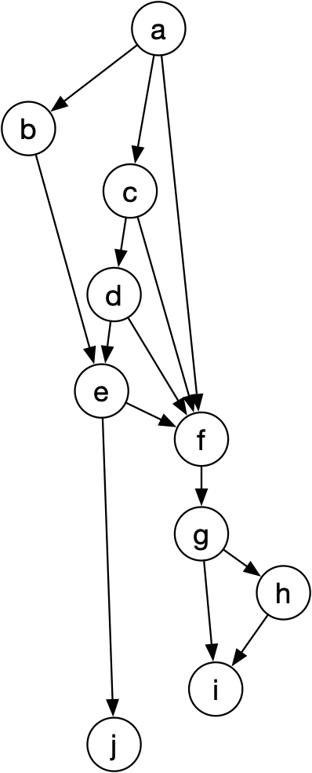
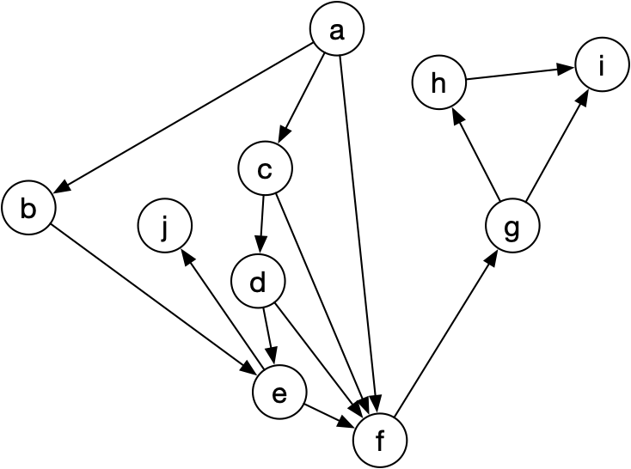
Topological Sort
Example 1:
Can arrange all vertices such that arrows only go down
Sort is a,b,c,d,e,f,g,h,i,j

Slide 74
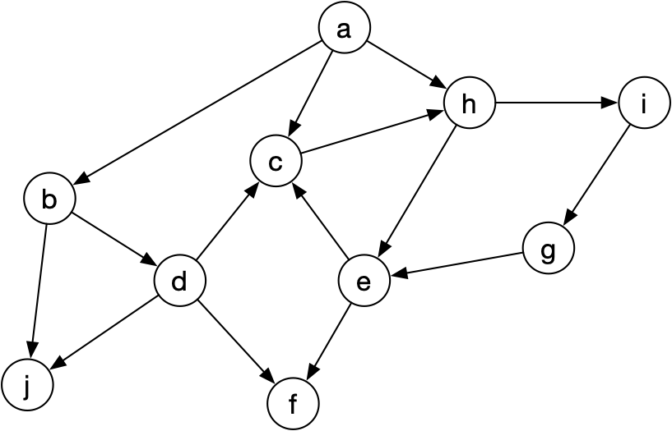
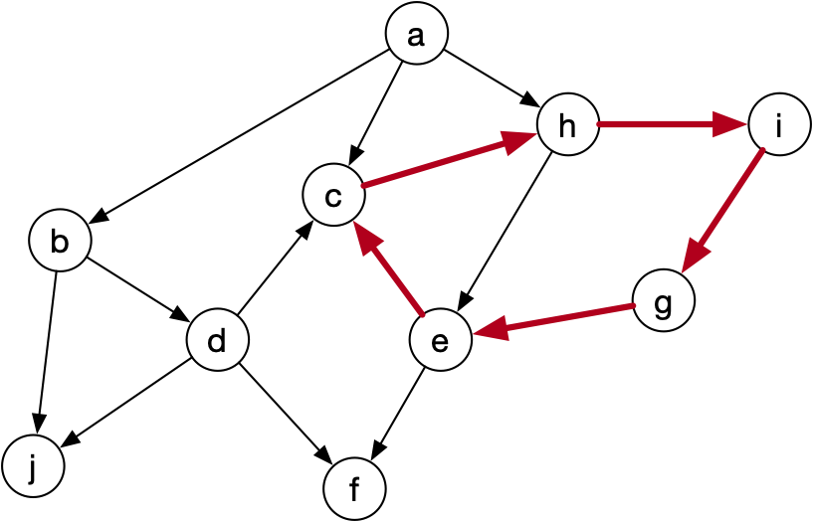
Topological Sort
Example:
There is a cycle, a topological sort is not possible

Slide 75
Topological Sort
A simple algorithm:
Go to the adjacency list
Find a vertex with empty list, add it to a list, and remove it from the graph
a: b,c,h
b: d,j
c:
d: c
e: f
f:
g:
h: e
i: g
j:

Slide 76
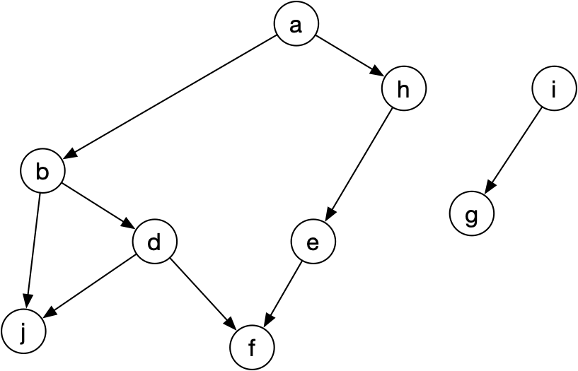
Topological Sort
A simple algorithm
List contains $\{c\}$
a: b,c,h
b: d,j
c:
d: c
e: f
f:
g:
h: e
i: g
j:

Slide 77
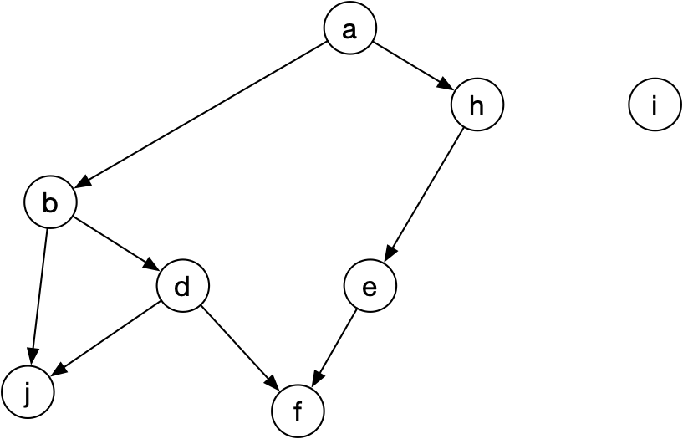
Topological Sort
A simple algorithm
Remove g and add it to the list $\{c,g\}$
a: b,c,h
b: d,j
c:
d: c
e: f
f:
g:
h: e
i: g
j:

Slide 78
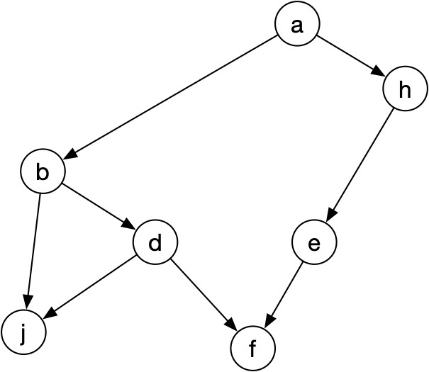
Topological Sort
A simple algorithm
Remove i and add it to the list $\{c,g,i\}$
a: b,c,h
b: d,j
c:
d: c
e: f
f:
g:
h: e
i: g
j:

Slide 79
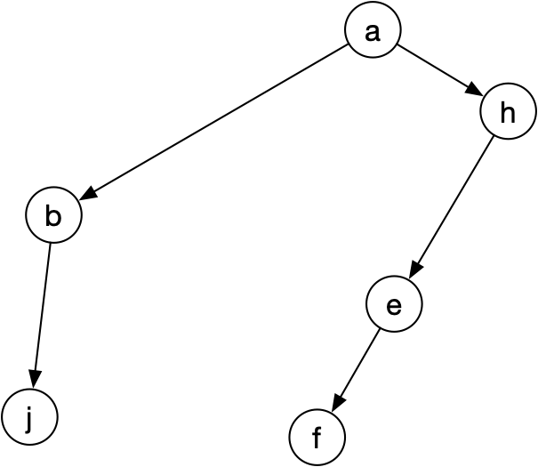
Topological Sort
A simple algorithm
Remove d and add it to the list $\{c,g,i,d\}$
a: b,c,h
b: d,j
c:
d: c
e: f
f:
g:
h: e
i: g
j:

Slide 80
Topological Sort
A simple algorithm
Remove f and add it to the list $\{c,g,i,d,f\}$
a: b,c,h
b: d,j
c:
d: c
e: f
f:
g:
h: e
i: g
j:

Slide 81
Topological Sort
A simple algorithm
Remove j and add it to the list $\{c,g,i,d,f,j\}$
a: b,c,h
b: d,j
c:
d: c
e: f
f:
g:
h: e
i: g
j:

Slide 82
Topological Sort
A simple algorithm
Remove b and add it to the list $\{c,g,i,d,f,j,b\}$
a: b,c,h
b: d,j
c:
d: c
e: f
f:
g:
h: e
i: g
j:

Slide 83
Topological Sort
A simple algorithm
Remove e and add it to the list $\{c,g,i,d,f,j,b,e\}$
a: b,c,h
b: d,j
c:
d: c
e: f
f:
g:
h: e
i: g
j:

Slide 84
Topological Sort
A simple algorithm
Remove a and add it to the list $\{c,g,i,d,f,j,b,e,h,a\}$
a: b,c,h
b: d,j
c:
d: c
e: f
f:
g:
h: e
i: g
j:

Slide 85
Topological Sort
The reverse list is the topological sort:
$$\{a,h,e,b,j,f,d,i,g,c\}$$

Slide 86
Topological Sort
In this version, we have
To determine the length of the adjacency list
After selecting a vertex, delete that vertex from all the adjacency lists
The latter means scanning all adjacency lists repeatedly
This is inefficient

Slide 87
Topological Sort
Question: How can we do this better?

Slide 88
Topological Sort
Instead of optimizing the search for vertices, we can optimize the selection of the vertex for removal
Better algorithm:
Find the in-degree for all vertices
That is the number of edges going into a vertex
While there are vertices with in-degree 0
Remove the vertex
Update the in-degrees

Slide 89
Topological Sort
Example:
Initialize in-degree 0 for all vertices
a: b,c,h
b: d,j
c:
d: c, j
e: f
f:
g:
h: e
i: g
j:

Slide 90
Topological Sort
Example:
Initialize in-degree 0 for all vertices
a: b,c,h
b: d,j
c:
d: c,j
e: f
f:
g:
h: e
i: g
j:

Slide 91
Topological Sort
Example:
Go through the adjacency list.
For each vertex in an adjacency list, add 1 to the in-degree
For a, we change three in-degrees
a: b,c,h
b: d,j
c:
d: c,j
e: f
f:
g:
h: e
i: g
j:

Slide 92
Topological Sort
Example:
Go through the adjacency list.
After processing all adjacency lists, we have the correct in-degrees
a: b,c,h
b: d,j
c:
d: c,j
e: f
f:
g:
h: e
i: g
j:

Slide 93
Topological Sort
Example:
Now we start the removal phase
We need to find a vertex with in-degree 0
How can we make this more efficient?
a: b,c,h
b: d,j
c:
d: c,j
e: f
f:
g:
h: e
i: g
j:

Slide 94
Topological Sort
Example:
Now we start the removal phase
We need to find a vertex with in-degree 0
Could place the vertices in a heap
a: b,c,h
b: d,j
c:
d: c,j
e: f
f:
g:
h: e
i: g
j:

Slide 95
Topological Sort
Example:
We select a for the removal
We go through its adjacency list and reset the in-degrees of the nodes there
a: b,c,h
b: d,j
c:
d: c,j
e: f
f:
g:
h: e
i: g
j:

Slide 96
Topological Sort
Example:
We select a for the removal: $\{a\}$
We go through its adjacency list and reset the in-degrees of the nodes there
a: b,c,h
b: d,j
c:
d: c,j
e: f
f:
g:
h: e
i: g
j:

Slide 97
Topological Sort
Example:
We update our heap and select one of the 0-in-degree vertices:
b: $\{a,b\}$
and update the in-degrees of d and j
a: b,c,h
b: d,j
c:
d: c,j
e: f
f:
g:
h: e
i: g
j:

Slide 98
Topological Sort
Example:
We update our heap and select one of the 0-in-degree vertices:
b: $\{a,b\}$
and update the in-degrees of d and j
a: b,c,h
b: d,j
c:
d: c,j
e: f
f:
g:
h: e
i: g
j:

Slide 99
Topological Sort
Example:
We now randomly pick on of the vertices with degree 0, let's pick i
Deleting it means just decrementing the in-degree of g
a: b,c,h
b: d,j
c:
d: c,j
e: f
f:
g:
h: e
i: g
j:

Slide 100
Topological Sort
Example:
We add g to our list $\{a,b,i,g\}$
a: b,c,h
b: d,j
c:
d: c,j
e: f
f:
g:
h: e
i: g
j:

Slide 101
Topological Sort
Example:
There are three nodes with in-degree 0, let's pick h
a: b,c,h
b: d,j
c:
d: c,j
e: f
f:
g:
h: e
i: g
j:

Slide 102
Topological Sort
Example:
There are three nodes with in-degree 0, let's pick h
a: b,c,h
b: d,j
c:
d: c,j
e: f
f:
g:
h: e
i: g
j:

Slide 103
Topological Sort
Example:
Need to update in-degree of e
$$\{a,b,i,g,h\}$$
a: b,c,h
b: d,j
c:
d: c,j
e: f
f:
g:
h: e
i: g
j:

Slide 104
Topological Sort
Example:
There are two nodes with in-degree 0, let's pick d
a: b,c,h
b: d,j
c:
d: c,j
e: f
f:
g:
h: e
i: g
j:

Slide 105
Topological Sort
Example:
$$\{a,b,i,g,h,d\}$$
a: b,c,h
b: d,j
c:
d: c,j
e: f
f:
g:
h: e
i: g
j:

Slide 106
Topological Sort
Example:
$$\{a,b,i,g,h,d\}$$
Can pick among four nodes: e
a: b,c,h
b: d,j
c:
d: c,j
e: f
f:
g:
h: e
i: g
j:

Slide 107
Topological Sort
Example:
$$\{a,b,i,g,h,d,e\}$$
Can pick among four nodes in any order
a: b,c,h
b: d,j
c:
d: c,j
e: f
f:
g:
h: e
i: g
j:

Slide 108
Topological Sort
Example:
$$\{a,b,i,g,h,d,e,h,j,f\}$$
Can pick among four nodes in any order
a: b,c,h
b: d,j
c:
d: c,j
e: f
f:
g:
h: e
i: g
j:

Slide 109
Topological Sort
Analysis for topological sort on $G=(V,E)$
Need to establish in-degrees:
Process all elements in an adjacency list
Correspond to edges
work $∼|E|$
For each vertex:
find the vertex as a vertex of minimum in-degree
update in-degrees by going through the adjacency list
Latter work is $∼|E|$ because we process each adjacency list entry once
Delete the adjacency list
Work is $∼V$

Slide 110
Topological Sort
This algorithm is almost $O(|E|)$ but for finding the minimum in-degree
We will see a better algorithm shortly

Slide 111
Weighted Graphs
Graphs with edge weights
Often, graphs in CS have edge weights
Example: edge weight indicates the size of a pipeline
such as network connection, capacity of roads, etc.
How much can you pump from source to
destination if the pipes have the indicated
capacities (Flow Problem)

Slide 112
Weighted Graphs
Graphs with edge weights
Weights can indicate distance
What is the shortest distance from source to destination

