Slide 1
Applications of Depth First Search
Thomas Schwarz, SJ

Slide 2
Topological Sort
Recall topological sort
We are given a directed graph
Want to order all vertices such that no edge goes from a higher-numbered vertex to a lower-numbered vertex
If this is impossible, then we have a cycle
So, our algorithm also detects whether there is a cycle in a directed graph
We use DFS for an even better algorithm

Slide 3
Topological Sort
Run DFS on all nodes
Order nodes according to finish time in descending order

Slide 4
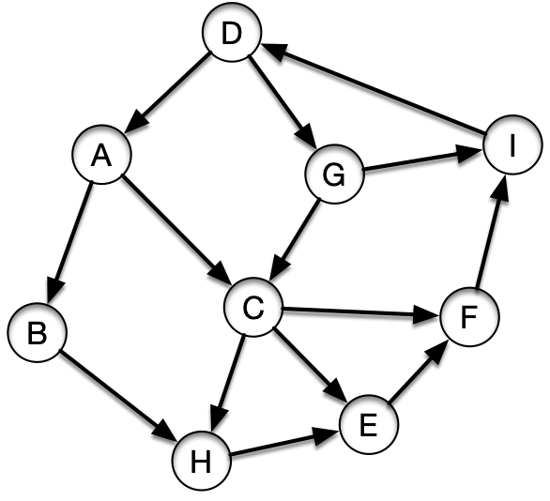
Topological Sort
Start in A
Order adjacency lists alphabetically
A: B,C
B: H
C: E,F,H
D: A,G
E: F
F: I
G: C
H:
I: D

Slide 5
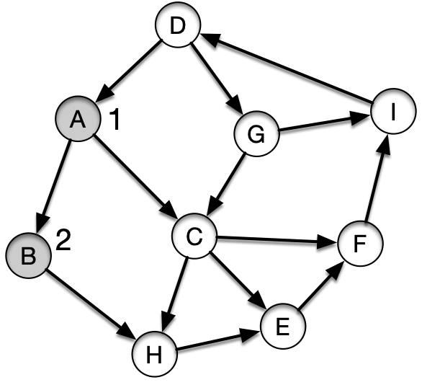
Topological Sort
Visit B
A: B,C
B: H
C: E,F,H
D: A,G
E: F
F: I
G: C
H:
I: D
visit(B)
visit(A)

Slide 6
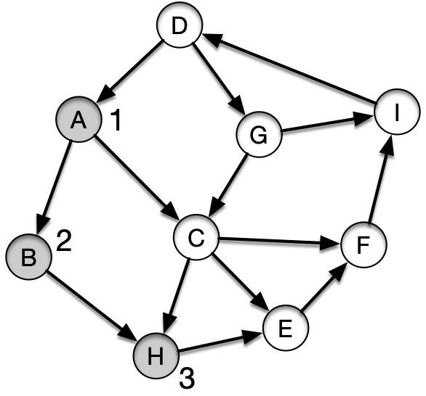
Topological Sort
Visit H
A: B,C
B: H
C: E,F,H
D: A,G
E: F
F: I
G: C
H:
I: D
visit(H)
visit(B)
visit(A)

Slide 7
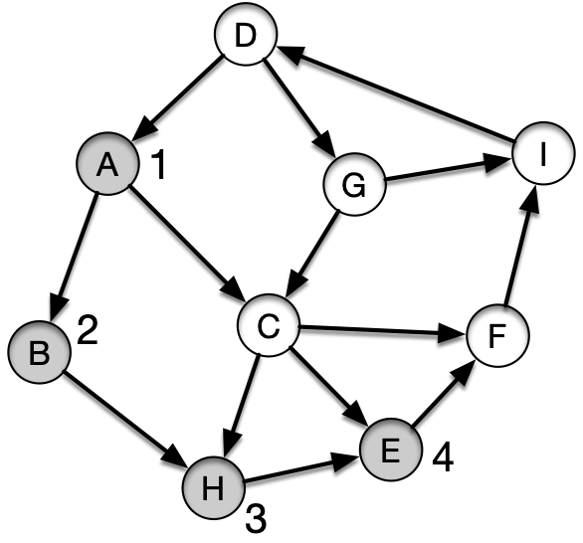
Topological Sort
Visit E
A: B,C
B: H
C: E,F,H
D: A,G
E: F
F: I
G: C
H:
I: D
visit(E)
visit(H)
visit(B)
visit(A)

Slide 8
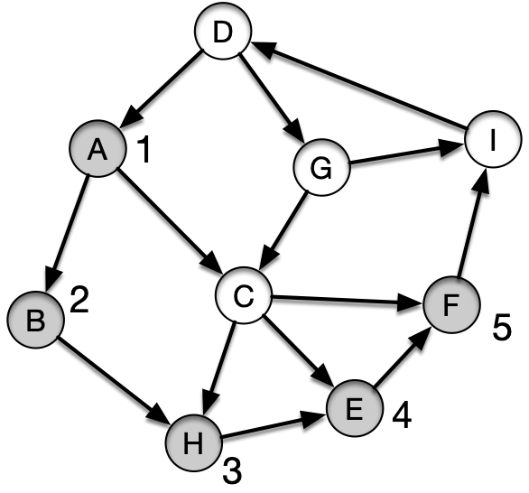
Topological Sort
Visit F
A: B,C
B: H
C: E,F,H
D: A,G
E: F
F: I
G: C
H:
I: D
visit(F)
visit(E)
visit(H)
visit(B)
visit(A)

Slide 9
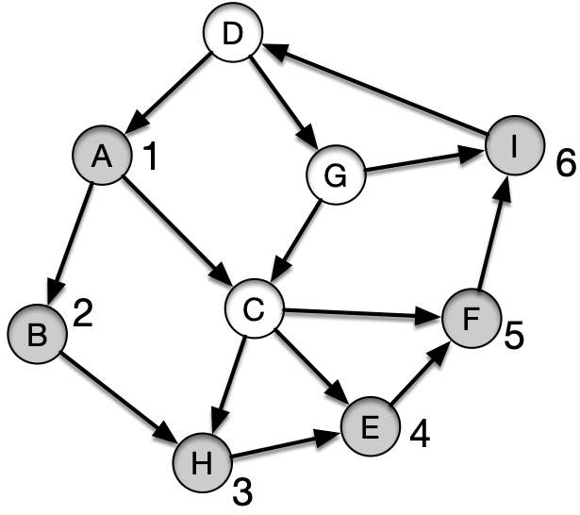
Topological Sort
Visit I
A: B,C
B: H
C: E,F,H
D: A,G
E: F
F: I
G: C
H:
I: D
visit(I)
visit(F)
visit(E)
visit(H)
visit(B)
visit(A)

Slide 10
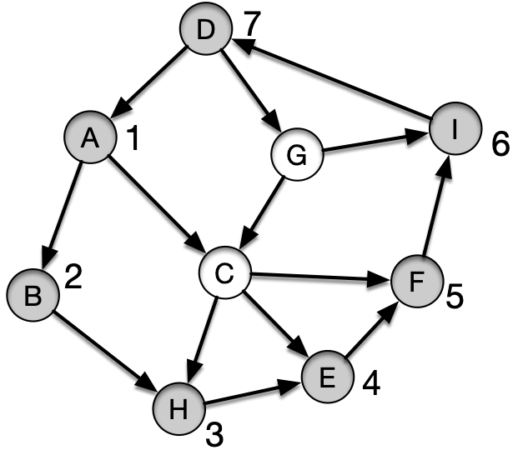
Topological Sort
Visit D
A: B,C
B: H
C: E,F,H
D: A,G
E: F
F: I
G: C
H:
I: D
visit(D)
visit(I)
visit(F)
visit(E)
visit(H)
visit(B)
visit(A)

Slide 11
Topological Sort
At this point:
The adjacency list of D starts with A
A is gray
This edge becomes a back edge!
And shows that there is a cycle
A: B,C
B: H
C: E,F,H
D: A,G
E: F
F: I
G: C
H:
I: D
visit(D)
visit(I)
visit(F)
visit(E)
visit(H)
visit(B)
visit(A)

Slide 12
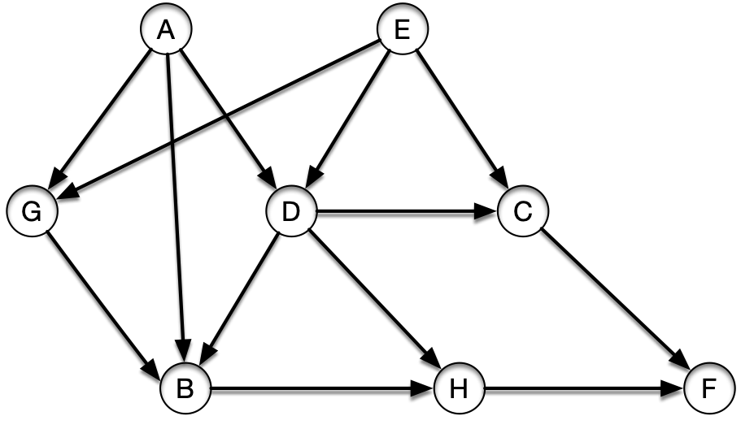
Topological Sort
A different example
Start in A
A: B,D,G
B: H
C: F
D: B,H
E: C,D,G
F:
G: B
H: F

Slide 13
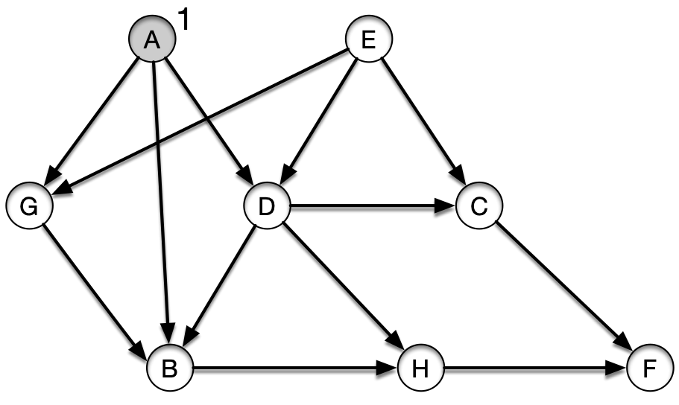
Topological Sort
A different example
Start in A
A: B,D,G
B: H
C: F
D: B,H
E: C,D,G
F:
G: B
H: F
visit(A)

Slide 14
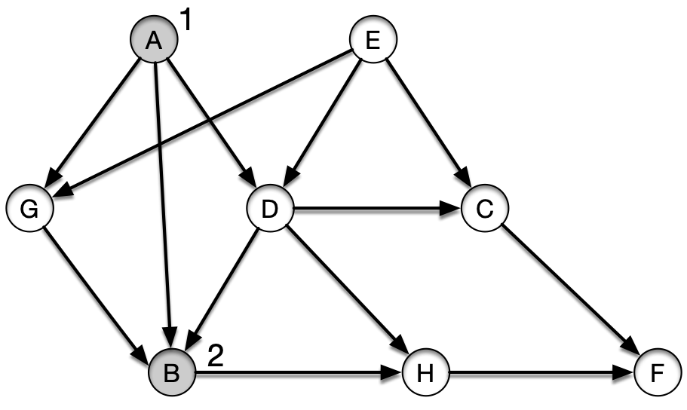
Topological Sort
Visit B
A: B,D,G
B: H
C: F
D: B,H
E: C,D,G
F:
G: B
H: F
visit(B)
visit(A)

Slide 15
Topological Sort
Visit H
A: B,D,G
B: H
C: F
D: B,H
E: C,D,G
F:
G: B
H: F
visit(H)
visit(B)
visit(A)

Slide 16
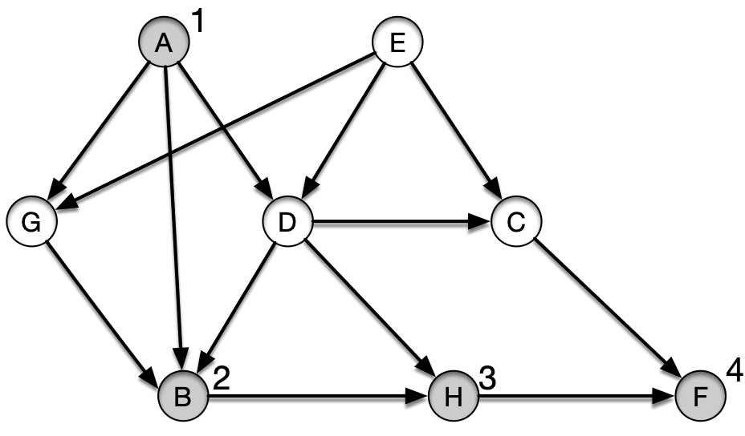
Topological Sort
Visit F
A: B,D,G
B: H
C: F
D: B,H
E: C,D,G
F:
G: B
H: F
visit(F)
visit(H)
visit(B)
visit(A)

Slide 17
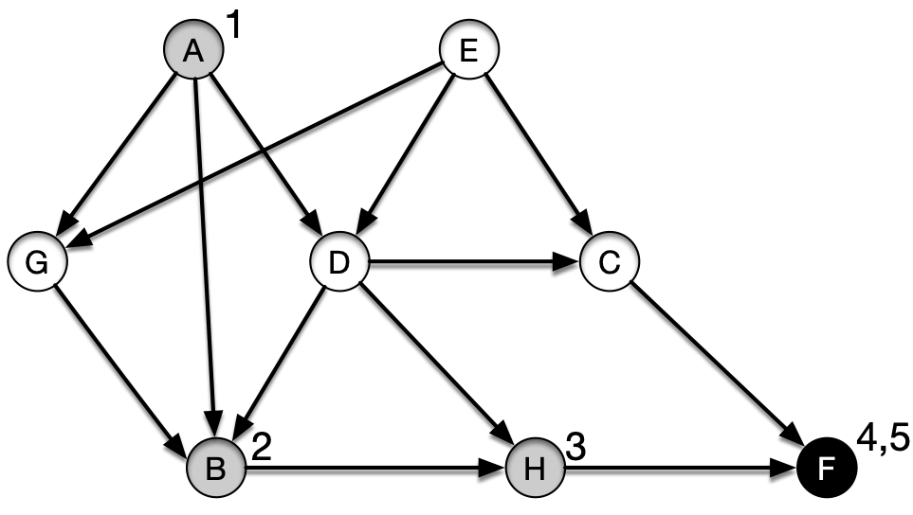
Topological Sort
Finish F
Push F at front: [F]
A: B,D,G
B: H
C: F
D: B,H
E: C,D,G
F:
G: B
H: F
visit(F)
visit(H)
visit(B)
visit(A)

Slide 18
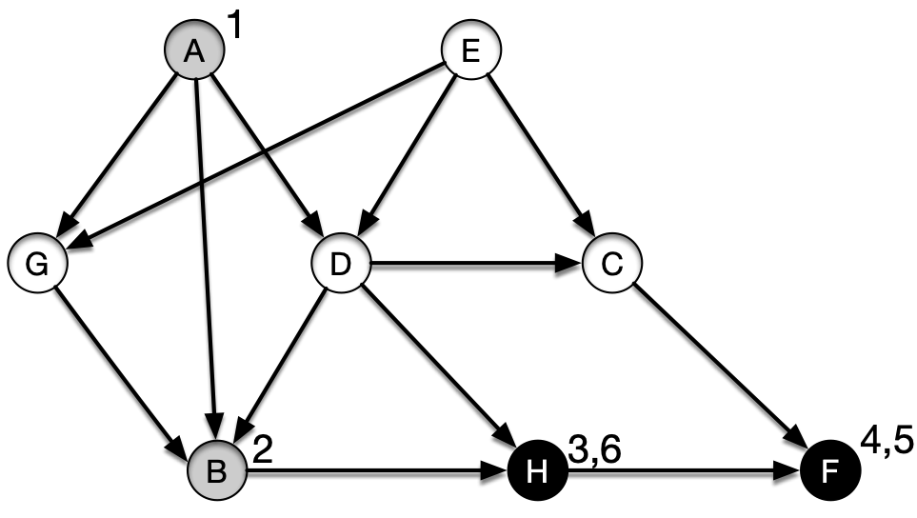
Topological Sort
Finish H
Push H at front: [H, F]
A: B,D,G
B: H
C: F
D: B,H
E: C,D,G
F:
G: B
H: F
visit(H)
visit(B)
visit(A)

Slide 19
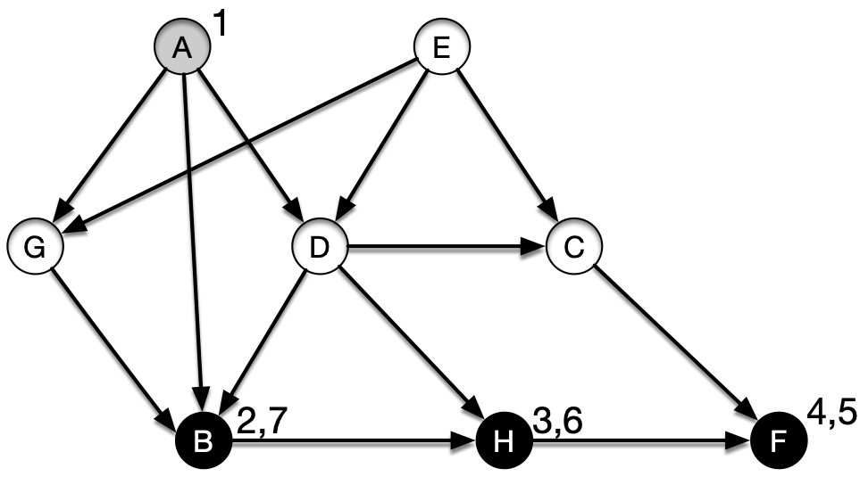
Topological Sort
Finish B
Push B at front: [B,H, F]
A: B,D,G
B: H
C: F
D: B,H
E: C,D,G
F:
G: B
H: F
visit(B)
visit(A)

Slide 20
Topological Sort
Go back to visit A
[B,H, F]
A: B,D,G
B: H
C: F
D: B,H
E: C,D,G
F:
G: B
H: F
visit(A)

Slide 21
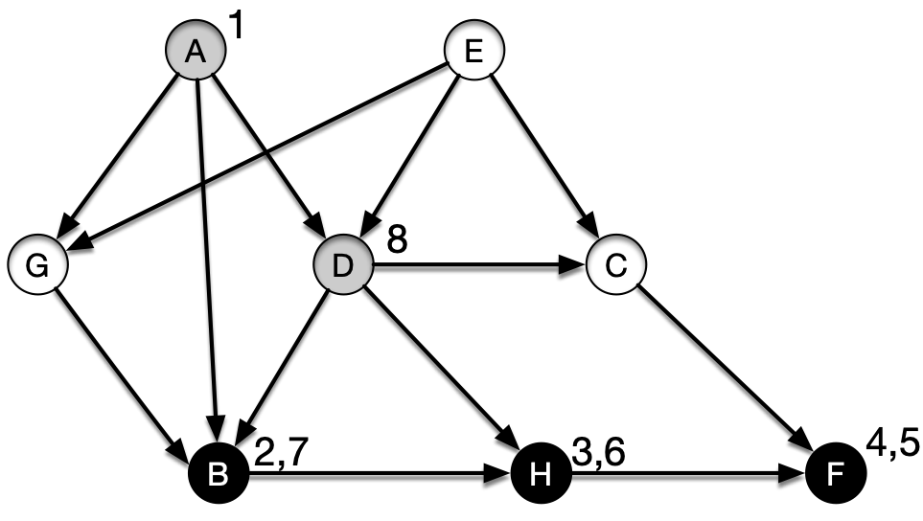
Topological Sort
Visit D
[B,H, F]
A: B,D,G
B: H
C: F
D: B,H
E: C,D,G
F:
G: B
H: F
visit(D)
visit(A)

Slide 22
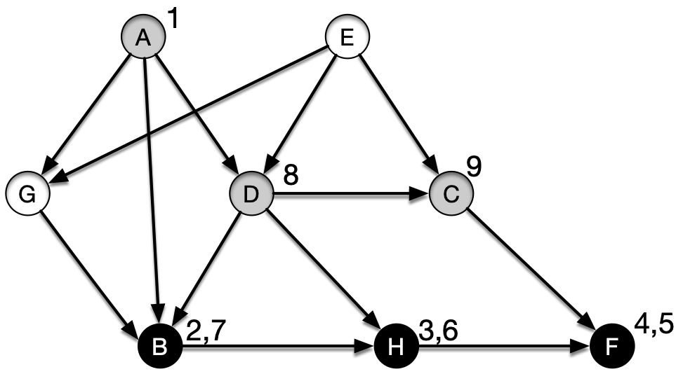
Topological Sort
Visit C
[B,H, F]
A: B,D,G
B: H
C: F
D: B,H
E: C,D,G
F:
G: B
H: F
visit(C)
visit(D)
visit(A)

Slide 23
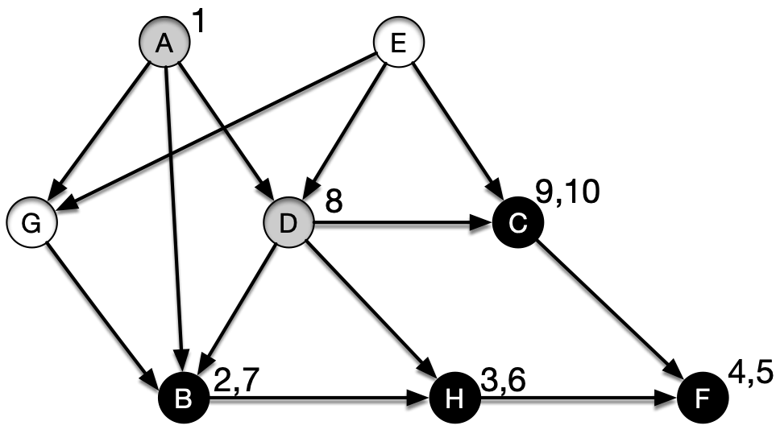
Topological Sort
Finish C
[C, B,H, F]
A: B,D,G
B: H
C: F
D: B,H
E: C,D,G
F:
G: B
H: F
visit(C)
visit(D)
visit(A)

Slide 24
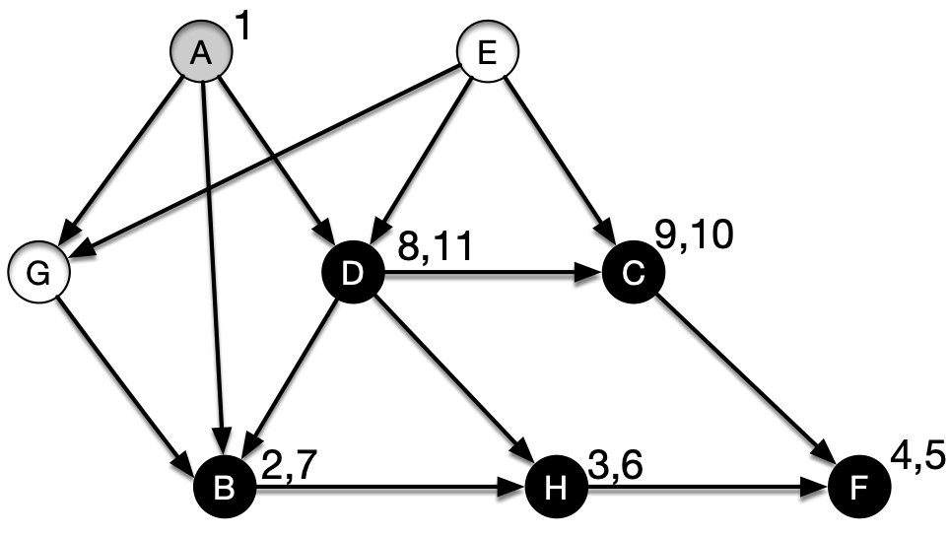
Topological Sort
Go back and finish D
[D, C, B, H, F]
A: B,D,G
B: H
C: F
D: B,H
E: C,D,G
F:
G: B
H: F
visit(D)
visit(A)

Slide 25
Topological Sort
We are back to visit A
Next node is G
[D, C, B, H, F]
A: B,D,G
B: H
C: F
D: B,H
E: C,D,G
F:
G: B
H: F
visit(A)

Slide 26
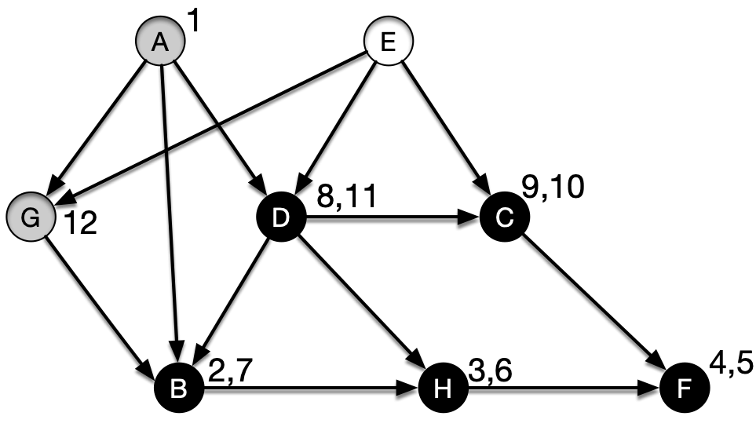
Topological Sort
Visit G
[D, C, B, H, F]
A: B,D,G
B: H
C: F
D: B,H
E: C,D,G
F:
G: B
H: F
visit(G)
visit(A)

Slide 27
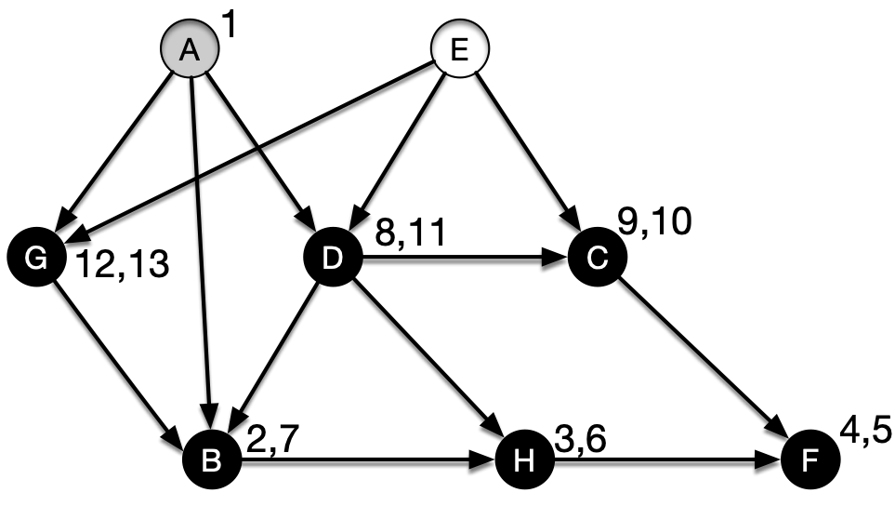
Topological Sort
Finish G
[G, D, C, B, H, F]
A: B,D,G
B: H
C: F
D: B,H
E: C,D,G
F:
G: B
H: F
visit(G)
visit(A)

Slide 28
Topological Sort
Go back to A
[G, D, C, B, H, F]
A: B,D,G
B: H
C: F
D: B,H
E: C,D,G
F:
G: B
H: F
visit(A)

Slide 29
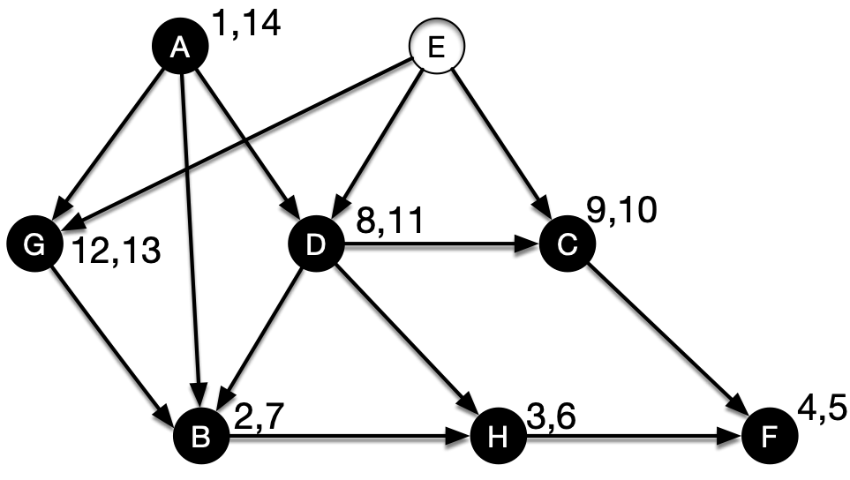
Topological Sort
Finish A
[A, G, D, C, B, H, F]
A: B,D,G
B: H
C: F
D: B,H
E: C,D,G
F:
G: B
H: F
$$∅$$

Slide 30
Topological Sort
Done with visit(A)
[A, G, D, C, B, H, F]
A: B,D,G
B: H
C: F
D: B,H
E: C,D,G
F:
G: B
H: F
$$∅$$

Slide 31
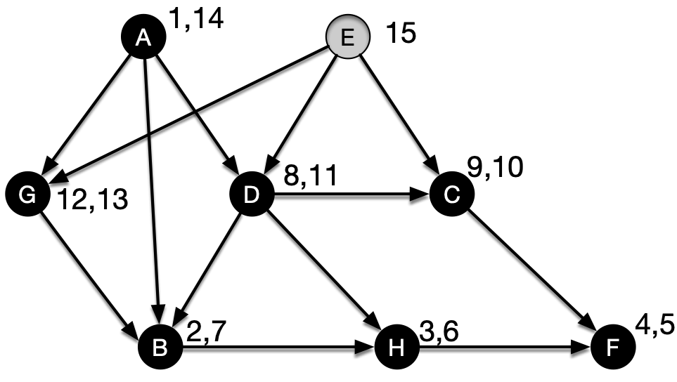
Topological Sort
One white node left: E
Visit E
[A, G, D, C, B, H, F]
A: B,D,G
B: H
C: F
D: B,H
E: C,D,G
F:
G: B
H: F
visit(E)

Slide 32
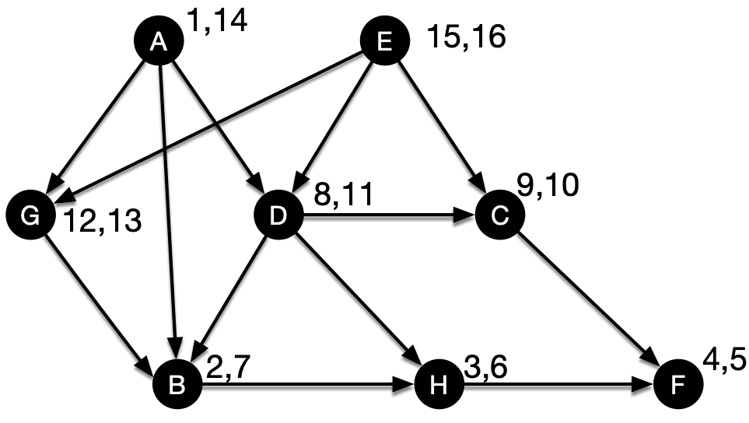
Topological Sort
Finish E
[E, A, G, D, C, B, H, F]
A: B,D,G
B: H
C: F
D: B,H
E: C,D,G
F:
G: B
H: F

Slide 33
Topological Sort
Key observation from the examples:
We have a cycle if we ever try to visit a gray node

Slide 34
Topological Sort
Lemma: A directed graph $G=(V,E)$ is acyclic if and only if a DFS of G yields no back edges

Slide 35
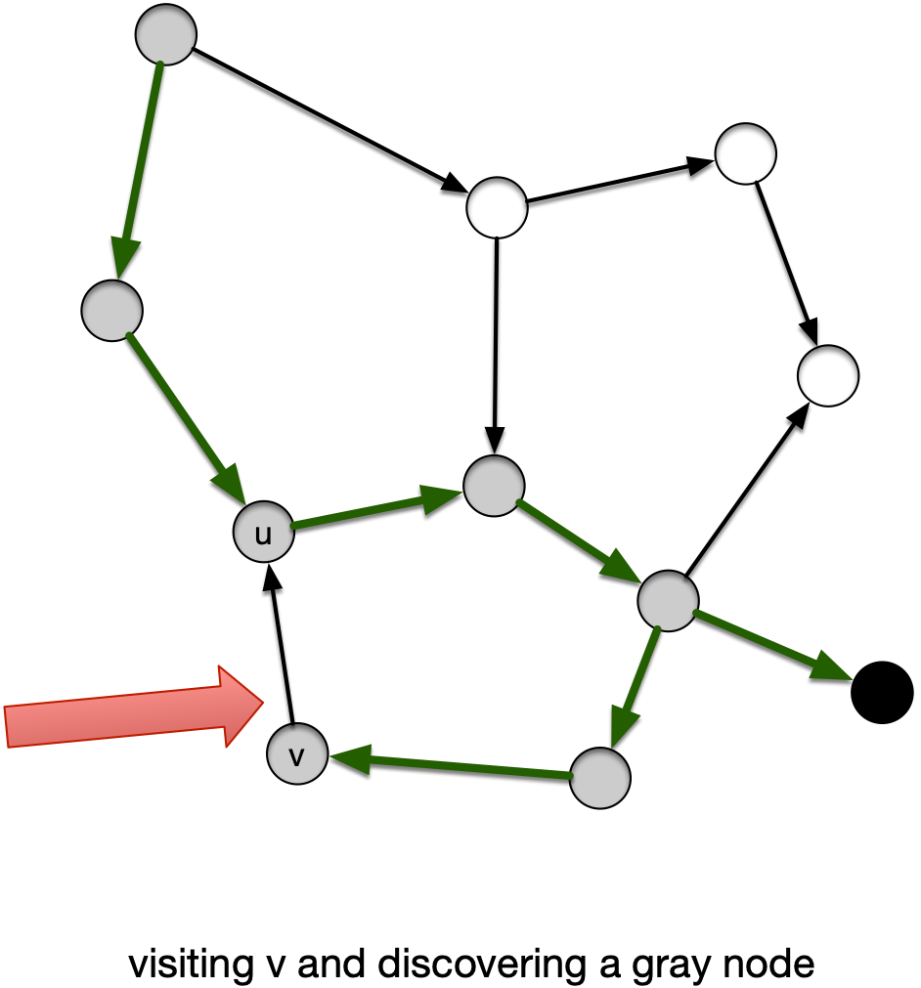
Topological Sort
Proof: "$⇒$"
If DFS produces a back-edge $(v,u)$ then $u$ is an ancestor of $v$
There is a path from $u$ to $v$ in the tree
The edge $(v,u)$ closes a cycle
from $u$ to $v$ back to $u$

Slide 36
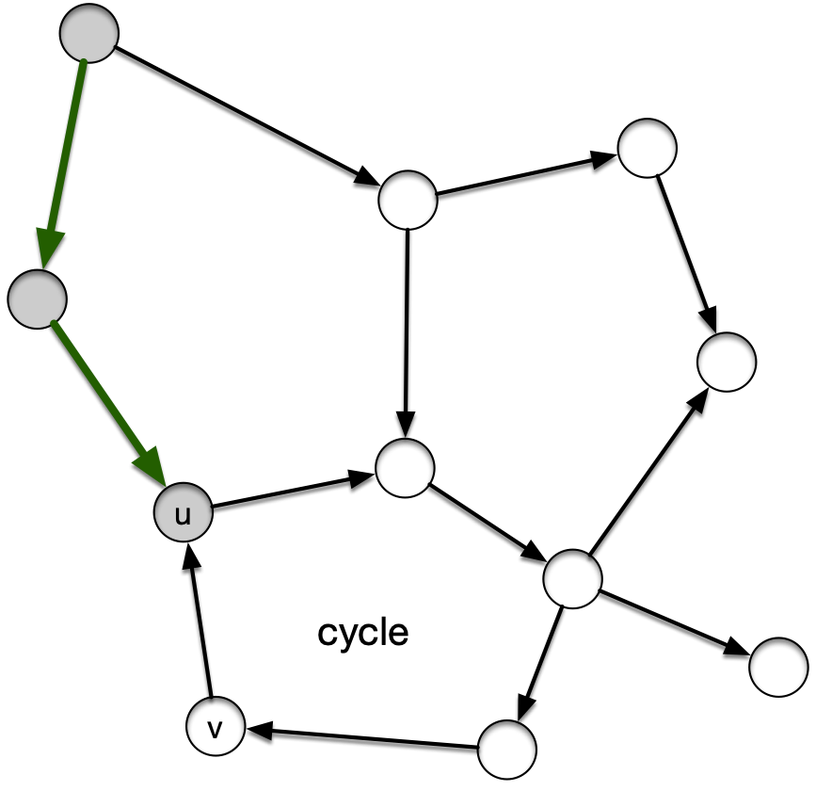
Topological Sort
Proof: "$⇐$"
Suppose $G$ has a cycle
Let $u$ be the first vertex in the cycle to be discovered

Slide 37
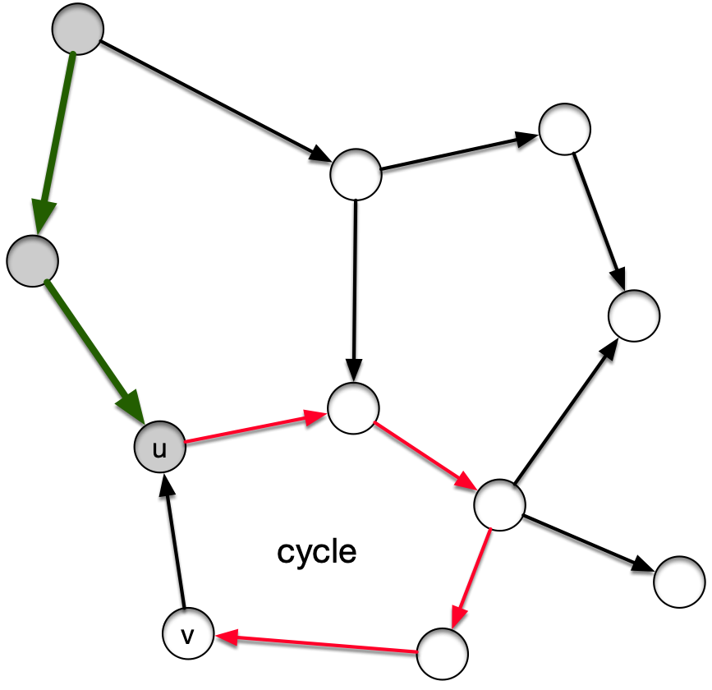
Topological Sort
All other vertices in the cycle are white and there is a white-path to the node $v$ just in front of $u$

Slide 38
Topological Sort
By the white-path theorem:
We will discover $v$ from $u$
(Though not necessarily through the cycle since there might be more cycles)
Thus, $(v,u)$ is a back edge

Slide 39
Topological Sort
Theorem: DFS gives a topological sort or discovers a cycle
Proof:
Need to show:
If DFS does not discover a cycle, then for each edge $(u,v)$, we have $u.f>v.f$

Slide 40
Topological Sort
Proof:
At the time that we are first looking at $(u,v)$:
$v$ cannot be gray, because then we would have a back-edge

Slide 41
Topological Sort
At the time that we are first looking at $(u,v)$:
If $v$ is white:
Then by the white path theorem, $u$ becomes an ancestor of $v$
By the parenthesis theorem $v.f<u.f$

Slide 42
Topological Sort
Proof:
At the time that we are first looking at $(u,v)$:
If $v$ is black, then $u$ is still be visited, so
$u$ is not yet black
so, $u.f>v.f$
qed

Slide 43
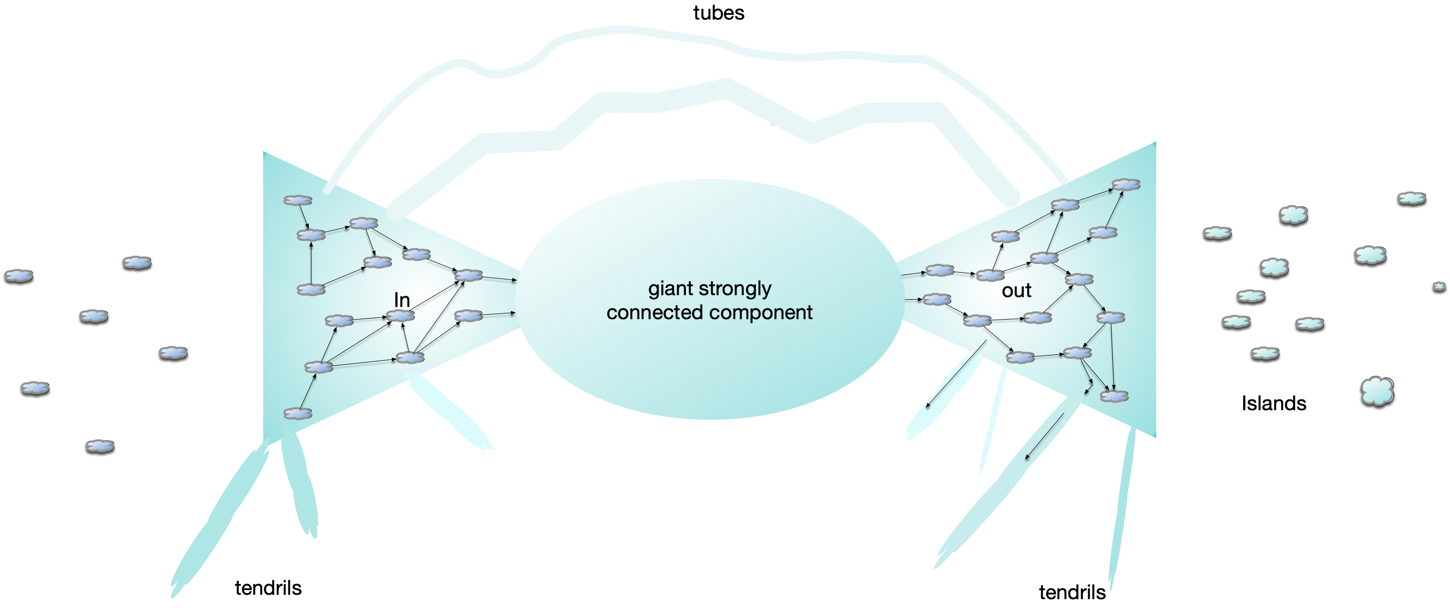
Strongly Connected Components
WWW graph:
Nodes: pages
Edges: links from one page to another page
Broder et al. study (2000): 200 million pages and 1.5 billion links

Slide 44
Strongly Connected Components
Bowtie:
Strongly connected component at the center of the WWW (28%) of all nodes

Slide 45
Strongly Connected Components
Islands: Isolated areas of the web

Slide 46
Strongly Connected Components
In: Possible to reach the giant
Out: Reachable from the giant

Slide 47
Strongly Connected Components
Weird stuff: Tubes that move from In to Out bypassing the giant

Slide 48
Strongly Connected Components
Weird stuff: Tendrils to In and tendrils to Out

Slide 49
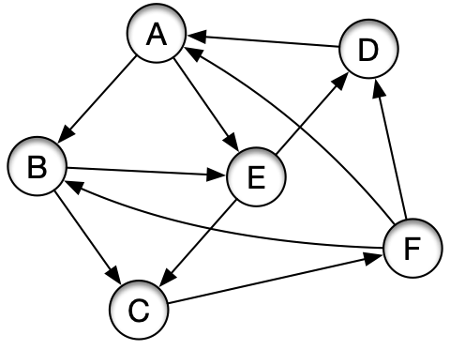
Strongly Connected Components
Strongly connected component:
Can reach any vertex from any other vertex

Slide 50
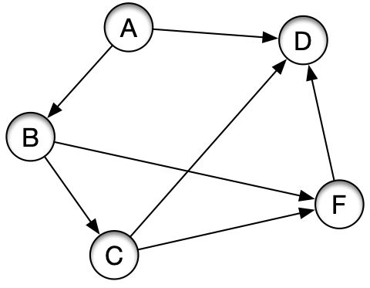
Strongly Connected Components
Strongly connected component
This is NOT strongly connected
There is no way to get from D to A

Slide 51
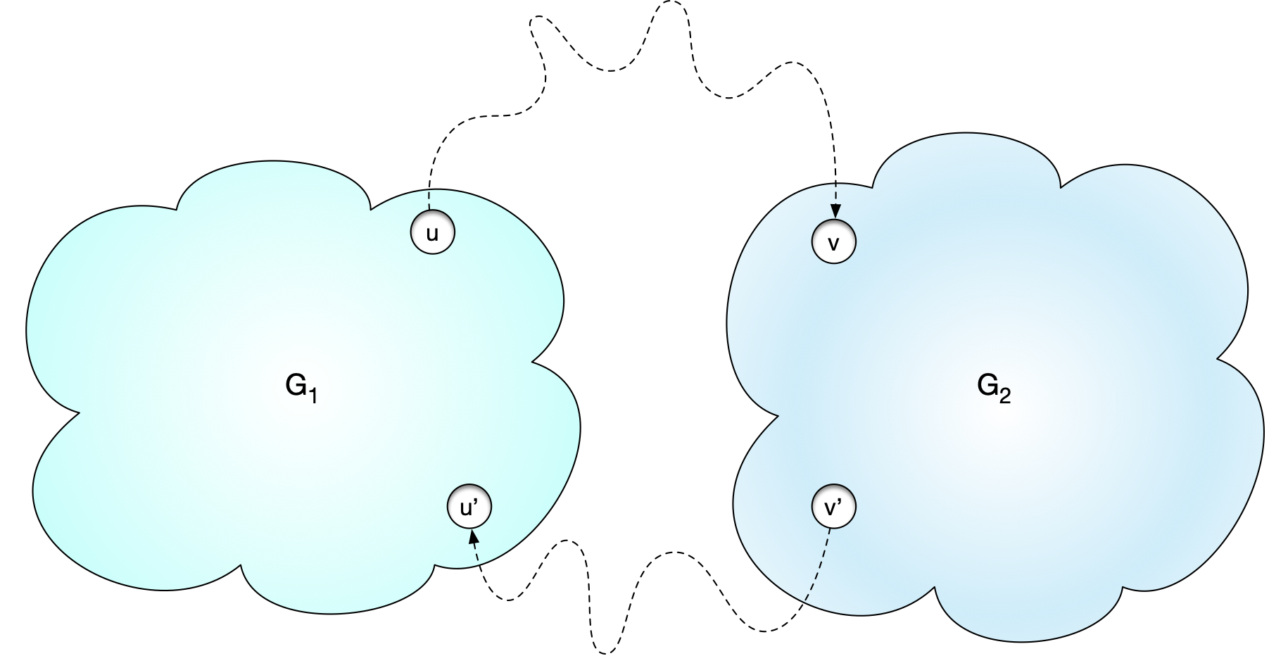
Strongly Connected Components
Lemma: Let $G_{1}$ and $G_{2}$ be two strongly connected subgraphs of a graph $G$ and assume that there is a path from a vertex in $G_{1}$ to a vertex in $G_{2}$ and also a path from a vertex of $G_{2}$ to $G_{1}$, then $G_{1}∪G_{2}$ is strongly connected

Slide 52
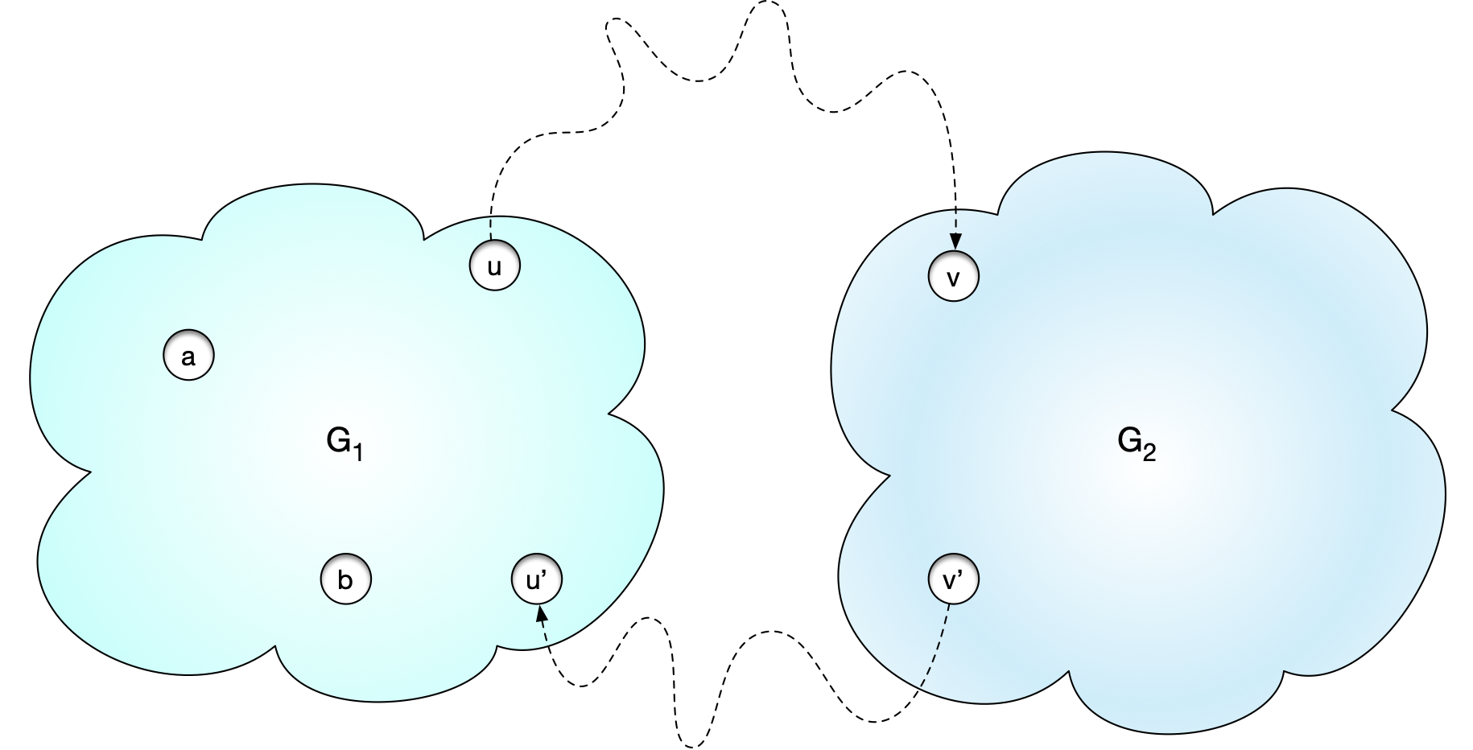
Strongly Connected Components
Proof: Take two nodes $a$ and $b$ in $G_{1}∪G_{2}$.
If both are in $G_{1}$ then there is a path between $a$ and $b$ because they are in $G_{1}$

Slide 53
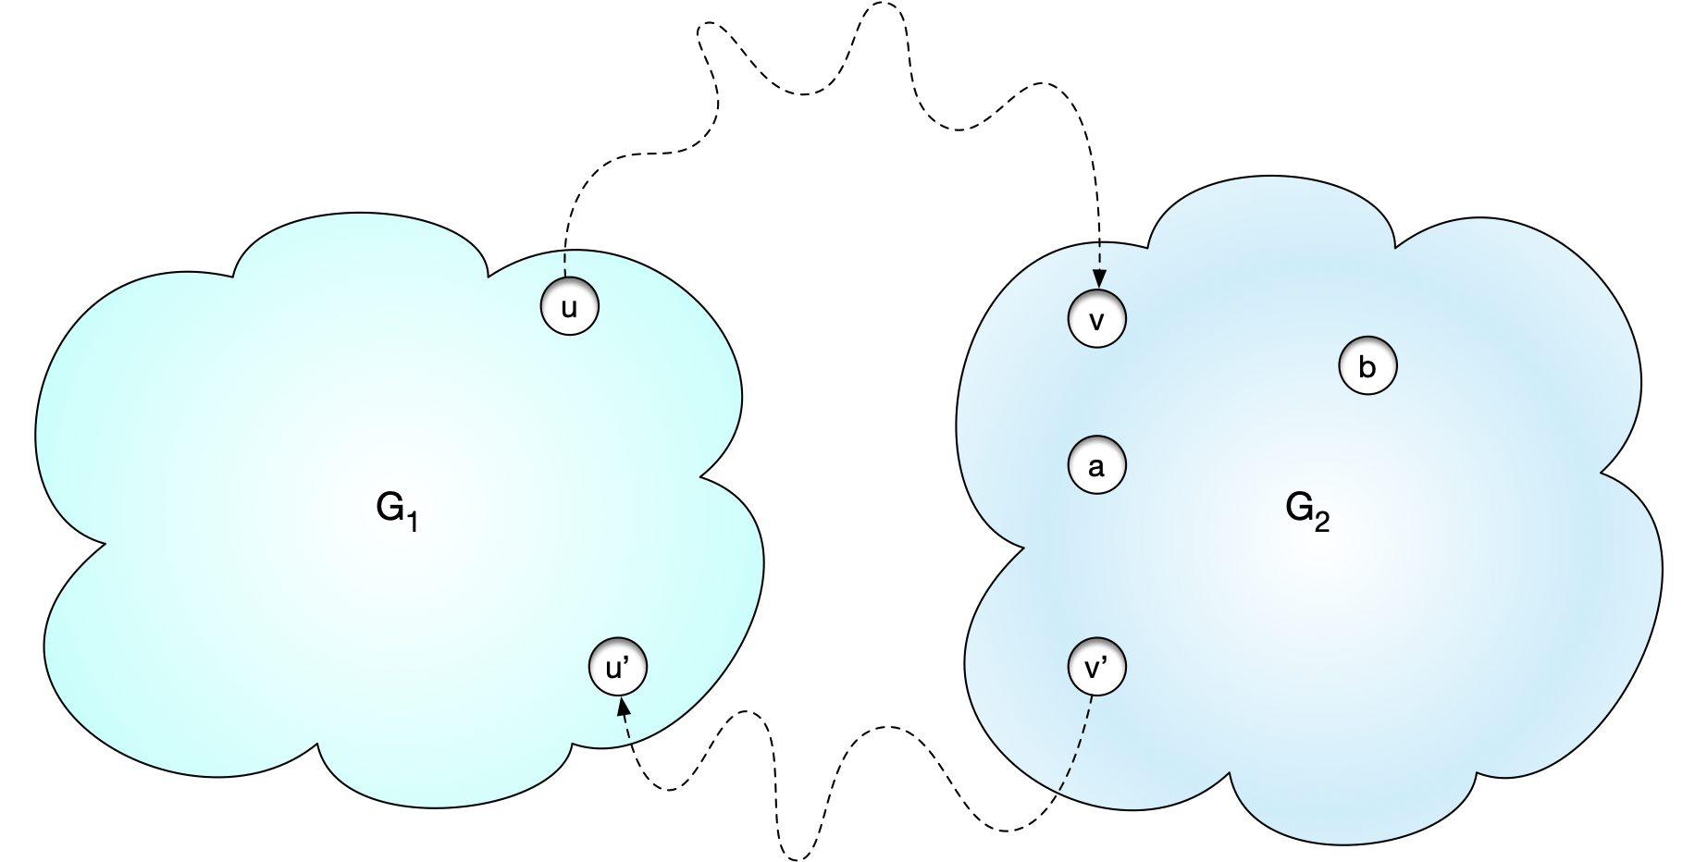
Strongly Connected Components
Proof: Take two nodes $a$ and $b$ in $G_{1}∪G_{2}$.
If both are in $G_{2}$ then there is a path between $a$ and $b$ because they are in $G_{2}$

Slide 54
Strongly Connected Components
If $a∈V(G_{1})$ and $b∈V(G_{2})$, then we can move from $a$ to $u$ and from $u$ to $v$ and then from $v$ to $b$.
After removing cycles, this is now a path from $a$ to $b$

Slide 55
Strongly Connected Components
Similarly, if $a∈V(G_{2})$ and $b∈V(G_{1})$, then we can move from $a$ to $v^{′}$ and from $v^{′}$ to $u^{′}$ and then from $u^{′}$ to $b$.
After removing cycles, this is now a path from $a$ to $b$

Slide 56
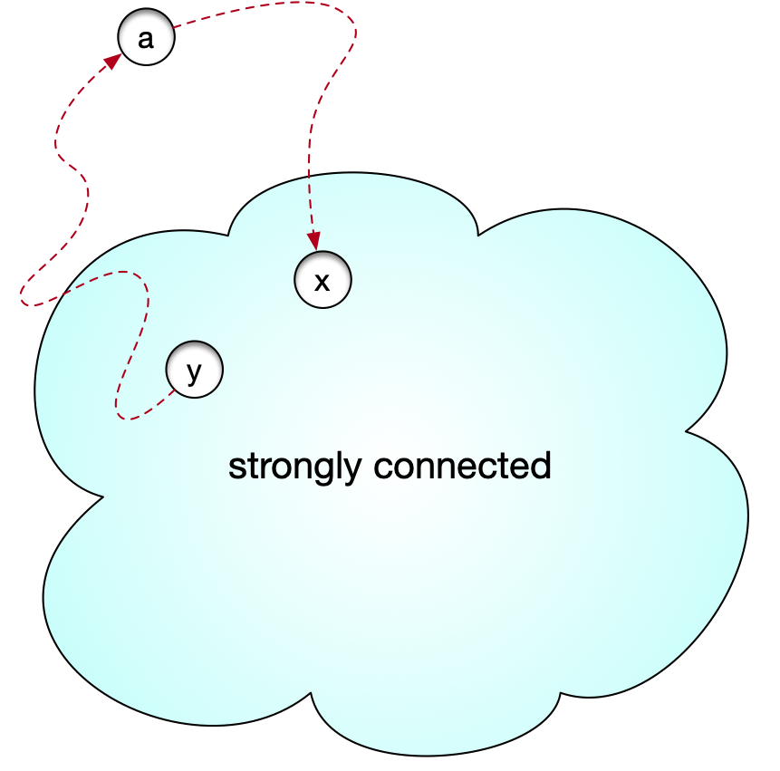
Strongly Connected Components
A single node is a strongly connected subgraph
For each strongly connected subgraph, we can try to grow by adding other nodes
If a node a has a path to and from a strongly connected subgraph, then by the lemma, we can add the node and get a bigger strongly connected subgraph

Slide 57
Strongly Connected Components
Strongly connected component : A maximal strongly connected subgraph
The nodes of any directed graph can be divided into strongly connected components

Slide 58
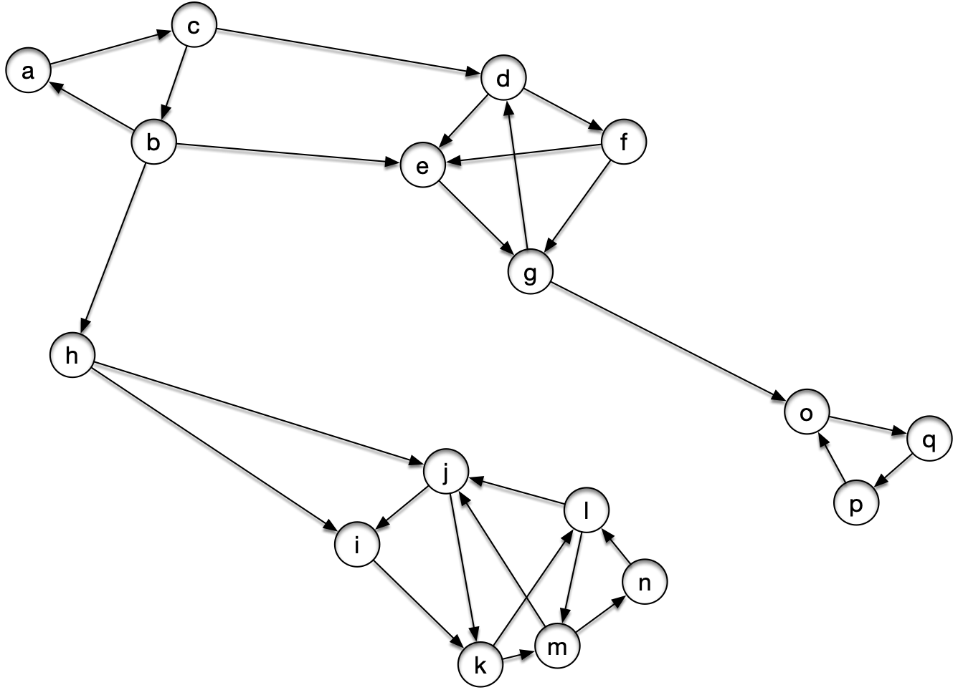
Strongly Connected Components
Example:

Slide 59
Strongly Connected Components
Try it out by growing from individual nodes

Slide 60
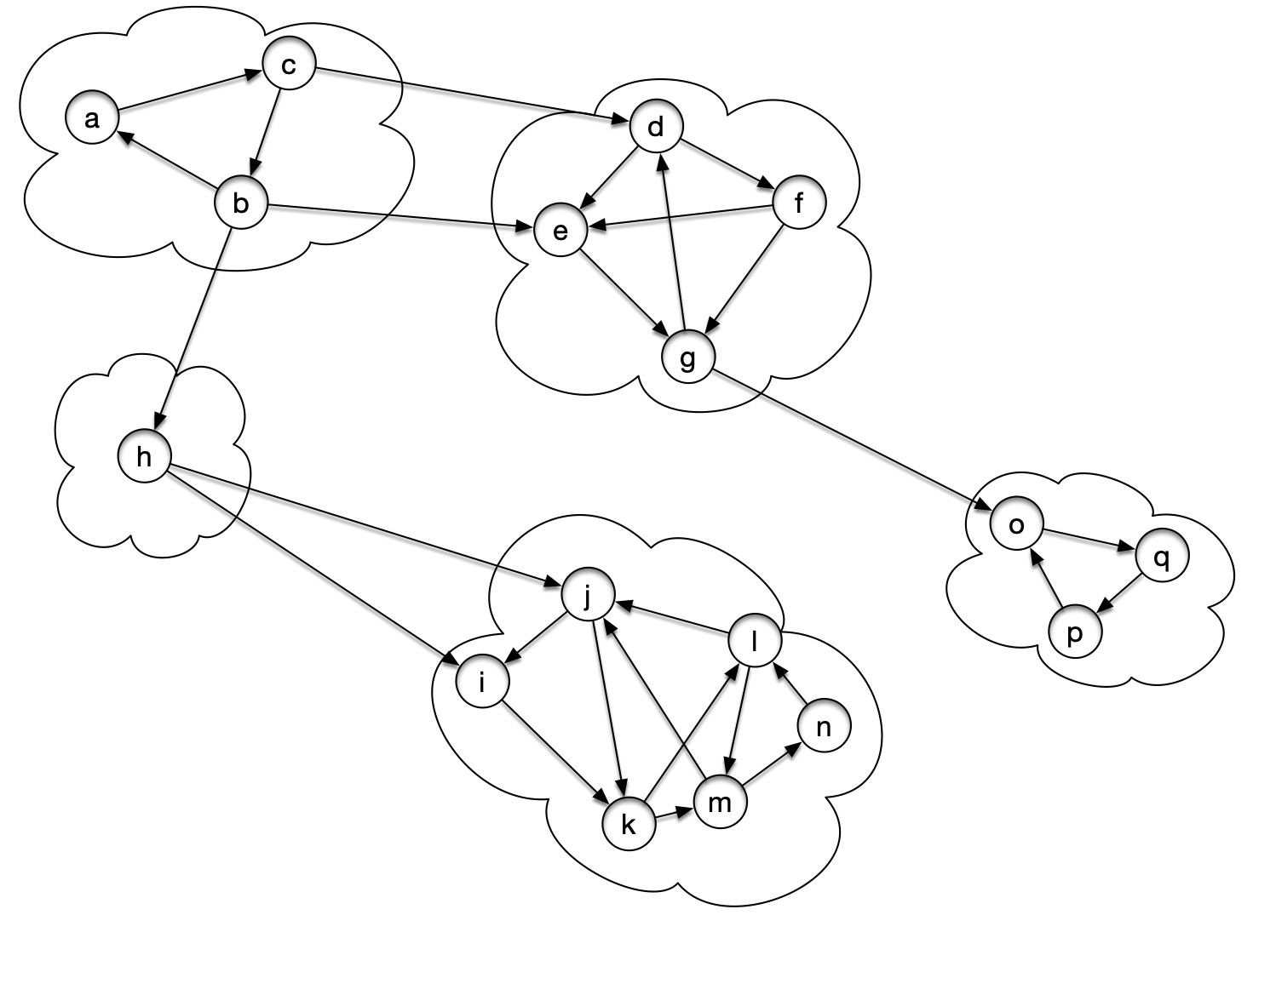
Strongly Connected Components
Result:

Slide 61
Strongly Connected Components
If we only look at the connected components we get the SCC metagraph
Nodes are the strongly connected components
Edges represent the existence of an edge from one component to the next

Slide 62
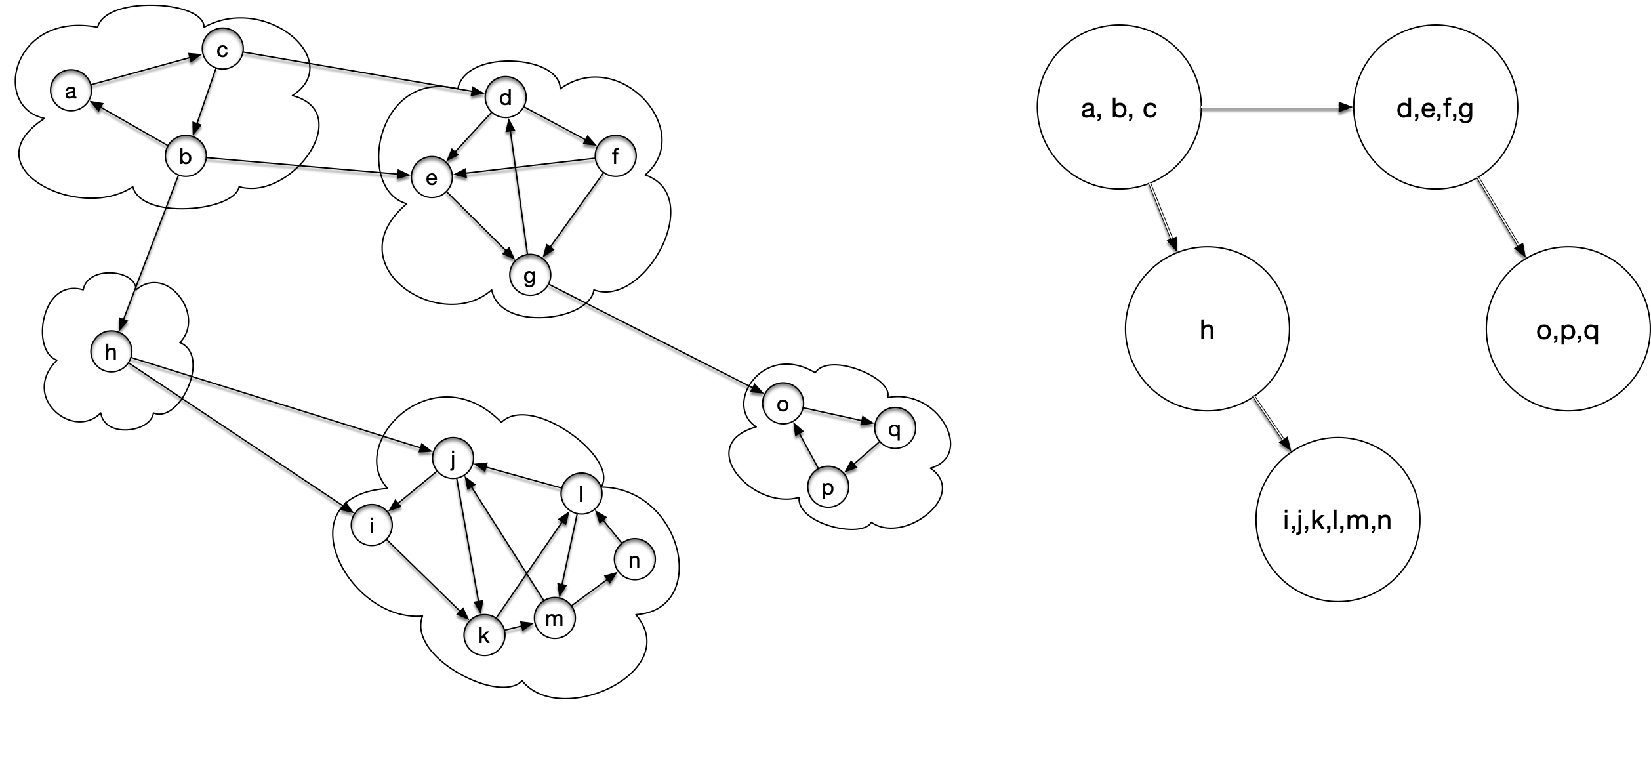
Strongly Connected Components

Slide 63
Strongly Connected Components
The resulting metagraph has to be acyclic
If there is a cycle in the metagraph, then by the lemma, the metanodes can be merged into bigger strongly connected subgraphs

Slide 64
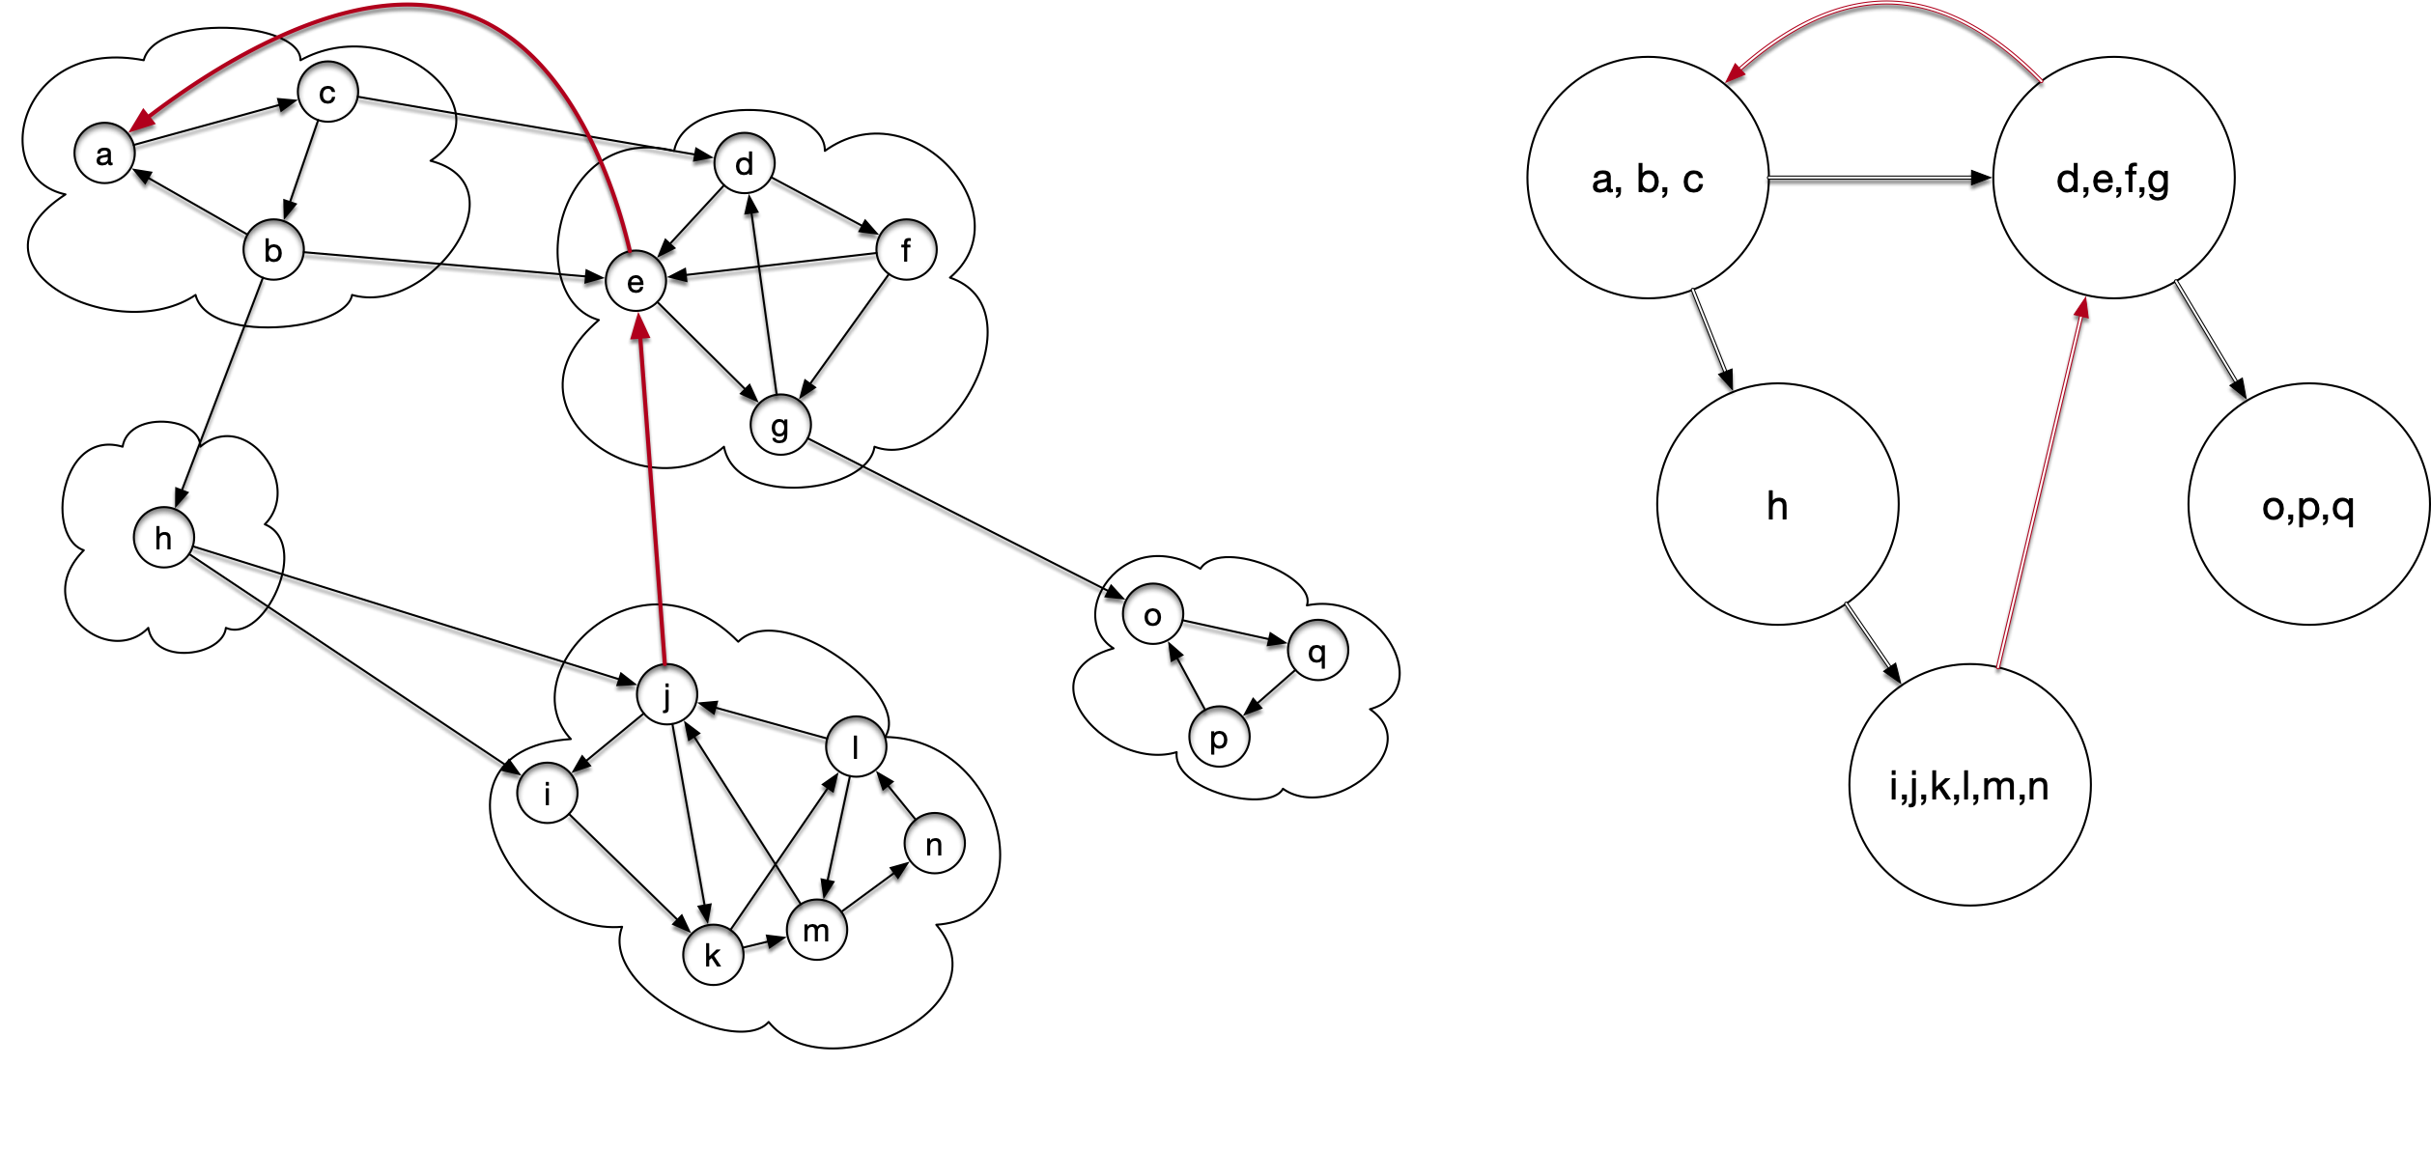
Strongly Connected Components
Example: Add two edges

Slide 65
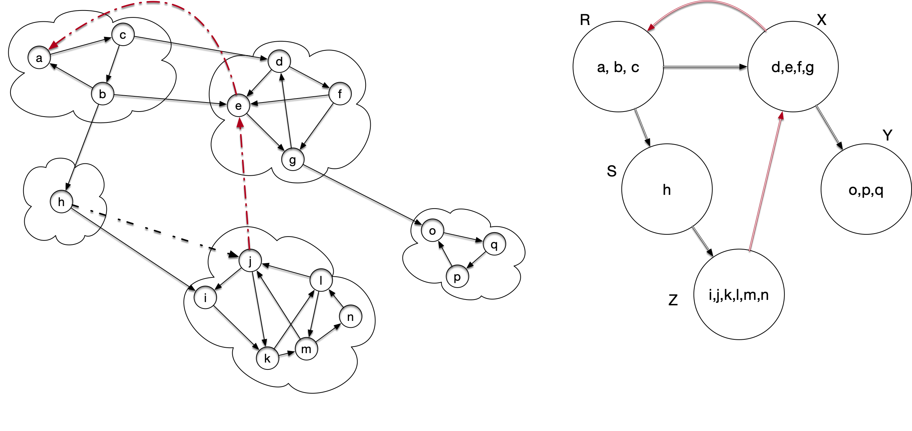
Strongly Connected Components
Now we can start merging via the Lemma
There is a path from components S to R and vice versa

Slide 66
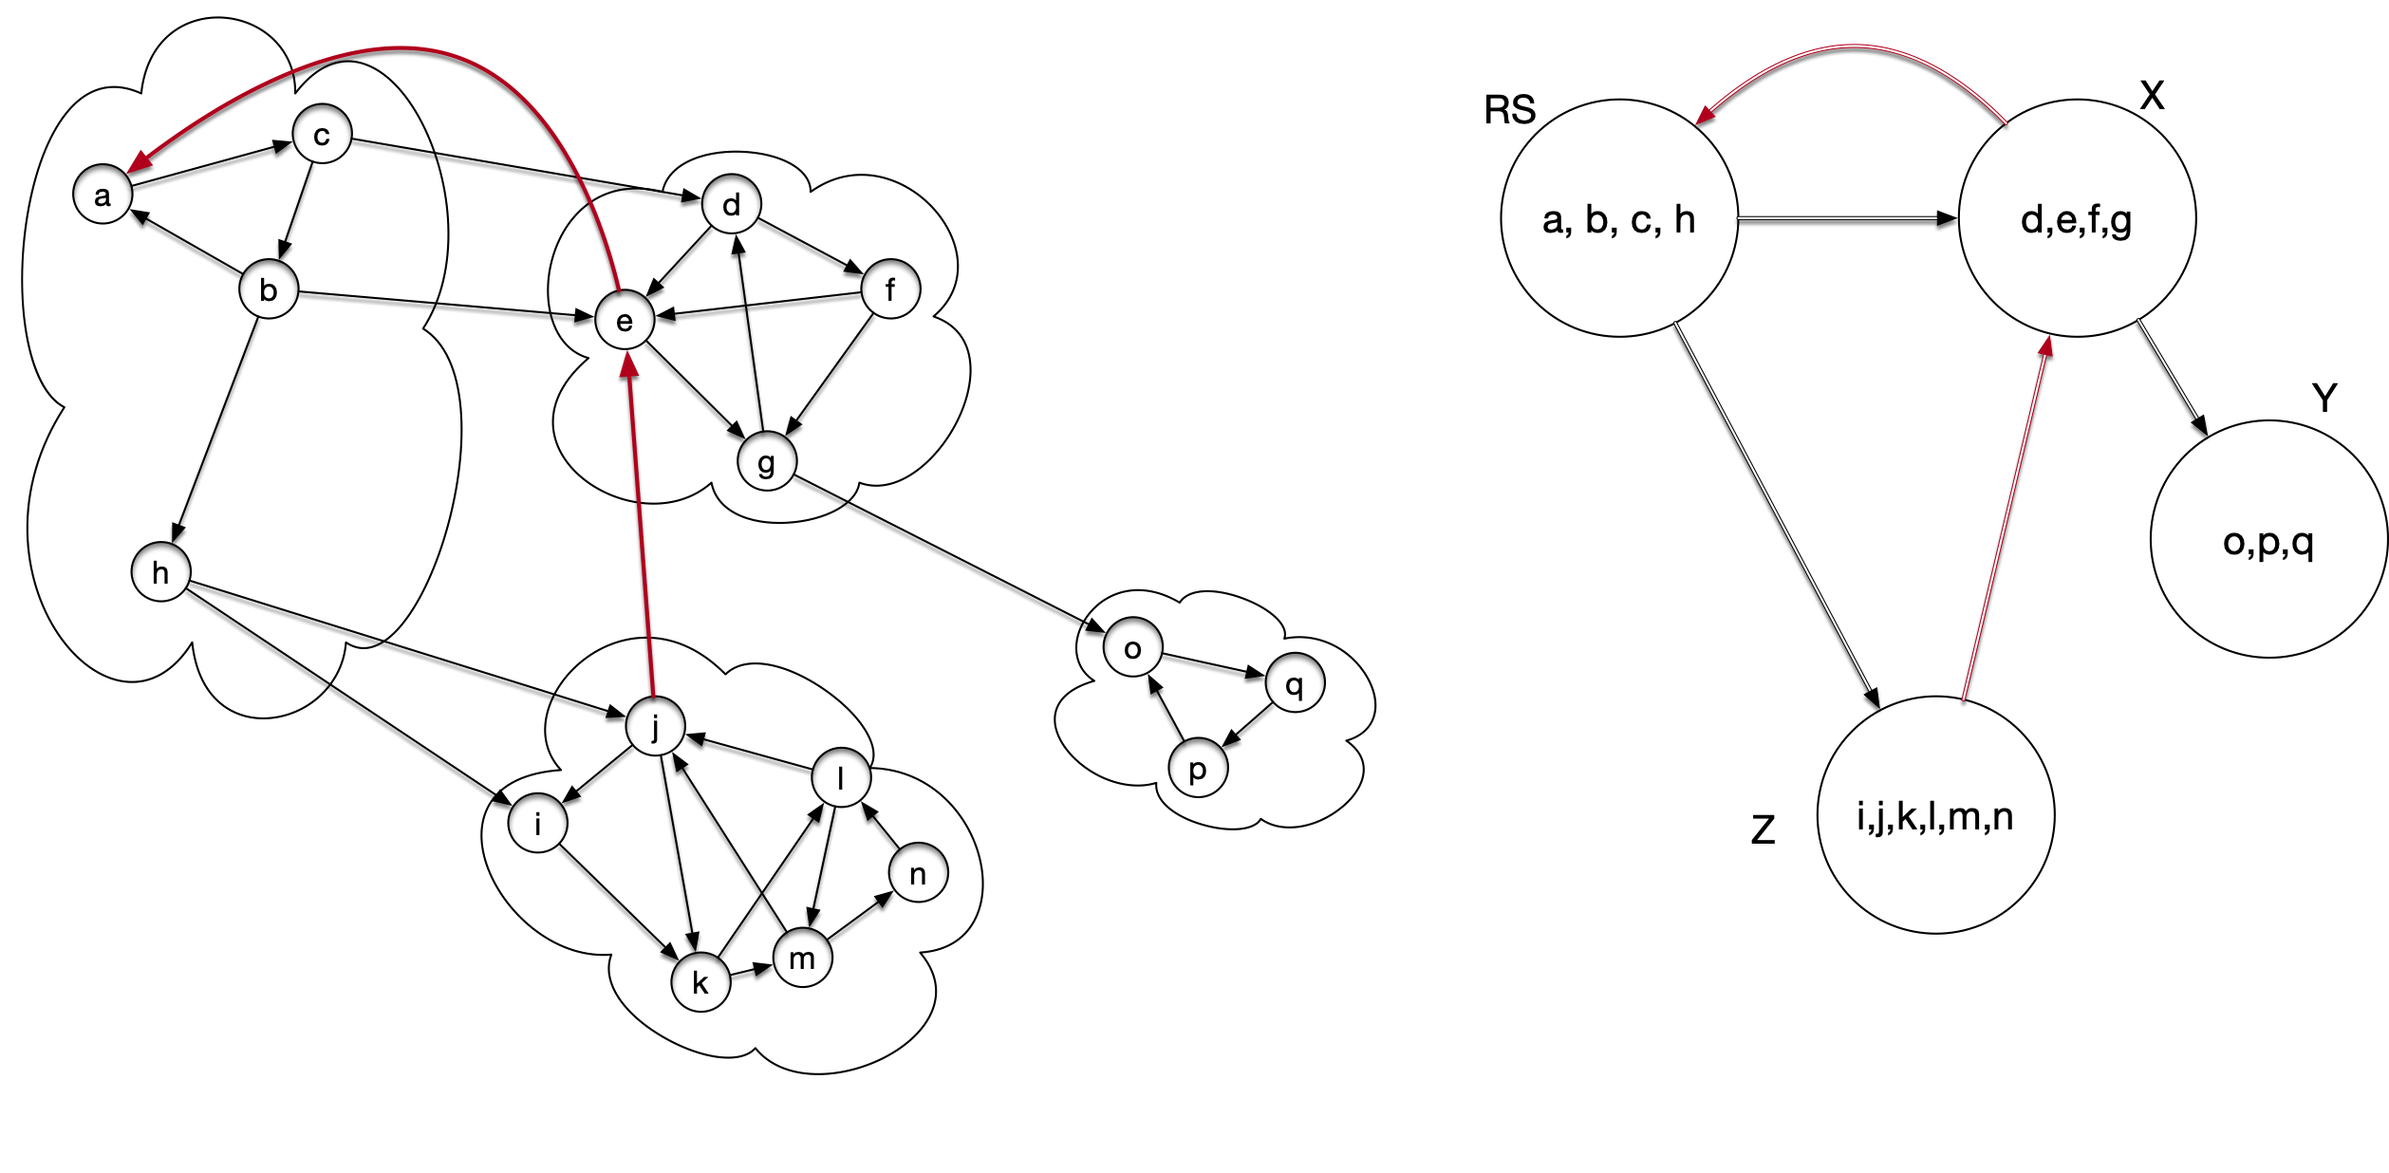
Strongly Connected Components
So we merge

Slide 67
Strongly Connected Components
There is a path from RS to X and vice versa:

Slide 68
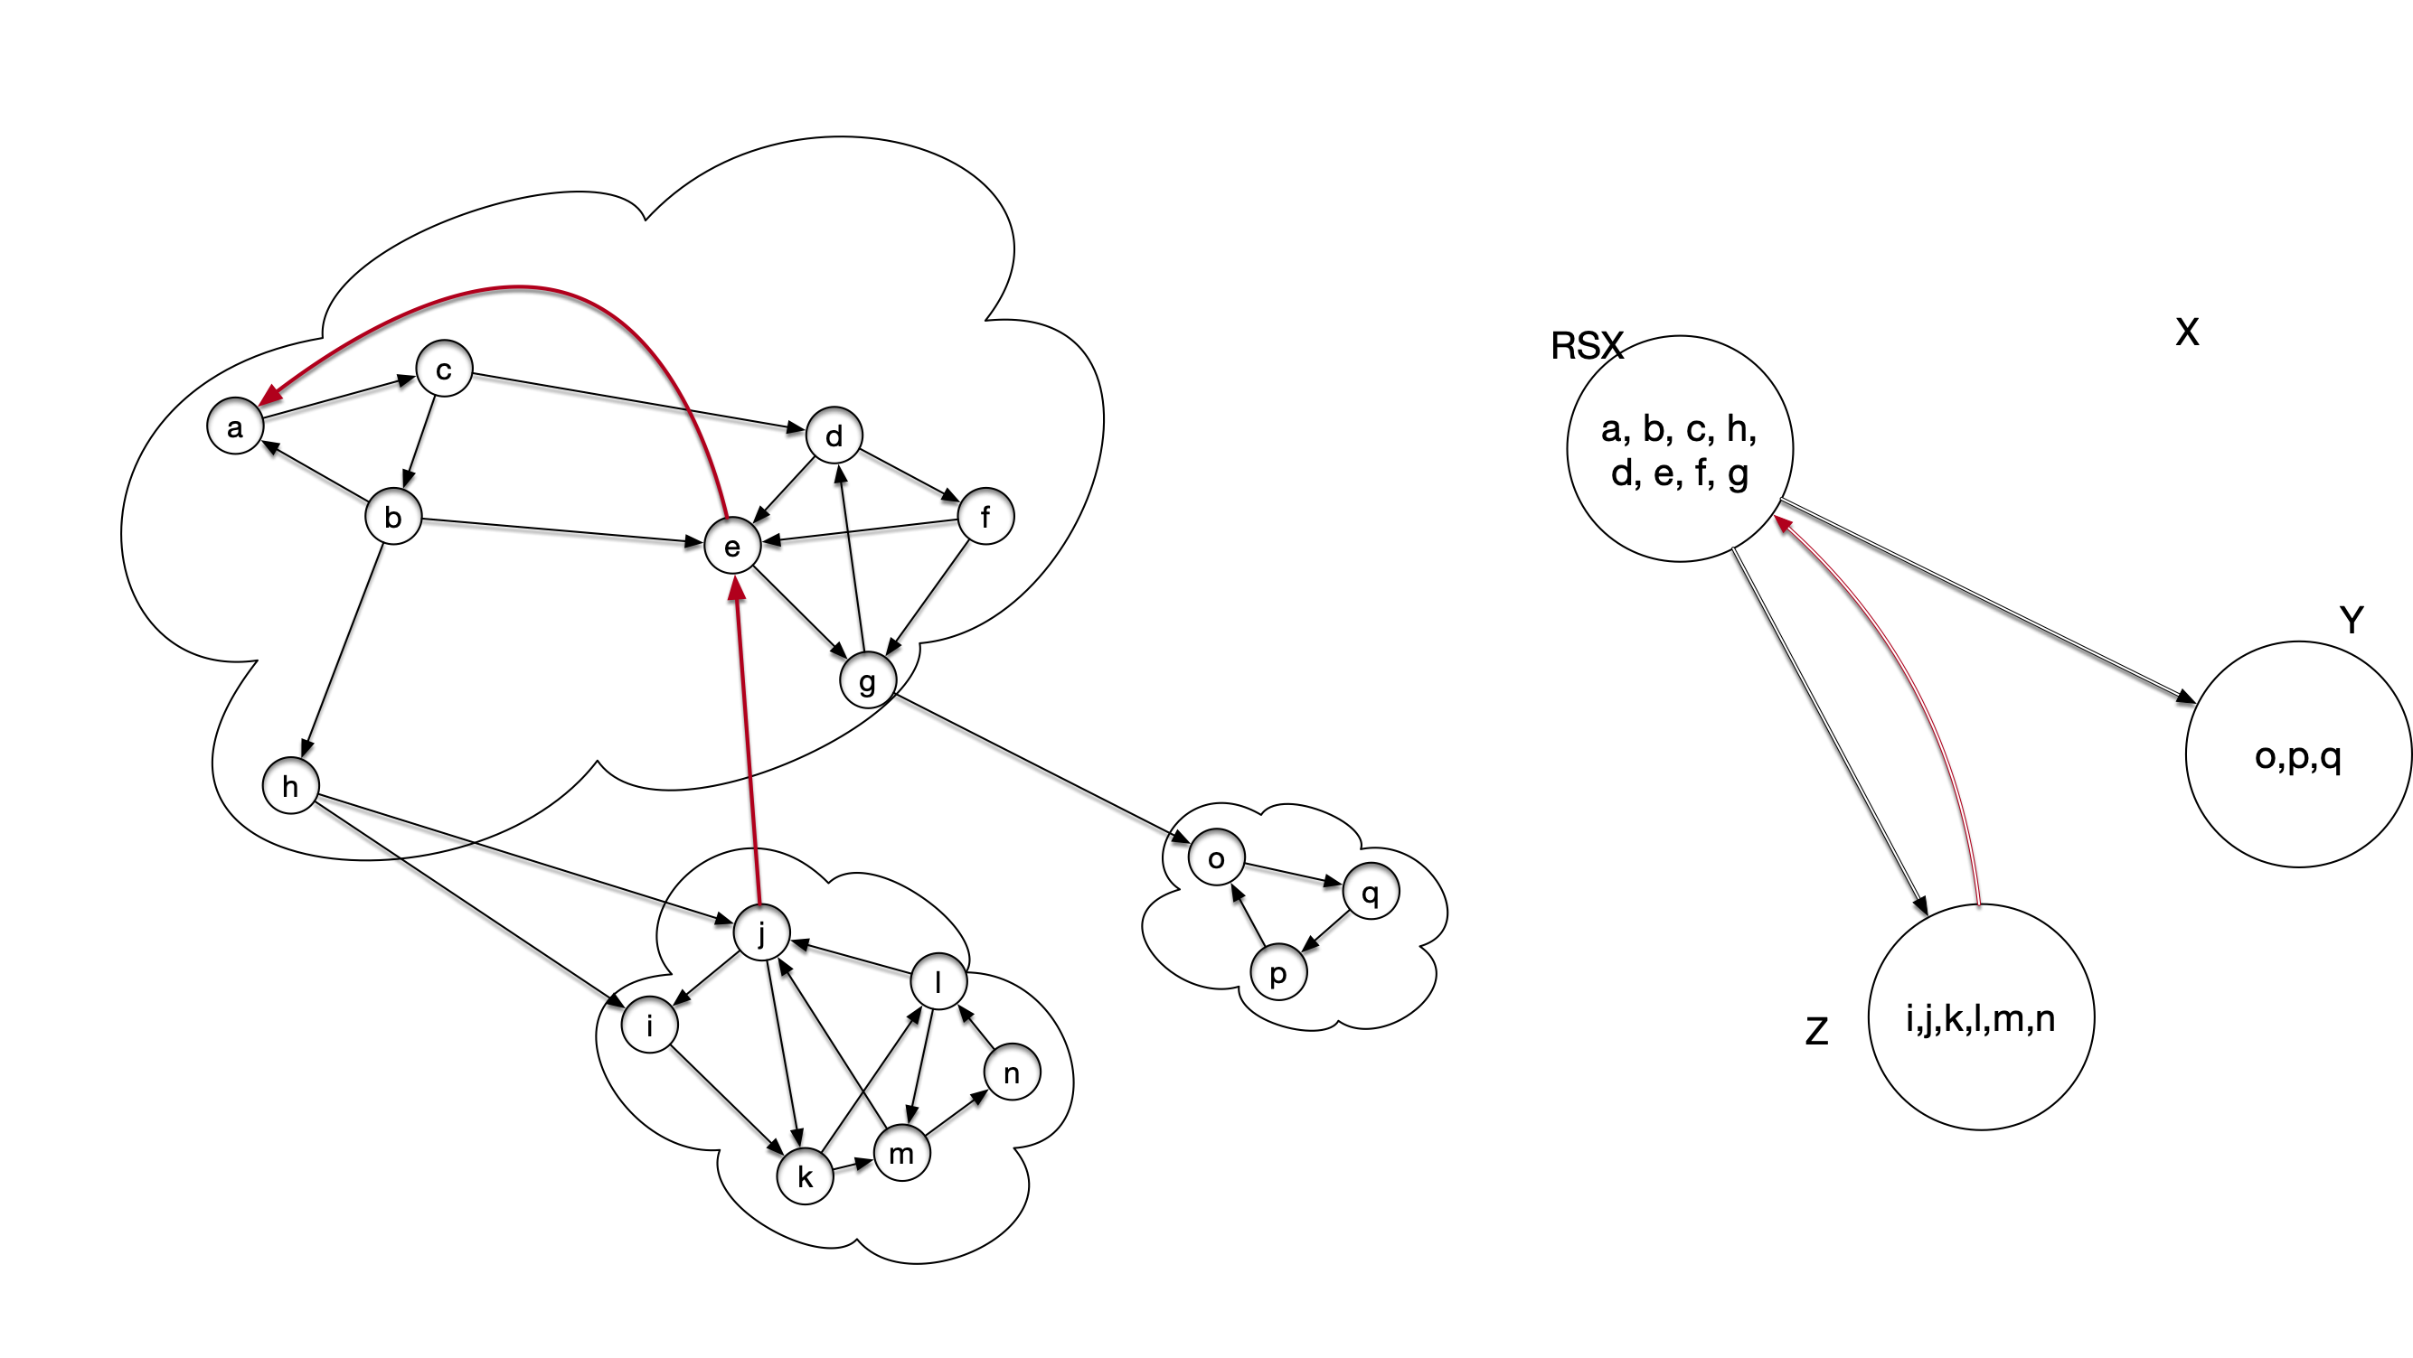
Strongly Connected Components
We can merge

Slide 69
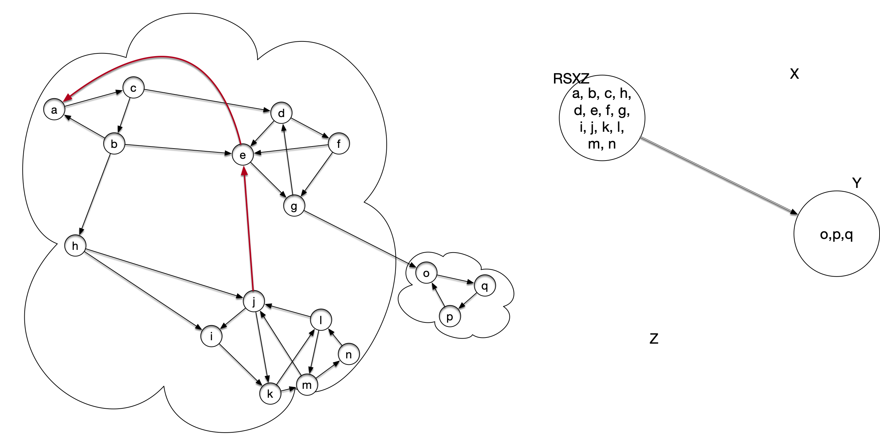
Strongly Connected Components
Finally, we can merge Z with the new supernode

Slide 70
Strongly Connected Components
This can be generalized:
Theorem: The metagraph is acyclic

Slide 71
Strongly Connected Components
How can we apply DFS to the problem of determining connected components?
The WWW graph in 2000 would have been to big for anything but linear time algorithms

Slide 72
Strongly Connected Components
Answer:
Use DFS several times
Including indirectly on the metagraph

Slide 73
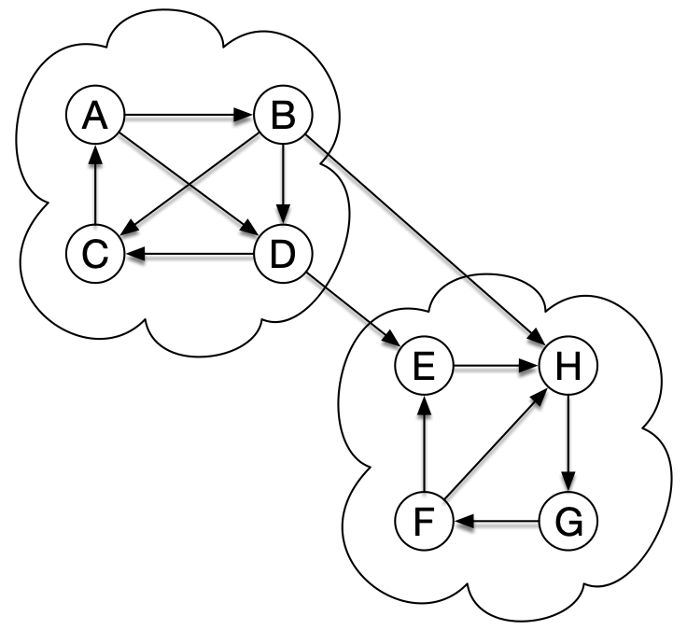
Strongly Connected Components
If we start DFS at a node in a strongly connected component
DFS will visit all nodes in the strongly connected component by the white path theorem

Slide 74
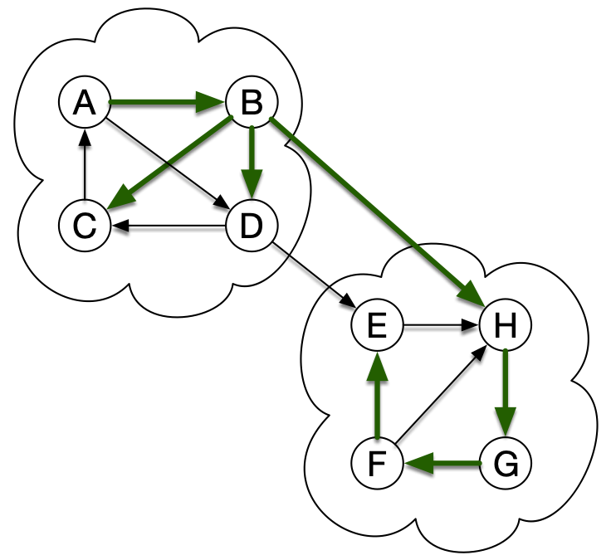
Strongly Connected Components
If we start DFS at A
DFS will visit all nodes in the strongly connected component by the white path theorem
But also possibly other strongly connected components

Slide 75
Strongly Connected Components
Want to make sure that we start at a "sink" of the SCC metagraph
This we can do by running topological sort on the SCC metagraph
If we only had it!
But we can do something similar by running DFS on the graph itself
After we make sure that we are in sinks of the SCC graph, we run DFS again to identify the strongly connected components

Slide 76
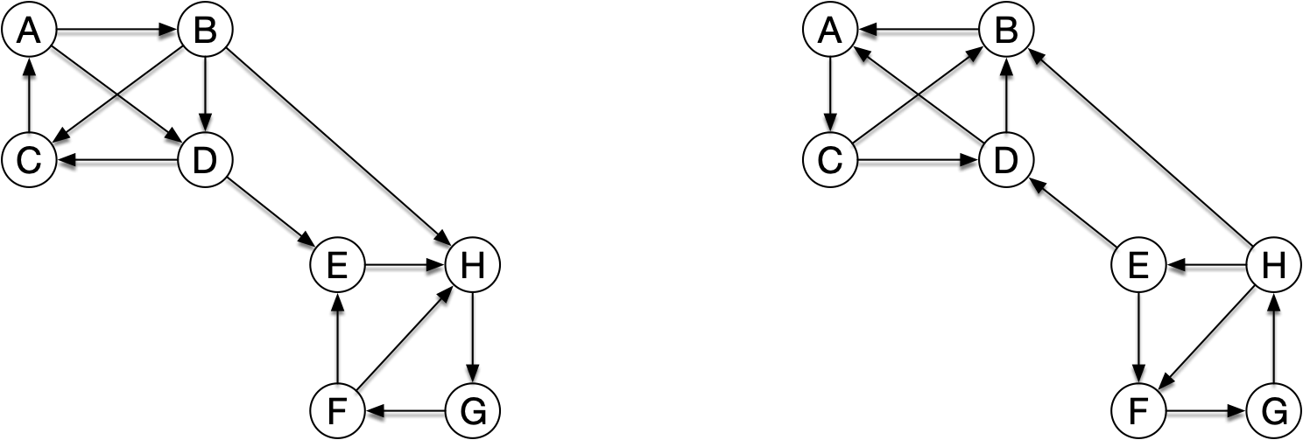
Strongly Connected Components
To do this, need to run a DFS backward
Reverse graph:
Same nodes, but all edges are now reversed

Slide 77
Strongly Connected Components
How to build the reverse graph from adjacency lists?
If Y is in the adjacency list of X:
Then X is in the adjacency list of Y
A: B,D
B: C,D,H
C: A
D: C,E
E: H
F: E,H
G: F
H: G

Slide 78
Strongly Connected Components
Create empty adjacency list for the reverse graph
A: B,D
B: C,D,H
C: A
D: C,E
E: H
F: E,H
G: F
H: G
A:
B:
C:
D:
E:
F:
G:
H:

Slide 79
Strongly Connected Components
Go through the adjacency list of all vertices
Start out with A
Find B
Add A to the list for B
A: B,D
B: C,D,H
C: A
D: C,E
E: H
F: E,H
G: F
H: G
A:
B: A
C:
D:
E:
F:
G:
H:

Slide 80
Strongly Connected Components
Go through the adjacency list of all vertices
Start out with A
Find D
Add A to the list for D
A: B,D
B: C,D,H
C: A
D: C,E
E: H
F: E,H
G: F
H: G
A:
B: A
C:
D: A
E:
F:
G:
H:

Slide 81
Strongly Connected Components
Go through the adjacency list of all vertices
Continue with B
Find C
Add B to the list for C
A: B,D
B: C,D,H
C: A
D: C,E
E: H
F: E,H
G: F
H: G
A:
B: A
C: B
D: A
E:
F:
G:
H:

Slide 82
Strongly Connected Components
Go through the adjacency list of all vertices
Continue with B
Find D
Add B to the list for D
A: B,D
B: C,D,H
C: A
D: C,E
E: H
F: E,H
G: F
H: G
A:
B: A
C: B,
D: A,B
E:
F:
G:
H:

Slide 83
Strongly Connected Components
Go through the adjacency list of all vertices
Continue with B
Find H
Add B to the list for H
A: B,D
B: C,D,H
C: A
D: C,E
E: H
F: E,H
G: F
H: G
A:
B: A
C: B
D: A,B
E:
F:
G:
H: B

Slide 84
Strongly Connected Components
Now continue
A: B,D
B: C,D,H
C: A
D: C,E
E: H
F: E,H
G: F
H: G
A: C
B: A
C: B,D
D: A,B
E: D
F: G
G: H
H: B,E

Slide 85
Strongly Connected Components
Calculating the reverse graph costs
creating empty adjacency lists for the reverse graph
$$Θ(|V|)$$
going through all elements in the adjacency list and add an element to one adjacency list for the reverse graph
$$Θ(|E|)$$
Total: $Θ(|V|+|E|)$, i.e. linear in the size of the graph

Slide 86
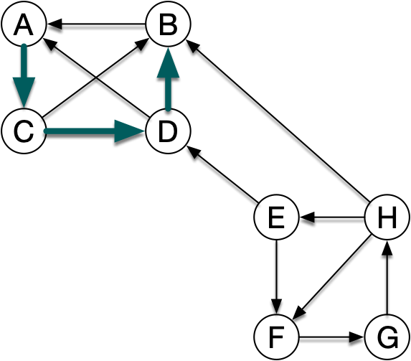
Strongly Connected Components
If we start out with A in the reverse graph, then DFS yields
The DFS forest has one component, with nodes in the strongly connected component of A
Same thing if we start out with any other node in the strongly connected component

Slide 87
Strongly Connected Components
Now we have the basic idea of Kosaraju's algorithm
Run DFS on the graph
Run DFS again, but on the reversed graph, select the nodes to visit in order of the finishing times of the first run
The trees in the DFS forest of the second run are the strongly connected components of the graph

Slide 88
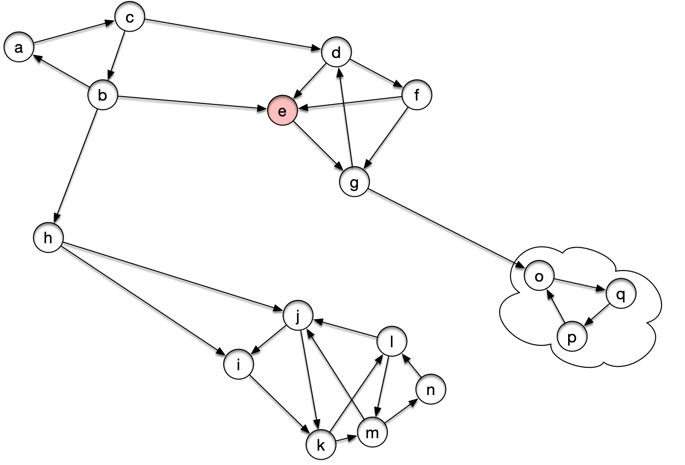
Strongly Connected Components
Example: Start in E

Slide 89
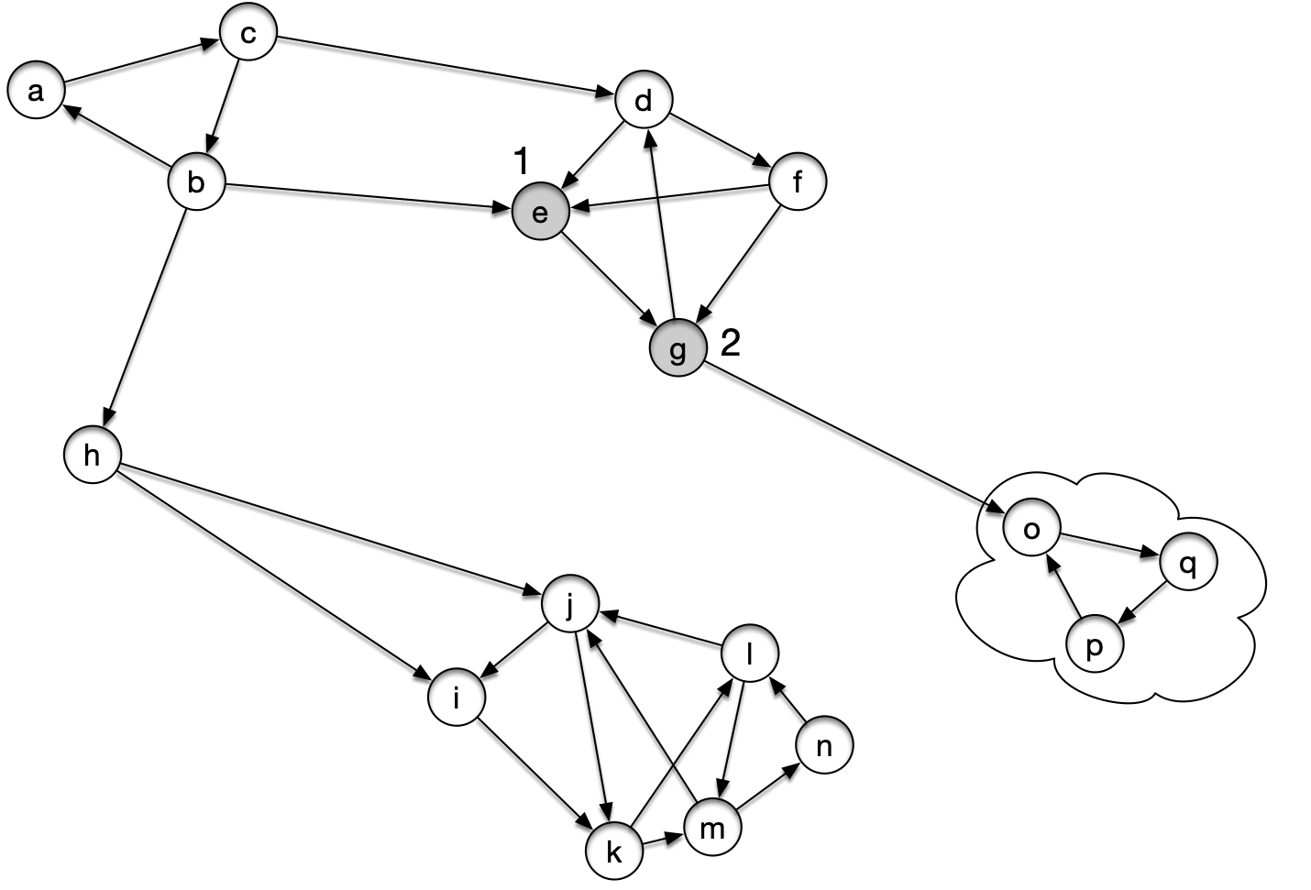
Strongly Connected Components

Slide 90
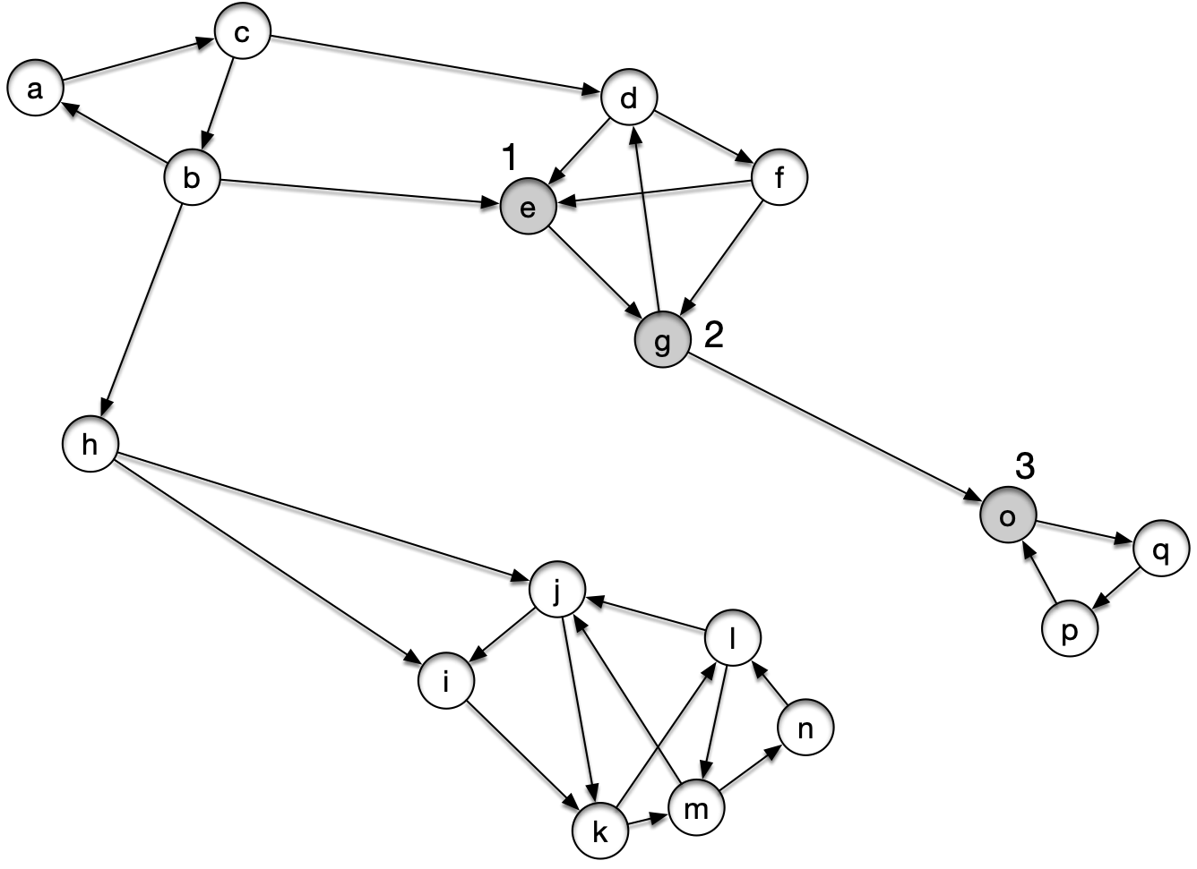
Strongly Connected Components

Slide 91
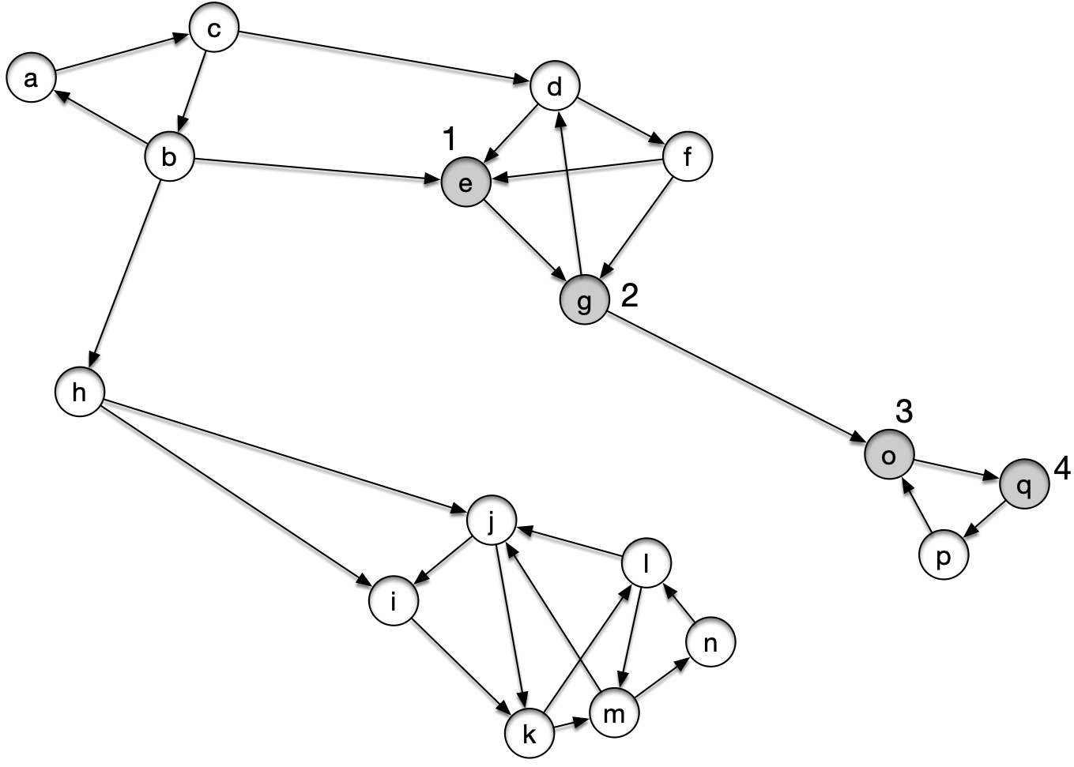
Strongly Connected Components

Slide 92
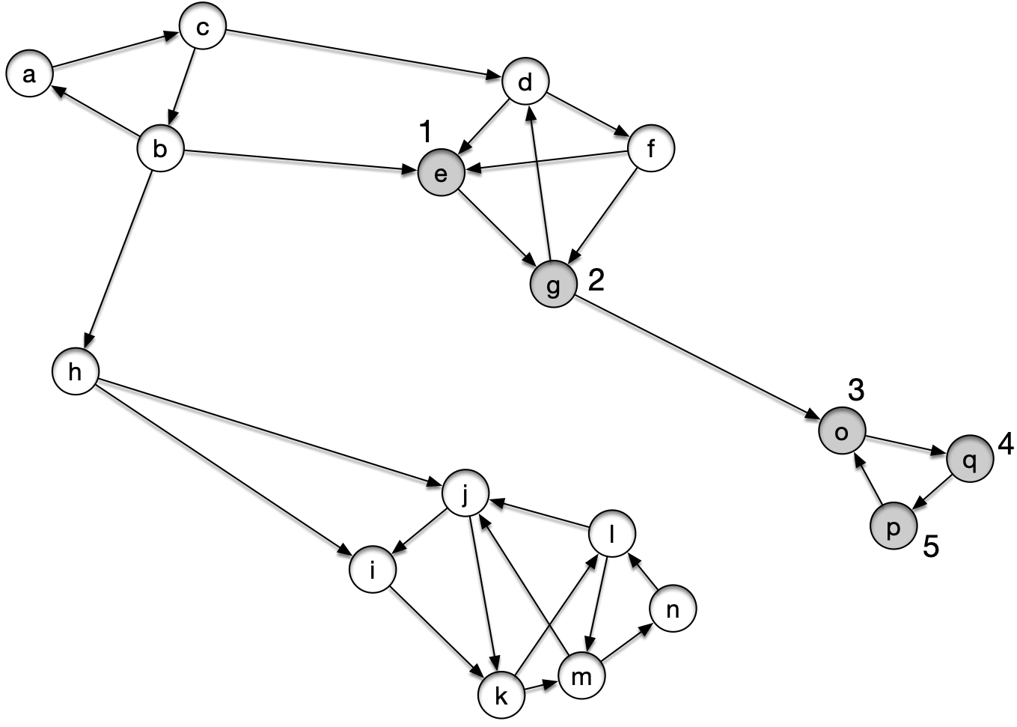
Strongly Connected Components

Slide 93
Strongly Connected Components

Slide 94
Strongly Connected Components

Slide 95
Strongly Connected Components

Slide 96
Strongly Connected Components

Slide 97
Strongly Connected Components

Slide 98
Strongly Connected Components

Slide 99
Strongly Connected Components

Slide 100
Strongly Connected Components

Slide 101
Strongly Connected Components

Slide 102
Strongly Connected Components

Slide 103
Strongly Connected Components
The visit in E is done, we need to select a remaining white vertex. We pick l

Slide 104
Strongly Connected Components

Slide 105
Strongly Connected Components

Slide 106
Strongly Connected Components

Slide 107
Strongly Connected Components

Slide 108
Strongly Connected Components

Slide 109
Strongly Connected Components

Slide 110
Strongly Connected Components

Slide 111
Strongly Connected Components

Slide 112
Strongly Connected Components

Slide 113
Strongly Connected Components

Slide 114
Strongly Connected Components

Slide 115
Strongly Connected Components

Slide 116
Strongly Connected Components
Again, DFS will select a white node. Let it be b

Slide 117
Strongly Connected Components

Slide 118
Strongly Connected Components

Slide 119
Strongly Connected Components

Slide 120
Strongly Connected Components

Slide 121
Strongly Connected Components

Slide 122
Strongly Connected Components

Slide 123
Strongly Connected Components

Slide 124
Strongly Connected Components

Slide 125
Strongly Connected Components
Now:
Decorate each vertex with the finishing time obtained
Reverse all edges (in linear time)
Start DFS, but select starting vertices in decreasing order of the finishing time
This means we start with b

Slide 126
Strongly Connected Components

Slide 127
Strongly Connected Components

Slide 128
Strongly Connected Components

Slide 129
Strongly Connected Components

Slide 130
Strongly Connected Components

Slide 131
Strongly Connected Components

Slide 132
Strongly Connected Components

Slide 133
Strongly Connected Components
We have finished visit in b
We can print out its descendants
$$\{a,b,c\}$$
This is the first connected component
We then select the white node with the highest finishing time from the previous run: h

Slide 134
Strongly Connected Components

Slide 135
Strongly Connected Components

Slide 136
Strongly Connected Components
Again, we print out the descendants of h and now have
$\{a,b,c\}$, $\{h\}$
We then select the vertex with the next highest finishing time

Slide 137
Strongly Connected Components

Slide 138
Strongly Connected Components

Slide 139
Strongly Connected Components

Slide 140
Strongly Connected Components

Slide 141
Strongly Connected Components

Slide 142
Strongly Connected Components

Slide 143
Strongly Connected Components

Slide 144
Strongly Connected Components

Slide 145
Strongly Connected Components

Slide 146
Strongly Connected Components

Slide 147
Strongly Connected Components

Slide 148
Strongly Connected Components

Slide 149
Strongly Connected Components
We admit the new tree as a SCC
$\{a,b,c\}$, $\{h\}$, $\{l,i,k,j,m,n\}$
Now we go with g

Slide 150
Strongly Connected Components

Slide 151
Strongly Connected Components

Slide 152
Strongly Connected Components

Slide 153
Strongly Connected Components

Slide 154
Strongly Connected Components

Slide 155
Strongly Connected Components

Slide 156
Strongly Connected Components

Slide 157
Strongly Connected Components

Slide 158
Strongly Connected Components
We add $\{g,d,e,f\}$ to the list of SCC

Slide 159
Strongly Connected Components

Slide 160
Strongly Connected Components

Slide 161
Strongly Connected Components

Slide 162
Strongly Connected Components

Slide 163
Strongly Connected Components

Slide 164
Strongly Connected Components

Slide 165
Strongly Connected Components
At this point, we emit our final SCC as $\{o,p,q\}$

Slide 166
Strongly Connected Components
This example shows
how the first pass DFS identifies SCC that are high up in the SCC meta-graph
how the DFS in the reverse graph identifies then SCC, but because of the choice of the starting points, any SCC that can be reached are already done and all blackened

Slide 167
Strongly Connected Components
For any set of nodes $U⊂V$, we set
$$U.d=min(\{u.d|u∈U\})$$
$$U.f=max(\{u.f|u∈U\}$$
This means:
the discovery time of $U$ is the earliest discovery time in $U$
the finish time of $U$ is the latest finish time of a node in $U$

Slide 168
Strongly Connected Components
Lemma:
Let C and C' be two strongly connected components of the directed graph $G=(V,E)$.
Suppose there is an edge $(u,v)$ with $u∈C$ and $v∈C^{′}$
Then $C.f>C^{′}.f$

Slide 169
Strongly Connected Components
Proof:
Assume that we discover a vertex in $C_{1}$first
Let $x$ be that vertex
Then there is a white path from $x$ to any vertex in $C_{2}$ (maybe via $v$)
So $x$ becomes an ancestor of all nodes in $C_{2}$
Therefore, $x$ finishes after all nodes in $C_{2}$ and has a later finishing time

Slide 170
Strongly Connected Components
Assume that we discover a vertex $x$ in $C_{2}$ first
There cannot be a path from $x$ to any node in $C_{1}$ or by the previous lemma, the two SCC would be the same

Slide 171
Strongly Connected Components
By the white path theorem, $x$ is not going to be an ancestor of any node in $C_{1}$, but it is going to be an ancestor of everything in $C_{2}$
Therefore, $x$ finishes before anything in $C_{1}$ can be discovered.
qed

Slide 172
Strongly Connected Components
Applied to the reverse graph, we get
Let C and C' be two strongly connected components of the directed graph $G=(V,E)$.
Suppose there is an edge $(u,v)$ with $u∈C$ and $v∈C^{′}$
Then $C.f<C^{′}.f$ in the DFS running on the reverse graph of $G$

Slide 173
Strongly Connected Components
Theorem
The algorithm correctly calculates the SCC of a graph
Proof proceeds by induction on the number $k$ of depth first trees found in the second pass of DFS
Induction base: $k=0$ is trivial
Induction step: Assume the first $k$ SCCs have been correctly generated

Slide 174
Strongly Connected Components
We start out from a vertex $u$
$u∈C$ for a strongly connected component $C$
because we pick $u$ in order of finishing time, any other SCC $C^{′}$ has a finishing time in the first pass smaller than $u$
by the consequence of the lemma and induction hypothesis, all edges that leave C in the reverse graph can only be to SCC already emitted
All nodes in $C$ must be white by induction hypothesis
Thus, the descendants of $u$ are exactly the nodes in $C$

