Slide 1
Stored Procedures
Thomas Schwarz, SJ

Slide 2
Stored Routines
Stored Routine:
SQL statement or set of SQL statements that can be stored in the database server
Can be a function
Can be a stored procedure

Slide 3
MySQL Stored Procedures
Delimiters
Semicolon acts as a delimiter in SQL and Procedures
Need to change delimiter
Can be set to anything
E.g. double dollar sign
Afterwards reset it
DELIMITER $$
…
DELIMITER ;

Slide 4
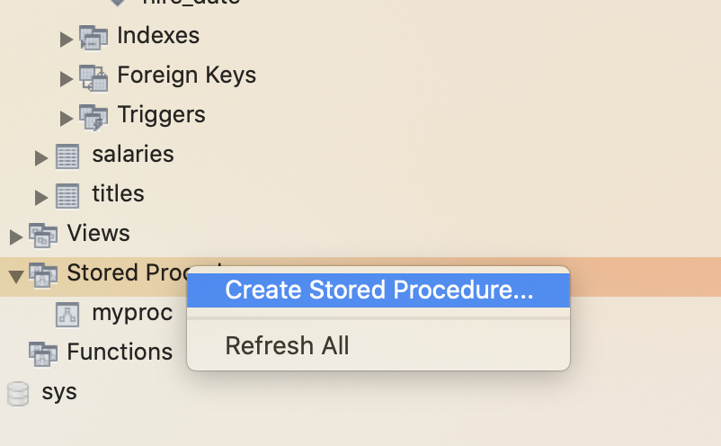
MySQL Stored Procedures
We can generate stored procedures from within MySQL workbench
Click on Stored Procedures at the end of the schema and select create stored procedure

Slide 5
MySQL Stored Procedures
We can generate stored procedure using SQL
use employees;
DELIMITER $$
CREATE PROCEDURE myproc()
BEGIN
SELECT *
FROM employees
WHERE first_name LIKE 'th%';
END
DELIMITER ;
Keywords are CREATE PROCEDURE

Slide 6
MySQL Stored Procedures
We can generate stored procedure using SQL
use employees;
DELIMITER $$
CREATE PROCEDURE myproc()
BEGIN
SELECT *
FROM employees
WHERE first_name LIKE 'th%';
END
DELIMITER ;
Need to give it a name

Slide 7
MySQL Stored Procedures
We can generate stored procedure using SQL
use employees;
DELIMITER $$
CREATE PROCEDURE myproc()
BEGIN
SELECT *
FROM employees
WHERE first_name LIKE 'th%';
END
DELIMITER ;
Can have arguments

Slide 8
MySQL Stored Procedures
We can generate stored procedure using SQL
use employees;
DELIMITER $$
CREATE PROCEDURE myproc()
BEGIN
SELECT *
FROM employees
WHERE first_name LIKE 'th%';
END
DELIMITER ;
BEGIN END encapsulate a SQL query terminated with ;

Slide 9
MySQL Stored Procedures
We can generate stored procedure using SQL
use employees;
DELIMITER $$
CREATE PROCEDURE myproc()
BEGIN
SELECT *
FROM employees
WHERE first_name LIKE 'th%';
END
DELIMITER ;
Don't forget to change the delimiter back to ;

Slide 10
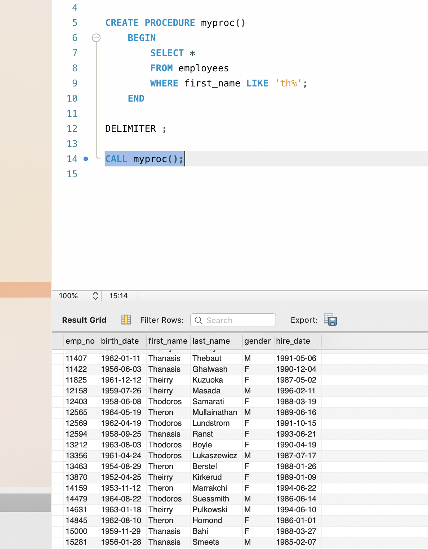
MySQL Stored Procedures
We can call a stored procedure
From within the workbench, by clicking on it
Using CALL procedureName( )

Slide 11
MySQL Stored Procedures
Procedure parameters have three times
IN — input
OUT — output
INOUT — both input and output
Procedure parameters have type
Definition of parameter:

Slide 12
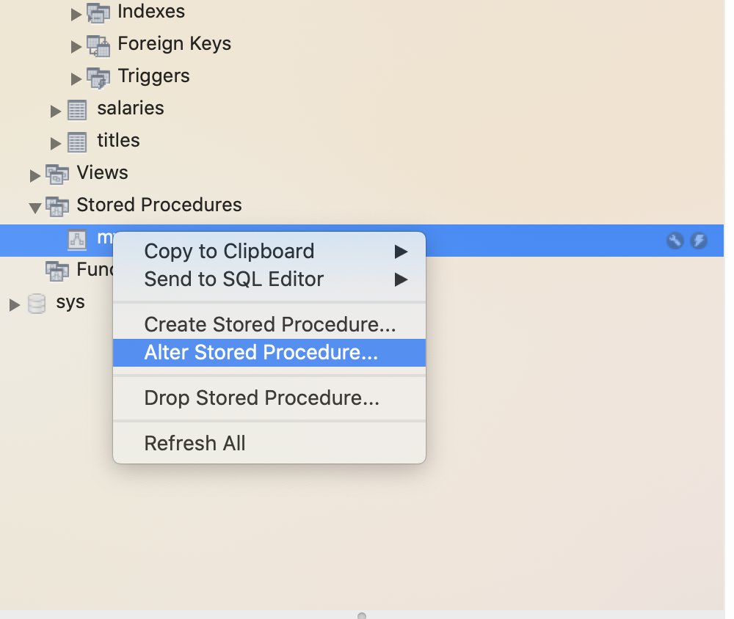
MySQL Stored Procedures
Example:
Change a procedure
You can use workbench by selecting the name of the procedure and select 'alter procedure'

Slide 13
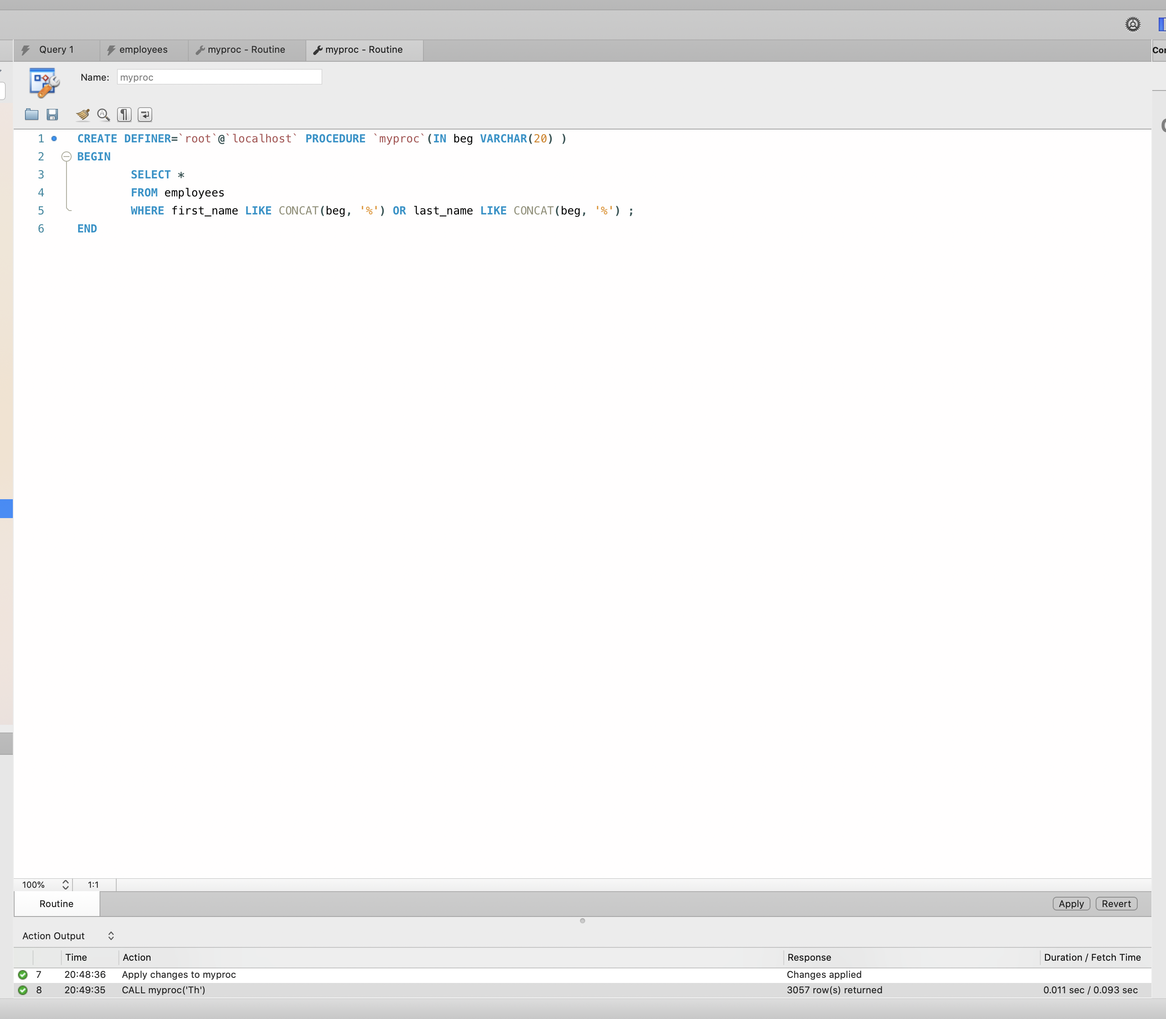
MySQL Stored Procedures
Changing a procedure
After editing, click Apply

Slide 14
MySQL Stored Procedures
Changing a procedure:
Combine with DROP and CREATE

Slide 15
MySQL Stored Procedures
Single Parameter
DELIMITER $$
CREATE PROCEDURE partial_name( IN beg VARCHAR(20) )
BEGIN
SELECT first_name, last_name, gender
FROM employees
WHERE first_name LIKE CONCAT(beg, '%') OR last_name LIKE CONCAT(beg, '%');
END
DELIMITER ;
CALL partial_name('dan');

Slide 16
MySQL Stored Procedures
DELIMITER $$
CREATE PROCEDURE partial_name( IN beg VARCHAR(20) )
BEGIN
SELECT first_name, last_name, gender
FROM employees
WHERE first_name LIKE CONCAT(beg, '%') OR last_name LIKE CONCAT(beg, '%');
END
DELIMITER ;
CALL partial_name('dan');
Have not yet discussed variables

Slide 17
MySQL Stored Procedures
TASK
Write a stored procedure that takes as input the first name and the last name of a current employee.
It then returns:
The first and last name, gender, employee number, department, and last salary of the person (if it is in the database)

Slide 18
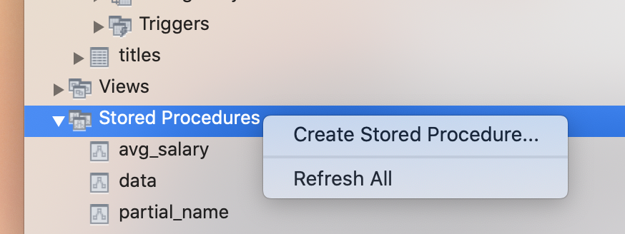
HINT
If you are working with MySQL Workbench, it is less frustrating to define and make changes in the Stored Procedures tab on the left.
The delimiter statements do not work too well

Slide 19
MySQL Stored Procedures
DELIMITER $$
CREATE PROCEDURE data(IN first VARCHAR(14), IN last VARCHAR(16))
BEGIN
SELECT e.first_name, e.last_name, e.gender, d.dept_name,
s.salary
FROM employees e, departments d, salaries s, dept_emp de
WHERE e.emp_no = de.emp_no AND de.dept_no = d.dept_no
AND s.emp_no = e.emp_no AND s.to_date = '9999-01-01'
AND e.first_name = first AND e.last_name = last;
END
DELIMITER ;

Slide 20
MySQL Stored Procedures
TASK
Write a stored procedure that takes as input the first name and the last name of a current or past employee.
It then returns:
The first and last name, and average salary of the person

Slide 21
MySQL Stored Procedures
CREATE PROCEDURE `avg_salary`(
IN first VARCHAR(12),
last VARCHAR(16)
)
BEGIN
SELECT e.first_name, e.last_name, AVG(s.salary)
FROM employees e, salaries s
WHERE e.first_name = first
AND e.last_name = last
AND e.emp_no = s.emp_no;
END

Slide 22
MySQL Stored Procedures
Using output variables
Let's change the previous procedure to return the average salary
We need to use the SELECT … INTO … construct

Slide 23
MySQL Stored Procedures
CREATE PROCEDURE avg_salary(
IN first VARCHAR(12),
last VARCHAR(16),
out average_salary DECIMAL(10,2)
)
BEGIN
SELECT AVG(s.salary)
INTO average_salary
FROM employees e, salaries s
WHERE e.first_name = first
AND e.last_name = last
AND e.emp_no = s.emp_no;
END
This is our output

Slide 24
MySQL Stored Procedures
CREATE PROCEDURE avg_salary(
IN first VARCHAR(12),
last VARCHAR(16),
out average_salary DECIMAL(10,2)
)
BEGIN
SELECT AVG(s.salary)
INTO average_salary
FROM employees e, salaries s
WHERE e.first_name = first
AND e.last_name = last
AND e.emp_no = s.emp_no;
END
Type is Decimal with two digits after comma

Slide 25
MySQL Stored Procedures
CREATE PROCEDURE avg_salary(
IN first VARCHAR(12),
last VARCHAR(16),
out average_salary DECIMAL(10,2)
)
BEGIN
SELECT AVG(s.salary)
INTO average_salary
FROM employees e, salaries s
WHERE e.first_name = first
AND e.last_name = last
AND e.emp_no = s.emp_no;
END
This is how we set the value

Slide 26
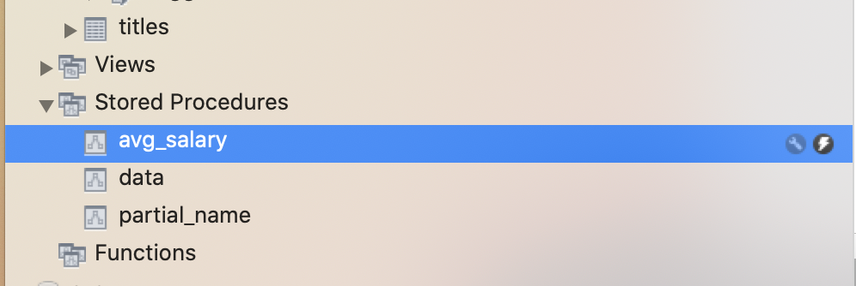
MySQL Stored Procedures
How do we call this?
Easiest is using the lightning symbol in the MySQL work-bench

Slide 27
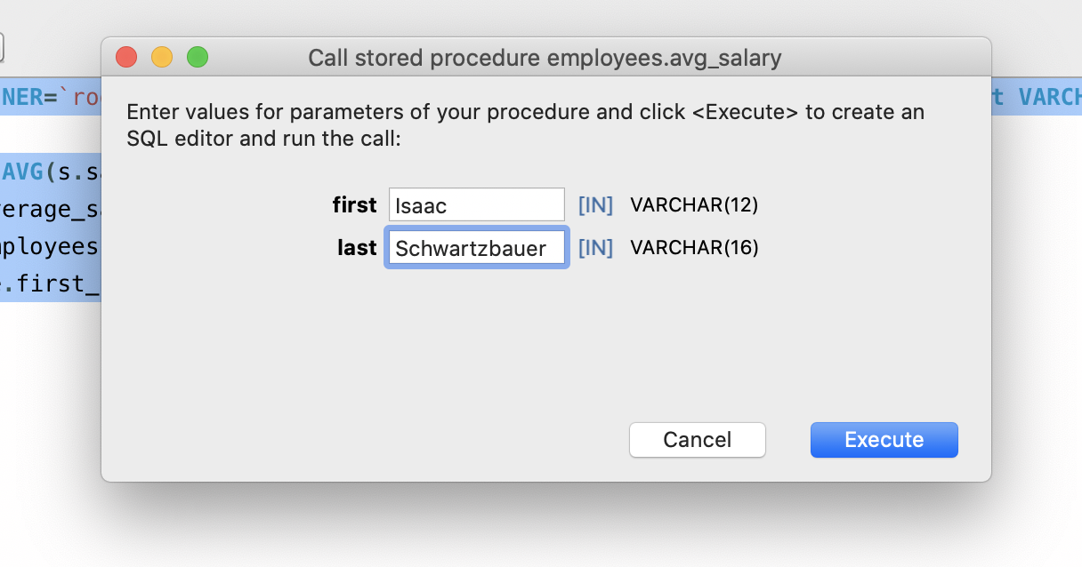
MySQL Stored Procedures
This gives you an interactive window

Slide 28
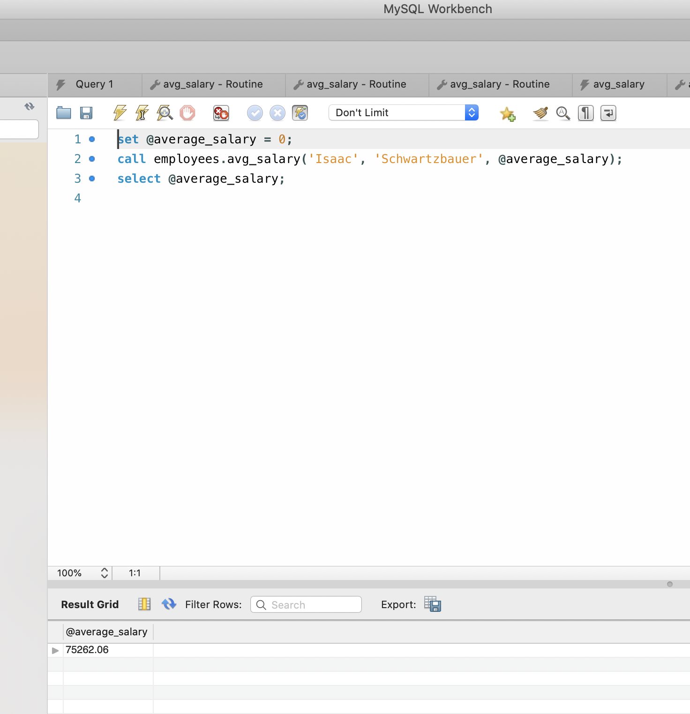
MySQL Stored Procedures
Result grid shows the value
$75262.06
But you can also see how to call the procedure as well.

Slide 29
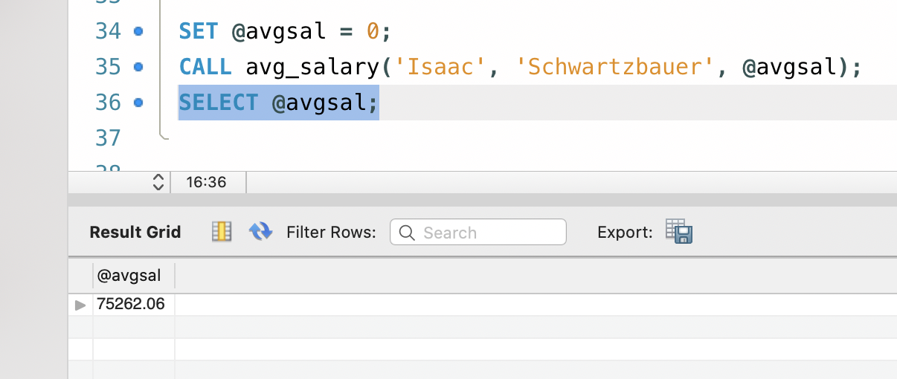
MySQL Stored Procedures
First, we need to define a variable

Slide 30
MySQL Stored Procedures
Defining variables
Variables start with an ampersand @myvar
You can enclose the name with ' ' or " " to use other characters than alpha-numeric and '$'
Initialized with SET
Assignment is with integer, decimal, floating-point, binary or non-binary string, or NULL
Can use CAST if necessary

Slide 31
MySQL Stored Procedures
We call the function with
Notice how
we include the output variable in the call
we use SELECT to access the value of the variable
SET @avgsal = 0;
CALL avg_salary('Isaac', 'Schwartzbauer', @avgsal);
SELECT @avgsal;

Slide 32
MySQL Stored Procedures
TASK
Write a stored procedure that takes as input the first name and the last name of a current or past employee.
It then returns:
The employee number
Call it from the query tab

Slide 33
MySQL Stored Procedures
Solution
CREATE DEFINER=`root`@`localhost` PROCEDURE `employee_number`(
IN first VARCHAR(12),
IN last VARCHAR(16),
OUT empl_numb INT
)
BEGIN
SELECT emp_no
INTO empl_numb
FROM employees
WHERE first_name = first
AND last_name = last;
END

Slide 34
MySQL Stored Procedures
Solution
set @empl_numb = 0;
call employees.employee_number(
'Isaac',
'Schwartzbauer',
@empl_numb
);
select @empl_numb;

Slide 35
MySQL Functions
A procedure can have more than one output
Functions have none or one output
MySQL functions return exactly one value

Slide 36
MySQL Functions
We can use the MySQL workbench by clicking on Functions in the scheme pane
Just below stored procedures
Or can use a query
Function values are obtained through a SELECT statement
select employees.f_avg(101010);

Slide 37
MySQL Functions
Example:
Definition of a function
CREATE FUNCTION f_avg (p_emp_no INTEGER)
RETURNS decimal(10,2)
READS SQL DATA
BEGIN
DECLARE v_avg_salary DECIMAL(10,2);
SELECT AVG(salary)
INTO v_avg_salary
FROM salaries s
WHERE s.emp_no = p_emp_no;
RETURN v_avg_salary;
END

Slide 38
MySQL Functions
Example:
Name
CREATE FUNCTION f_avg (p_emp_no INTEGER)
RETURNS decimal(10,2)
READS SQL DATA
BEGIN
DECLARE v_avg_salary DECIMAL(10,2);
SELECT AVG(salary)
INTO v_avg_salary
FROM salaries s
WHERE s.emp_no = p_emp_no;
RETURN v_avg_salary;
END

Slide 39
MySQL Functions
Name and type of input variable
Example:
CREATE FUNCTION f_avg (p_emp_no INTEGER)
RETURNS decimal(10,2)
READS SQL DATA
BEGIN
DECLARE v_avg_salary DECIMAL(10,2);
SELECT AVG(salary)
INTO v_avg_salary
FROM salaries s
WHERE s.emp_no = p_emp_no;
RETURN v_avg_salary;
END

Slide 40
MySQL Functions
Keyword Returns is needed plus specification of return value type
Example:
CREATE FUNCTION f_avg (p_emp_no INTEGER)
RETURNS decimal(10,2)
READS SQL DATA
BEGIN
DECLARE v_avg_salary DECIMAL(10,2);
SELECT AVG(salary)
INTO v_avg_salary
FROM salaries s
WHERE s.emp_no = p_emp_no;
RETURN v_avg_salary;
END

Slide 41
MySQL Functions
Describes behavior of the function
Example:
CREATE FUNCTION f_avg (p_emp_no INTEGER)
RETURNS decimal(10,2)
READS SQL DATA
BEGIN
DECLARE v_avg_salary DECIMAL(10,2);
SELECT AVG(salary)
INTO v_avg_salary
FROM salaries s
WHERE s.emp_no = p_emp_no;
RETURN v_avg_salary;
END

Slide 42
MySQL Functions
DETERMINISTIC:
always produces the same result for the same parameter
NO SQL:
function has no SQL statements
READS SQL DATA
contains statements that read via SQL, but does not modify the database
MODIFIES SQL DATA
contains statements that write (e.g. inserts)

Slide 43
MySQL Functions
Body of the function
Example:
CREATE FUNCTION f_avg (p_emp_no INTEGER)
RETURNS decimal(10,2)
READS SQL DATA
BEGIN
DECLARE v_avg_salary DECIMAL(10,2);
SELECT AVG(salary)
INTO v_avg_salary
FROM salaries s
WHERE s.emp_no = p_emp_no;
RETURN v_avg_salary;
END

Slide 44
MySQL Functions
Here we define a variable to be used in several statements
Example:
CREATE FUNCTION f_avg (p_emp_no INTEGER)
RETURNS decimal(10,2)
READS SQL DATA
BEGIN
DECLARE v_avg_salary DECIMAL(10,2);
SELECT AVG(salary)
INTO v_avg_salary
FROM salaries s
WHERE s.emp_no = p_emp_no;
RETURN v_avg_salary;
END

Slide 45
MySQL Functions
The variable has type Decimal(10,2) to represent currency values
Example:
CREATE FUNCTION f_avg (p_emp_no INTEGER)
RETURNS decimal(10,2)
READS SQL DATA
BEGIN
DECLARE v_avg_salary DECIMAL(10,2);
SELECT AVG(salary)
INTO v_avg_salary
FROM salaries s
WHERE s.emp_no = p_emp_no;
RETURN v_avg_salary;
END

Slide 46
MySQL Functions
The SELECT … INTO … clause updates the value of v_avg_salary
Example:
CREATE FUNCTION f_avg (p_emp_no INTEGER)
RETURNS decimal(10,2)
READS SQL DATA
BEGIN
DECLARE v_avg_salary DECIMAL(10,2);
SELECT AVG(salary)
INTO v_avg_salary
FROM salaries s
WHERE s.emp_no = p_emp_no;
RETURN v_avg_salary;
END

Slide 47
MySQL Functions
A function has to return a value
Example:
CREATE FUNCTION f_avg (p_emp_no INTEGER)
RETURNS decimal(10,2)
READS SQL DATA
BEGIN
DECLARE v_avg_salary DECIMAL(10,2);
SELECT AVG(salary)
INTO v_avg_salary
FROM salaries s
WHERE s.emp_no = p_emp_no;
RETURN v_avg_salary;
END

Slide 48
MySQL Functions
Functions and procedures can have more than one select value
Find the last salary of an employee given by first and last name
Query 1: Find the last from_date in salaries for the employee
We store it in a variable
Query 2: Return the corresponding salary

Slide 49
CREATE FUNCTION f_latest_salary(p_first_name VARCHAR(12), p_last_name VARCHAR(16))
RETURNS decimal(10,2)
READS SQL DATA
BEGIN
DECLARE v_max_from_date date;
DECLARE v_last_salary DECIMAL(10,2);
SELECT
MAX(from_date)
INTO v_max_from_date
FROM employees e
JOIN salaries s ON e.emp_no = s.emp_no
WHERE e.first_name = p_first_name
AND e.last_name = p_last_name;
SELECT
s.salary
INTO v_last_salary
FROM employees e
JOIN salaries s ON e.emp_no = s.emp_no
WHERE e.first_name = p_first_name
AND e.last_name = p_last_name
AND s.from_date = v_max_from_date;
RETURN v_last_salary;
END

Slide 50
CREATE FUNCTION f_latest_salary(p_first_name VARCHAR(12), p_last_name VARCHAR(16))
RETURNS decimal(10,2)
READS SQL DATA
BEGIN
DECLARE v_max_from_date date;
DECLARE v_last_salary DECIMAL(10,2);
SELECT
MAX(from_date)
INTO v_max_from_date
FROM employees e
JOIN salaries s ON e.emp_no = s.emp_no
WHERE e.first_name = p_first_name
AND e.last_name = p_last_name;
SELECT
s.salary
INTO v_last_salary
FROM employees e
JOIN salaries s ON e.emp_no = s.emp_no
WHERE e.first_name = p_first_name
AND e.last_name = p_last_name
AND s.from_date = v_max_from_date;
RETURN v_last_salary;
END
Declare a variable of type date to contain the last contract to-date

Slide 51
CREATE FUNCTION f_latest_salary(p_first_name VARCHAR(12), p_last_name VARCHAR(16))
RETURNS decimal(10,2)
READS SQL DATA
BEGIN
DECLARE v_max_from_date date;
DECLARE v_last_salary DECIMAL(10,2);
SELECT MAX(from_date)
INTO v_max_from_date
FROM employees e
JOIN salaries s ON e.emp_no = s.emp_no
WHERE e.first_name = p_first_name
AND e.last_name = p_last_name;
SELECT
s.salary
INTO v_last_salary
FROM employees e
JOIN salaries s ON e.emp_no = s.emp_no
WHERE e.first_name = p_first_name
AND e.last_name = p_last_name
AND s.from_date = v_max_from_date;
RETURN v_last_salary;
END
Declare a variable of type Decimal for the salary

Slide 52
CREATE FUNCTION f_latest_salary(p_first_name VARCHAR(12), p_last_name VARCHAR(16))
RETURNS decimal(10,2)
READS SQL DATA
BEGIN
DECLARE v_max_from_date date;
DECLARE v_last_salary DECIMAL(10,2);
SELECT MAX(from_date)
INTO v_max_from_date
FROM employees e
JOIN salaries s ON e.emp_no = s.emp_no
WHERE e.first_name = p_first_name
AND e.last_name = p_last_name;
SELECT
s.salary
INTO v_last_salary
FROM employees e
JOIN salaries s ON e.emp_no = s.emp_no
WHERE e.first_name = p_first_name
AND e.last_name = p_last_name
AND s.from_date = v_max_from_date;
RETURN v_last_salary;
END
Determine the last contract from_date for an employee with given first and last name

Slide 53
CREATE FUNCTION f_latest_salary(p_first_name VARCHAR(12), p_last_name VARCHAR(16))
RETURNS decimal(10,2)
READS SQL DATA
BEGIN
DECLARE v_max_from_date date;
DECLARE v_last_salary DECIMAL(10,2);
SELECT MAX(from_date)
INTO v_max_from_date
FROM employees e
JOIN salaries s ON e.emp_no = s.emp_no
WHERE e.first_name = p_first_name
AND e.last_name = p_last_name;
SELECT
s.salary
INTO v_last_salary
FROM employees e
JOIN salaries s ON e.emp_no = s.emp_no
WHERE e.first_name = p_first_name
AND e.last_name = p_last_name
AND s.from_date = v_max_from_date;
RETURN v_last_salary;
END
and load it into the variable v_max_from_date

Slide 54
CREATE FUNCTION f_latest_salary(p_first_name VARCHAR(12), p_last_name VARCHAR(16))
RETURNS decimal(10,2)
READS SQL DATA
BEGIN
DECLARE v_max_from_date date;
DECLARE v_last_salary DECIMAL(10,2);
SELECT MAX(from_date)
INTO v_max_from_date
FROM employees e
JOIN salaries s ON e.emp_no = s.emp_no
WHERE e.first_name = p_first_name
AND e.last_name = p_last_name;
SELECT
s.salary
INTO v_last_salary
FROM employees e
JOIN salaries s ON e.emp_no = s.emp_no
WHERE e.first_name = p_first_name
AND e.last_name = p_last_name
AND s.from_date = v_max_from_date;
RETURN v_last_salary;
END
Second query:
Find the corresponding amount

Slide 55
CREATE FUNCTION f_latest_salary(p_first_name VARCHAR(12), p_last_name VARCHAR(16))
RETURNS decimal(10,2)
READS SQL DATA
BEGIN
DECLARE v_max_from_date date;
DECLARE v_last_salary DECIMAL(10,2);
SELECT MAX(from_date)
INTO v_max_from_date
FROM employees e
JOIN salaries s ON e.emp_no = s.emp_no
WHERE e.first_name = p_first_name
AND e.last_name = p_last_name;
SELECT
s.salary
INTO v_last_salary
FROM employees e
JOIN salaries s ON e.emp_no = s.emp_no
WHERE e.first_name = p_first_name
AND e.last_name = p_last_name
AND s.from_date = v_max_from_date;
RETURN v_last_salary;
END
And finally return this value

Slide 56
MySQL Functions
Why do we need functions?
Procedures can not be embedded in a select statement
But functions can

Slide 57
MySQL Variables
MySQL has three types of variables
Local: Scope is in a BEGIN … END block
Use DECLARE and no ampersand
Session
Starts and ends with making a connection to the database
One session per current user
Use SET @variable = NULL
Global

Slide 58
MySQL Variables
Global variables
Survives disconnection
Needs to be system variables
E.g. .max_connections( ), .max_join_size( )
SET GLOBAL max_connections = 1000;
SET @@global.max_connections = 1000;

Slide 59
MySQL Variables
Try it out
Set max_connections to 1
Then try another connection in MySQL workbench

Slide 60
Conditions
MySQL has an IF statement
MySQL has a CASE statement
My SQL has a CASE expression
which is the easiest
CASE attribute
WHEN … THEN …
ELSE …
END

Slide 61
CASE Statement
Example
Expanding gender
SELECT first_name, last_name, CASE
WHEN 'M' THEN 'male'
ELSE 'female'
END as GENDER
FROM employees
WHERE emp_id = p_emp_id;

Slide 62
CASE Statement
Example:
Select employee data, including whether they are managers or not
Information is in employees and in dept_manager table
One possibility: Use a LEFT JOIN
Also: limit queries to a range of emp_no chosen to have managers and no-managers in it

Slide 63
CASE Statement
SELECT e.emp_no,
e.first_name,
e.last_name,
dm.emp_no
FROM employees e LEFT JOIN dept_manager dm
ON e.emp_no = dm.emp_no
WHERE e.emp_no BETWEEN 109990 AND 111000;

Slide 64
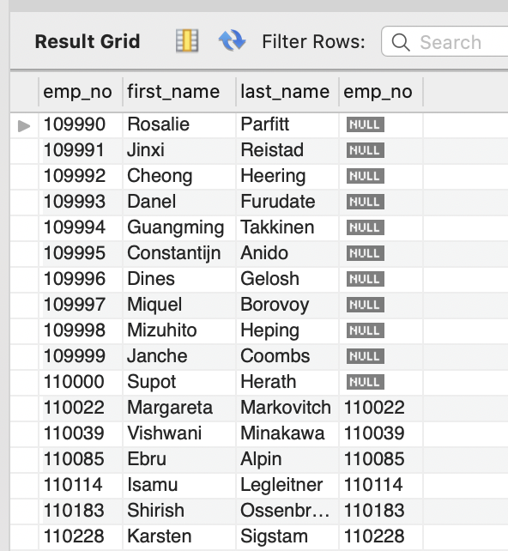
CASE Statement
SELECT e.emp_no,
e.first_name,
e.last_name,
dm.emp_no
FROM employees e LEFT JOIN dept_manager dm
ON e.emp_no = dm.emp_no
WHERE e.emp_no BETWEEN 109990 AND 111000;

Slide 65
CASE Statement
Because this is a left join, we match the emp_no, but keep both of them
the second one is for dept_manager
This means that we can use the case statement

Slide 66
CASE Statement
SELECT e.emp_no,
e.first_name,
e.last_name,
CASE
WHEN dm.emp_no IS NOT NULL THEN 'manager'
ELSE 'employee'
END
FROM employees e LEFT JOIN dept_manager dm
ON e.emp_no = dm.emp_no
WHERE e.emp_no BETWEEN 109990 AND 111000;

Slide 67
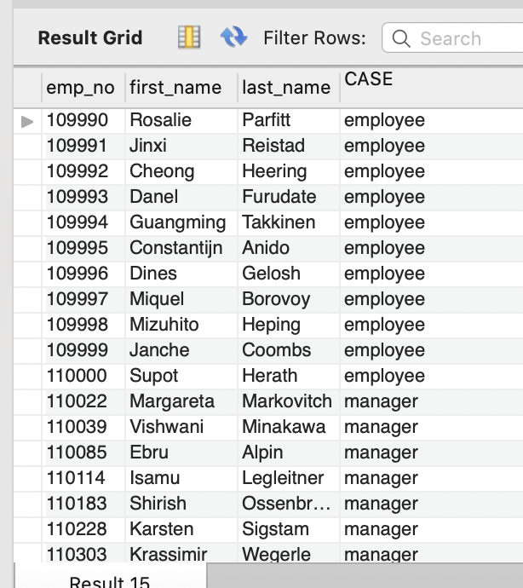
CASE Statement
The last column of the result is now the result of the CASE expression
The column name is bad, so we change it with an AS clause

Slide 68
CASE Statement
SELECT e.emp_no,
e.first_name,
e.last_name,
CASE
WHEN dm.emp_no IS NOT NULL THEN 'manager'
ELSE 'employee'
END AS 'role'
FROM employees e LEFT JOIN dept_manager dm
ON e.emp_no = dm.emp_no
WHERE e.emp_no BETWEEN 109990 AND 111000;

Slide 69
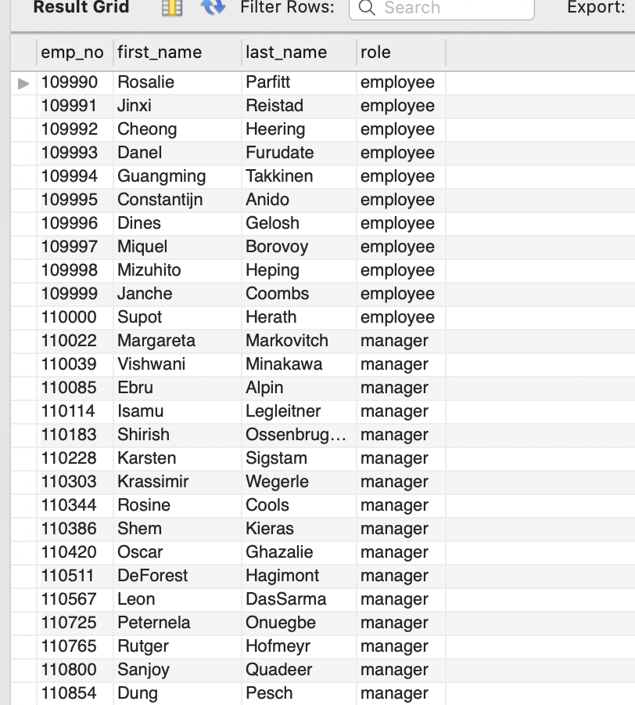
CASE Statement
SELECT e.emp_no,
e.first_name,
e.last_name,
CASE
WHEN dm.emp_no IS NOT NULL THEN 'manager'
ELSE 'employee'
END AS 'role'
FROM employees e LEFT JOIN dept_manager dm
ON e.emp_no = dm.emp_no
WHERE e.emp_no BETWEEN 109990 AND 111000;

Slide 70
CASE Statement
GOTCHA
NULL and NOT NULL cannot be compared
So: this does NOT work
SELECT e.emp_no,
e.first_name,
e.last_name,
CASE dm.emp_no
WHEN NOT NULL THEN 'manager'
ELSE 'employee'
END AS 'role'
FROM employees e LEFT JOIN dept_manager dm
ON e.emp_no = dm.emp_no
WHERE e.emp_no BETWEEN 109990 AND 111000;

Slide 71
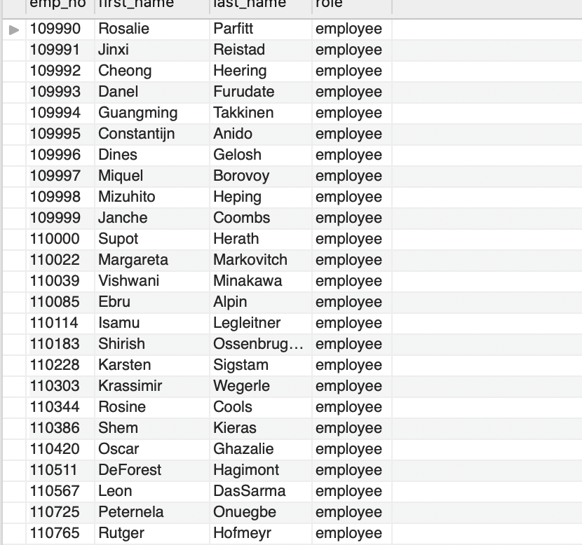
CASE Statement
Result:
Everyone is an employee because NOT NULL comparison is never-ever true

Slide 72
CASE Statement
MySQL has an IF expression
Can have only one test
Syntax is IF(condition, valiftrue, valiffalse)

Slide 73
CASE Statement
Inside a stored procedure, we can use the case statement to set a variable
CREATE PROCEDURE GetDeliveryStatus(
IN pOrderNumber INT,
OUT pDeliveryStatus VARCHAR(100)
)
BEGIN
DECLARE waitingDay INT DEFAULT 0;
SELECT
DATEDIFF(requiredDate, shippedDate)
INTO waitingDay
FROM orders
WHERE orderNumber = pOrderNumber;
CASE
WHEN waitingDay = 0 THEN
SET pDeliveryStatus = 'On Time';
WHEN waitingDay >= 1 AND waitingDay < 5 THEN
SET pDeliveryStatus = 'Late';
WHEN waitingDay >= 5 THEN
SET pDeliveryStatus = 'Very Late';
ELSE
SET pDeliveryStatus = 'No Information';
END CASE;

