Slide 1
Relational Model of Data
Thomas Schwarz, SJ

Slide 2
Data Model
Notation for describing data
Structure of the Data
Conceptual level, not binary
Operations on Data
Limits on operations are useful!
Constraints on Data

Slide 3
Data Model
In this class:
Relational Data Model
Semi-structured Data Model

Slide 4
Relational Data Model
Relational Model is based on Tables
The tables are conceptual
Implementations will differ
Title | Year | Length | Genre
Gone with the wind | 1939 | 231 | drama
Star wars | 1977 | 124 | scifi
Wayne’s world | 1992 | 95 | comedy

Slide 5
Relational Data Model
Operations are part of Relational Algebra
Constraints
On individual attributes
Non-null constraints
Unique constraints
On tuples

Slide 6
Semi-Structured Data Model
Data is presented (in general) using trees or graphs
Popular formats
XML
JSON
Describing metadata stored with data

Slide 7
{
"hollywood": {
"movies": [
{
"title": "Gone with the wind",
"year": "1939",
"length": "231",
"genre": "drama"
},
{
"title": "Star wars",
"year": "1977",
"length": "124",
"genre": "scifi"
},
{
"title": "Gone with the wind",
"year": "1992",
"length": "95",
"genre": "comedy"
}
]
}
}

Slide 8
Object Oriented Data Model
Values can have structure, not just primitive types
Relations can have associated methods
No consensus on how OO DBMS should look like
Industry implemented Object-Relational DBMS
Values no longer need to be primitive

Slide 9
Relational Data Model
Attributes:
Columns of a table are named by attributes
Schemas:
Name of a relation and the set of attributes
Tuples:
Rows of a table (other than header row)
Movies(title, year, length, genre)
(Gone with the wind, 1939, 231, drama)

Slide 10
Relational Data Model
Domains
All components of a tuple are atomic
All components of a tuple must be in domain
Movies(title:string, year:integer,
length:integer, genre:string)

Slide 11
Relational Data Model
Equivalent representation of a relation
Tables are sets of tuples
Attributes form a set
Can reorder rows and columns, but obtain the same table
Year | Genre | Title | Length
1977 | scifi | Star wars | 124
1992 | comedy | Wayne’s world | 95
1939 | drama | Gone with the wind | 231

Slide 12
Relational Data Model
Keys:
A set of attributes (always non-null):
Two tuples cannot share the same values in this set
Example:
Movies Table:
title and year form a key
No two movies in the same year have both the same title and the same year
Movies(title, year, length, genre)

Slide 13
Relational Data Model
Keys
Can be single attribute:
All persons working in the US (should) have a Social Security Number (SSN)
SSN are unique
Can be artificial tuple ids
Are defined locally (Marquette ID numbers)

Slide 14
Relational Data Model
Example
Movies(title: string,
year: string,
length: integer,
genre: string,
studioName: string,
producerC#: integer)

Slide 15
Relational Data Model
Example
MovieStar(name: string,
year: string,
address: string,
gender: char,
birthdate: date)

Slide 16
Relational Data Model
Example
StarsIn(movieTitle: string,
movieYear: int,
starName: string)

Slide 17
Relational Data Model
Example
MovieExec( name: string,
address: string,
cert#: integer,
netWorth: integer)

Slide 18
Relational Data Model
Example
Studio(name: string,
address: string,
presC#: integer)

Slide 19
SQL DDL
Create a database with CREATE DATABASE
CREATE DATABASE IF NOT EXISTS USNavy;

Slide 20
SQL DDL
Three type of tables in SQL
Stored Relations, called tables
Views: relations calculated by computation
Temporary tables: created during query execution

Slide 21
SQL DDL
Data Types
Character strings of fixed or varying length
CHAR(n) - fixed length string of up to n characters
VARCHAR(n) - fixed length string of up to n characters
Uses and endmarker or string-length for storage efficiency
Bit strings
BIT(n) strings of length exactly n
BIT VARYING(n) - strings of length up to n

Slide 22
SQL DDL
Data Types:
Boolean: BOOLEAN: TRUE, FALSE, UNKNOWN
Integers: INT = INTEGER, SHORTINT
Floats: FLOAT = REAL, DOUBLE, DECIMAL(n,m)
Dates: DATE
SQL Standard: ‘1948-05-14’)
Times: TIME
SQL Standard: 19:20:02.4

Slide 23
SQL DDL
Data Types:
MySQL: ENUM('M', 'F')

Slide 24
SQL DDL
CREATE TABLE creates a table
CREATE TABLE Movies(
title CHAR(100),
year INT,
length INT,
genre CHAR(10),
studioName CHAR(30),
producerC# INT
);

Slide 25
SQL DDL
CREATE TABLE MovieStar(
name CHAR(30),
address VARCHAR(255),
gender CHAR(1),
birthday DATE
);

Slide 26
SQL DDL
Drop Table drops a table
DROP TABLE Movies;

Slide 27
SQL DDL
Altering a table with ALTER TABLE
with ADD followed by attribute name and data type
with DROP followed by attribute name
ALTER TABLE MovieStar ADD phone CHAR(16);
ALTER TABLE MovieStar DROP Birthday;

Slide 28
SQL DDL
Default Values
Conventions for unknown data
Usually, NULL
Can use other values for unknown data
CREATE TABLE MovieStar(
name CHAR(30),
address VARCHAR(255),
gender CHAR(1) DEFAULT '?',
birthday DATE DEFAULT '0000-00-00'
);

Slide 29
SQL DDL
Declaring Keys
Declare one attribute to be a key
Add one additional declaration:
Particular set of attributes is a key
Can use
PRIMARY KEY
UNIQUE

Slide 30
SQL DDL
UNIQUE for a set S:
Two tuples cannot agree on all attributes of S unless one of them is NULL
Any attempted update that violates this will be rejected
PRIMARY KEY for a set S:
Attributes in S cannot be NULL

Slide 31
SQL DDL
CREATE TABLE MovieStar(
name CHAR(30) PRIMARY KEY,
address VARCHAR(255),
gender CHAR(1),
birthday DATE
);

Slide 32
SQL DDL
CREATE TABLE MovieStar(
name CHAR(30),
address VARCHAR(255),
gender CHAR(1) DEFAULT '?',
birthday DATE DEFAULT '0000-00-00',
PRIMARY KEY (name)
);

Slide 33
SQL DDL
CREATE TABLE Movies(
title CHAR(100),
year INT,
length INT,
genre CHAR(10),
studioName CHAR(30),
producerC# INT,
PRIMARY KEY (title, year)
);

Slide 34
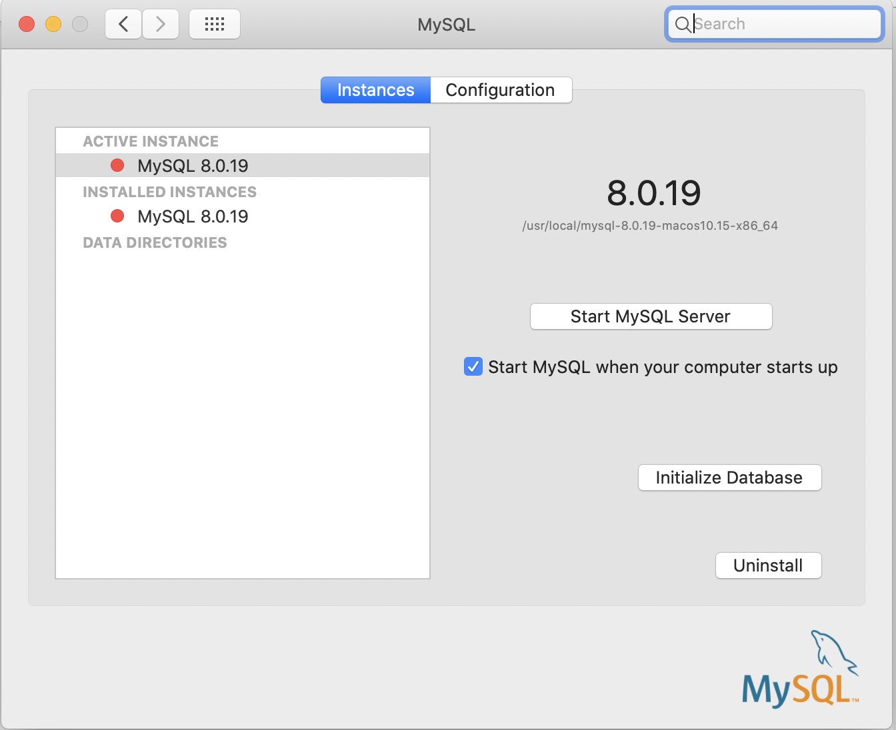
SQL Work Bench
Insure that your mysql server is running
MAC : System Preferences —> MySQL

Slide 35
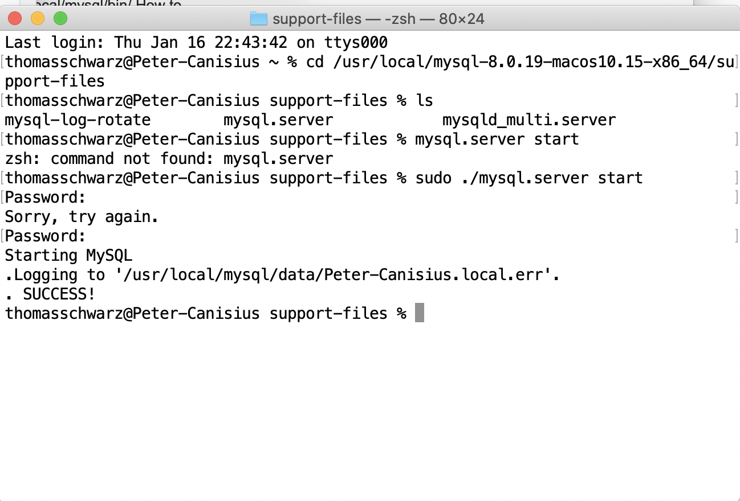
SQL Work Bench
Starting MySQL server through a terminal
Find mysql.server

Slide 36
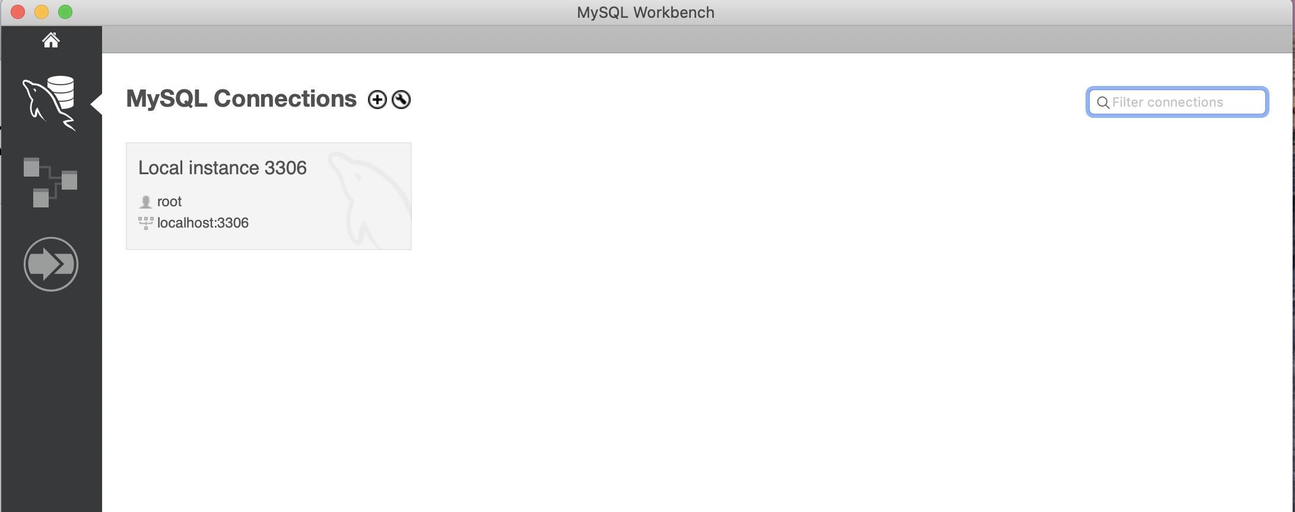
SQL Workbench
Open up SQL workbench
Select the SQL server (should be only one)

Slide 37
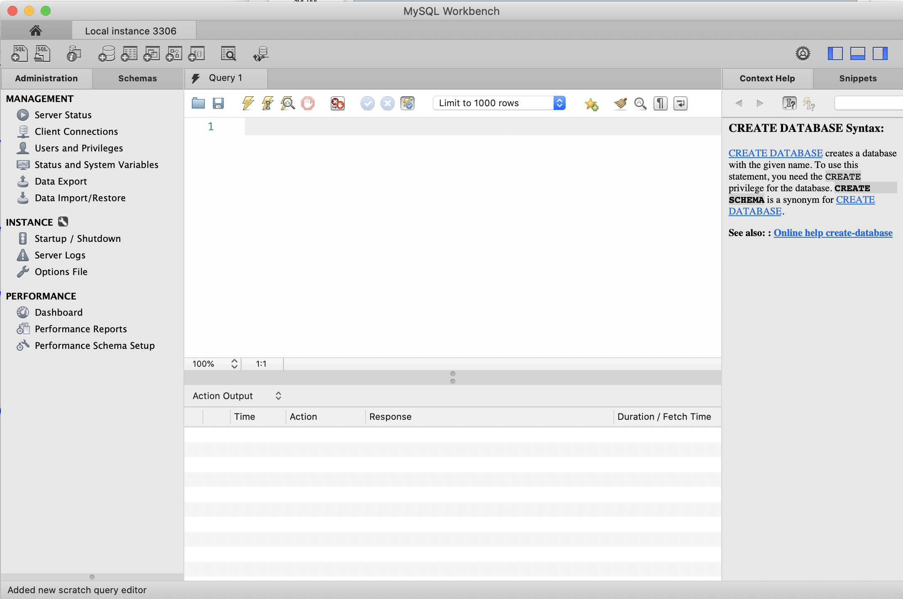
SQL Workbench
Select panels on the right

Slide 38
SQL Workbench
Select Schemas
Should have at least one master schema calles sys

Slide 39
SQL Workbench
Write queries in middle panel
Execute them with the flash symbol
CREATE DATABASE IF NOT EXISTS sales;

Slide 40
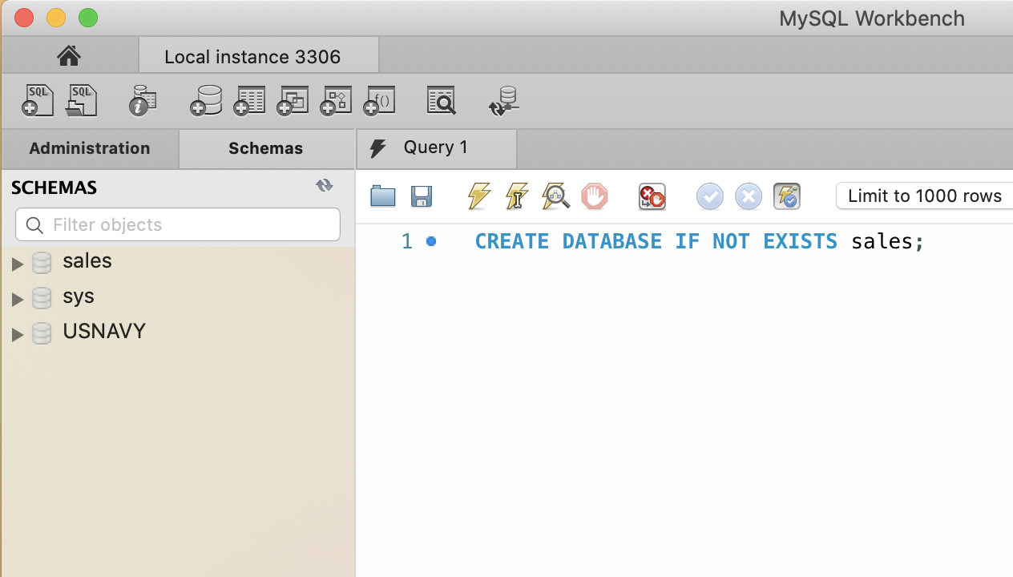
SQL Workbench
After creating a database, need to update schemas in the upper right corner

Slide 41
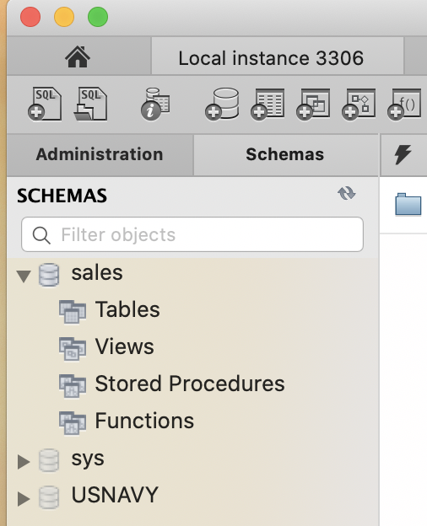
SQL Workbench
There is more information on the schema

Slide 42
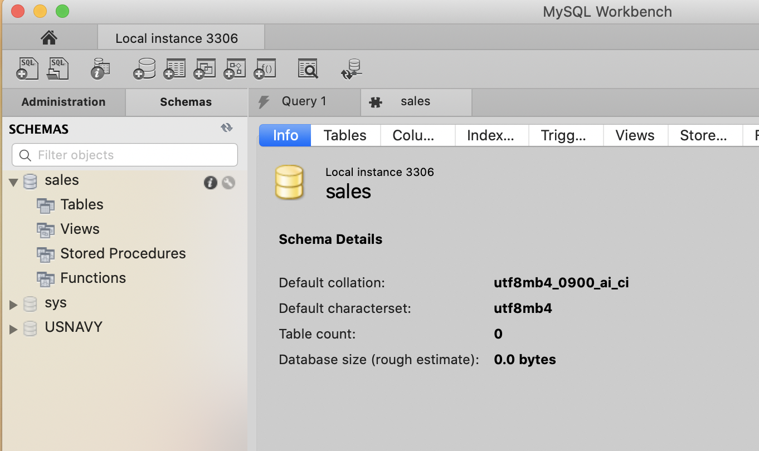
SQL Workbench
The information symbol (i) has more information

Slide 43
SQL Workbench
Execute a query
Now we can manipulate and use this database
USE sales;

Slide 44
SQL Workbench
Use queries to create a table
sales(purchase_number:int,
date_of_purchase:date,
customer_id:int,
item_code VARCHAR(10) )

Slide 45
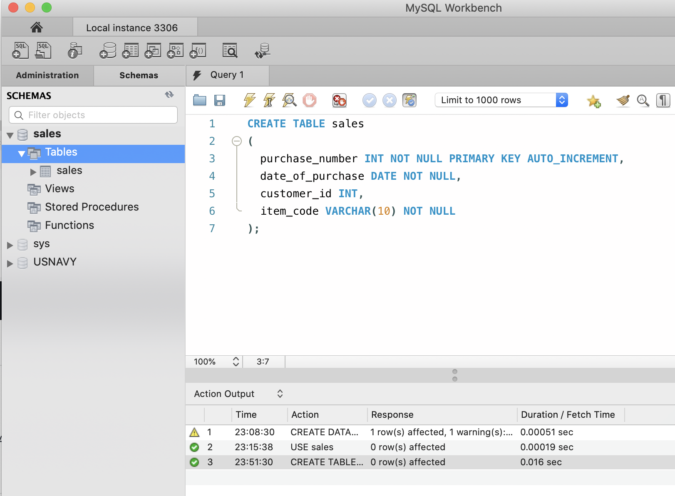
SQL Workbench

Slide 46
SQL Workbench
Create a table
customers(customer_id: int,
first_name: varchar(255),
last_name: varchar(255),
email_address: varchar(255),
number_of_complaints: int)

Slide 47
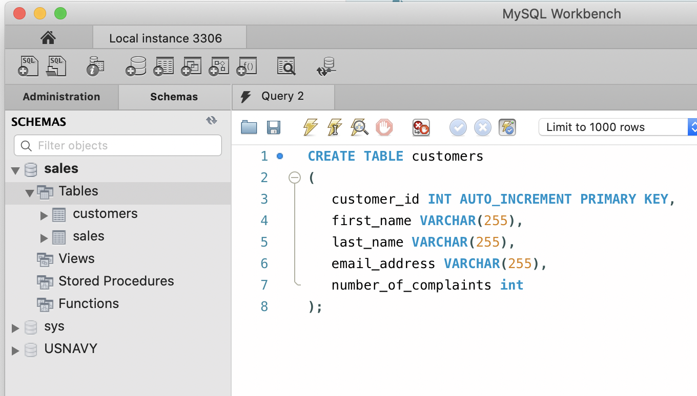
SQL Workbench

Slide 48
SQL Workbench
Referring to MYSQL objects
Use a default database
USE sales;
SELECT * FROM customers;
Use the dot notation to specify database
SELECT * FROM sales.customers;

Slide 49
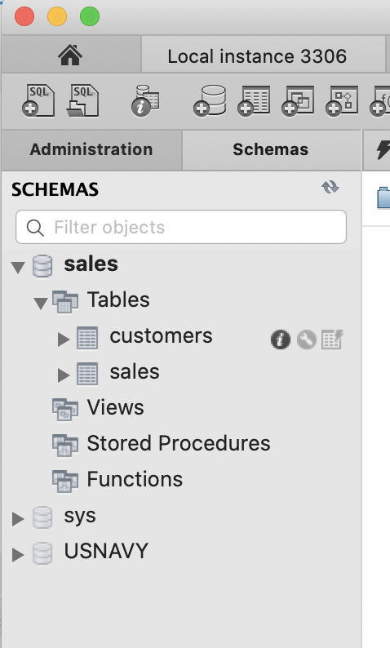
SQL Workbench
Information on Tables appears next to them in the left panel

Slide 50
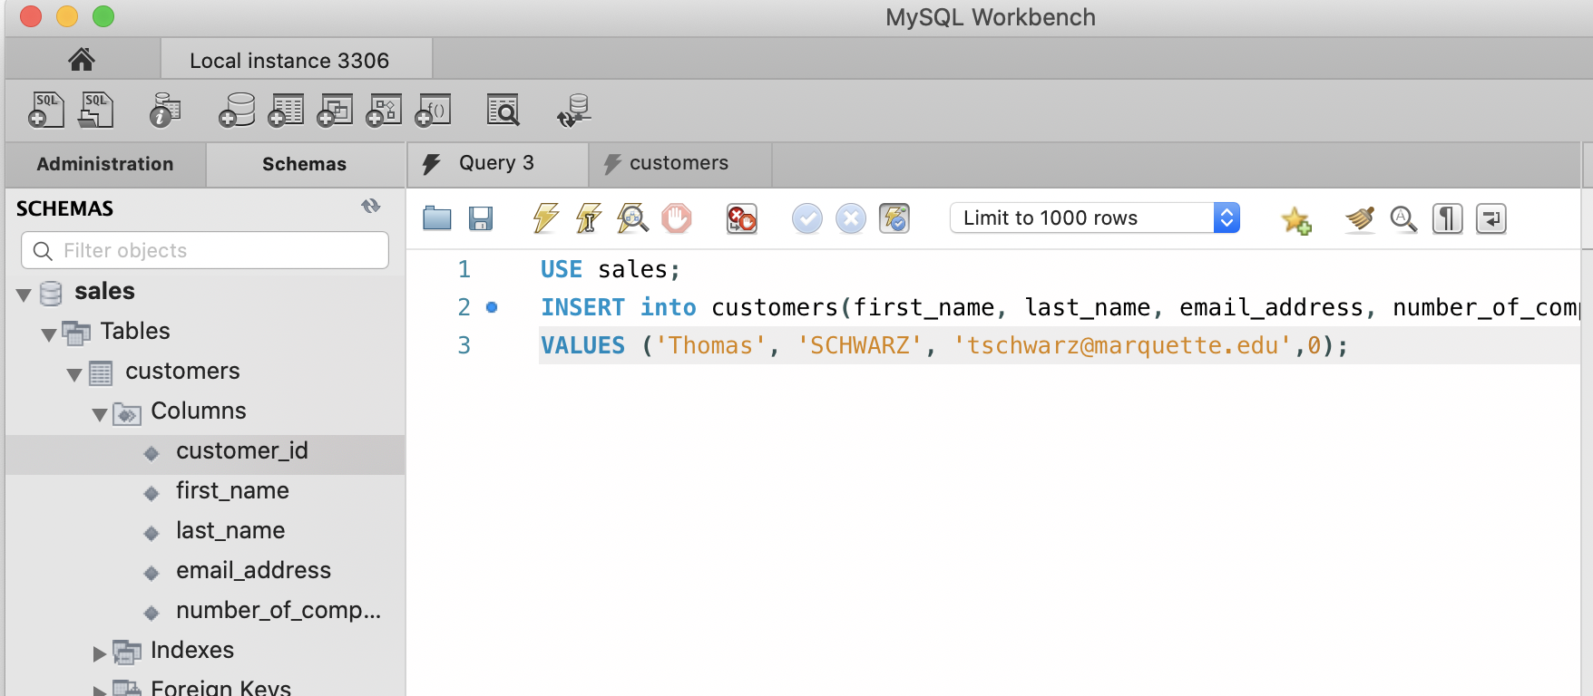
SQL Workbench
Inserting into a data base:

Slide 51
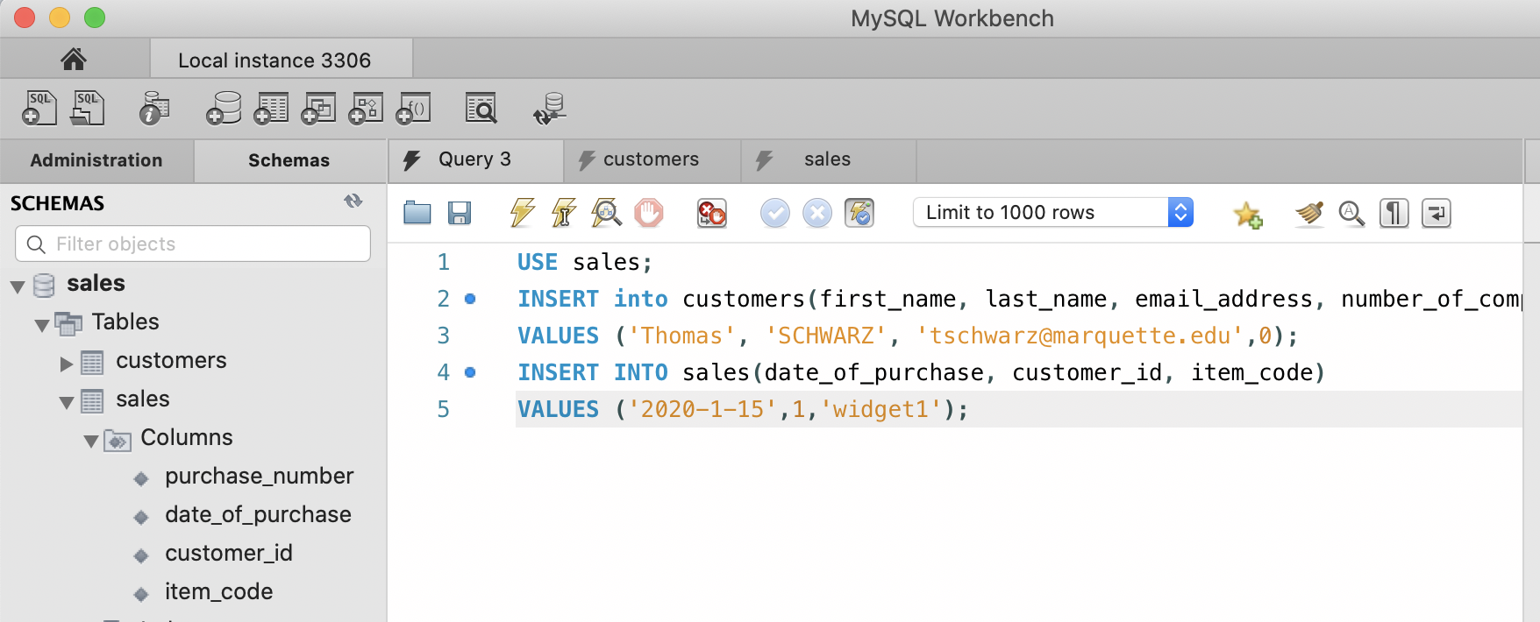
SQL Workbench

Slide 52
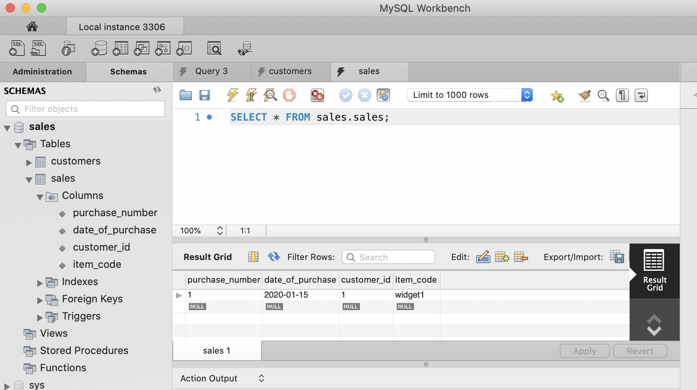
SQL Workbench

Slide 53
An Algebraic Query Language
Set operations
Selection (removes rows) and Projection (removes columns)
Combination operations: Cartesian products, joins
Renaming

Slide 54
An Algebraic Query Language
Set operations for relations
Assume $R$ and $S$ are relations with
identical sets of attributes
ordered in the same way
$R∪S$ Union
$R∩S$ Intersection
$R-S$ Difference

Slide 55
An Algebraic Query Language
Projection
Creates a new relation with a subset of the attributes
$π_{A_{1},A_{2},…,A_{n}}(R)$ is the relation with values from $R$ but only attributes $A_{1},A_{2},…,A_{n}$

Slide 56
An Algebraic Query Language
Selection
$σ_{\text{cond}}(R)$ is a relation with the same attributes, but only tupes from $R$ that satisfy the condition

Slide 57
An Algebraic Query Language
Cartesian product $R×S$
Assumes that set of attributes are disjoint
The same as for sets
$R×S=\{(r,s)|r∈R,s∈S\}$.

Slide 58
An Algebraic Query Language
Natural join $R⋈S$
New relation with attributes that are attributes in one or the other relation
All combinations of tuples in $R$ and $S$ that agree on all common attributes.

Slide 59
An Algebraic Query Language
Example:
Cartesian Product
Needs to make attributes disjoint
R A B
1 2
3 4
5 6
S A C
1 4
5 6
R x S R.A B S.A C
1 2 1 4
1 2 5 6
3 4 1 4
3 4 5 6
5 6 1 4
5 6 5 6

Slide 60
An Algebraic Query Language
Example:
Natural join: Common attribute is A
Look at common values
R A B
1 2
3 4
5 6
S A C
1 4
5 6
R $⋈$ S A B C
1 2 4
5 6 6

Slide 61
An Algebraic Query Language
Example:
Natural join: All combinations of tuples with equal values for A and B:
R A B C
1 1 2
1 1 3
1 2 4
S A B D
1 1 2
1 1 5
2 1 4
2 2 1
$R⋈S$ A B C D
1 1 2 2
1 1 2 5
1 1 3 2
1 1 3 5

Slide 62
An Algebraic Query Language
$Θ$ - Joins (Theta Joins)
Natural joins compares sub-tuples based on equality
Theta joins use arbitrary boolean conditions on attribute values
The condition is indicated as a subscript under the bowtie, usually named $θ$.

Slide 63
An Algebraic Query Language
Example
$R⋈_{θ}S$ with $θ=R.A≥S.A$
R A B C
1 2 1
0 1 2
3 3 3
S A B D
1 1 5
1 2 6
4 1 2
$R⋈_{θ}S$ A R.B S.B C D
1 2 1 1 5
1 2 2 2 6
3 3 1 3 5
3 3 2 3 6

Slide 64
An Algebraic Query Language
Example
$R⋈_{θ}S$ with $θ=(R.A≠S.A\text{AND}R.B=S.B)$
R A B C
1 2 1
0 1 2
3 3 3
S A B D
1 1 5
1 2 6
4 1 2
$R⋈_{θ}S$ R.A S.A B C D
0 1 2 1 6
0 4 1 2 2

Slide 65
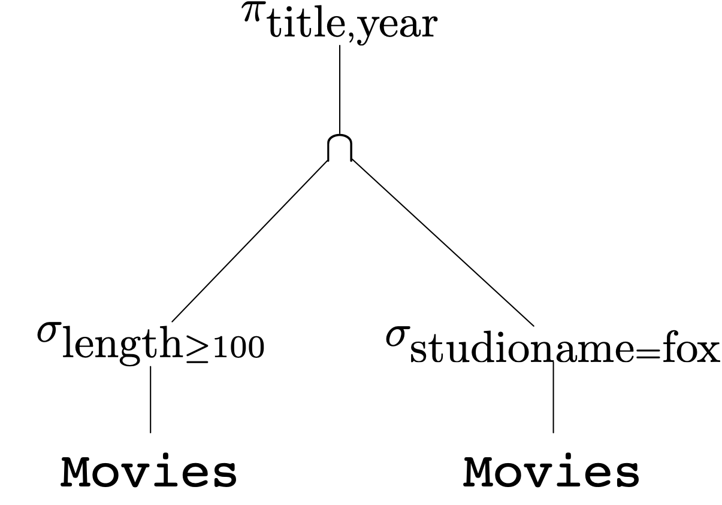
An Algebraic Query Language
Combining operations to form queries
Example: What are the titles and years of movies made by Fox that are at least 100 minutes long

Slide 66
An Algebraic Query Language
$$π_{\text{title},\text{year}}(σ_{\text{length}≥100}(\text{movies})∩σ_{\text{studioname}=\text{fox}}(\text{movies}))$$

Slide 67
An Algebraic Query Language
Query Optimizer
First translate query to an expression tree
Then apply transformation rules to generate equivalent expression trees
with lower associated run-times

Slide 68
An Algebraic Query Language
Naming and Renaming
Instead of following a convention, we use an explicit rename operator
$ρ_{S(A_{1},A_{2},…,A_{n})}(R)$ yields
A relation called S
with attributes called $A_{1}$, $A_{2}$, … , $A_{n}$

Slide 69
An Algebraic Query Language
Relationships among operations
There are some algebraic identities
$$R∩S=R-(R-S)$$
$$R⋈_{C}S=σ_{C}(R×S)$$
This means that we can only use operations
Selection
Projection
Product
Renaming
Union
Difference

Slide 70
Constraints on Relations
Constraints restrict the ability to insert data into relations
Necessary for maintaining data integrity

Slide 71
Constraints
Expression in Relational Algebra
$R=∅$ for any relational algebra expression $R$
$R⊆S$ for any relational algebra expressions $R,S$

Slide 72
Referential Integrity Constraint
Referential Integrity constraints
An attribute value appearing in one relation should also be in another relation
Example: A star should be the star of at least one movie
$π_{A}(R)⊆π_{A}(S)$

Slide 73
Referential Integrity Constraint
Selftest:
Movies(title, year, length genre, studioName, producerC#)
MovieExec(name, address, cert#, netWorth)
How do we insure that all producers appear in the MovieExec table?

Slide 74
Referential Integrity Constraint
Answer
$$π_{\text{producerC\#}}(\text{Movies})⊆π_{\text{cert\#}}(\text{MovieExec})$$

Slide 75
Referential Integrity Constraint
Selftest
Any movie in
StarsIn(movieTitle, movieYear, starName)
needs to appear in
Movies(title, year, length genre, studioName, producerC#)

Slide 76
Referential Integrity Constraint
Solution
$$π_{\text{movieTitle, movieYear}}(\text{StarsIn})⊆π_{\text{title, year}}(\text{Movies})$$

Slide 77
Key Constraints
Use Relational Algebra to express that an attribute is a key?
Any two tuples with the same value in the key must be the same
Create a Cartesian Product to get all pairs of tuples
Need to rename the copies for clarity
Then use a Select on the product

Slide 78
Key Constraints
Example:
MovieStar(name, address, gender, birthday)
Create two copies
$$ρ_{\text{MS1(name, address, gender, birthday}}(\text{MovieStar})$$
$$ρ_{\text{MS2(name, address, gender, birthday}}(\text{MovieStar})$$
Make sure that name determines address
$$σ_{\text{MS1.name=MS2.name AND MS1.address}≠\text{MS2.address}}(\text{MS1}×\text{MS2})=∅$$
Continue: name determines Gender
Continue: name determines birthday

Slide 79
Constraints
Quiz:
Value constraint:
Gender in Moviestar can be only 'M', 'F', 'NB'

Slide 80
Constraints
Quiz:
Given:
MovieExec(name, address, cert#, netWorth)
Studio(name, address, presC#)
Express the property rule that one can only be the president of a studio if the net worth exceeds US$10,000,000.00

Slide 81
Solution

