Slide 1
Linear and Logistic Regression
Thomas Schwarz, SJ

Slide 2
Linear Regression
Sir Francis Galton : 16 Feb 1822 — Jan 17 1911
Cousin of Charles Darwin
Discovered "Regression towards Mediocrity":
Individuals with exceptional measurable traits have more normal progreny
If parent's trait is at $xσ$ from $μ$, then progeny has traits at $ρxσ$ from $μ$
$ρ$ is the coefficient of correlation between trait of parent and of progeny

Slide 3
Linear Regression

Slide 4
Statistical Aside
Regression towards mediocrity does not mean
Differences in future generations are smoothed out
It reflects a selection biases
Trait of parent is mean + inherited trait + error
The parents we look at have both inherited trait and error >>0
Progeny also has mean + inherited trait + error
But the error is now random, and on average ~ 0.

Slide 5
Statistical Aside
Example:
You do exceptionally well in a chess tournament
Result is Skill + Luck
You probably will not do so well in the next one
Your skill might have increased, but you cannot expect your luck to stay the same
It might, and you might be even luckier, but the odds are against it

Slide 6
Aside: Regression to Normality
Israeli fighter pilot training:
Proposes to criticize pilots in training severely
When pilots in training are reprimanded for a bad maneuver, then they are most likely to not do the same maneuver as badly the next time
When pilots in training are praised for a well-executed maneuver, then they are not likely to repeat the same maneuver as well

Slide 7
Aside: Regression to Normality
Regression to Normality explanation:
The quality of a maneuver is a (statistically distributed) random variable
After a high-quality maneuver, the quality of the next maneuver is still distributed randomly
And therefore much more likely to be worse
After a low-quality maneuver, the quality of the next maneuver is still distributed randomly
And therefore much more likely to be better

Slide 8
Aside: Regression to Normality
Regression to Normality
Do not fall into the gambler’s fallacy
A better than average maneuver is equally likely after a better than average maneuver as after a worse than average maneuver

Slide 9
Review of Statistics
We have a population with traits
We are interested in only one trait
We need to make predictions based on a sample, a (random) collection of population members
We estimate the population mean by the sample mean
$m=\frac{1}{N}\overset{N}{\underset{i=1}{∑}}x_{i}$
We estimate the population standard deviations by the (unbiased) sample standard deviation
$s^{2}=\frac{1}{N-1}\overset{N}{\underset{i=1}{∑}}(x_{i}-μ)^{2}$

Slide 10
Unbiased ?
Normally distributed variable with mean $μ$ and st. dev. $σ$
Take sample $\{x_{1},…,x_{N}\}$
Calculate $s^{2}=\frac{1}{N}\overset{N}{\underset{i=1}{∑}}(x_{i}-μ)^{2}$
Turns out: expected value for $s$ is less than $σ$
Call $N-1$ the degree of freedom

Slide 11
Forecasting
Mean model
We have a sample
We predict the value of the next population member to be the sample mean
What is the risk?
Measure the risk by the standard deviation

Slide 12
Forecasting
Normally distributed variable with mean $μ$ and st. dev. $σ$
Take sample $\{x_{1},…,x_{N}\}$
What is the expected squared difference of $m$ and $μ$: $E((m-μ)^{2})$
"Standard error of the mean"
$E((m-μ)^{2})=\frac{s}{\sqrt{N}}$

Slide 13
Forecasting
Forecasting Error of : $x_{N+1}←\frac{1}{N}\overset{N}{\underset{i=1}{∑}}X_{i}$
Two sources of error:
We estimate the standard deviation wrongly
$x_{N+1}$ is on average one standard deviation away from the mean
Expected error
$$=\sqrt{s^{2}+(\frac{s}{\sqrt{N}})^{2}}=s\sqrt{1+\frac{1}{N}}$$
model
error
parameter
error

Slide 14
Forecasting
There is still a model risk
We just might not have the right model
The underlying distribution is not normal

Slide 15
Confidence Intervals
Assume that the model is correct
Simulate the model run times
The x-confidence interval then
contains x% of the runs contain the true value

Slide 16
Confidence Intervals
Confidence intervals usually are $±t×(\text{standard error of forecast}$)
Contained in t-tables and depend on sample size

Slide 17
Example
Create a simulation that gives you a single figure of merit
Create a batch of 50 simulations and get the average
Repeat this 30 times
Because each of the 30 values is an average, it is more closely normally distributed

Slide 18
Example
Values:
x = np.array([46.38324392, 48.32716522, 42.80399487,
45.81826266, 43.23515335, 43.6001169 ,
47.49314264, 49.08597766, 42.95018079,
45.25707317, 45.43143526, 44.20980892,
44.86189782, 38.33234082, 44.17152394,
44.636054 , 46.95339903, 43.35623343,
44.08015344, 43.14105973, 46.28812561,
46.01398139, 46.25844065, 41.6666845 ,
45.42620433, 47.35499856, 42.46798488,
45.21081934, 43.64197297, 43.68351126])

Slide 19
Example
Calculate sample mean and sample std deviation
Get confidence interval at $α=0.01$ using stats.t.interval
loc = np.mean(x)
scale=np.std(x, ddof=1)/np.sqrt(len(x))
print(stats.t.interval(1-0.01,
len(x)-1,
loc = np.mean(x),
scale=np.std(x,
ddof=1)/np.sqrt(len(x))))

Slide 20
Result
(38.75273429019668, 50.723328447136645))
(True value was 45)

Slide 21
Student t-distribution
Gossett (writing as "Student")
Distribution of
$\frac{(m-μ)}{s/{\sqrt{N}}}$
With increasing $N$ comes close to normal distribution

Slide 22
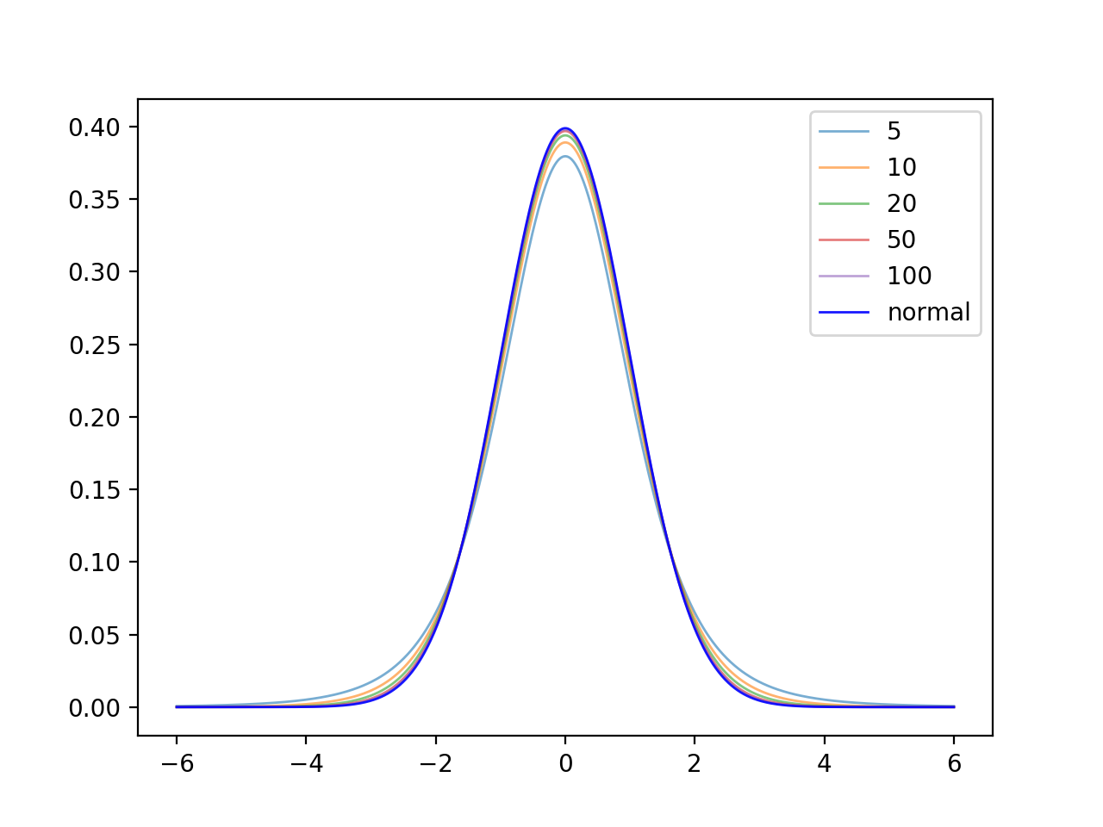
Student-t distribution

Slide 23
Example
T-test for testing whether two means of two populations are different or not
$t=\frac{μ_{X}-μ_{Y}}{\sqrt{\frac{σ_{X}^{2}}{n_{X}}+\frac{σ_{Y}^{2}}{n_{Y}}}}$ with sample st. dev. $σ_{X}$ and $σ_{Y}$
Distributed according to degrees of freedom:
$$n_{X}+n_{Y}-2$$

Slide 24
Example
Blood pressure measurements for patients given a drug and a placebo
Use scipy.stats.ttest_ind
Notice: there are many variants of t-tests:
drug = [100, 110, 122, 109, 108, 111, 118, 105, 115, 119, 106]
placebo = [129, 125, 136, 129, 135, 134, 140, 128]
print(stats.ttest_ind(drug, placebo, equal_var=False))

Slide 25
Example
Result is
Since the p-value is so small
Conclude that the null hypothesis: "means are equal" is wrong
Ttest_indResult(statistic=-7.761660781121691, pvalue=5.591331997397221e-07)

Slide 26
Linear Regression
Thomas Schwarz, SJ

Slide 27
Simple Linear Regression
Linear regression uses straight lines for prediction
Model:
"Causal variable" $x$, "observed variable" $y$
Connection is linear (with or without a constant)
There is an additive "error" component
Subsuming "unknown" causes
With expected value of 0
Usually assumed to be normally distributed

Slide 28
Simple Linear Regression
Model:
$$y=b_{0}+b_{1}x+ϵ$$

Slide 29
Simple Linear Regression
Assume $y=b_{0}+b_{1}x$
Minimize $S=\overset{n}{\underset{i=1}{∑}}(y_{i}-\left(b_{0}+b_{1}x_{i}\right))^{2}$
Take the derivative with respect to $b_{0}$ and set it to zero:
$$\frac{δS}{δb_{0}}=\overset{n}{\underset{i=1}{∑}}-2(y_{i}-b_{0}-b_{1}x_{i})=0$$
$$⇒\overset{n}{\underset{i=1}{∑}}y_{i}=b_{0}n+b_{1}\overset{n}{\underset{i=1}{∑}}x_{i}⇒b_{0}=\frac{1}{n}\overset{n}{\underset{i=1}{∑}}y_{i}-b_{1}\frac{1}{n}\overset{n}{\underset{i=1}{∑}}x_{i}$$
$$⇒b_{0}=\overline{y}-b_{1}\overline{x}$$

Slide 30
Simple Linear Regression
Assume $y=b_{0}+b_{1}x$
Minimize $S=\overset{n}{\underset{i=1}{∑}}(y_{i}-\left(b_{0}+b_{1}x_{i}\right))^{2}$
Take the derivative with respect to $b_{1}$ and set it to zero:
$$\frac{δS}{δb_{1}}=\overset{n}{\underset{i=1}{∑}}-2x_{i}(y_{i}-b_{0}-b_{1}x_{i})=0$$
$$⇒\overset{n}{\underset{i=1}{∑}}x_{i}(y_{i}-b_{0}-b_{1}x_{i})=\overset{n}{\underset{i=1}{∑}}(x_{i}y_{i}-b_{0}x_{i}-b_{1}x_{i}^{2})=0$$

Slide 31
Simple Linear Regression
From previous, we know $b_{0}=\overline{y}-b_{1}\overline{x}$
Our formula $\overset{n}{\underset{i=1}{∑}}(x_{i}y_{i}-b_{0}x_{i}-b_{1}x_{i}^{2})=0$ becomes
$$\overset{n}{\underset{i=1}{∑}}\left(x_{i}y_{i}-(\overline{y}-b_{1}\overline{x})x_{i}-b_{1}x_{i}^{2}\right)=0$$
$$\overset{n}{\underset{i=1}{∑}}\left(x_{i}y_{i}-\overline{y}x_{i}\right)+b_{1}\overset{n}{\underset{i=1}{∑}}\left(\overline{x}x_{i}-x_{i}^{2}\right)=0$$

Slide 32
Simple Linear Regression
This finally gives us a solution:
$b_{1}=\frac{∑_{i=1}^{n}(x_{i}y_{i}-\overline{y}x_{i})}{∑_{i=1}^{n}(x_{i}^{2}-\overline{x}x_{i})}$
$b_{0}=\overline{y}-b_{1}\overline{x}$

Slide 33
Simple Linear Regression
Measuring fit:
Calculate the sum of squares $SS_{\text{tot}}=\overset{n}{\underset{i=1}{∑}}(y_{i}-\overline{y})^{2}$
Residual sum of squares $SS_{\text{res}}=\overset{n}{\underset{i=1}{∑}}(b_{0}+b_{1}x_{i}-y_{i})^{2}$
Coefficient of determination $R^{2}=1-\frac{SS_{\text{res}}}{SS_{\text{tot}}}$

Slide 34
Simple Linear Regression
$R^{2}$ can be used as a goodness of fit
Value of 1: perfect fit
Value of 0: no fit
Negative values: wrong model was chosen

Slide 35
Simple Linear Regression
Look at residuals:
Determine statistics on the residuals
Question: do they look normally distributed?

Slide 36
Simple Linear Regression
Example 1: brain sizes versus IQ
A number of female students were given an IQ test
They were also given an MRI to measure the size of their brain
Is there a relationship between brains size and IQ?
VerbalIQ Brain Size
132 816.932
132 951.545
90 928.799
136 991.305
90 854.258
129 833.868
120 856.472
100 878.897
71 865.363
132 852.244
112 808.02
129 790.619
86 831.772
90 798.612
83 793.549
126 866.662
126 857.782
90 834.344
129 948.066
86 893.983

Slide 37
Simple Linear Regression
First package: statsmodels
Linear Regression can use different models
Standard: Ordinary least squares OLS
Exogenous variables: variable determined outside the model (an independent variable)
Endogenous variables: variable determined from other variables according to the model (dependent variable)
model is sm.OLS(endogenous_data, exogenous_data)
result is model.fit

Slide 38
Simple Linear Regression
Can use statsmodels
import statsmodels.api as sm
df = pd.read_csv('brain-size.txt', sep = '\t')
Y = df['VerbalIQ']
X = df['Brain Size']
X = sm.add_constant(X)
model = sm.OLS(Y,X).fit()
predictions = model.predict(X)
print(model.summary())
Add's a column of ones

Slide 39
Simple Linear Regression
Gives a very detailed feed-back
OLS Regression Results
==============================================================================
Dep. Variable: VerbalIQ R-squared: 0.065
Model: OLS Adj. R-squared: 0.013
Method: Least Squares F-statistic: 1.251
Date: Thu, 02 Jul 2020 Prob (F-statistic): 0.278
Time: 16:22:00 Log-Likelihood: -88.713
No. Observations: 20 AIC: 181.4
Df Residuals: 18 BIC: 183.4
Df Model: 1
Covariance Type: nonrobust
==============================================================================
coef std err t P>|t| [0.025 0.975]
------------------------------------------------------------------------------
const 24.1835 76.382 0.317 0.755 -136.288 184.655
Brain Size 0.0988 0.088 1.119 0.278 -0.087 0.284
==============================================================================
Omnibus: 5.812 Durbin-Watson: 2.260
Prob(Omnibus): 0.055 Jarque-Bera (JB): 1.819
Skew: -0.259 Prob(JB): 0.403
Kurtosis: 1.616 Cond. No. 1.37e+04
==============================================================================

Slide 40
Simple Linear Regression
Interpreting the outcome:
Are the residuals normally distributed?
Omnibus: test for skew and kurtosis
Should be zero
In this case: Probability of this or worse is 0.055
Omnibus: 5.812 Durbin-Watson: 2.260
Prob(Omnibus): 0.055 Jarque-Bera (JB): 1.819
Skew: -0.259 Prob(JB): 0.403
Kurtosis: 1.616 Cond. No. 1.37e+04

Slide 41
Simple Linear Regression
Interpreting the outcome:
Are the residuals normally distributed?
Durbin-Watson: tests homoscedasticity
Is the Variance of the errors consistent
Omnibus: 5.812 Durbin-Watson: 2.260
Prob(Omnibus): 0.055 Jarque-Bera (JB): 1.819
Skew: -0.259 Prob(JB): 0.403
Kurtosis: 1.616 Cond. No. 1.37e+04

Slide 42
Simple Linear Regression
Homoscedasticity
Observe that variance increases

Slide 43
Simple Linear Regression
Durbin Watson statistics is between 0 and 4
Value of 2.0 means no correlation
Values close to 4.0 mean positive correlation
Values close to 0 mean negative correlation

Slide 44
Simple Linear Regression
Interpreting the outcome:
Jarque-Bera:
Tests skew and kurtosis of residuals
Here acceptable probability
Omnibus: 5.812 Durbin-Watson: 2.260
Prob(Omnibus): 0.055 Jarque-Bera (JB): 1.819
Skew: -0.259 Prob(JB): 0.403
Kurtosis: 1.616 Cond. No. 1.37e+04

Slide 45
Simple Linear Regression
Interpreting the outcome:
Condition number
Indicates either multicollinearity or numerical problems: small changes would have large effects
Multicollinearity: two or more explanatory variables are highly linearly related
Omnibus: 5.812 Durbin-Watson: 2.260
Prob(Omnibus): 0.055 Jarque-Bera (JB): 1.819
Skew: -0.259 Prob(JB): 0.403
Kurtosis: 1.616 Cond. No. 1.37e+04

Slide 46
Simple Linear Regression
Plotting
my_ax = df.plot.scatter(x='Brain Size', y='VerbalIQ')
x=np.linspace(start=800,stop=1000)
my_ax.plot(x,24.1835+0.0988*x)

Slide 47
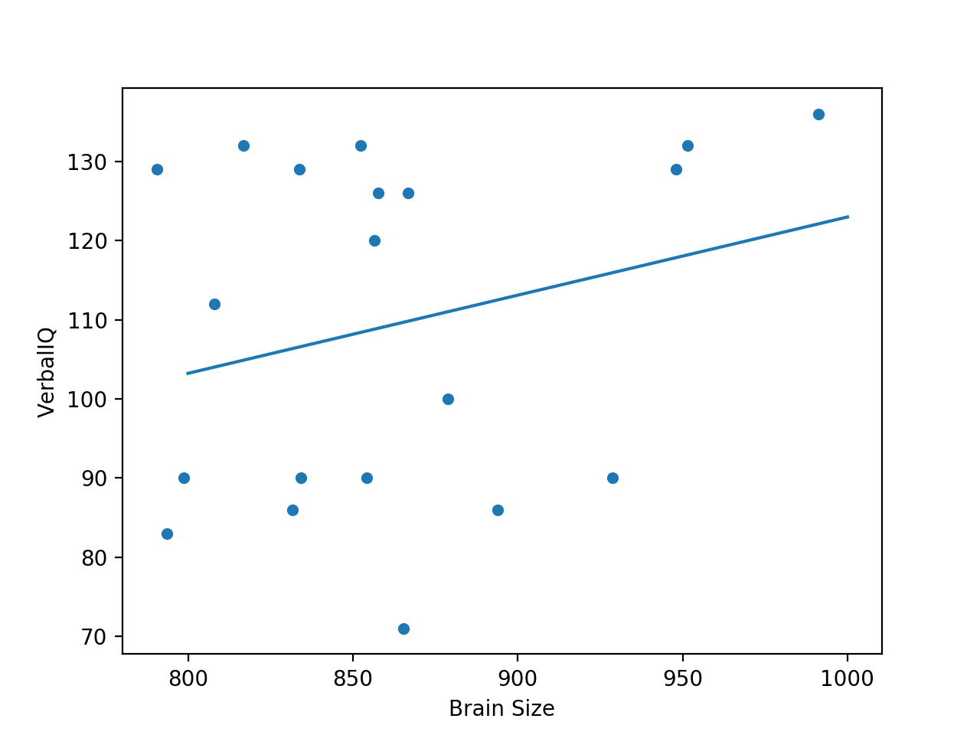
Simple Linear Regression

Slide 48
Simple Linear Regression
scipy has a stats package
from scipy import stats
df = pd.read_csv('brain-size.txt', sep = '\t')
Y = df['VerbalIQ']
X = df['Brain Size']
x = np.linspace(800,1000)
slope, intercept, r_value, p_value, std_err = stats.linregress(X, Y)

Slide 49
Simple Linear Regression
plotting using plt
plt.plot(X, Y, 'o', label='measurements')
plt.plot(x, intercept+slope*x, 'r:', label='fitted')
plt.legend(loc='lower right')
print(slope, intercept, r_value, p_value)
plt.show()

Slide 50
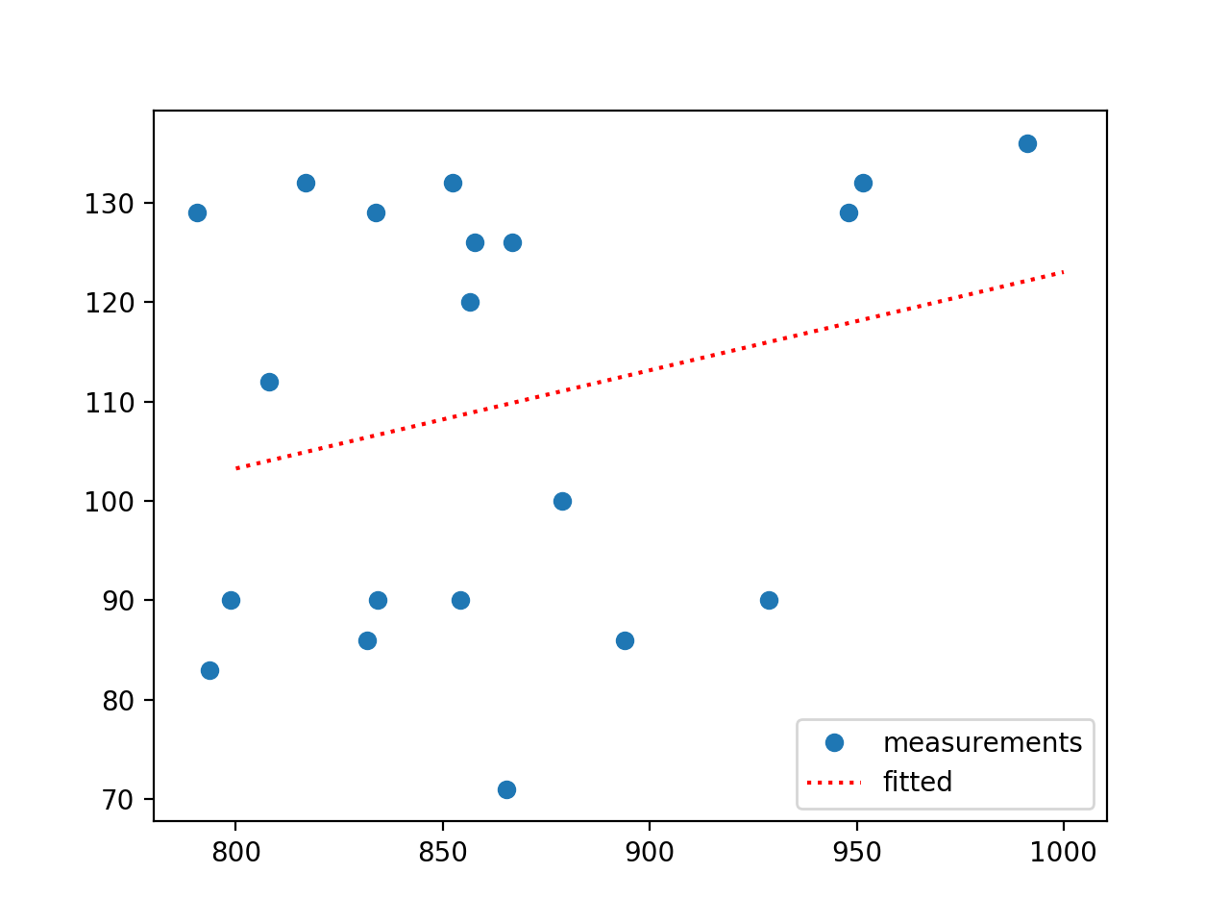
Simple Linear Regression

Slide 51
Multiple Regression
Assume now more explanatory variables
$$y=b_{0}+b_{1}x_{1}+b_{2}x_{2}+…+b_{r}x_{r}$$

Slide 52
Multiple Regression
Seattle Housing Market
Data from Kaggle
df = pd.read_csv('kc_house_data.csv')
df.dropna( inplace=True)

Slide 53
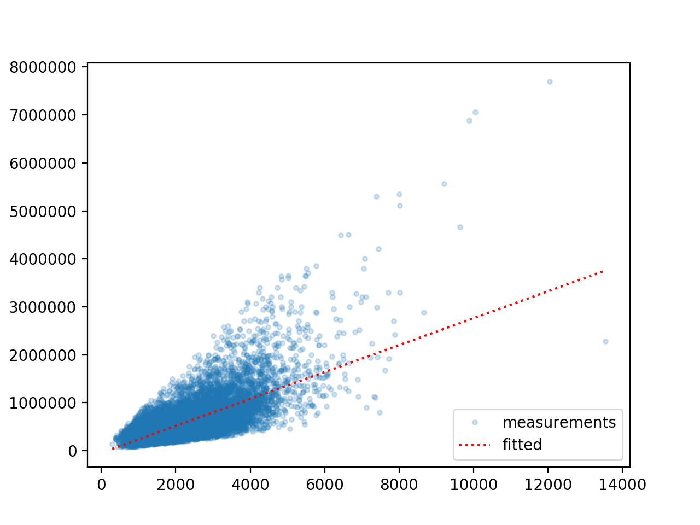
Multiple Regression
Linear regression: price — grade

Slide 54
Multiple Regression
Can use the same Pandas recipes
df = pd.read_csv('kc_house_data.csv')
df.dropna( inplace=True)
Y = df['price']
X = df[ ['sqft_living', 'bedrooms', 'condition', 'waterfront'] ]
model = sm.OLS(Y,X).fit()
predictions = model.predict(X)
print(model.summary())

Slide 55
OLS Regression Results
=======================================================================================
Dep. Variable: price R-squared (uncentered): 0.857
Model: OLS Adj. R-squared (uncentered): 0.857
Method: Least Squares F-statistic: 3.231e+04
Date: Thu, 02 Jul 2020 Prob (F-statistic): 0.00
Time: 20:47:11 Log-Likelihood: -2.9905e+05
No. Observations: 21613 AIC: 5.981e+05
Df Residuals: 21609 BIC: 5.981e+05
Df Model: 4
Covariance Type: nonrobust
===============================================================================
coef std err t P>|t| [0.025 0.975]
-------------------------------------------------------------------------------
sqft_living 303.8804 2.258 134.598 0.000 299.455 308.306
bedrooms -5.919e+04 2062.324 -28.703 0.000 -6.32e+04 -5.52e+04
condition 3.04e+04 1527.531 19.901 0.000 2.74e+04 3.34e+04
waterfront 7.854e+05 1.96e+04 40.043 0.000 7.47e+05 8.24e+05
==============================================================================
Omnibus: 13438.261 Durbin-Watson: 1.985
Prob(Omnibus): 0.000 Jarque-Bera (JB): 437567.612
Skew: 2.471 Prob(JB): 0.00
Kurtosis: 24.482 Cond. No. 2.65e+04
==============================================================================
Warnings:
[1] Standard Errors assume that the covariance matrix of the errors is correctly specified.
[2] The condition number is large, 2.65e+04. This might indicate that there are
strong multicollinearity or other numerical problems.

Slide 56
Multiple Regression
sklearn
from sklearn import linear_model
df = pd.read_csv('kc_house_data.csv')
df.dropna( inplace=True)
Y = df['price']
X = df[ ['sqft_living', 'bedrooms', 'condition', 'waterfront'] ]
regr = linear_model.LinearRegression()
regr.fit(X, Y)
print('Intercept: \n', regr.intercept_)
print('Coefficients: \n', regr.coef_)

Slide 57
Multiple Regression
sklearn:
Score to get $R^{2}$ value:
regr = linear_model.LinearRegression()
regr.fit(X, Y)
print(regr.score(X, Y))

Slide 58
Multiple Regression
statsmodel
ols takes the model as a string
Example:
model1 = ols("Y~Xsl+Xbr+Xco+Xwf", house).fit()

Slide 59
Multiple Regression
import pandas as pd
import numpy as np
import matplotlib.pyplot as plt
from statsmodels.formula.api import ols
df = pd.read_csv('kc_house_data.csv')
y = df['price']
x1 = df['sqft_living']
x2 = df['grade']
model = ols("y ~ x1 + x2", df).fit()
print(model.summary())

Slide 60
Multiple Regression
How can we access the importance of the different explanatory variables?
The size of the coefficient depends on the scale
Change sqft to square-meters and the coefficient will change by about 10

Slide 61
Multiple Regression
How can we access the importance of the different explanatory variables?
Use the $R^{2}$ score differences
Example:
Waterside contributes 0.034
Bedrooms contribute 0.012
Notice that bedrooms correlates with square feet: correlation is 0.577
 | R^2
All variables | 0.548
All variables but waterside | 0.514
All variables but bedrooms | 0.536
house.sqft_living.corr(house.bedrooms)

Slide 62
Multiple Regression
How can we access the importance of the different explanatory variables?
Depending on decision model (how do we penalize being wrong)
Sometimes use the square root of $R^{2}$, i.e. $R$

Slide 63
Multiple Regression
How can we access the importance of the different explanatory variables?
Can use "standardized regression coefficient"
$\overline{b_{j}}=b_{j}\frac{S_{X_{j}}}{S_{Y}}$ with $S_{X_{j}}$ std. dev. of $X_{j}$ and $S_{Y}$ std. dev of $Y$
Example:
square-feet: 0.765
bedroom: -0.134
condition: 0.082
waterfront: 0.185
model1.params[1]*Xsl.std()/Y.std()

Slide 64
Polynomial Regression
What if the explanatory variables enter as powers?
Can still apply multi-linear regression
$$y=b_{0}+b_{1}x_{1}+b_{2}x_{2}+b_{3}x_{1}^{2}+b_{4}x_{1}x_{2}+b_{5}x_{2}^{2}$$

Slide 65
Logistic Regression

Slide 66
Categorical Data
Outcomes can be categorical
Often, outcome is binary:
President gets re-elected or not
Customer is satisfied or not
Often, explanatory variables are categorical as well
Person comes from an under-performing school
Order was made on a week-end
…

Slide 67
Prediction Models for Binary Outcomes
Famous example:
Taken an image of a pet, predict whether this is a cat or a dog

Slide 68
Prediction Models for Binary Outcomes
Bayes: generative classifier
Predicts indirectly $P(c|d)$
$$\overset{̂}{c}={\text{arg max}}_{c∈C}P(d|c)P(c)$$
Evaluates product of likelihood and prior
Prior: Probability of a category $c$ without looking at data
Likelihood: Probability of observing data if from a category $c$
Likelihood
Prior

Slide 69
Prediction Models for Binary Outcomes
Regression is a discriminative classifier
Tries to learn directly the classification from data
E.g.: All dog pictures have a collar
Collar present —> predict dog
Collar not present —> predict cat
Computes directly $P(c|d)$

Slide 70
Prediction Models for Binary Outcomes
Regression:
Supervised learning: Have a training set with classification provided
Input is given as vectors of numerical features
$$x^{(i)}=(x_{1,i},x_{2,i},…,x_{n,i})$$
Classification function that calculates the predicted class $\overset{̂}{y}(x)$
An objective function for learning: Measures the goodness of fit between true outcome and predicted outcome
An algorithm to optimize the objective function

Slide 71
Prediction Models for Binary Outcomes
Linear Regression:
Classification function of type
$$\overset{̂}{y}\left((x_{1},x_{2},…,x_{n})\right)=a_{1}x_{1}+a_{2}x_{2}+…a_{n}x_{n}+b$$
Objective function (a.k.a cost function)
Sum of squared differences between predicted and observed outcomes
E.g. Test Set $T=\{x^{(1)},x^{(2)},…x^{(m)}\}$
Minimize cost function $\overset{m}{\underset{i=1}{∑}}(y^{(i)}-{\overset{̂}{y}}^{(i)})^{2}$

Slide 72
Prediction Models for Binary Outcomes
Linear regression can predict a numerical value
It can be made to predict a binary value
If the predictor is higher than a cut-off value: predict yes
Else predict no
But there are better ways to generate a binary classifier

Slide 73
Prediction Models for Binary Outcomes
Good binary classifier:
Since we want to predict the probability of a category based on the features:
Should look like a probability
Since we want to optimize:
Should be easy to differentiate
Best candidate classifier that has emerged:
Sigmoid classifier

Slide 74
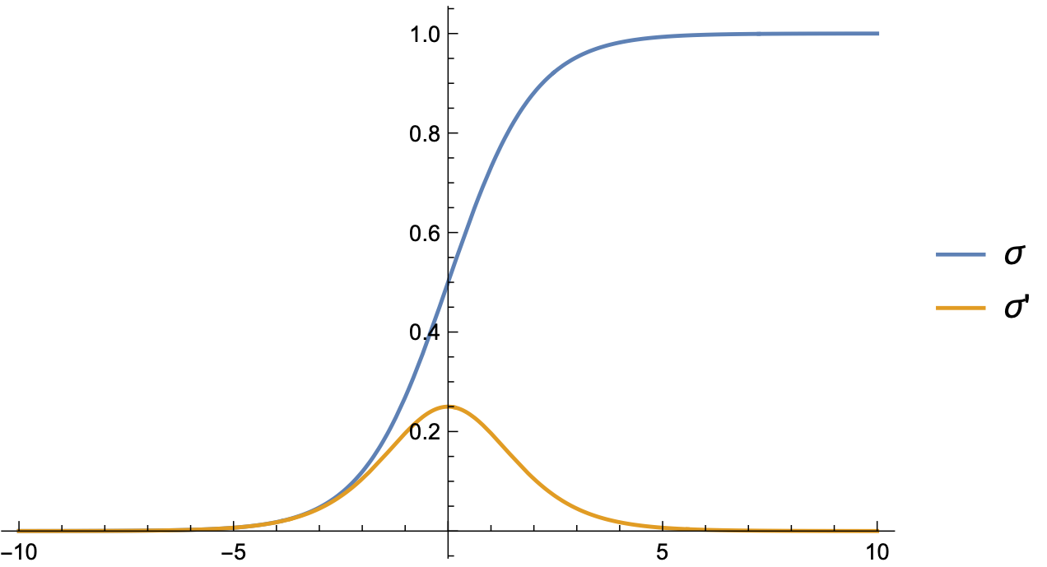
Logistic Regression
Use logistic function
$σ(z)=\frac{1}{1+exp(-z)}$

Slide 75
Logistic Regression
Combine with linear regression to obtain logistic regression approach:
Learn best weights in
$$\overset{̂}{y}\left((x_{1},x_{2},…,x_{n})\right)=σ(b+w_{1}x_{1}+w_{2}x_{2}+…w_{n}x_{n})$$
We now interpret this as a probability for the positive outcome '+'
Set a decision boundary at 0.5
This is no restriction since we can adjust $b$ and the weights

Slide 76
Logistic Regression
We need to measure how far a prediction is from the true value
Our predictions $\overset{̂}{y}$ and the true value $y$ can only be 0 or 1
If $y=1$: Want to support $\overset{̂}{y}=1$ and penalize $\overset{̂}{y}=0$.
If $y=0$: Want to support $\overset{̂}{y}=0$ and penalize $\overset{̂}{y}=1$.
One successful approach:
$$\text{Loss}(\overset{̂}{y},y)={\overset{̂}{y}}^{y}(1-\overset{̂}{y})^{(1-y)}$$

Slide 77
Logistic Regression
Easier: Take the negative logarithm of the loss function
Cross Entropy Loss
$${\text{L}}_{\text{CE}}=-ylog(\overset{̂}{y})-(1-y)log(1-\overset{̂}{y})$$

Slide 78
Logistic Regression
This approach is successful, because we can use Gradient Descent
Training set of size $m$
Minimize $\overset{m}{\underset{i=1}{∑}}{\text{L}}_{\text{CE}}(y^{(i)},{\overset{̂}{y}}^{(i)})$
Turns out to be a convex function, so minimization is simple! (As far as those things go)
Recall:
$$\overset{̂}{y}\left((x_{1},x_{2},…,x_{n})\right)=σ(b+w_{1}x_{1}+w_{2}x_{2}+…w_{n}x_{n})$$
We minimize with respect to the weights and $b$

Slide 79
Logistic Regression
Calculus:
$\frac{δ{\text{L}}_{\text{CE}}(w,b)}{δw_{j}}=\left(σ(w_{1}x_{1}+…w_{n}x_{n}+b)-y\right)x_{j}$
$=(\overset{̂}{y}-y)x_{j}$
Difference between true $y$ and estimated outcome $\overset{̂}{y}$, multiplied by input coordinate

Slide 80
Logistic Regression
Stochastic Gradient Descent
Until gradient is almost zero:
For each training point $x^{(i)},y^{(i)}$:
Compute prediction ${\overset{̂}{y}}^{(i)}$
Compute loss
Compute gradient
Nudge weights in the opposite direction using a learning weight $η$
$$(w_{1},…,w_{n})←(w_{1},…,w_{n})-η∇{\text{L}}_{\text{CE}}$$
Adjust $η$

Slide 81
Logistic Regression
Stochastic gradient descent uses a single data point
Better results with random batches of points at the same time

Slide 82
Lasso and Ridge Regression
If the feature vector is long, danger of overfitting is high
We learn the details of the training set
Want to limit the number of features with positive weight
Dealt with by adding a regularization term to the cost function
Regularization term depends on the weights
Penalizes large weights

Slide 83
Lasso and Ridge Regression
L2 regularization:
Use a quadratic function of the weights
Such as the euclidean norm of the weights
Called Ridge Regression
Easier to optimize

Slide 84
Lasso and Ridge Regression
L1 regularization
Regularization term is the sum of the absolute values of weights
Not differentiable, so optimization is more difficult
BUT: effective at lowering the number of non-zero weights
Feature selection:
Restrict the number of features in a model
Usually gives better predictions

Slide 85
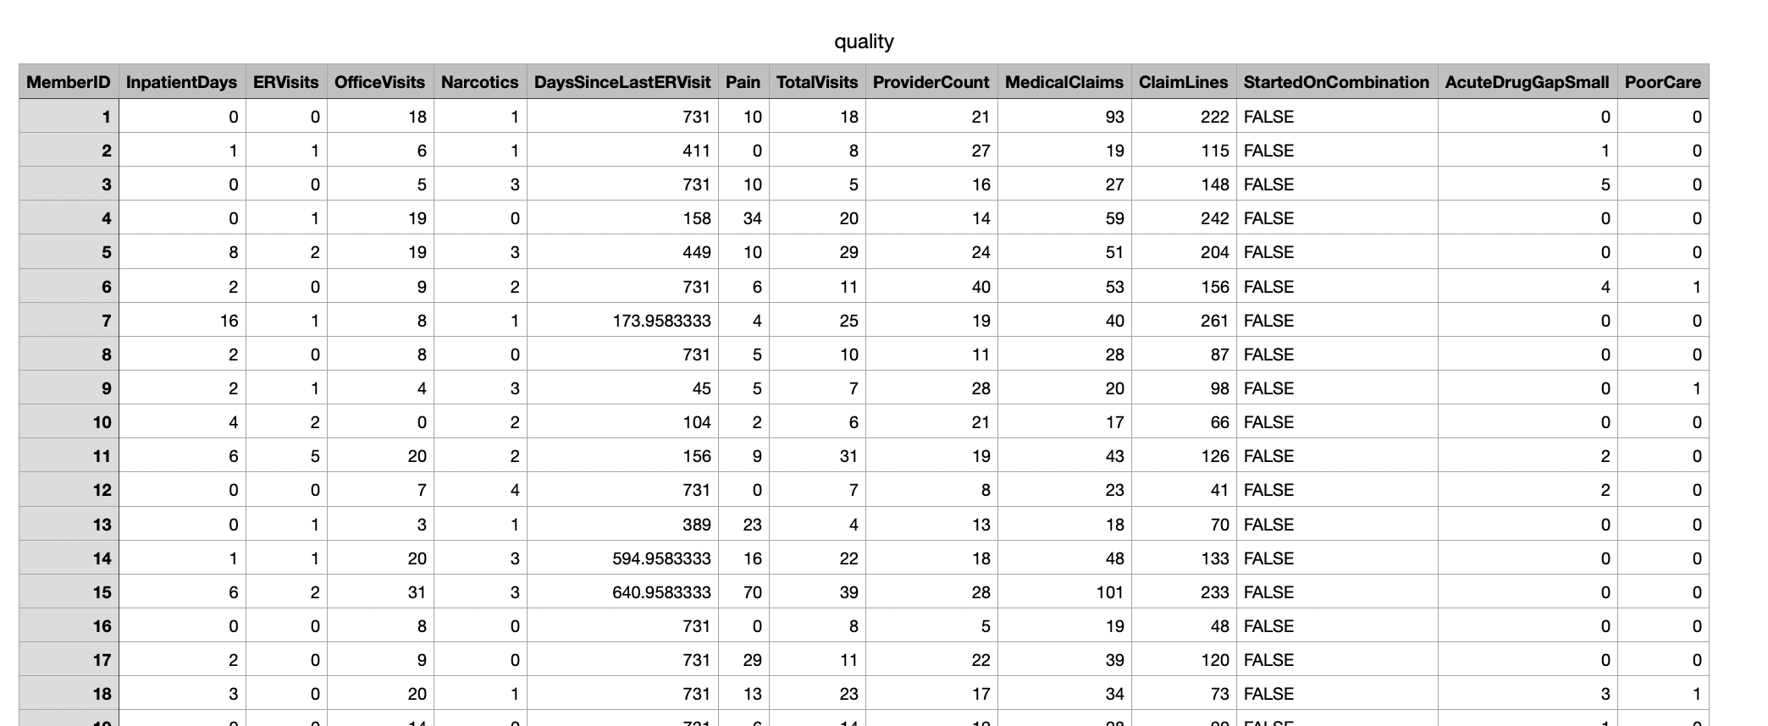
Examples
Example: quality.csv
Try to predict whether patient labeled care they received as poor or good

Slide 86
Examples
First column is an arbitrary patient ID
we make this the index
One column is a Boolean, when imported into Python
so we change it to a numeric value
df = pd.read_csv('quality.csv', sep=',', index_col=0)
df.replace({False:0, True:1}, inplace=True)

Slide 87
Examples
Farmington Heart Data Project:
https://framinghamheartstudy.org
Monitoring health data since 1948
2002 enrolled grandchildren of first study

Slide 88
Examples

Slide 89
Examples
Contains a few NaN data
We just drop them
df = pd.read_csv('framingham.csv', sep=',')
df.dropna(inplace=True)

Slide 90
Logistic Regression
in Stats-Models
Import statsmodels.api
Interactively select the columns that gives us high p-values
import statsmodels.api as sm
cols = [ 'Pain', 'TotalVisits',
'ProviderCount',
'MedicalClaims', 'ClaimLines',
'StartedOnCombination',
'AcuteDrugGapSmall',]

Slide 91
Logistic Regression
in Stats-Models
Create a logit model
Can do as we did for linear regression with a string
Can do using a dataframe syntax
Print the summary pages
logit_model=sm.Logit(df.PoorCare,df[cols])
result=logit_model.fit()
print(result.summary2())

Slide 92
Logistic Regression
in Stats-Models
Print the results
This gives the "confusion matrix"
Coefficient [i,j] gives:
predicted i values
actual j values
print(result.pred_table())

Slide 93
Logistic Regression
in Stats-Models
Quality prediction:
7 False negative and 18 false positives
[[91. 7.]
[18. 15.]]

Slide 94
Logistic Regression
in Stats-Models
Heart Event Prediction:
26 false negatives
523 false positives
[[3075. 26.]
[ 523. 34.]]

Slide 95
Logistic Regression
in Stats-Models
Can try to improve using Lasso
result=logit_model.fit_regularized()

Slide 96
Logistic Regression
in Stats-Models
Can try to improve selecting only columns with high P-values
Optimization terminated successfully.
Current function value: 0.423769
Iterations 6
Results: Logit
================================================================
Model: Logit Pseudo R-squared: 0.007
Dependent Variable: TenYearCHD AIC: 3114.2927
Date: 2020-07-12 18:18 BIC: 3157.7254
No. Observations: 3658 Log-Likelihood: -1550.1
Df Model: 6 LL-Null: -1560.6
Df Residuals: 3651 LLR p-value: 0.0019166
Converged: 1.0000 Scale: 1.0000
No. Iterations: 6.0000
----------------------------------------------------------------
Coef. Std.Err. z P>|z| [0.025 0.975]
----------------------------------------------------------------
currentSmoker 0.0390 0.0908 0.4291 0.6679 -0.1391 0.2170
BPMeds 0.5145 0.2200 2.3388 0.0193 0.0833 0.9457
prevalentStroke 0.7716 0.4708 1.6390 0.1012 -0.1511 1.6944
prevalentHyp 0.8892 0.0983 9.0439 0.0000 0.6965 1.0818
diabetes 1.4746 0.2696 5.4688 0.0000 0.9461 2.0030
totChol -0.0067 0.0007 -9.7668 0.0000 -0.0081 -0.0054
glucose -0.0061 0.0019 -3.2113 0.0013 -0.0098 -0.0024
================================================================

Slide 97
Logistic Regression
in Stats-Models
Select the columns
Get a better (?) confusion matrix:
False negatives has gone down
False positives has gone up
cols = ['currentSmoker', 'BPMeds',
'prevalentStroke', 'prevalentHyp',
'diabetes', 'totChol','glucose']
[[3086. 15.]
[ 549. 8.]]

Slide 98
Logistic Regression
in Scikit-learn
Import from sklearn
from sklearn.linear_model import LogisticRegression
from sklearn import metrics
from sklearn.metrics import confusion_matrix
from sklearn.model_selection import train_test_split
from sklearn.metrics import classification_report

Slide 99
Logistic Regression
in Scikit-learn
Create a logistic regression object and fit it on the data
logreg = LogisticRegression()
logreg.fit(X=df[cols], y = df.TenYearCHD)
y_pred = logreg.predict(df[cols])
confusion_matrix = confusion_matrix(df.TenYearCHD, y_pred)
print(confusion_matrix)

Slide 100
Logistic Regression
in Scikit-learn
Scikit-learn uses a different algorithm
Confusion matrix on the whole set is
[[3087 14]
[ 535 22]]

Slide 101
Logistic Regression
in Scikit-learn
Can also divide the set in training and test set
X_train, X_test, y_train, y_test =
train_test_split(df[cols],
df.TenYearCHD,
test_size=0.3,
random_state=0)
logreg.fit(X_train, y_train)
y_pred = logreg.predict(X_test)
confusion_matrix = confusion_matrix(y_test, y_pred)
print(confusion_matrix)

Slide 102
Logistic Regression
in Scikit-learn
Confusion matrix
[[915 1]
[176 6]]

Slide 103
Measuring Success
precision recall f1-score support
0 0.84 1.00 0.91 916
1 0.86 0.03 0.06 182
accuracy 0.84 1098
macro avg 0.85 0.52 0.49 1098
weighted avg 0.84 0.84 0.77 1098

Slide 104
Measuring Success
How can we measure accuracy?
accuracy = (fp+fn)/(tp+tn+fp+fn)
Unfortunately, because of skewed data sets, often very high
precision = tp/(tp+fp)
recall = tp/(tp+fn)
F measure = harmonic mean of precision and recall

Slide 105
Probit Regression
Instead of using the logistic function $σ$, can also use the cumulative distribution function of the normal distribution
$$\text{erf}(z)=\frac{2}{\sqrt{π}}∫_{0}^{z}exp(-t^{2})dt$$
Predictor is then
$$\frac{1}{2}\left(1+\text{erf}(b+w_{1}x_{1}+w_{2}x_{2}+…+w_{n}x_{n})\right)$$

Slide 106
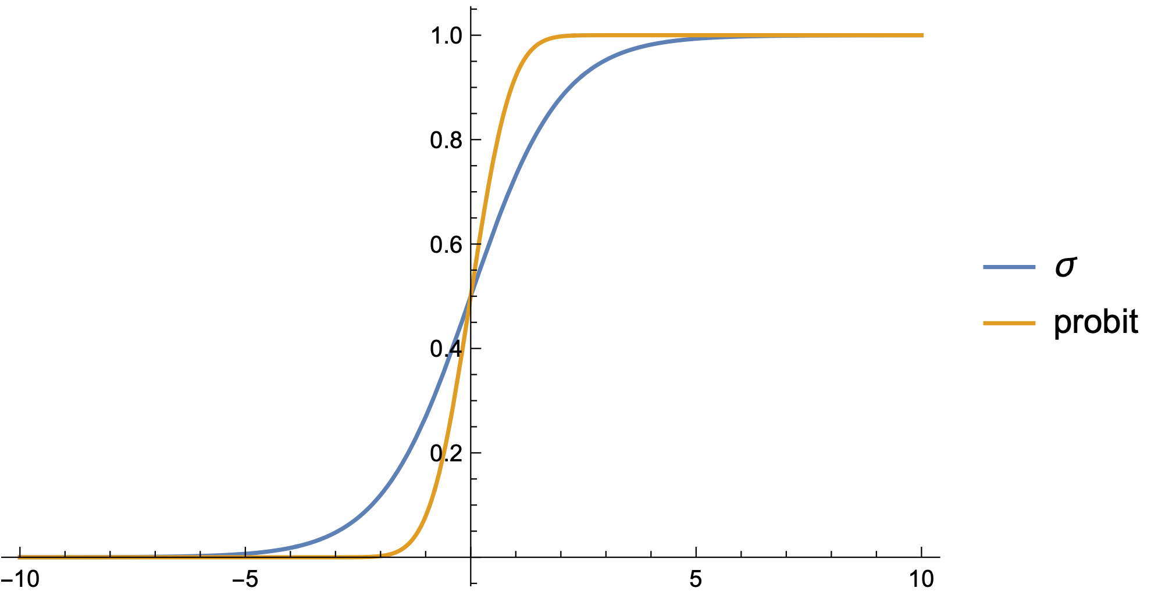
Probit Regression

Slide 107
Probit Regression
Calculations with probit are more involved
Statsmodels implements it
Fit the probit model
from statsmodels.discrete.discrete_model import Probit
probit_model=Probit(df.TenYearCHD,df[cols])
result=probit_model.fit()
print(result.summary())
print(result.pred_table())
for i in range(20):
print(df.TenYearCHD.iloc[i], result.predict(df[cols]).iloc[i])

Slide 108
Probit Regression
Confusion matrix is now
More false positives but less false negatives
[[3085. 16.]
[ 547. 10.]]

Slide 109
Multinomial Logistic Regression
Want to predict one of several categories based on feature vector
Use the softmax function $\text{softmax}\left(z_{1},z_{2},…,z_{m}\right)=\left(\frac{e^{z_{1}}}{\sum_{i=1}^{m}{e^{z_{i}}}},\frac{e^{z_{2}}}{\sum_{i=1}^{m}{e^{z_{i}}}},…,\frac{e^{z_{m}}}{\sum_{i=1}^{m}{e^{z_{i}}}}\right)$

Slide 110
Multinomial Logistic Regression
Learning is still possible, but more complicated

Slide 111
Multinomial Logistic Regression
model1 = LogisticRegression(random_state=0,
multi_class='multinomial',
penalty='none',
solver='newton-cg').fit(X_train, y_train)
preds = model1.predict(X_test)

Slide 112
Final Example
Spine data
Use explanations to give column names
Remove last column
Col1 Col2 Col3 Col4 Col5 Col6 Col7 Col8 Col9 Col10 Col11 Col12 Class_att
63.0278175 22.55258597 39.60911701 40.47523153 98.67291675 -0.254399986 0.744503464 12.5661 14.5386 15.30468 -28.658501 43.5123 Abnormal
39.05695098 10.06099147 25.01537822 28.99595951 114.4054254 4.564258645 0.415185678 12.8874 17.5323 16.78486 -25.530607 16.1102 Abnormal
68.83202098 22.21848205 50.09219357 46.61353893 105.9851355 -3.530317314 0.474889164 26.8343 17.4861 16.65897 -29.031888 19.2221 Abnormal Prediction is done by using binary classification.
69.29700807 24.65287791 44.31123813 44.64413017 101.8684951 11.21152344 0.369345264 23.5603 12.7074 11.42447 -30.470246 18.8329 Abnormal
49.71285934 9.652074879 28.317406 40.06078446 108.1687249 7.918500615 0.543360472 35.494 15.9546 8.87237 -16.378376 24.9171 Abnormal
40.25019968 13.92190658 25.1249496 26.32829311 130.3278713 2.230651729 0.789992856 29.323 12.0036 10.40462 -1.512209 9.6548 Abnormal Attribute1 = pelvic_incidence (numeric)

Slide 113
Final Example
back_data = pd.read_csv("spine.csv")
del back_data['Unnamed: 13']
back_data.columns = ['pelvic_incidence','pelvic tilt',
'lumbar_lordosis_angle','sacral_slope',
'pelvic_radius','degree_spondylolisthesis',
'pelvic_slope','Direct_tilt','thoracic_slope',
‘cervical_tilt','sacrum_angle','scoliosis_slope',
‘Status']
print(back_data.Status.describe())

Slide 114
Final Example
Can also change the values of Status Column to 0 or 1
back_data.loc[back_data.Status=='Abnormal','Status'] = 1
back_data.loc[back_data.Status=='Normal','Status'] = 0
X = back_data.iloc[:, :12]
y = back_data.iloc[:, 12]

Slide 115
Final Example
First task:
Are any of the columns strongly correlated?
Otherwise, model would have difficulties
Create a seaborn heatmap of the correlation
corr_back = back_data.corr()
sns.heatmap(corr_back, center=0, square=True, linewidths=.5)

Slide 116
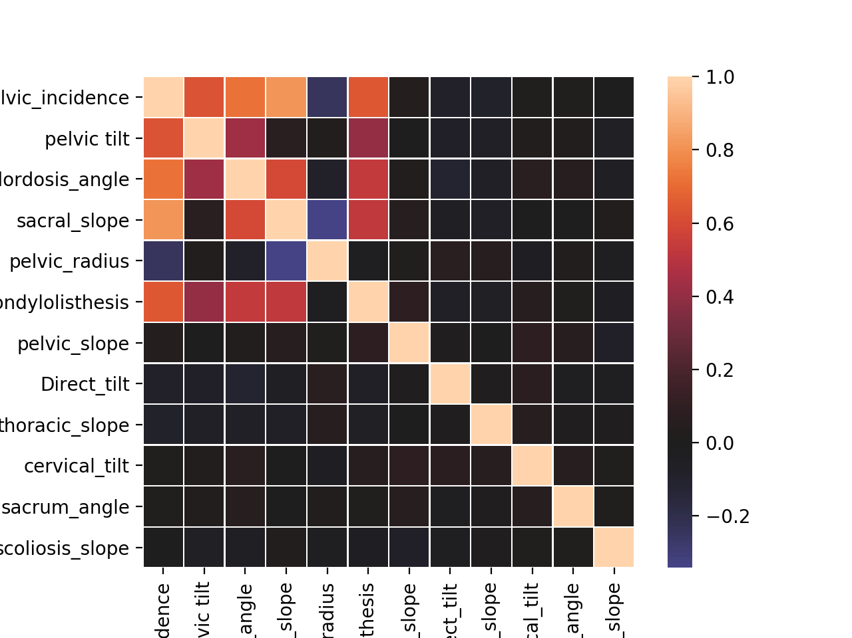
Final Example

Slide 117
Final Example
We now see whether the values differ between normal and abnormal spines:
for x in back_data.columns[:-1]:
print(x, back_data.groupby(‘Status').mean()[x])
for x in back_data.columns[:-1]:
print(x, back_data.groupby(‘Status').median()[x])

Slide 118
Final Example
Can also use a box plot to see the difference
fig, axes = plt.subplots(3, 4, figsize = (15,15))
axes = axes.flatten()
for i in range(0,len(back_data.columns)-1):
sns.boxplot(x="Status", y=back_data.iloc[:,i],
data=back_data, orient='v', ax=axes[i])
plt.tight_layout()
plt.show()

Slide 119
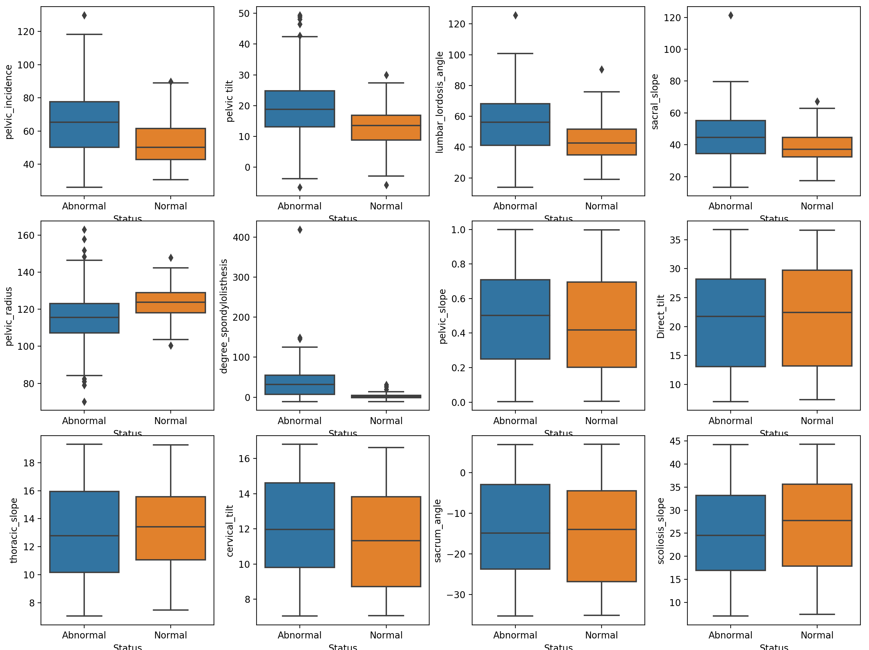
Final Example

Slide 120
Final Example
Need to create training set and test set
Need to scale:
Mean is set to 0
StDev is set to 1
Can be done with
sklearn.preprocessing.StandardScaler

Slide 121
Final Example
def data_preprocess(X,y):
X_train, X_test, y_train,
y_test = train_test_split(X, y.values.ravel(),
test_size=0.3,
random_state=0)
from sklearn.preprocessing import StandardScaler
scaler = StandardScaler(copy=True,
with_mean=True,
with_std=True)
scaler.fit(X_train)
train_scaled = scaler.transform(X_train)
test_scaled = scaler.transform(X_test)
return(train_scaled, test_scaled, y_train, y_test)

Slide 122
Final Example
We use the logistic regression model from sklearn
from sklearn.linear_model import LogisticRegression
X_train_scaled, X_test_scaled, y_train, y_test = data_preprocess(X,y)
logreg = LogisticRegression().fit(X_train_scaled, y_train)
logreg_result = logistic_regression(X_train_scaled, y_train)
logreg = LogisticRegression().fit(x, y)

Slide 123
Final Example
We can now read the results:
logreg_result.score(X_train_scaled,y_train)
Training set score: 0.876
logreg_result.score(X_test_scaled,y_test)
Test set score: 0.817

Slide 124
Final Example
To see what influence variables have, we use statsmodels
X_train_scaled, X_test_scaled, y_train, y_test = data_preprocess(X,y)
logit_model = sm.Logit(y_train, X_train_scaled)
result = logit_model.fit()
print(result.summary2())

Slide 125
Final Example
Results: Logit
=====================================================================
Model: Logit Pseudo R-squared: 0.248
Dependent Variable: y AIC: 229.3058
Date: 2020-11-19 18:19 BIC: 269.8646
No. Observations: 217 Log-Likelihood: -102.65
Df Model: 11 LL-Null: -136.45
Df Residuals: 205 LLR p-value: 3.4943e-10
Converged: 0.0000 Scale: 1.0000
No. Iterations: 35.0000
---------------------------------------------------------------------
Coef. Std.Err. z P>|z| [0.025 0.975]
---------------------------------------------------------------------
x1 0.0814 11580039.8359 0.0000 1.0000 -22696460.9366 22696461.0993
x2 0.0765 6600560.9760 0.0000 1.0000 -12936861.7142 12936861.8673
x3 -0.2797 0.3142 -0.8904 0.3733 -0.8955 0.3361
x4 -0.5412 9111339.5243 -0.0000 1.0000 -17857897.8597 17857896.7773
x5 -1.1234 0.2351 -4.7773 0.0000 -1.5842 -0.6625
x6 2.3250 0.4401 5.2832 0.0000 1.4625 3.1875
x7 0.1711 0.1790 0.9561 0.3390 -0.1797 0.5220
x8 -0.2115 0.1770 -1.1950 0.2321 -0.5583 0.1354
x9 0.0724 0.1738 0.4166 0.6770 -0.2683 0.4131
x10 0.2003 0.1772 1.1301 0.2584 -0.1471 0.5476
x11 -0.1042 0.1804 -0.5778 0.5634 -0.4578 0.2493
x12 -0.2749 0.1764 -1.5579 0.1193 -0.6207 0.0709
=====================================================================

Slide 126
Final Example
There was no convergence, meaning that there was some high correlation between variables
Pelvic Incidence column is sum of Pelvic Tilt and Sacral Slope
Let’s remove these
And run again
cols_to_include = [cols for cols in X.columns
if cols not in
['pelvic_incidence', 'pelvic tilt','sacral_slope']]
X = back_data[cols_to_include]

Slide 127
Final Example
Optimization terminated successfully.
Current function value: 0.481933
Iterations 7
Results: Logit
=================================================================
Model: Logit Pseudo R-squared: 0.234
Dependent Variable: y AIC: 227.1591
Date: 2020-11-19 18:23 BIC: 257.5781
No. Observations: 217 Log-Likelihood: -104.58
Df Model: 8 LL-Null: -136.45
Df Residuals: 208 LLR p-value: 8.5613e-11
Converged: 1.0000 Scale: 1.0000
No. Iterations: 7.0000
--------------------------------------------------------------------
Coef. Std.Err. z P>|z| [0.025 0.975]
--------------------------------------------------------------------
x1 -0.5434 0.2568 -2.1158 0.0344 -1.0468 -0.0400
x2 -0.9642 0.2080 -4.6364 0.0000 -1.3719 -0.5566
x3 2.2963 0.4142 5.5443 0.0000 1.4846 3.1081
x4 0.1499 0.1771 0.8464 0.3974 -0.1972 0.4971
x5 -0.2442 0.1738 -1.4047 0.1601 -0.5849 0.0965
x6 0.0640 0.1732 0.3694 0.7118 -0.2754 0.4034
x7 0.2068 0.1747 1.1841 0.2364 -0.1355 0.5491
x8 -0.1183 0.1777 -0.6660 0.5054 -0.4666 0.2299
x9 -0.2872 0.1736 -1.6547 0.0980 -0.6274 0.0530
=================================================================

Slide 128
Final Example
We concentrate on those variables with a low P-value:
--------------------------------------------------------------------
Coef. Std.Err. z P>|z| [0.025 0.975]
--------------------------------------------------------------------
x1 -0.5434 0.2568 -2.1158 0.0344 -1.0468 -0.0400
x2 -0.9642 0.2080 -4.6364 0.0000 -1.3719 -0.5566
x3 2.2963 0.4142 5.5443 0.0000 1.4846 3.1081
x4 0.1499 0.1771 0.8464 0.3974 -0.1972 0.4971
x5 -0.2442 0.1738 -1.4047 0.1601 -0.5849 0.0965
x6 0.0640 0.1732 0.3694 0.7118 -0.2754 0.4034
x7 0.2068 0.1747 1.1841 0.2364 -0.1355 0.5491
x8 -0.1183 0.1777 -0.6660 0.5054 -0.4666 0.2299
x9 -0.2872 0.1736 -1.6547 0.0980 -0.6274 0.0530
=================================================================

Slide 129
Final Example
X_trim_1 = X.loc[:,['lumbar_lordosis_angle’,
'pelvic_radius',
'degree_spondylolisthesis']]
X_train_scaled, X_test_scaled, y_train, y_test = data_preprocess(X_trim_1,y)
logit_model = sm.Logit(y_train, X_train_scaled)
result = logit_model.fit()
print(result.summary2())

Slide 130
Final Example
=====================================
Optimization terminated successfully.
Current function value: 0.498420
Iterations 7
Results: Logit
=================================================================
Model: Logit Pseudo R-squared: 0.207
Dependent Variable: y AIC: 222.3145
Date: 2020-11-19 18:30 BIC: 232.4542
No. Observations: 217 Log-Likelihood: -108.16
Df Model: 2 LL-Null: -136.45
Df Residuals: 214 LLR p-value: 5.1622e-13
Converged: 1.0000 Scale: 1.0000
No. Iterations: 7.0000
--------------------------------------------------------------------
Coef. Std.Err. z P>|z| [0.025 0.975]
--------------------------------------------------------------------
x1 -0.4688 0.2426 -1.9325 0.0533 -0.9443 0.0067
x2 -0.9188 0.2037 -4.5100 0.0000 -1.3181 -0.5195
x3 2.1897 0.3937 5.5626 0.0000 1.4182 2.9613
=================================================================

Slide 131
Final Example
Some improvement in scores:
Training set score: 0.857
Test set score: 0.774

