Slide 1
Data Visualization

Slide 2
Basics
Use matplotlib.pyplot
Based on matlab
Allows
histograms
line plots
box-plots
scatter plots
hex-density plots

Slide 3
Basics
Import numpy as np
Import pandas as pd
Import matplotlib.pyplot as plt

Slide 4
Basic Example
Import an artificial time series
Show it:
>>> ts1 = pd.read_csv('../Data/ts1.csv')
>>> ts1.info()
<class 'pandas.core.frame.DataFrame'>
RangeIndex: 5000 entries, 0 to 4999
Data columns (total 2 columns):
time 5000 non-null int64
TS 5000 non-null float64
dtypes: float64(1), int64(1)
memory usage: 78.2 KB

Slide 5
Basic Example
Use head and tail
To make it more realistic, we need to make the index into one with actual dates
Drop the column 'time'
We want to change the data frame, so we need to set inplace to True
ts1.head()
ts1.tail()

Slide 6
Basic Example
>>> ts1.drop(columns=['time'], inplace=True)
>>> ts1.head()
TS
0 1027.096129
1 1041.701344
2 1046.905793
3 1038.360279
4 1033.118933
Create a new column with dates starting at January 1, 2001.
Use Bing to Google the name of the function:
>>> ts1['time'] = pd.date_range(start='1/1/2001', periods = 5000)

Slide 7
Basic Example
We still have an index, but now a new column
>>> ts1['time'] = pd.date_range(start='1/1/2001', periods=5000)
>>> ts1.head()
TS time
0 1027.096129 2001-01-01
1 1041.701344 2001-01-02
2 1046.905793 2001-01-03
3 1038.360279 2001-01-04
4 1033.118933 2001-01-05

Slide 8
Basic Example
Now we can re-index by setting the index
>>> ts1.set_index('time', inplace = True)
>>> ts1.info()
<class 'pandas.core.frame.DataFrame'>
DatetimeIndex: 5000 entries, 2001-01-01 to 2014-09-09
Data columns (total 1 columns):
TS 5000 non-null float64
dtypes: float64(1)
memory usage: 78.1 KB
>>> ts1.head()
TS
time
2001-01-01 1027.096129
2001-01-02 1041.701344

Slide 9
Basic Example
If we try to only access the TS data, we run into a problem
>>> ts1.TS
Traceback (most recent call last):
File "<pyshell#73>", line 1, in <module>
ts1.TS
File "/Library/Frameworks/Python.framework/Versions/3.8/lib/python3.8/site-packages/pandas/core/generic.py", line 5179, in __getattr__
return object.__getattribute__(self, name)
AttributeError: 'DataFrame' object has no attribute 'TS'

Slide 10
Basic Example
We can look at the columns of the data frame
And now we see the problem (cost me about an hour of my life)
The csv file has an additional white space after the comma
>>> ts1.columns
Index([' TS'], dtype='object')
>>> ts1.columns
Index([' TS'], dtype='object')

Slide 11
Basic Example
We better rename that column
>>> ts1.rename(columns={' TS': 'TS'}, inplace = True)
>>> ts1.TS
time
2001-01-01 1027.096129
2001-01-02 1041.701344
2001-01-03 1046.905793
2001-01-04 1038.360279
2001-01-05 1033.118933
...
2014-09-05 1019.451193
2014-09-06 1017.043391
2014-09-07 1046.658204
2014-09-08 1030.316278
2014-09-09 1044.078304
Name: TS, Length: 5000, dtype: float64
[5000 rows x 1 columns]

Slide 12
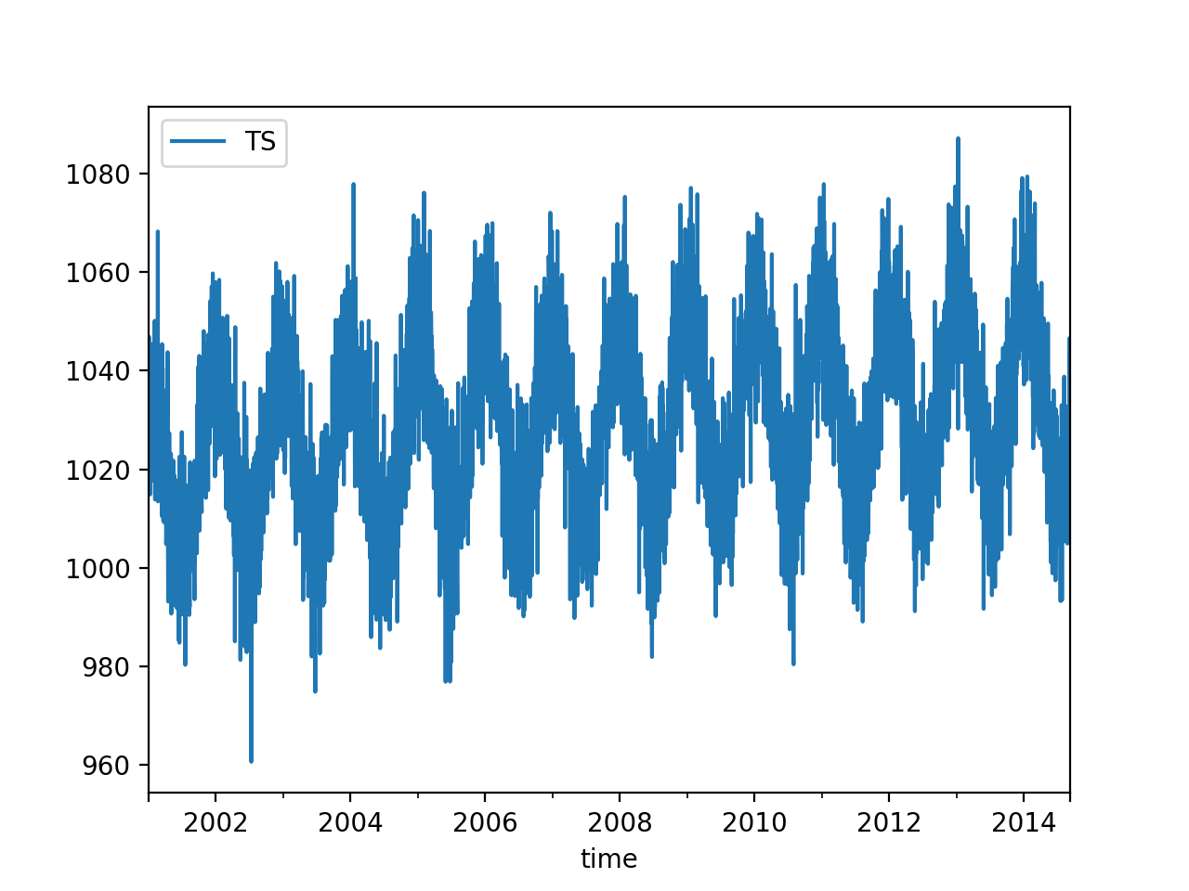
Basic Example
We can now use the plotting component of Pandas
ts1.plot()
plt.show()

Slide 13
Basic Example
We can also do a scatter graph
But this needs to be specialized because scatter graphs usually need two numeric values
plt.plot_date(ts1.index, ts1.TS)

Slide 14
Basic Example
Let's see whether we can make the line plot clearer
Use curve smoothing
Can use rolling, then mean, then plot
>>> ts1.rolling(10).mean().plot()
<matplotlib.axes._subplots.AxesSubplot object at 0x7fbb221e1be0>
>>> plt.show()

Slide 15
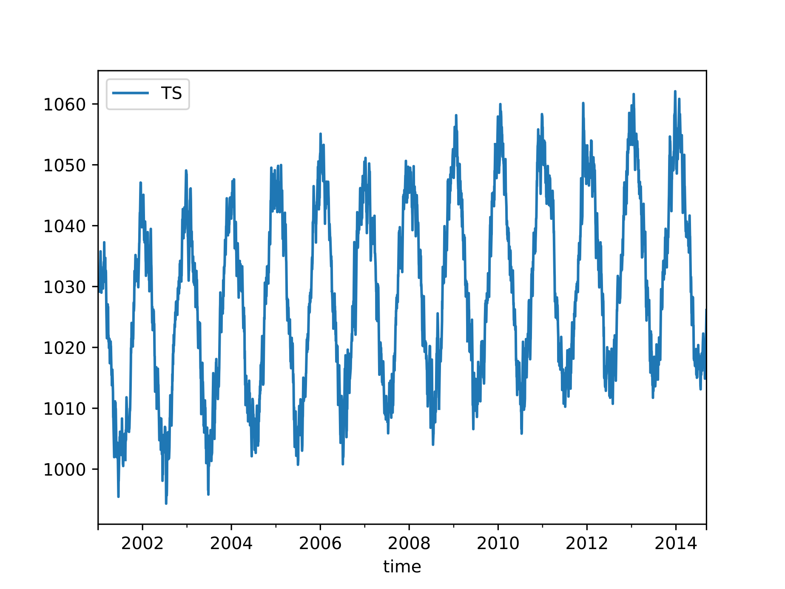
Basic Example
rolling window 10

Slide 16
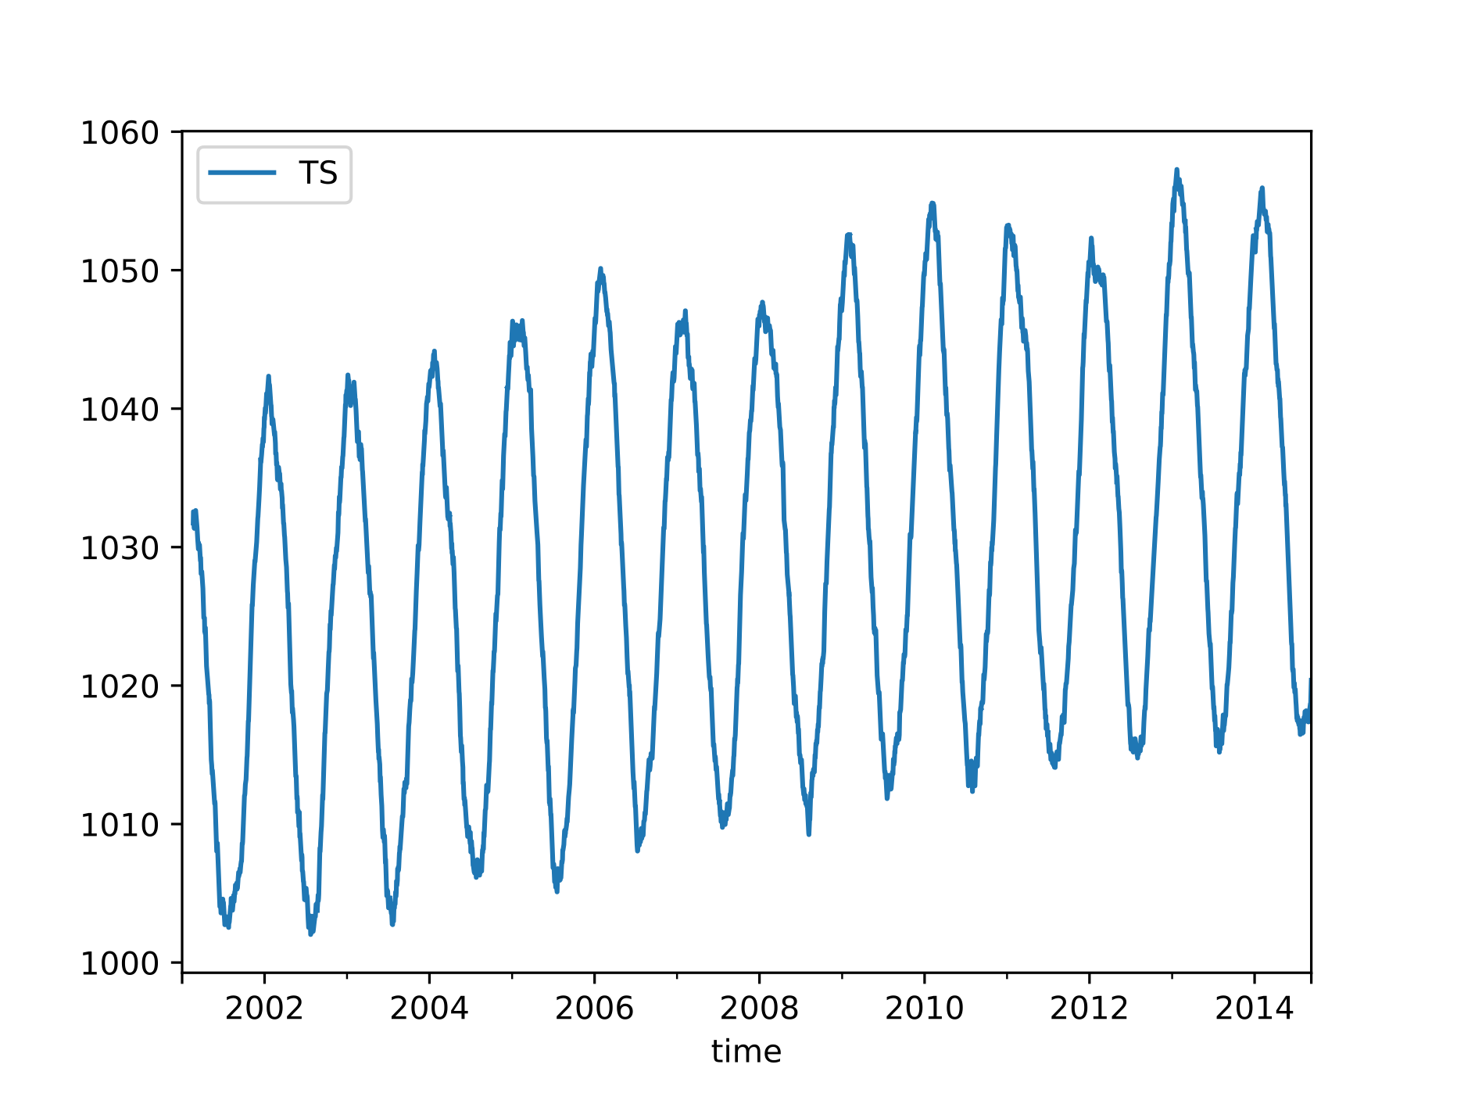
Basic Example
rolling window 50

Slide 17
Basic Example
While rolling takes all observations in the window at the same value, we can also use exponential weighted windows
ts1.ewm(span=10).mean().plot()

Slide 18
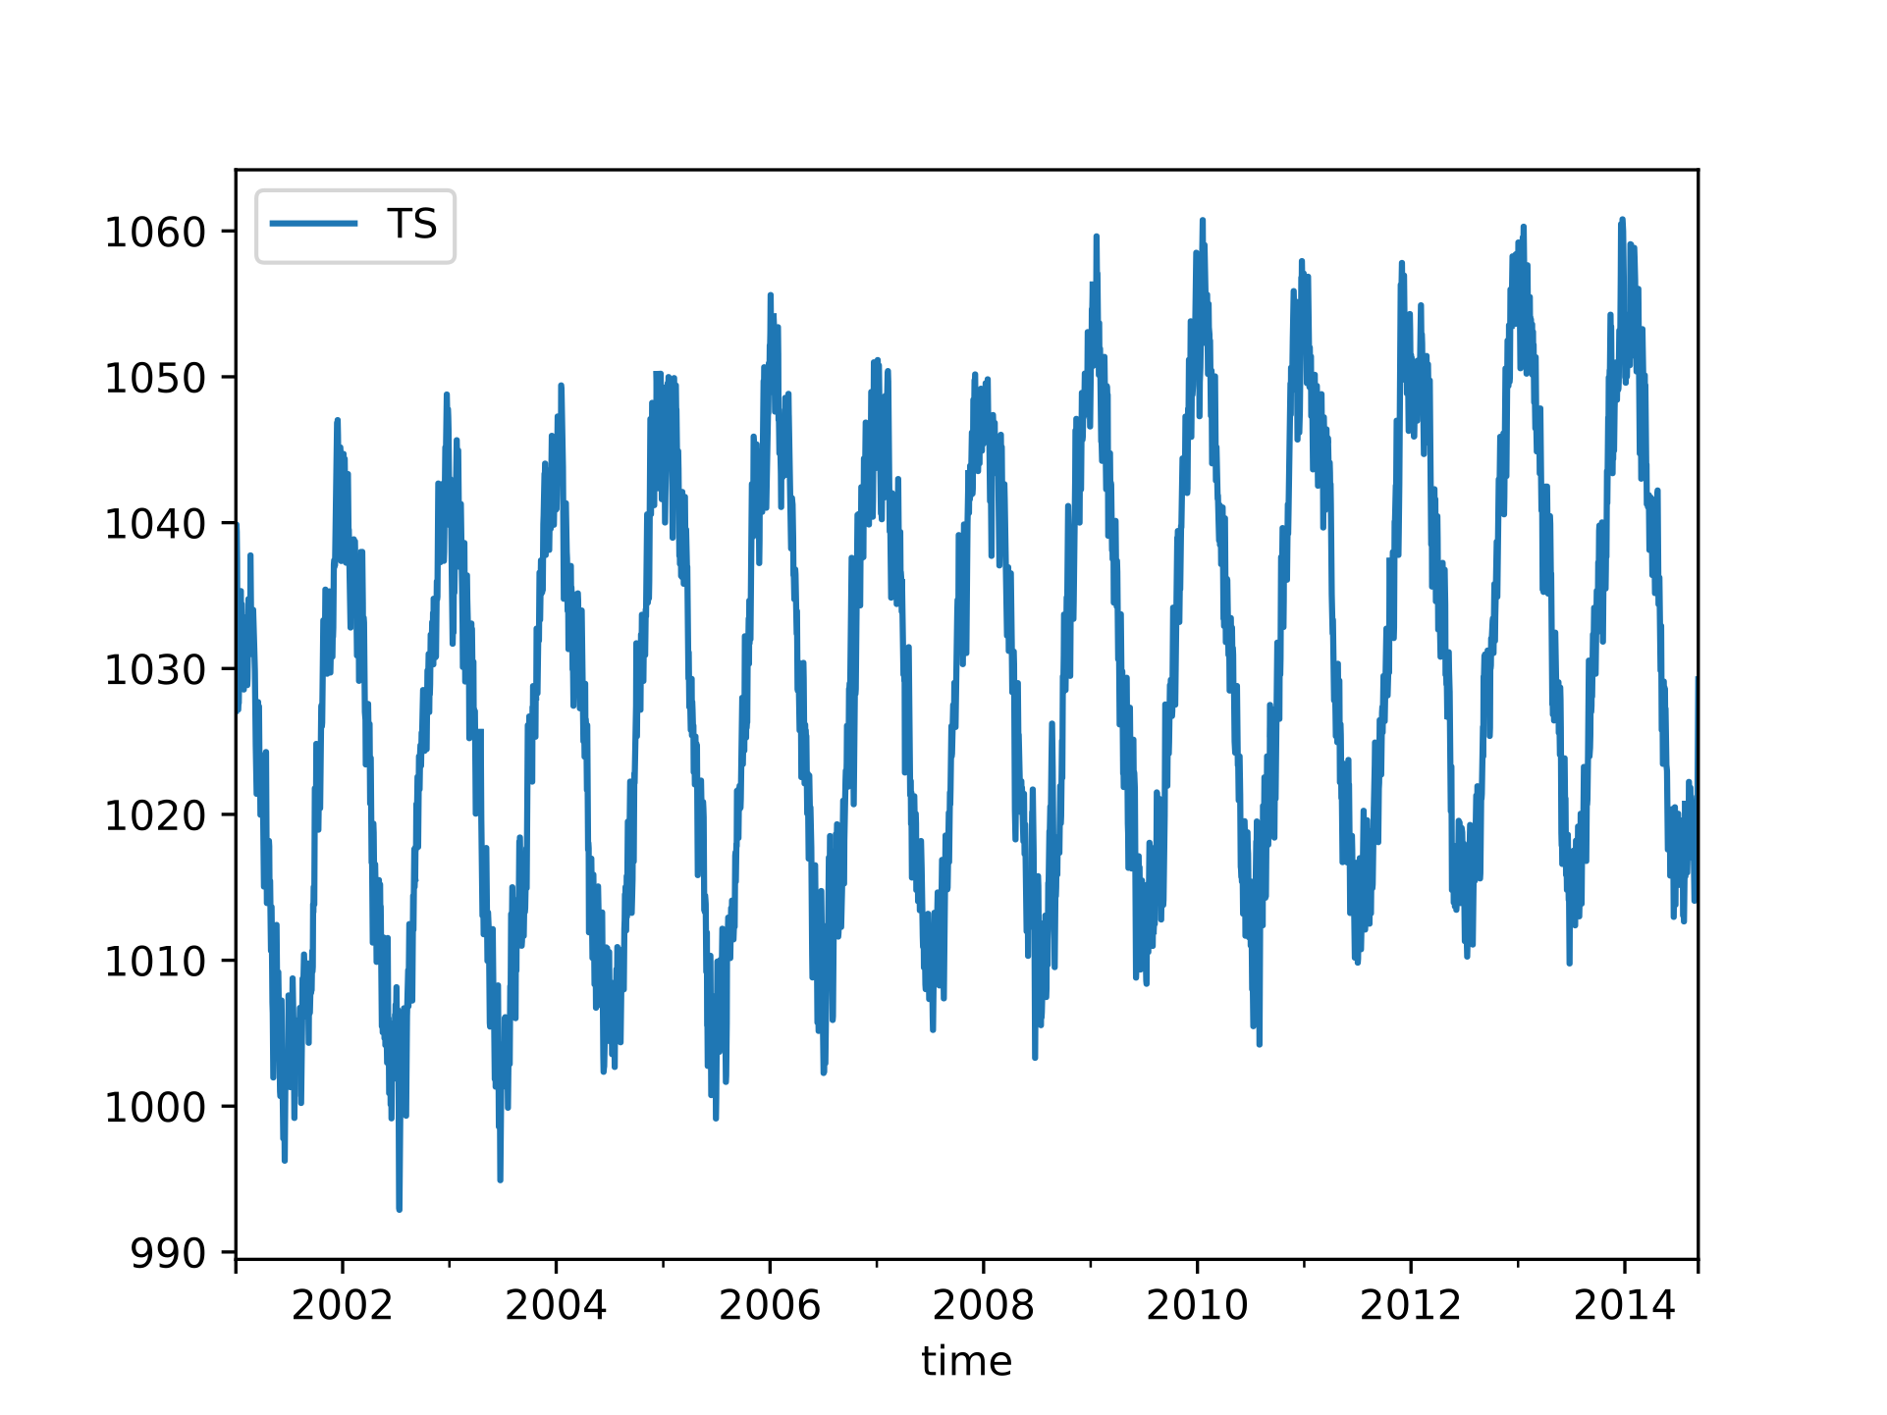
Basic Example
window size 10

Slide 19
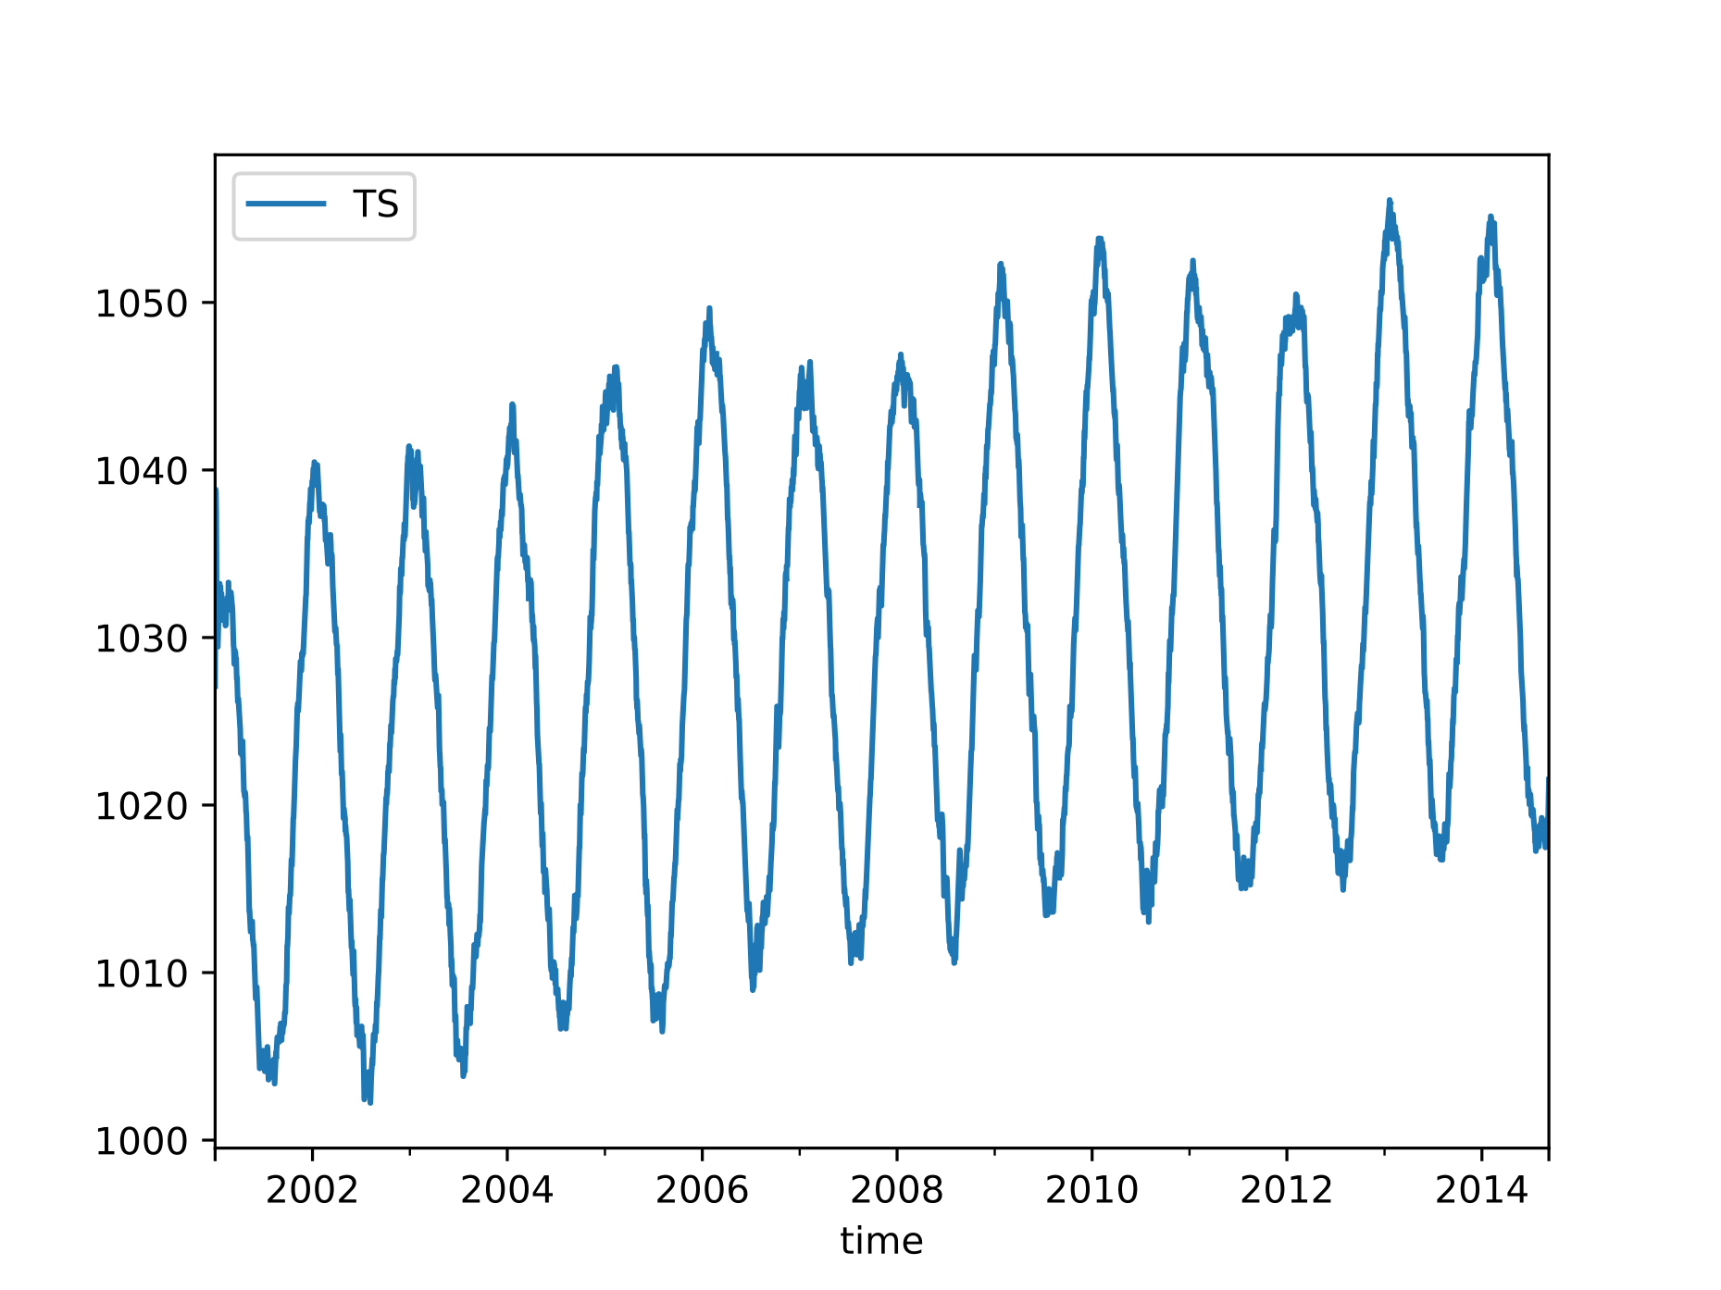
Basic Example
window size 50

Slide 20
Fundamentals
The basic plotting tool is still matplotlib
It can be wrapped by
Pandas
Seaborn ggplot
Holoview

Slide 21
Fundamentals
Importing
Just as np from numpy and pd for pandas, we use traditional shortcuts
Usually only need the latter
import matplotlib as mpl
import matplotlib.pyplot as plt

Slide 22
Fundamentals
We can pick style
We can find styles with
plt.style.use('classic')
plt.style.available
['seaborn-dark', 'seaborn-darkgrid', 'seaborn-ticks', 'fivethirtyeight', 'seaborn-whitegrid', 'classic', '_classic_test', 'fast', 'seaborn-talk', 'seaborn-dark-palette', 'seaborn-bright', 'seaborn-pastel', 'grayscale', 'seaborn-notebook', 'ggplot', 'seaborn-colorblind', 'seaborn-muted', 'seaborn', 'Solarize_Light2', 'seaborn-paper', 'bmh', 'tableau-colorblind10', 'seaborn-white', 'dark_background', 'seaborn-poster', 'seaborn-deep']

Slide 23
Fundamentals
Plotting from a script
Use plt.show( )
Interacts with the system
Results are system dependent
plt.show( ) does a lot in the background
should only be run once in a script

Slide 24
Fundamentals
Plotting from a notebook
Use matplotlib inline
Creates a new cell to embed any png created with plt.plot()

Slide 25
Fundamentals
Saving figures to files
Use fig.savefig(address )
File format is inferred from file extension

Slide 26
Fundamentals
Two interfaces:
MATLAB style interface
Best for relatively simple plots
Keeps track of all figure elements
Object oriented interface
Create figures and "axes"
Use method calls

Slide 27
Fundamentals
Example:
MATLAB interface
x = np.linspace(-1,10)
plt.figure( ) #create figure
plt.subplot(1,2,1) #rows columns panel number
plt.plot(x, np.sin(x))
plt.subplot(1,2,2)
plt.plot(x, np.cos(x))

Slide 28
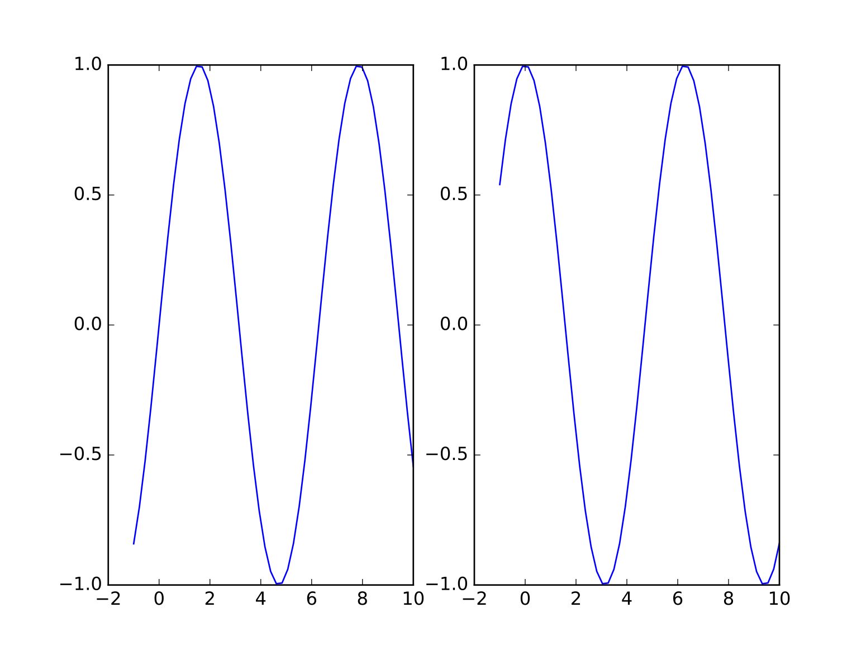
Fundamentals

Slide 29
Fundamentals
OO interface
Figure : single container with potentially many axes
Axes : bounding box with many elements
Axis, Tick, Line2D, Text, Polygon
fig, ax = plt.subplots(ncols=2)
ax[0].plot(x, np.sin(x))
ax[1].plot(x, np.cos(x))

Slide 30
Simple Line Plots
Define a Figure and an Axes object
Create an array of x values [0., 0.01, 0.02, 0.03, 0.04, … ]
Create an array of y values
plt.style.use('seaborn-whitegrid')
fig = plt.figure
ax = plt.axes()
x = np.linspace(0,10, 1000)
ax.plot(x, (x**2+1)/(x**2+x+1))

Slide 31
Simple Line Plots
Line colors
colors have
names,
abbreviations (rgbcmyk),
Grayscales between 0 and 1
Hexcodes (RRGGBB) between 00 and FF
RGB tuples with values between 0 and 1
HTML color names

Slide 32
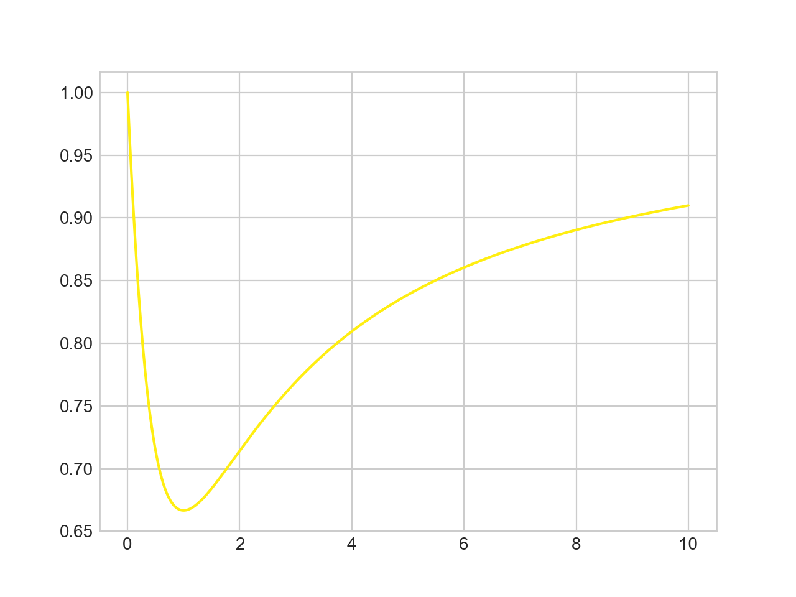
Simple Line Plots
x = np.linspace(0,10, 1001)
ax.plot(x, (x**2+1)/(x**2+x+1), color = '#FFEE11')

Slide 33
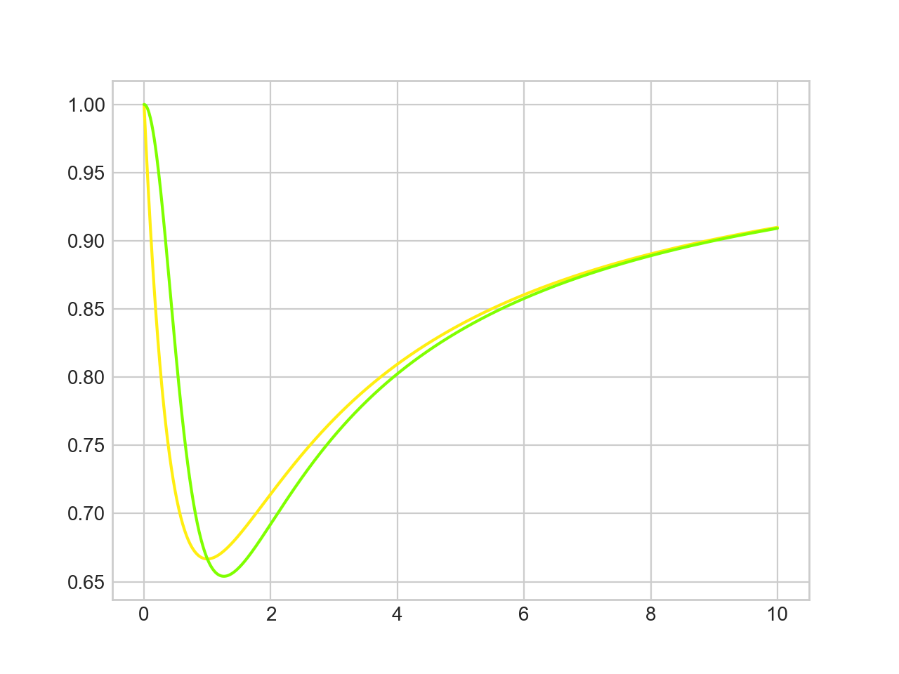
Simple Line Plots
x = np.linspace(0,10, 1001)
ax.plot(x, (x**2+1)/(x**2+x+1), color = '#FFEE11')
ax.plot(x, (x**3+1)/(x**3+x**2+1), color = 'chartreuse')

Slide 34
Simple Line Plots
Line Styles
'solid', 'dashed', 'dashdot' 'dotted'
Abbreviated as
'-', '- -', '-.', ':'

Slide 35
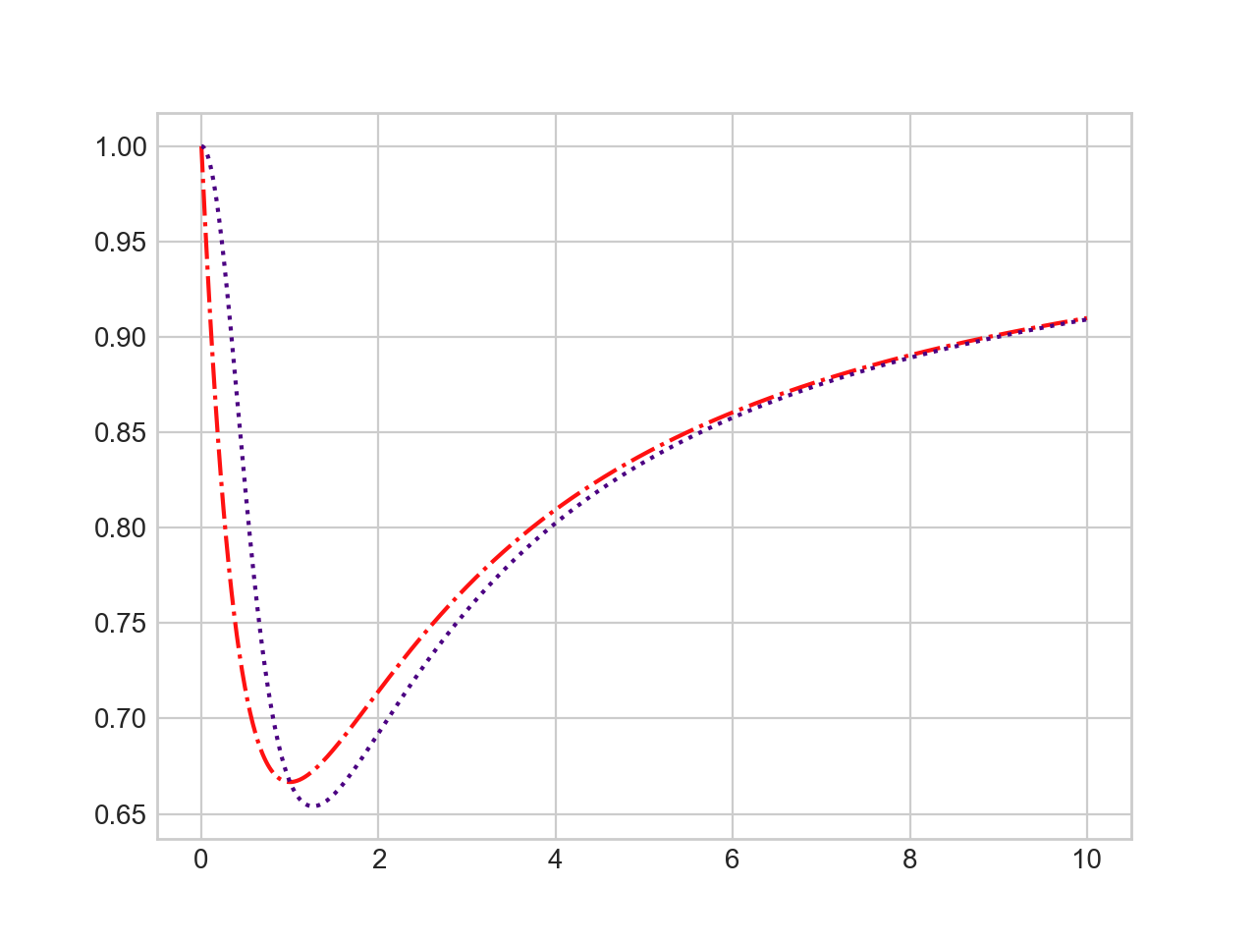
Simple Line Plots
ax.plot(x, (x**2+1)/(x**2+x+1), color = '#FF1111', linestyle='dashdot')
ax.plot(x, (x**3+1)/(x**3+x**2+1), color = 'indigo', linestyle = ':')

Slide 36
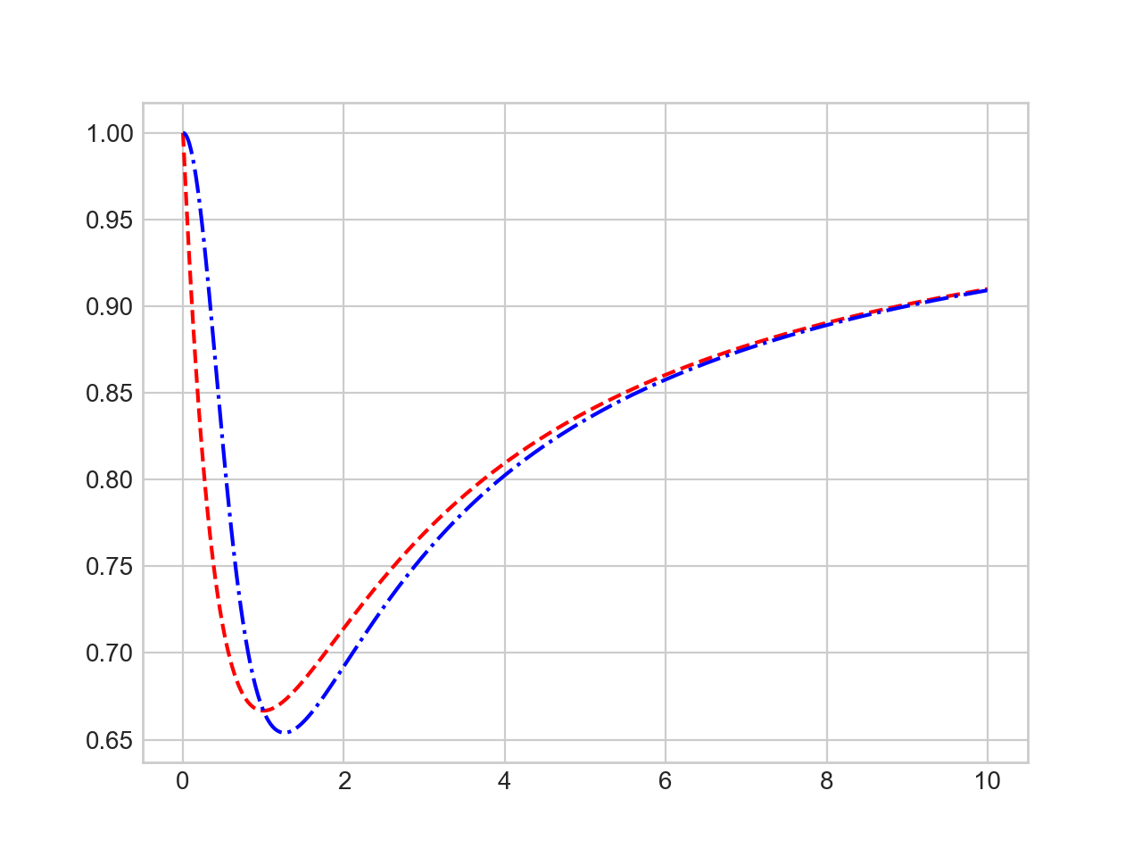
Simple Line Plots
These can also be combined
ax.plot(x, (x**2+1)/(x**2+x+1), 'r--')
ax.plot(x, (x**3+1)/(x**3+x**2+1), 'b-.')

Slide 37
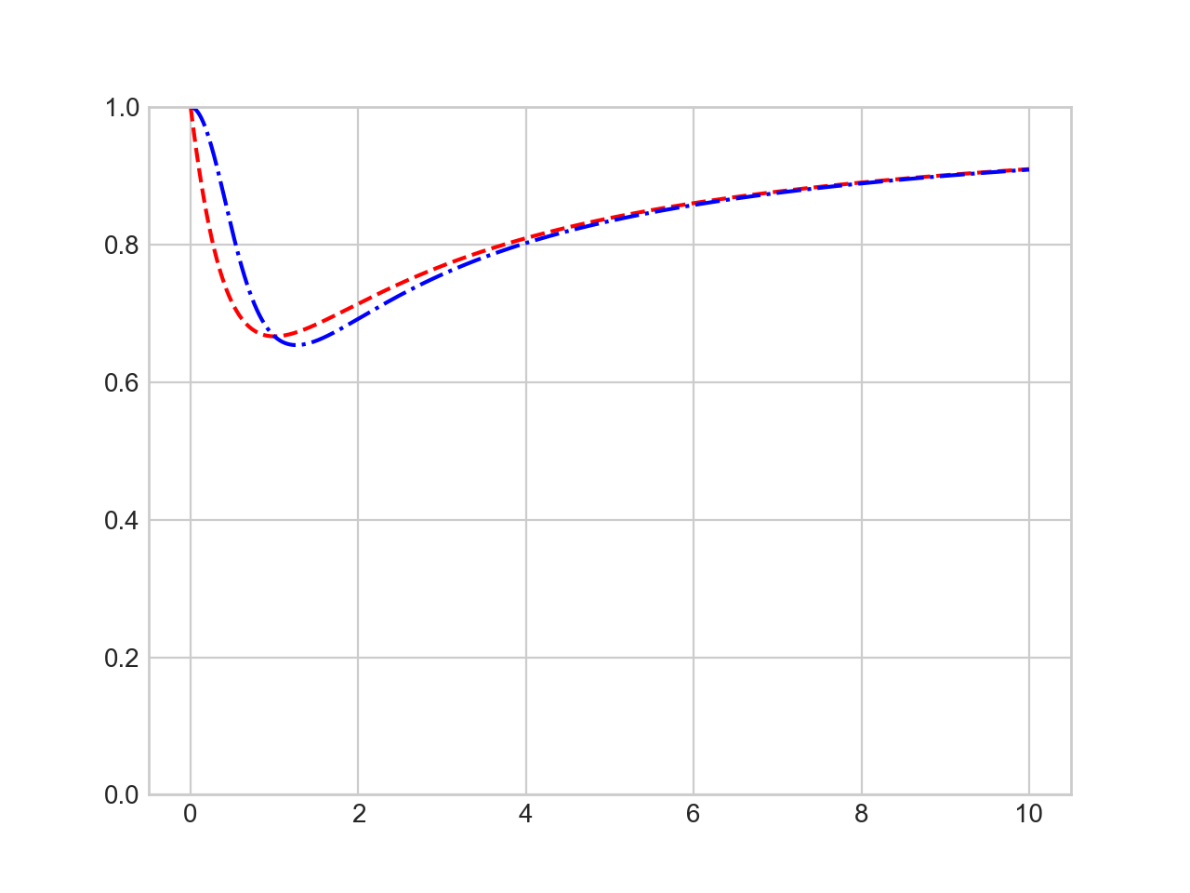
Simple Line Plots
Axes Limits for finer control
set xlim, ylim
plt.ylim(0,1)
ax.plot(x, (x**2+1)/(x**2+x+1), 'r--')
ax.plot(x, (x**3+1)/(x**3+x**2+1), 'b-.')

Slide 38
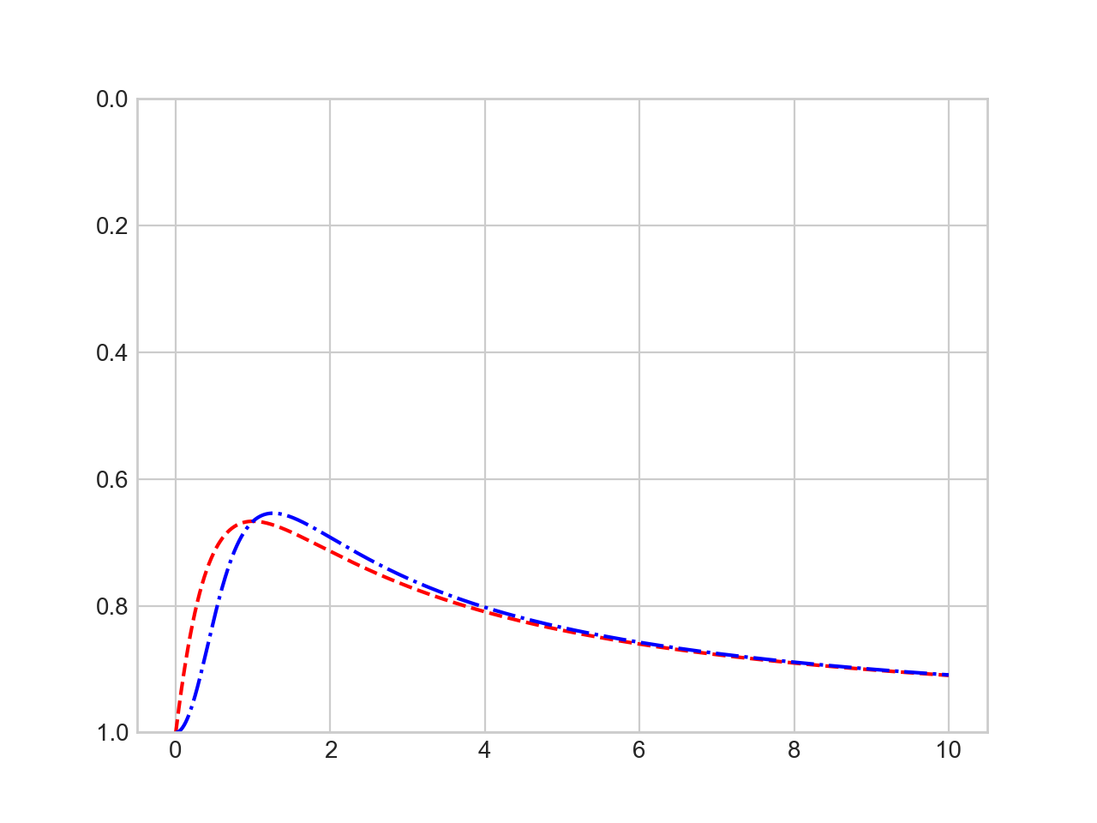
Simple Line Plots
You can even revert an axis
plt.ylim(1,0)
ax.plot(x, (x**2+1)/(x**2+x+1), 'r--')
ax.plot(x, (x**3+1)/(x**3+x**2+1), 'b-.')

Slide 39
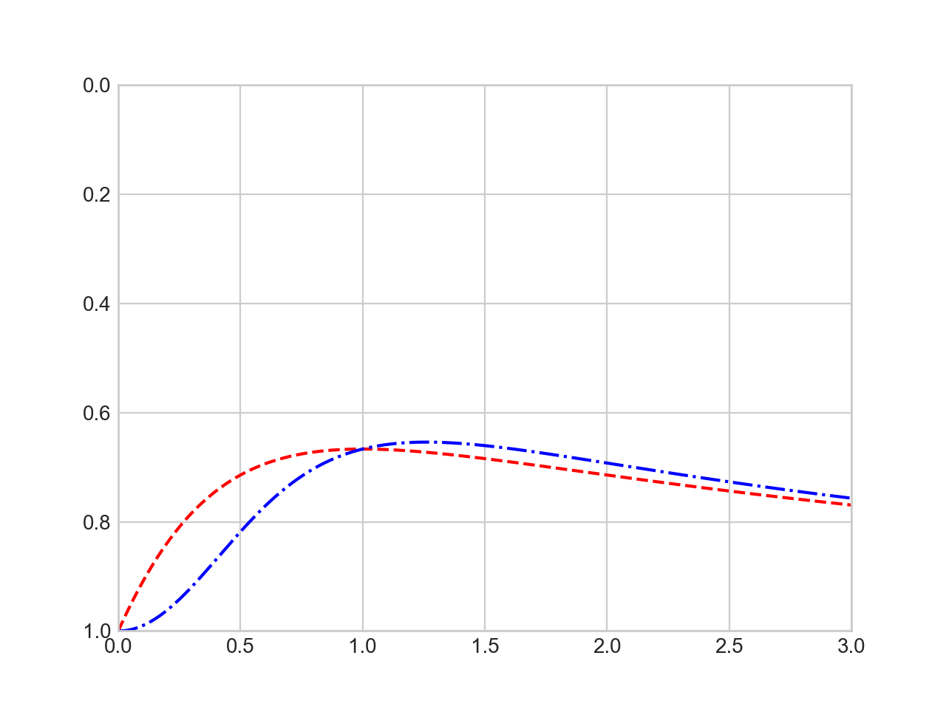
Simple Line Plots
You can set all axes with the confusingly named axis method
plt.axis([0,3,1,0])

Slide 40
Simple Line Plots
plt.axis actually allow even more plot control
'tight' to tighten bounds around current plot
''equal' for equal aspect ratio

Slide 41
Simple Line Plots
Plot axes can be labeled
fig = plt.figure
ax = plt.axes()
x = np.linspace(0,10, 1001)
plt.axis([0,3,0.5,1], 'tight')
plt.xlabel('t')
plt.ylabel('f(t)')
ax.plot(x, (x**2+1)/(x**2+x+1), 'r--')
ax.plot(x, (x**3+1)/(x**3+x**2+1), 'b-.')

Slide 42
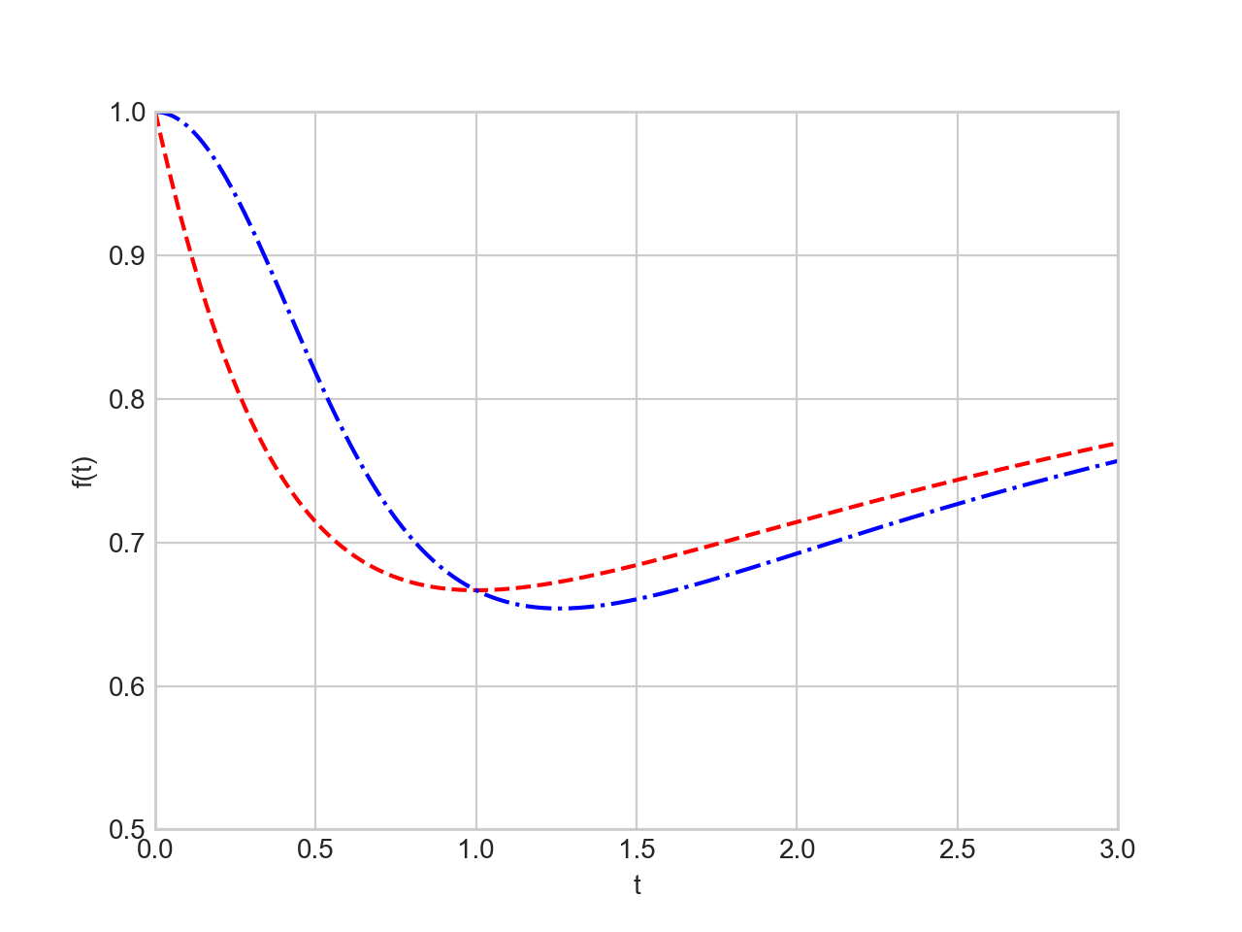
Simple Line Plots

Slide 43
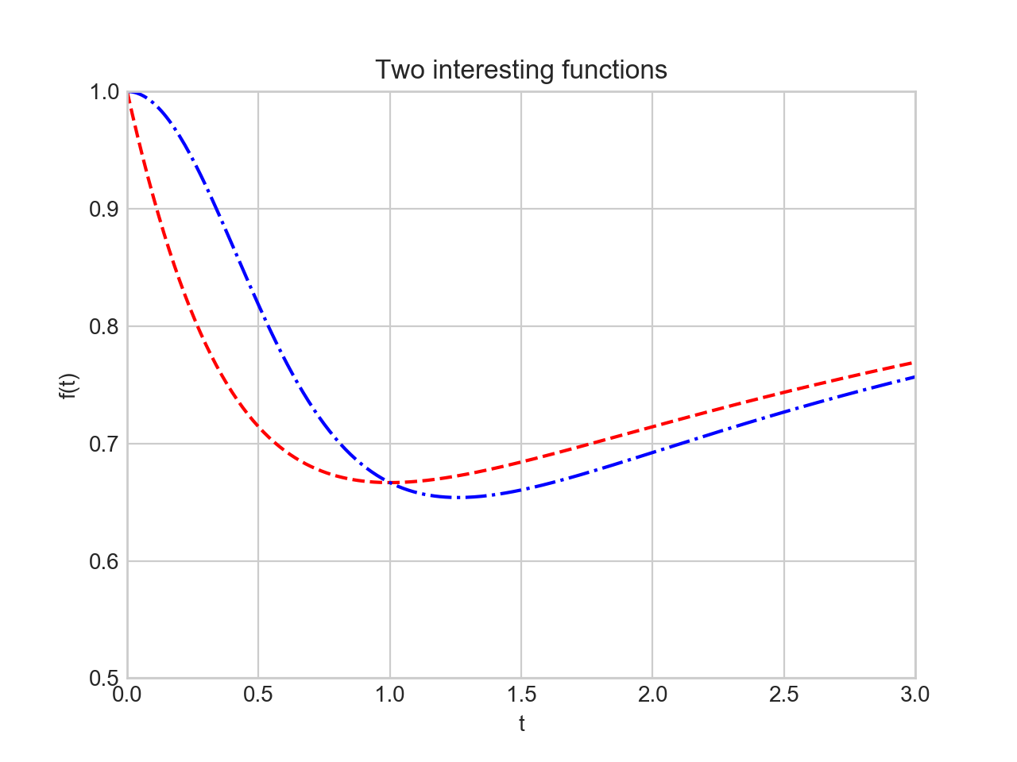
Simple Line Plots
We label a plot with plt.title

Slide 44
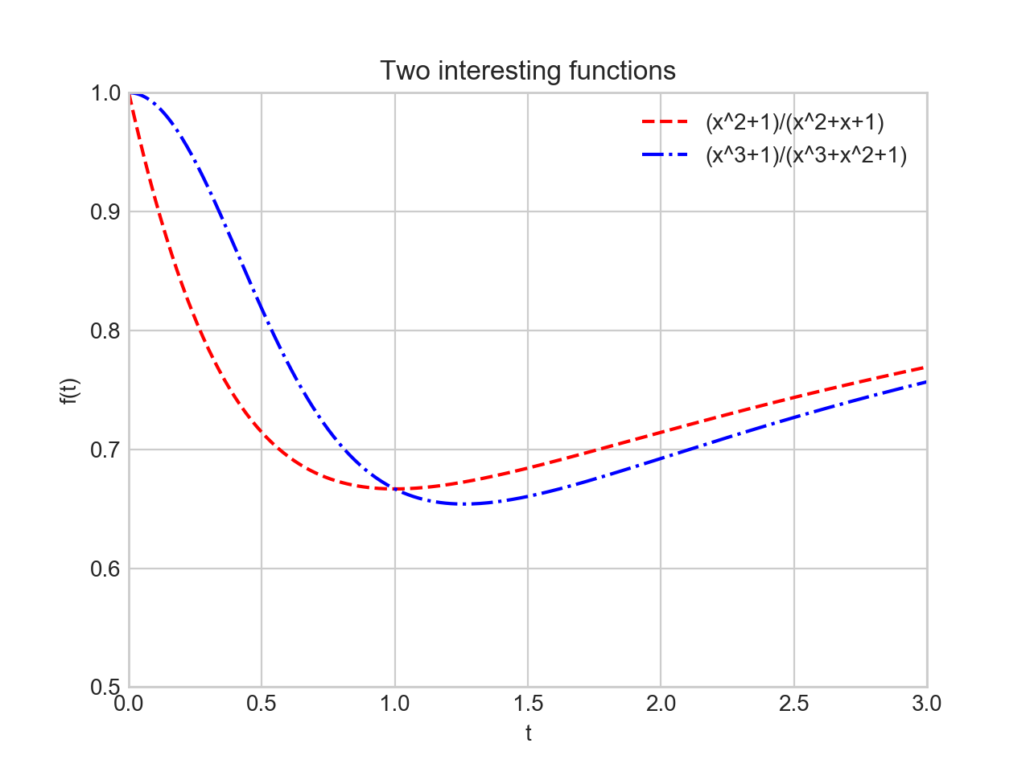
Simple Line Plots
And we can provide a legend
ax.plot(x, (x**2+1)/(x**2+x+1), 'r--', label='(x^2+1)/(x^2+x+1)')
ax.plot(x, (x**3+1)/(x**3+x**2+1), 'b-.', label='(x^3+1)/(x^3+x^2+1)')
plt.legend()

Slide 45
Simple Line Plots
OO translation:
plt.xlabel( ) —> ax.set_xlabel( )
plt.ylabel( ) —> ax.set_ylabel( )
plt.xlim( ) —> ax.set_xlim( )
plt.ylim( ) —> ax.set_ylim( )
plt.title( ) —> ax.set_title( )
or just use ax.set

Slide 46
Simple Line Plots
ax.plot(x, (x**2+1)/(x**2+x+1), 'r--', label='(x^2+1)/(x^2+x+1)')
ax.plot(x, (x**3+1)/(x**3+x**2+1), 'b-.', label='(x^3+1)/(x^3+x^2+1)')
ax.set(xlim=(0,1.5), ylim=(0.6, 1), xlabel='x', ylabel='f(y)',
title = 'Two functions')

Slide 47
Simple Line Plots

Slide 48
Simple Scatter Plots
plt.plot / ax.plot can also produce scatter plots
Just give it a marker
ax.plot(x, (x**2+1)/(x**2+x+1), 'o', color = 'black', label='(x^2+1)/(x^2+x+1)')
ax.plot(x, (x**3+1)/(x**3+x**2+1), 'x', color = 'red', label='(x^3+1)/(x^3+x^2+1)')
ax.set(xlim=(0,1.5), ylim=(0.6, 1), xlabel='x', ylabel='f(y)', title = 'Two functions')
ax.legend()

Slide 49
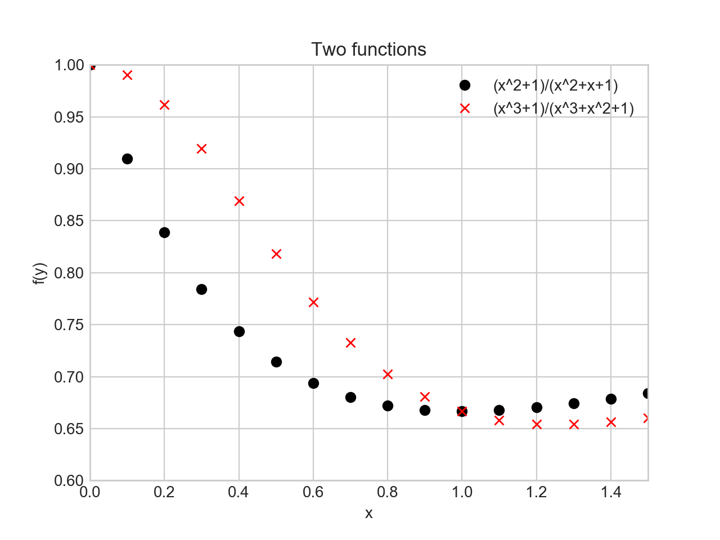
Simple Scatter Plots

Slide 50
Simple Scatter Plots
Additional argument represent the symbol
'o', '.', 'x', '+', 'v', '^', '<', '>',
's' square
'd' diamond

Slide 51
Simple Scatter Plots
More powerful: Use plt.scatter
Can control many more aspects
Example:
Create 100 random pairs of x, y
Create random colors (between 0 and 1)
Create random sizes (between 0 and 1000)
Set alpha = 0.3 in order to make things transparent

Slide 52
Simple Scatter Plots
np.random.seed(250620)
x = np.random.randn(100)
y = np.random.randn(100)
colors = np.random.rand(100)
sizes = 1000 * np.random.rand(100)
plt.scatter(x, y, c=colors, s=sizes, alpha = 0.3,
cmap = 'viridis')
plt.colorbar() # show color scale
plt.show()

Slide 53
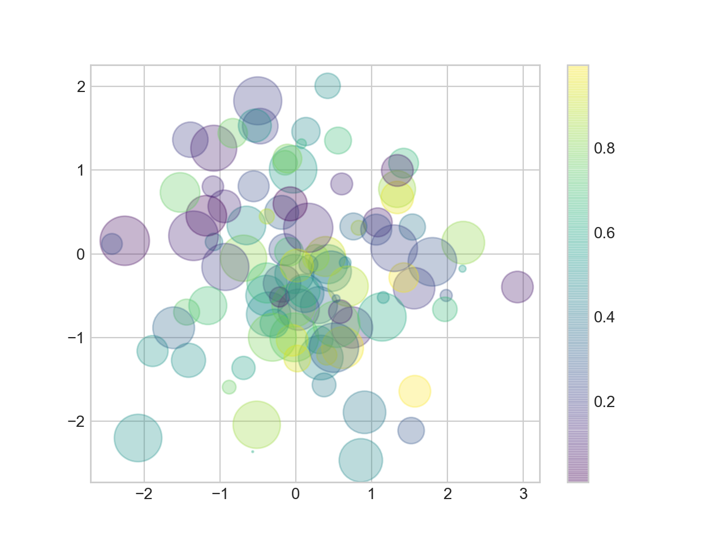
Simple Scatter Plots

Slide 54
Simple Scatter Plots
Example: Iris data set (from sklearn.datasets)
from sklearn.datasets import load_iris
iris = load_iris()
features = iris.data.T #need to transpose
plt.scatter(features[2], features[3], alpha = 0.6,
c=iris.target, cmap = 'prism')
plt.xlabel(iris.feature_names[2])
plt.ylabel(iris.feature_names[3])
plt.show()

Slide 55
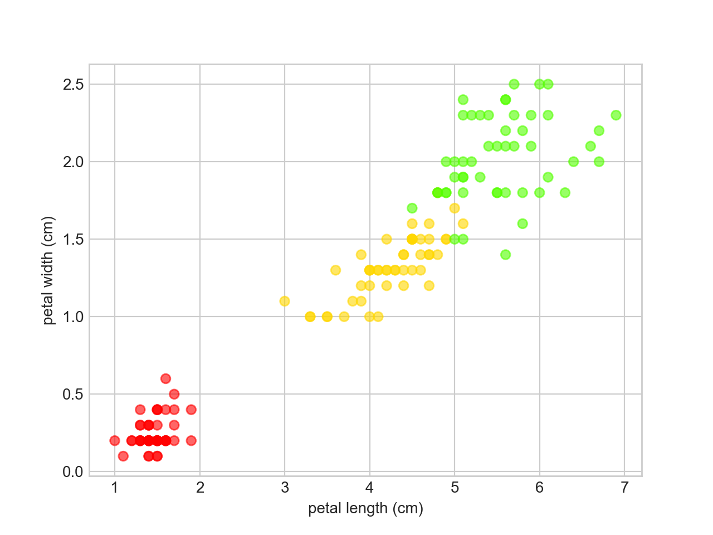
Simple Scatter Plots

Slide 56
Simple Scatter Plots
As datasets get larger, plot becomes more efficient than scatter

Slide 57
Error Bars
"it's not science if there is no statistics" thomas schwarz, sj
"it's not statistics if there are no errorbars" thomas schwarz, sj
When you have a data set, you should also have a confidence interval
This is displayed by an error bar
Use plt.errorbar with
x-values
y-values
confidence interval size
format code to control appearances (same as for lines and colors)

Slide 58
Error Bars
Example:
Use a simple function
Use random.normal in order to generate y-values centered around the random function
Then draw error bars with $y±2σ$

Slide 59
Error Bars
x = np.linspace(0,10,51)
y = np.random.normal(loc = x**2/10+x-1 , scale = 2+x/10)
plt.errorbar(x,y, yerr=2*(2+x/10), fmt='.k')
plt.plot(x, x**2/10+x-1, 'r-')
plt.show()

Slide 60
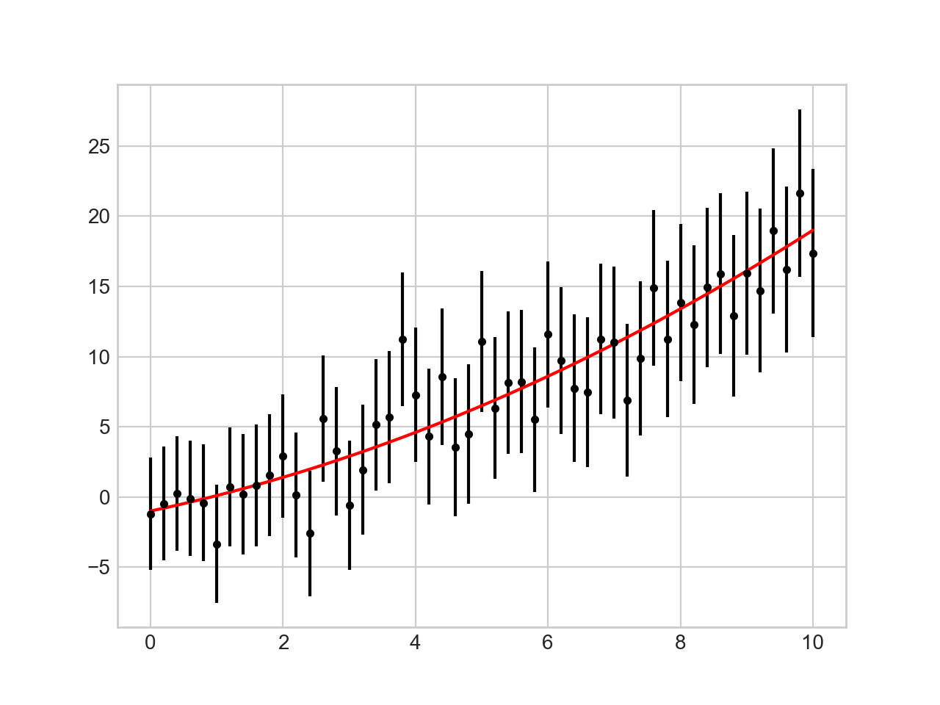
Error Bars

Slide 61
Error Bars
Continuous errors
No real support in matplotlib
Can make it ourselves with filling between curves
x = np.linspace(0,10,101)
y = np.random.normal(loc = x**2/10+x-1 , scale = 2+x/10)
plt.plot(x,y, 'x')
plt.plot(x, x**2/10+x-1, 'r-')
plt.fill_between(x, x**2/10+x-1-2*(2+x/10), x**2/10+2*(x-1+2+x/10), color = 'gray', alpha=0.2)
plt.show()

Slide 62
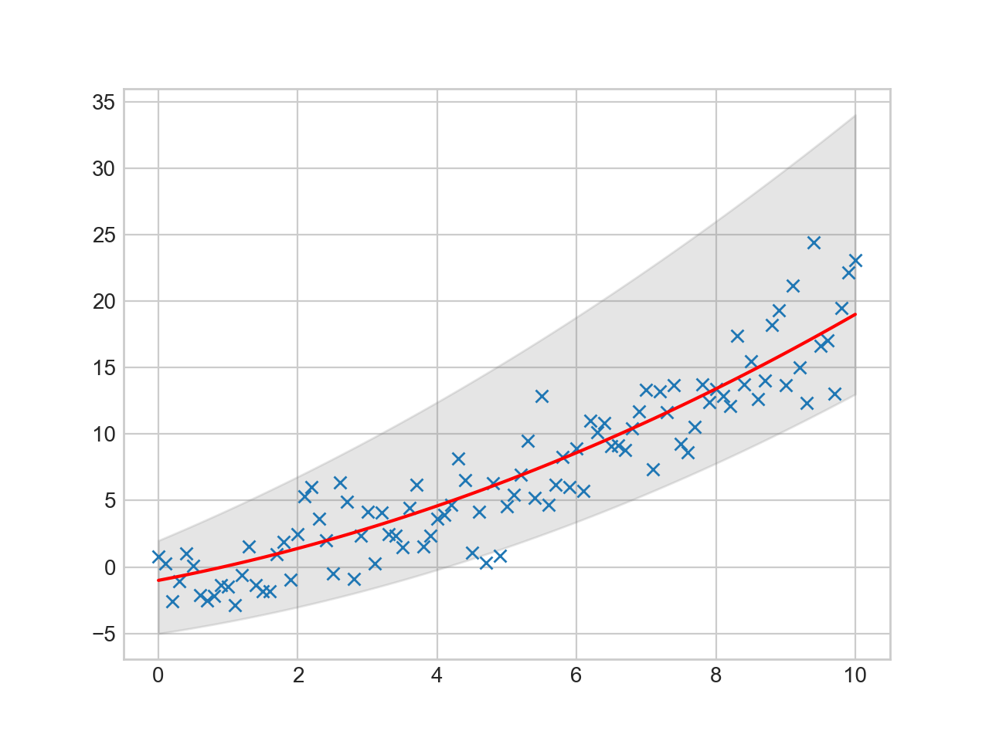
Error Bars

Slide 63
Contour / Density Plots
As an example, use the following function
def f(x,y):
return np.sin(x)**10+np.cos(10+y*x)*np.cos(x)

Slide 64
Contour / Density Plots
Contour plot
Need to create a grid
Easiest with meshgrid
x = np.linspace(-5,5,101)
y = np.linspace(-5,5,101)
X,Y = np.meshgrid(x,y)
Z = f(X,Y)

Slide 65
Contour / Density Plots
>>> X
array([[-5. , -4.9, -4.8, ..., 4.8, 4.9, 5. ],
[-5. , -4.9, -4.8, ..., 4.8, 4.9, 5. ],
[-5. , -4.9, -4.8, ..., 4.8, 4.9, 5. ],
...,
[-5. , -4.9, -4.8, ..., 4.8, 4.9, 5. ],
[-5. , -4.9, -4.8, ..., 4.8, 4.9, 5. ],
[-5. , -4.9, -4.8, ..., 4.8, 4.9, 5. ]])
>>> Y
array([[-5. , -5. , -5. , ..., -5. , -5. , -5. ],
[-4.9, -4.9, -4.9, ..., -4.9, -4.9, -4.9],
[-4.8, -4.8, -4.8, ..., -4.8, -4.8, -4.8],
...,
[ 4.8, 4.8, 4.8, ..., 4.8, 4.8, 4.8],
[ 4.9, 4.9, 4.9, ..., 4.9, 4.9, 4.9],
[ 5. , 5. , 5. , ..., 5. , 5. , 5. ]])

Slide 66
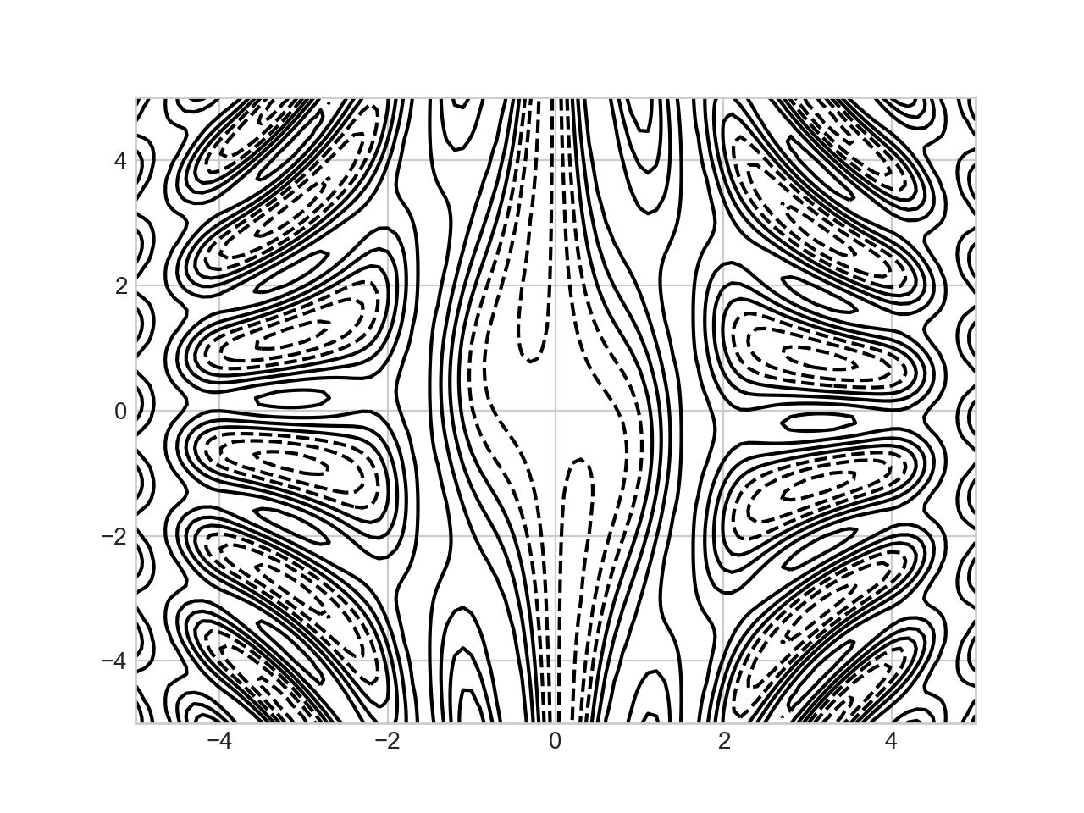
Contour / Density Plots
Simple contour plot: dashed lines stand for neg. values
plt.contour(X,Y,Z, colors='black')

Slide 67
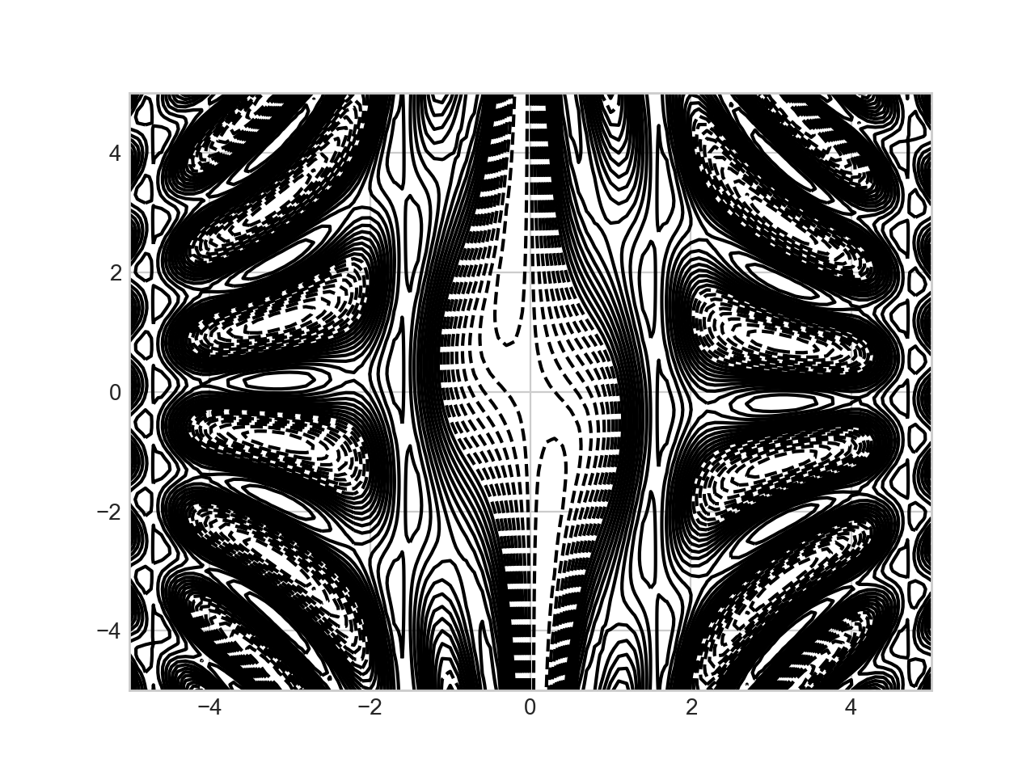
Contour / Density Plots
Can specify the number of contour lines
plt.contour(X,Y,Z, 20, colors='black')

Slide 68
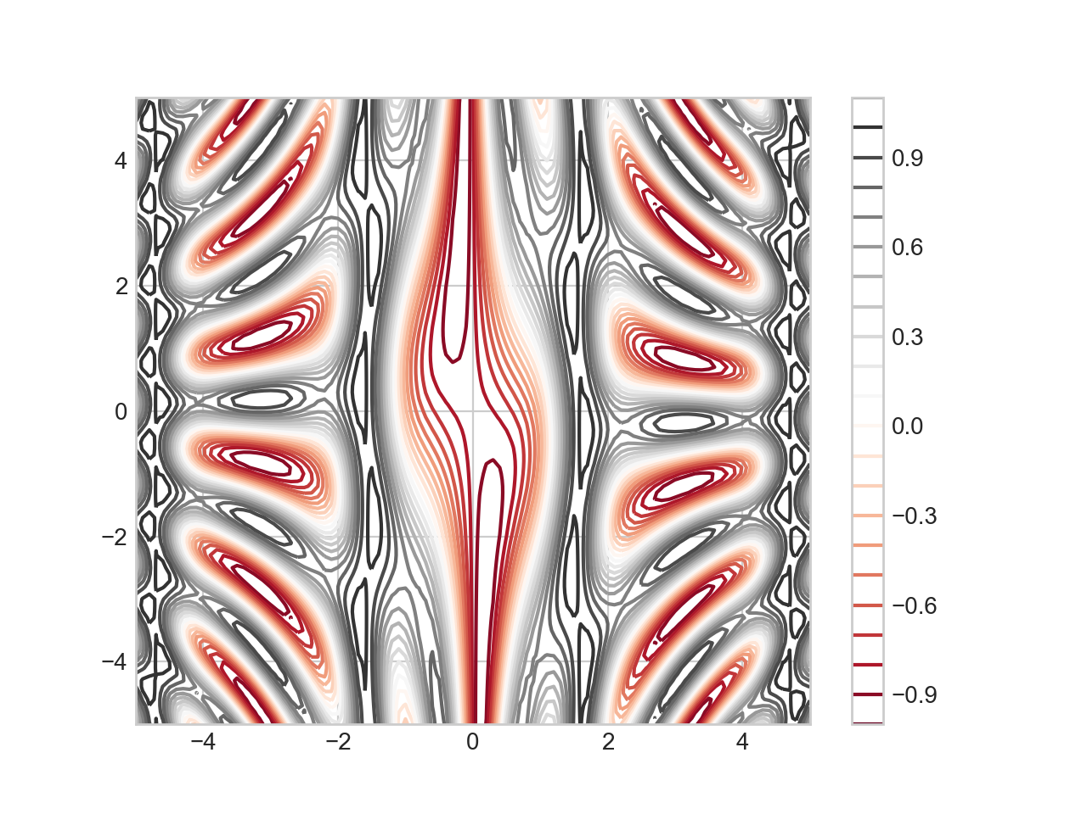
Contour / Density Plots
Can use a color map
plt.contour(X,Y,Z, 20, cmap = 'RdGy')
plt.colorbar()

Slide 69
Histograms
Let's use the iris data set
A pre-processed version is in sklearn.datasets
Which means importing it
We better look at it first:
iris = load_iris()
features = iris.data.T
>>> features[:,:10]
array([[5.1, 4.9, 4.7, 4.6, 5. , 5.4, 4.6, 5. , 4.4, 4.9],
[3.5, 3. , 3.2, 3.1, 3.6, 3.9, 3.4, 3.4, 2.9, 3.1],
[1.4, 1.4, 1.3, 1.5, 1.4, 1.7, 1.4, 1.5, 1.4, 1.5],
[0.2, 0.2, 0.2, 0.2, 0.2, 0.4, 0.3, 0.2, 0.2, 0.1]])

Slide 70
Histograms
Let's create histograms for all four properties of an Iris set
We can define a simple figure with four different panels
We then load the axes elements
fig, axs = plt.subplots(2,2, squeeze = True)
axs[0][0]
axs[0][1]
axs[1][0]
axs[1][1]

Slide 71
Histograms
For a histogram, we use the hist method of an axes
Needs a np.array and a number of bins
axs[0][0].hist(features[0,50:150], bins = 10)
axs[0][1].hist(features[1,50:150], bins = 10)
axs[1][0].hist(features[2,50:150], bins = 10)
axs[1][1].hist(features[3,50:150], bins = 10)

Slide 72
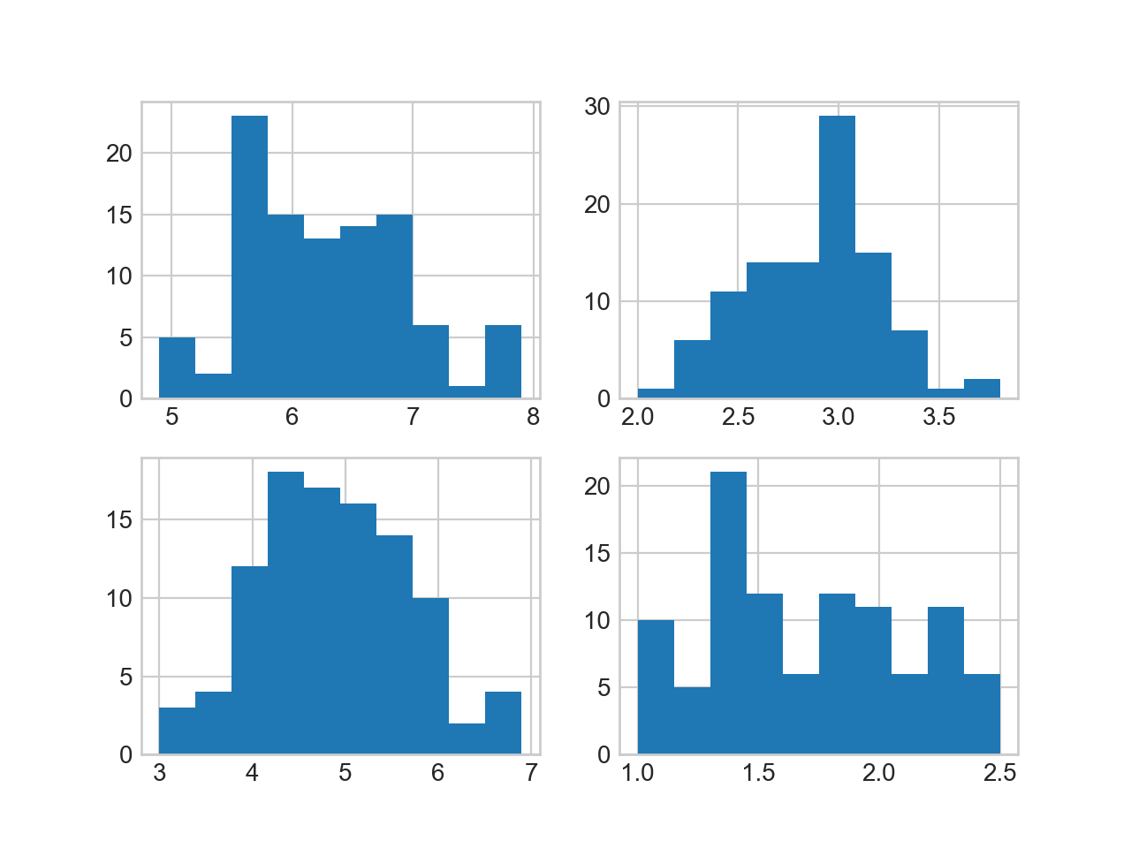
Histograms
Result so far:

Slide 73
Histograms
The axs objects are actually a tuple
N, bins, patches
with N the count in each bin
bins the number in each bin
patches gives us access to the properties drawn

Slide 74
Histograms
Here is how we get at them
And we can see what is in them
N00, bins00
N00,bins00,patches00 = axs[0][0].hist(features[0,50:150], bins=10)
N01,bins01,patches01 = axs[0][1].hist(features[1,50:150], bins=10)
N10,bins10,patches10 = axs[1][0].hist(features[2,50:150], bins=10)
N11,bins11,patches11 = axs[1][1].hist(features[3,50:150], bins=10)
array([ 5., 2., 23., 15., 13., 14., 15., 6., 1., 6.])
array([4.9, 5.2, 5.5, 5.8, 6.1, 6.4, 6.7, 7. , 7.3, 7.6, 7.9])

Slide 75
Histograms
The patches is a list of patch objects, one for each bin rectangle
We can for example update the color
Use patch.set_facecolor(color)
Where color is a number between 0 and 256
Which we can select according to colormaps

Slide 76
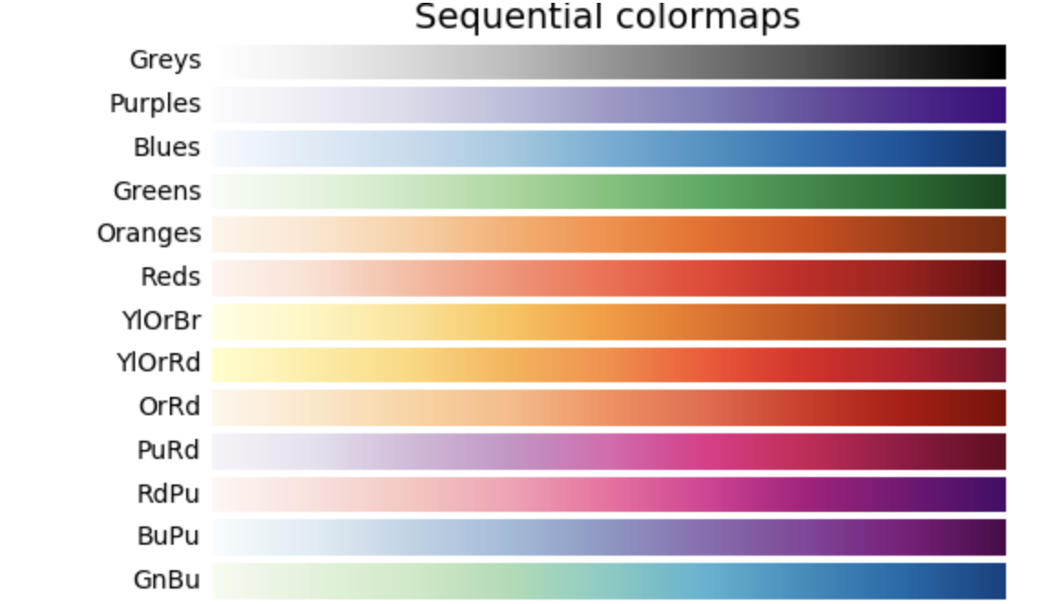
Colormaps

Slide 77
Histograms
For each of the four histograms, we can use a different color map
We pick the number uniformly through 1 … 256
for i, patch in enumerate(patches00):
color = plt.cm.viridis(i*256//9)
patch.set_facecolor(color)
for i, patch in enumerate(patches01):
color = plt.cm.magma(i*256//9)
patch.set_facecolor(color)

Slide 78
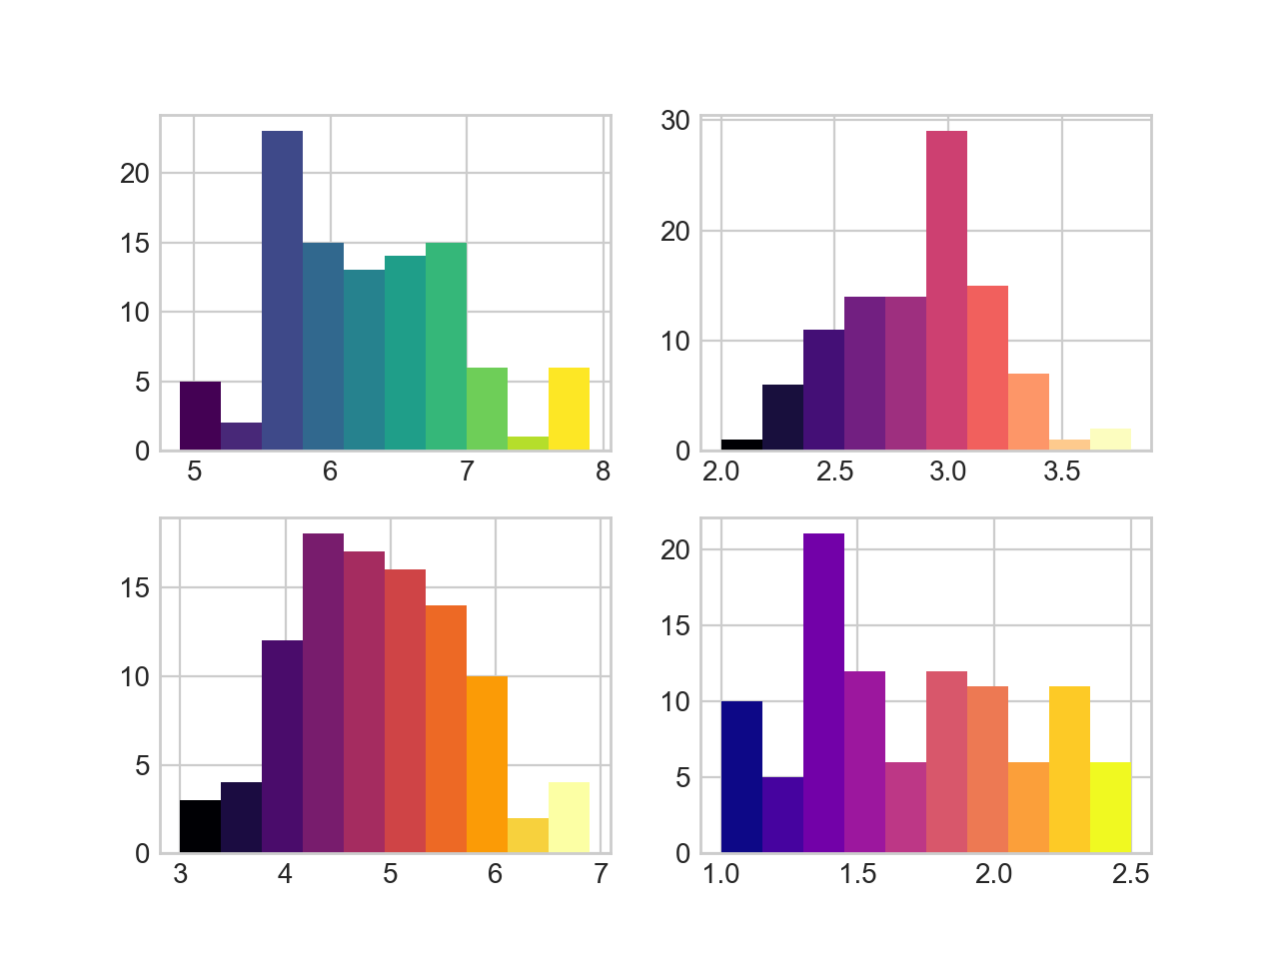
Histograms

Slide 79
Python enumerate
Remember that Python has some great list tools
enumerate(a_list_or_sequence)
will generate tuples of index and element

Slide 80
Histograms
We should describe what we are displaying
First, let's add labels for the axes
Turns out that the rows are too close together
Search the web: can be adjusted with tight_layout
for ax in axs:
for a in ax:
a.set_xlabel('mm')
a.set_ylabel('nr')
fig.tight_layout(pad=1.0)

Slide 81
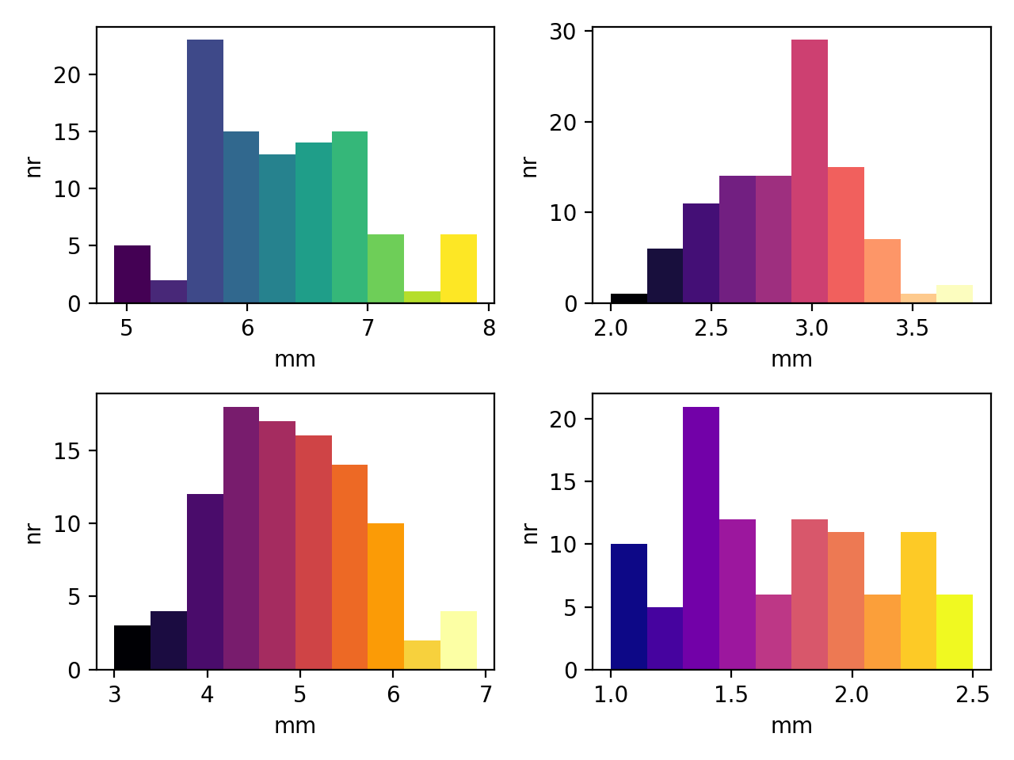
Histograms

Slide 82
Histograms
for ax in axs:
for a in ax:
a.set_xlabel('mm')
a.set_ylabel('nr')
axs[0][0].set_title('Sepal Length')
axs[0][1].set_title('Sepal Width')
axs[1][0].set_title('Petal Length')
axs[1][1].set_title('Petal Width')
fig.tight_layout(pad=1.0)

Slide 83
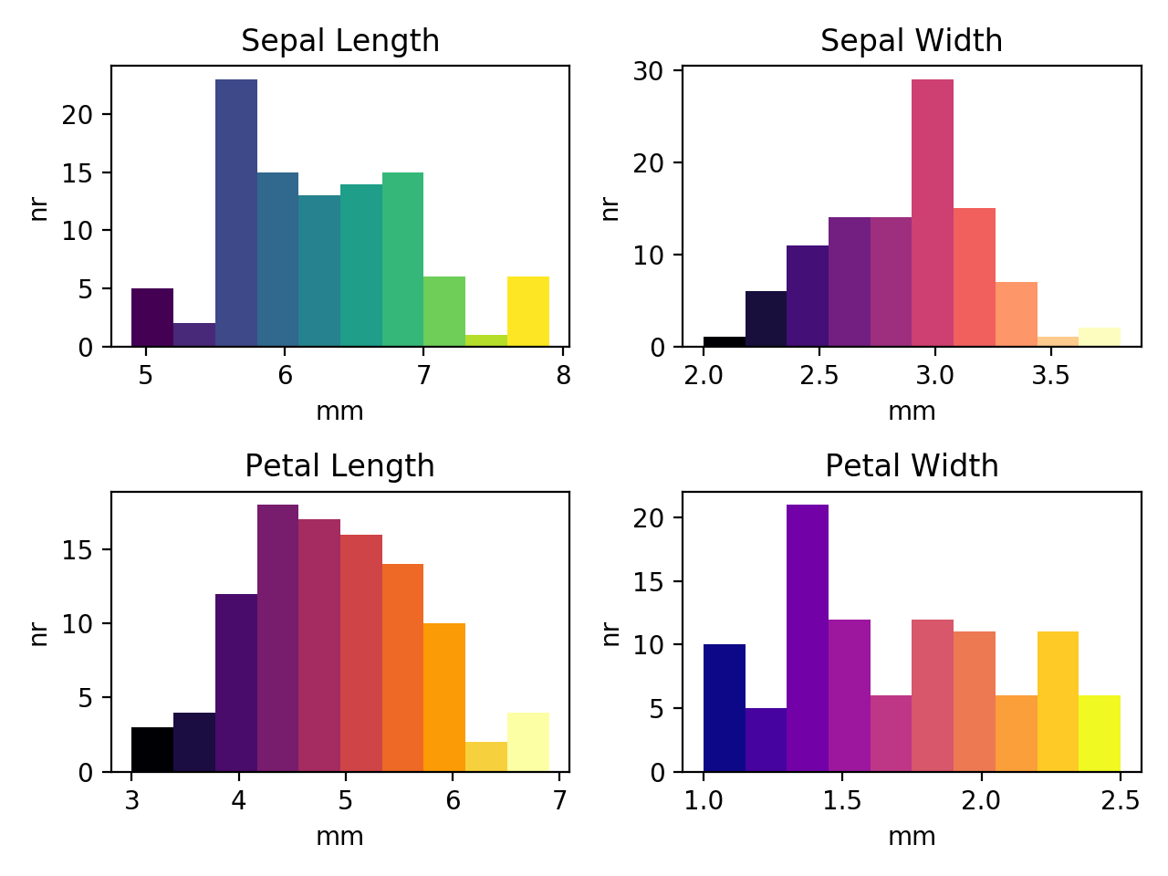
Histograms

Slide 84
2D-Histograms
Two-dimensional histograms use color to show the numbers into a two dimensional bin
import numpy as np
import matplotlib.pyplot as plt
from sklearn.datasets import load_iris
iris = load_iris()
features = iris.data.T
fig, axs = plt.subplots(1,2)
axs[0].hist2d(features[0,50:150],features[1,50:150])
axs[1].hist2d(features[2,50:150],features[3,50:150])
plt.show()

Slide 85
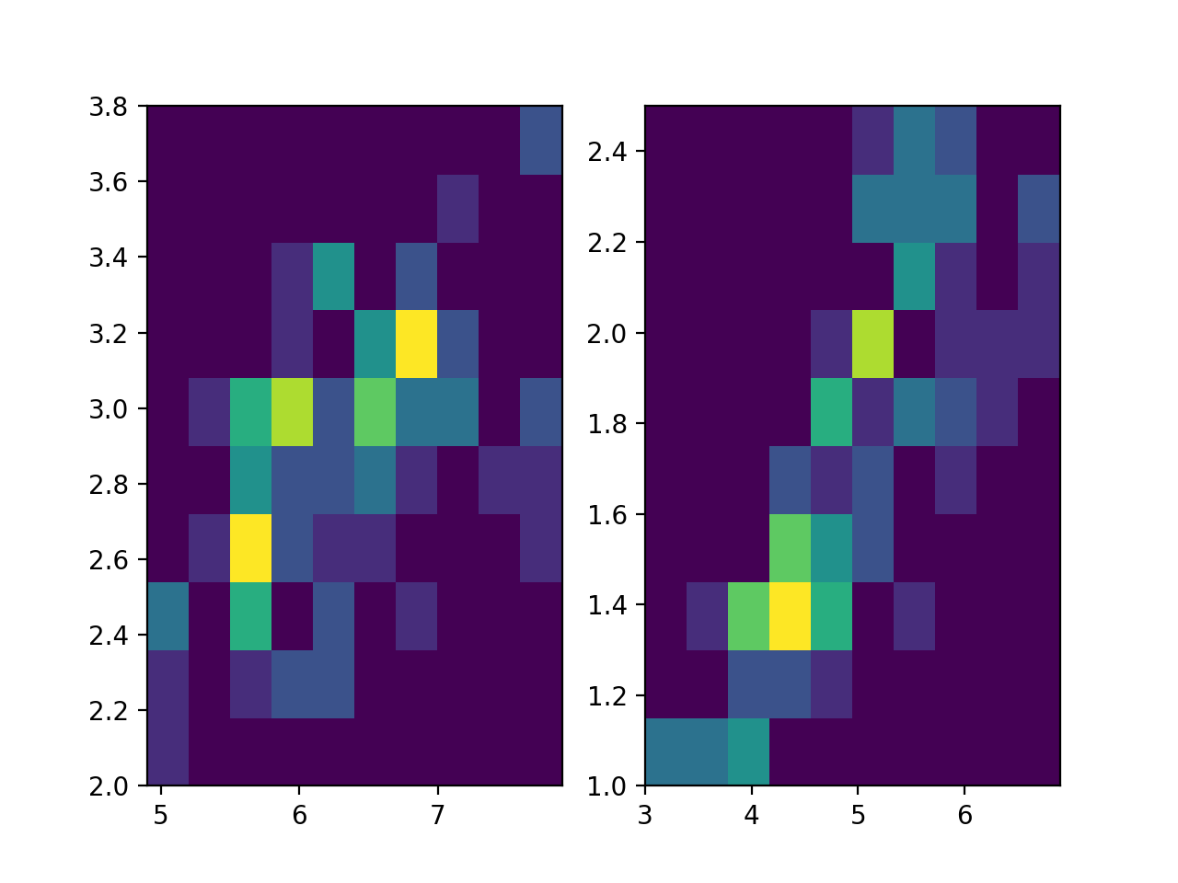
2D-Histograms
The result is harder to read:

Slide 86
2D-Histograms
We can adjust the number of bins on each side
And adjust the color scheme
set color map to something easily interpretable
from matplotlib import colors

Slide 87
2D-Histograms
fig, axs = plt.subplots(1,2)
axs[0].hist2d(features[0,50:150],
features[1,50:150],
bins=7,
norm=colors.LogNorm(),
cmap = 'Blues')
axs[1].hist2d(features[2,50:150],
features[3,50:150],
bins=7,
norm=colors.LogNorm(),
cmap = 'Blues')

Slide 88
2D-Histograms
Then add labels and titles
for i in range(2):
axs[i].set_xlabel('mm')
axs[i].set_ylabel('mm')
axs[0].set_title('Sepal')
axs[1].set_title('Petal')

Slide 89
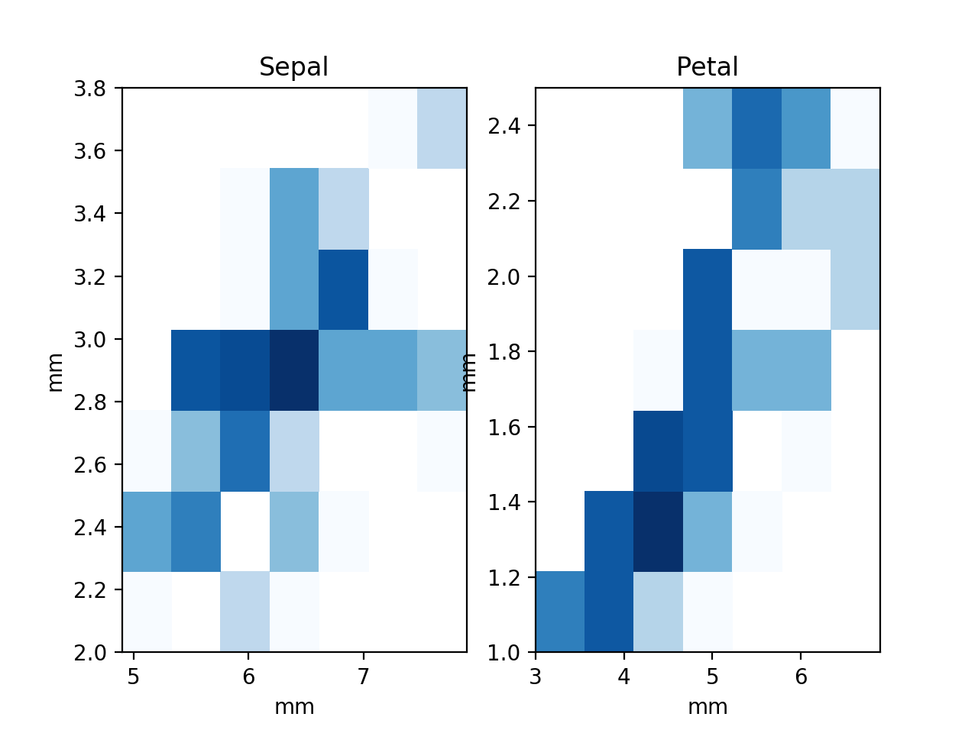
2D-Histograms

Slide 90
2D-Histograms
Need to adjust padding
for a in axs:
a.set_xlabel('mm')
a.set_ylabel('mm')
axs[0].set_title('Sepal')
axs[1].set_title('Petal')
fig.tight_layout(pad=1.0)

Slide 91
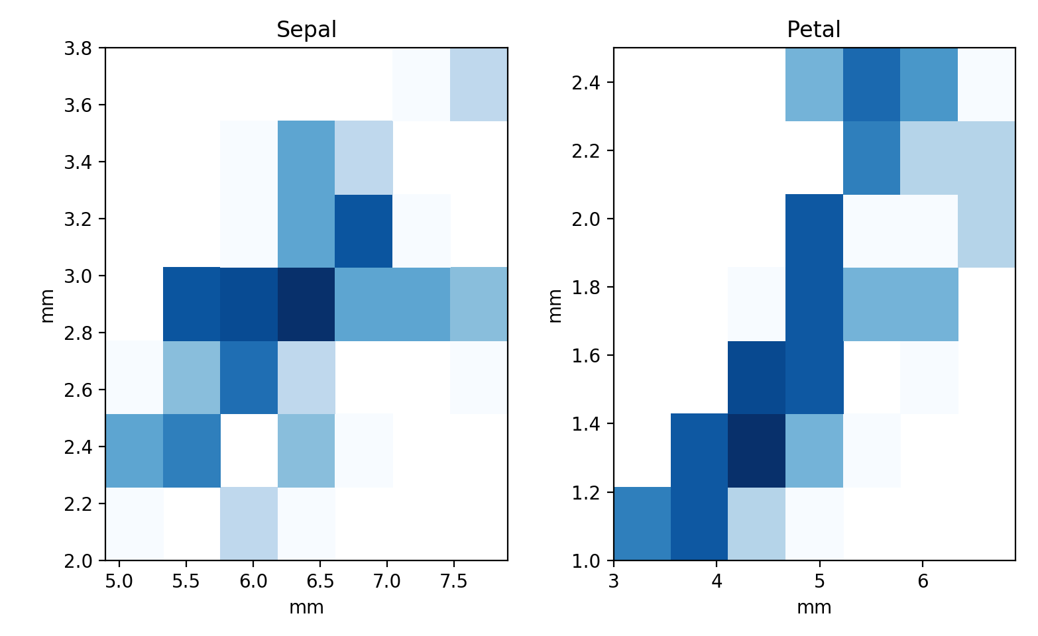
2D-Histograms

Slide 92
Plot Legends
Let's create a simple plot: compare arctan and the logistic functions
Provide a simple legend
Give a label to the plot
call legend and the axes object

Slide 93
Plot Legends
import numpy as np
import matplotlib.pyplot as plt
import scipy
import math
plt.style.use('classic')
x = np.linspace(-10,10,1001)
fig, ax = plt.subplots()
ax.plot(x, 2*np.arctan(x)/math.pi, 'b-', label='arctan')
ax.plot(x, 2/(np.exp(-x)+1)-1, 'r--', label='logistic 1')
ax.plot(x, 2/(np.exp(-x/2)+1)-1, 'g:', label='logistic 1/2')
ax.legend()
plt.show()

Slide 94
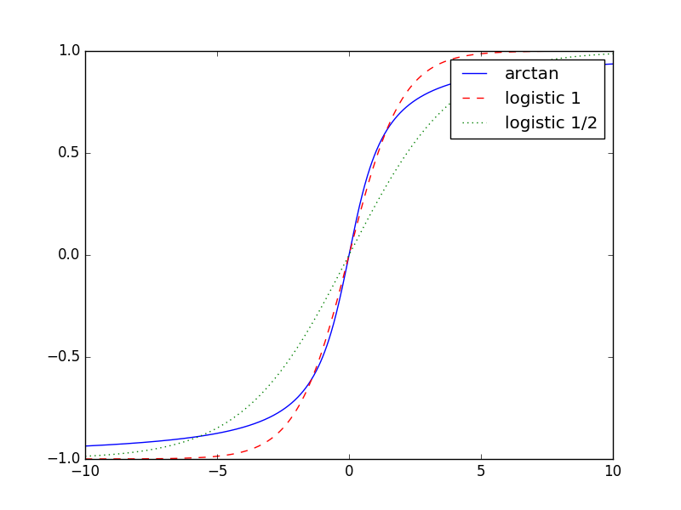
Plot Legends

Slide 95
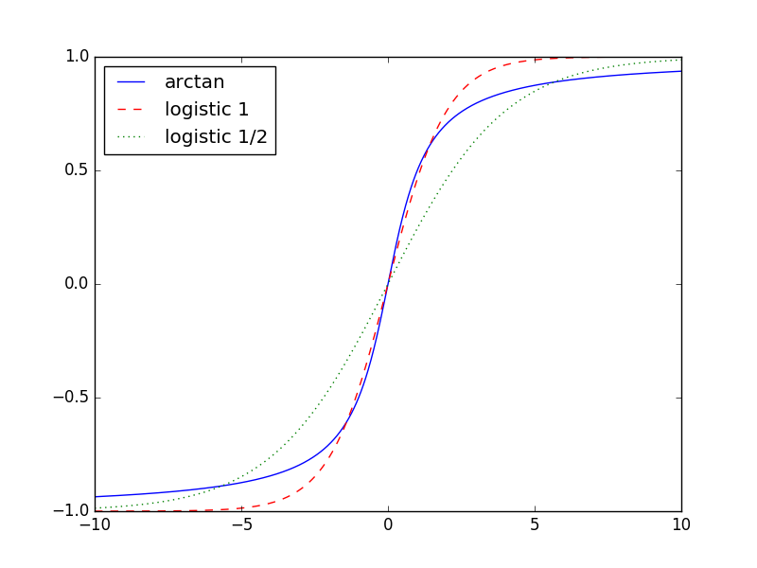
Plot Legends
Can specify placement of the legend
ax.legend(loc='upper left')

Slide 96
Plot Legends
Can specify the number of columns in the legend
x = np.linspace(-10,10,1001)
fig, ax = plt.subplots()
ax.plot(x, 2*np.arctan(x)/math.pi, 'b-', label='arctan')
ax.plot(x, 2*np.arctan(x/2)/math.pi, 'b-.', label='arctan 1/2')
ax.plot(x, 2/(np.exp(-x)+1)-1, 'r--', label='logistic 1')
ax.plot(x, 2/(np.exp(-x/2)+1)-1, 'g:', label='logistic 1/2')
ax.legend(loc='upper left', ncol = 2)
plt.show()

Slide 97
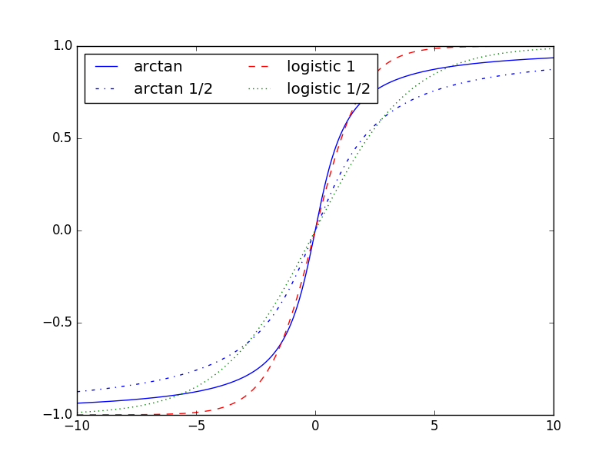
Plot Legends

Slide 98
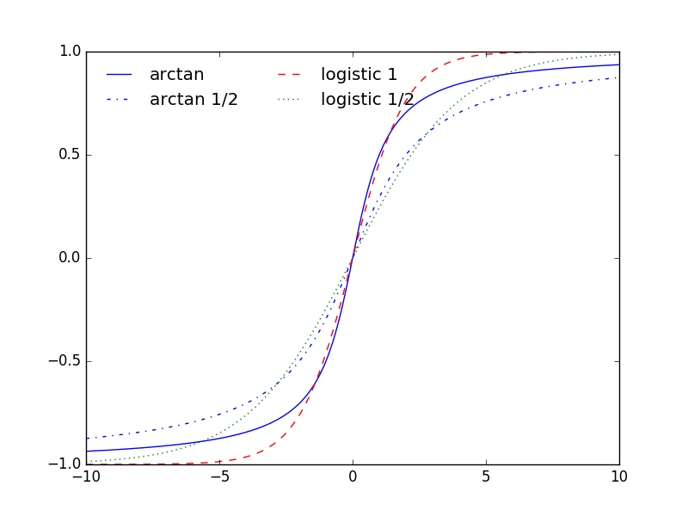
Plot Legends
Turn off the frame
ax.legend(loc='upper left',
ncol = 2,
frameon=False)

Slide 99
Plot Legends
If we do not provide a label in a plot, then it will be ignored

Slide 100
Plot Legends
Can use labels to provide additional information
Open california_cities.csv
Create a scatter plot based on latitude and longitude
Set the color to the population (decadic logarithm)
Set the size to the area of the city
Deploy a colorbar with a label (in LaTeX)

Slide 101
Plot Legends
cities = pd.read_csv('california_cities.csv')
lat, lon = cities['latd'], cities['longd']
population, area = cities['population_total'], cities['area_total_km2']
plt.scatter(lon, lat, label=None,
c = np.log10(population), cmap='Blues',
s = area, linewidth = 0, alpha = 0.5)
plt.axis(aspect='equal')
plt.xlabel('longitude')
plt.ylabel('latitude')
plt.colorbar(label='$\log_{10}$(population)')
plt.clim(3,7) #color scaling

Slide 102
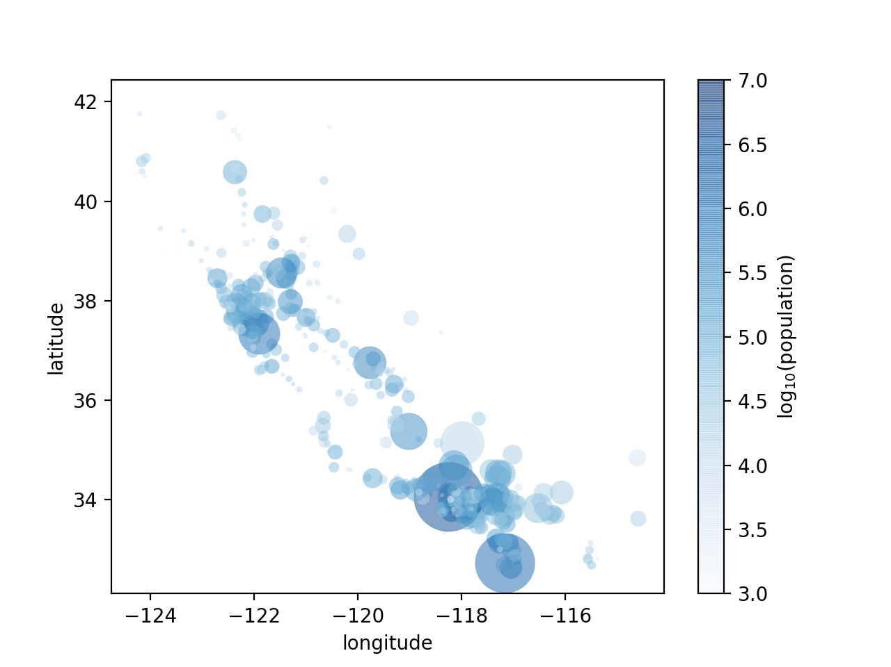
Plot Legends

Slide 103
Plot Legends
This lacks an explanation of the areas of the cities
In order to create a legend, we need to plot comparison cities with 'label'
But these cities do not have to exist
for area in [100, 250, 500]:
plt.scatter([],[], c='r',
alpha = 0.3, s=area,
label = str(area)+'km$^2$')
plt.legend(frameon = False, title='City Area')

Slide 104
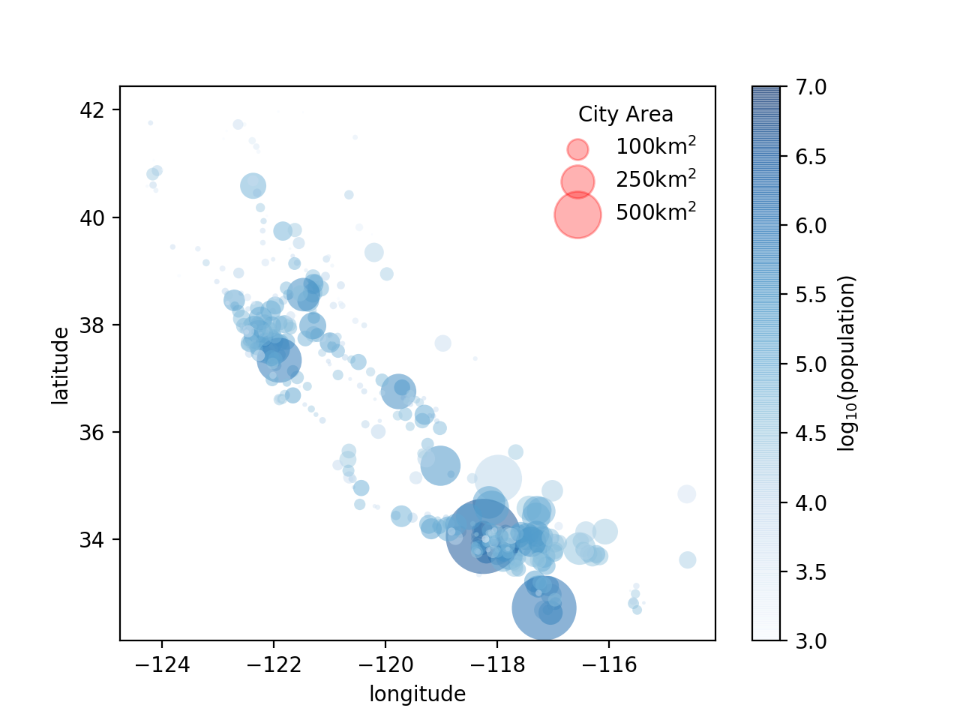
Plot Legends
The label isn't so great

Slide 105
Plot Legends
Use labelspacing to avoid overlap
plt.legend(frameon = False,
title='City Area',
labelspacing=1)

Slide 106
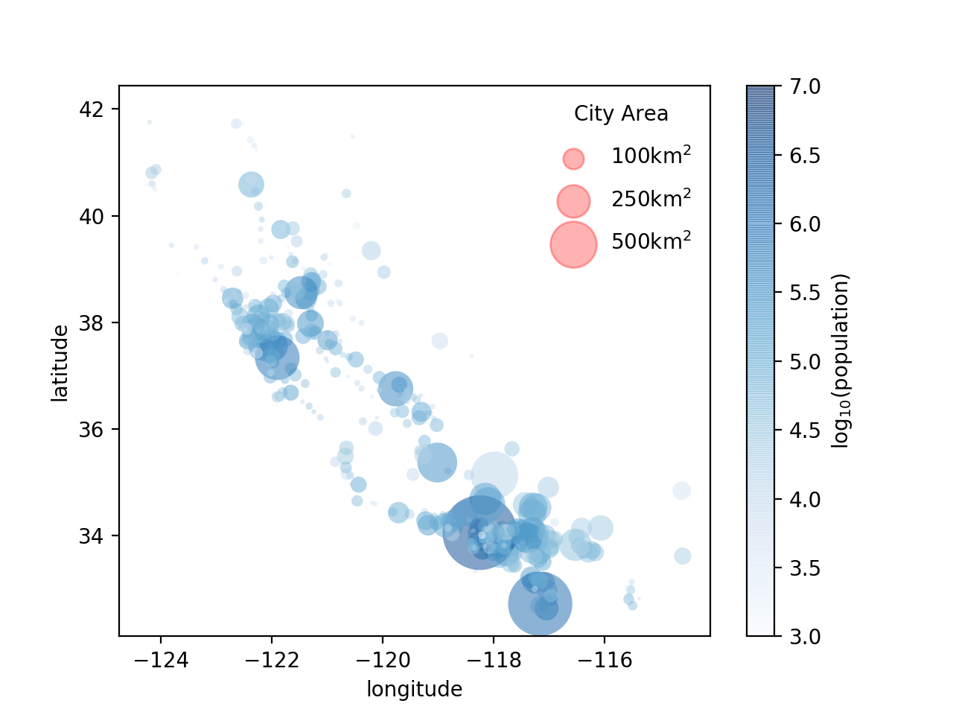
Plot Legends

Slide 107
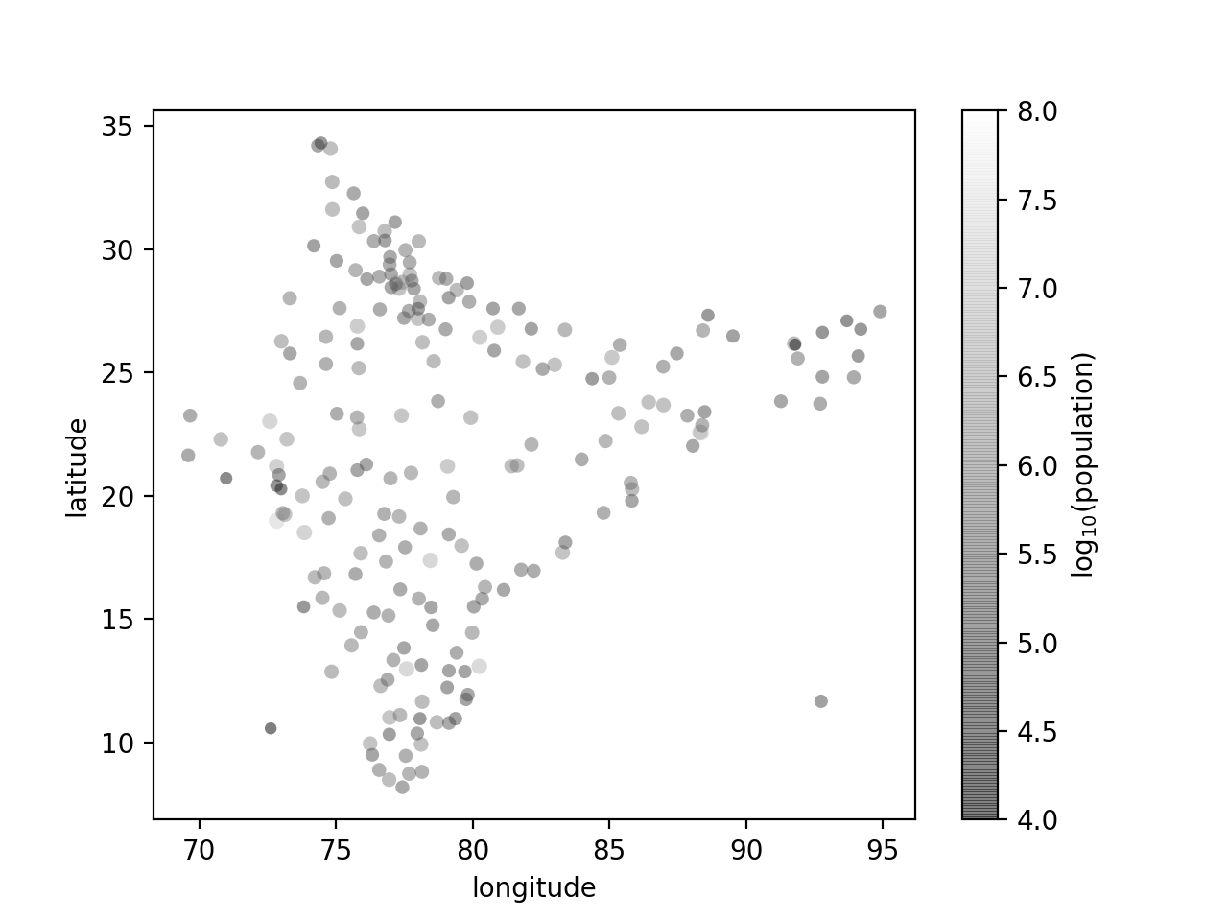
Homework
Use the in.csv map to create a map of India's cities

Slide 108
Homework
Restrict the map to cities of more than 2 million population
Use a better color-scheme

