Slide 1
Analysis of Euclidean Algorithm
Algorithms
Thomas Schwarz, SJ

Slide 2
Greatest Common Divisor
Given two numbers $a,b∈N$:
$a$ divides $b$ $a∣b:⟺∃x∈N:b=ax$
Divisors are smaller than the dividend
$$a∣b⟹a≤b$$
$r$ is a common divisor of $a$ and $b$ iff $r∣a∧r∣b$
$$\text{gcd}(a,b)=max\{r:r∣a∧r∣b\}$$
Always exists because the set is finite
Any finite subset of the natural numbers has a maximum

Slide 3
Greatest Common Divisor
Lemma 1: For all numbers $a,b∈N$: $\text{gcd}(a,b)=\text{gcd}(b,a)$
Proof: The set of common divisors does not depend on the order in which a and b are given:
$\{r:r∣a∧r∣b\}=\{r:r∣b∧r∣a\}$ because the logical and operator is commutative
Hence: $\text{gcd}(a,b)=max\{r:r∣a∧r∣b\}$
$$=max\{r:r∣b∧r∣a\}$$
$$=\text{gcd}(b,a)$$

Slide 4
Greatest Common Divisor
Lemma 2: If $a∈N$ and $a∣b$ then $\text{gcd}(a,b)=a$.
Proof:
$a$ is the largest divisor of itself.
$a$ is also a divisor of $b$ by assumption
Hence $a$ is the largest element in the set of common divisors $\{r:r∣a∧r∣b\}$.
This means that $a=max\{r:r∣a∧r∣b\}=\text{gcd}(a,b)$

Slide 5
Greatest Common Divisor
Lemma 3: If $a≡c(modb)$ then $\text{gcd}(a,b)=(c,b)$
Proof:
$a≡c(modb)⟺∃r,s,t∈N_{0}:a=rb+t∧c=sb+t∧0≤t<b$
We show that $\{r:r∣a∧r∣b\}=\{r:r∣c∧r∣b\}$
Assume that $d∈N$ is in the left side. We want to show that it is also in the right side. For this we need to show that $d$ also divides c.
What do we know: There exists $x,y∈N_{0}$ such that
$b=xd$ because $d$ divides $b$
$a=yd$ because $d$ divides $a$
$$a=rb+t,c=sb+t,0≤t<b$$

Slide 6
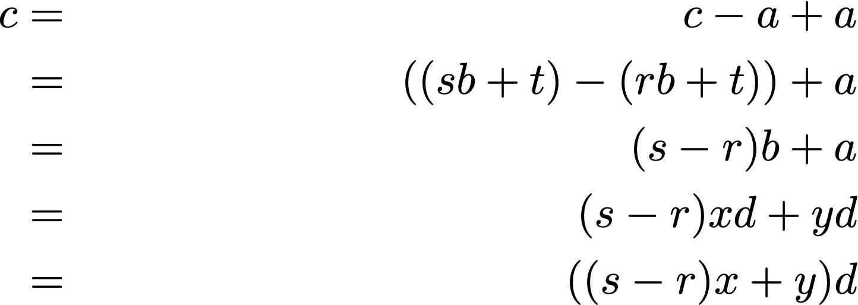
Greatest Common Divisor
Proof (continued)

Slide 7
Greatest Common Divisor
Proof: (cont)
Now we want to show that all elements on the right side of $\{r:r∣a∧r∣b\}=\{r:r∣c∧r∣b\}$ are in the left side.
However, since our assumptions are symmetric in $a$ and $c$, the same proof applies.

Slide 8
Euclidean Algorithm
Informal Version:
To compute $\text{gcd}(a,b)$ put the larger number of $a$ and $b$ on the left
Then divide $a$ by $b$ with remainder $r$ ($a=bx+r$)
If $r=0$, then $b∣a$ and $\text{gcd}(a,b)=b$.
Otherwise:
Notice that $r≡a(modb)$.
Therefore $\text{gcd}(a,b)=\text{gcd}(r,b)=\text{gcd}(b,r)$ by the Lemma
Continue until the remainder becomes 0

Slide 9
Euclidean Algorithm
gcd(1043, 4321)
= gcd(4321, 1043)
= gcd(1043, 149)
= 149 because 1043 % 149 = 0.
There is an interesting extension:
4321=4*1043+149, ergo 149 = 4321-4*1043, a linear combination of 4321 and 1043

Slide 10
Euclidean Algorithm
gcd(198, 168)
= gcd(168, 30)
= gcd(30, 18)
= gcd(18,12)
= gcd(12,6)
= 6
198-168=30
18 =168 - 5*30 =168-5(198-168)=6*168-5*198
12 = 30 - 18 = 198-168-6*168+5*198 = 6*198-7*168
6 = 18-12 = -5*198+6*168-6*198+7*168 = -11*198 + 13*168
GCD is a linear combination of the two parameters!

Slide 11
Euclidean Algorithm
Pseudo-code
def gcd(a, b):
if b==0:
return a
else:
return gcd(b, a%b)

Slide 12
Euclidean Algorithm
How do we prove the correctness of an algorithm?
Especially if it contains a loop
Usually, need to use induction
Sometimes using a loop invariant
In this case: gcd(var1,var2) does not change between between calls
That is Lemma 3!
End if the algorithm ever ends, it prints out the correct value by Lemma 1.
gcd(198, 168)
= gcd(168, 30)
= gcd(30, 18)
= gcd(18,12)
= gcd(12,6)
= gcd(6,0)

Slide 13
Euclidean Algorithm
How do we prove the correctness of the algorithm?
It is possible that an algorithm will never stop
(on some inputs, or on all inputs)
In our case, the smaller of the variables becomes strictly smaller
with the exception of the first step
Thus, we will run out of variables for our recursive calls sooner or later
Algorithm will eventually return the correct number

Slide 14
Euclidean Algorithm
Performance
Obviously, proportional to the number of recursive calls
Given two random inputs:
Can stop in one iteration
If second variable divides the first
Or can stop after many
In a case like this: look for the worst case scenario

Slide 15
Euclidean Algorithm
Theorem: If gcd(a,b) makes n recursive calls and a > b then $a≥f_{N+2}$ and $b≥f_{N+1}$

Slide 16
Euclidean Algorithm
def gcd(a, b):
if b==0:
return a
else:
return gcd(b, a%b)
Proof:
By induction
Base case: $N=1$:
In this case $b≠0$, hence $b≥1=f_{2}$
In this case $a>b$, so $a>b=1⟹a≥2=f_{2}$

Slide 17
Euclidean Algorithm
def gcd(a, b):
if b==0:
return a
else:
return gcd(b, a%b)
Induction step
Induction hypothesis:
If gcd has $N$ recursive calls then $a≥f_{N+2}$ and $b≥f_{N+1}$
To show:
If gcd has $N+1$ recursive calls, then $a≥f_{N+3}$ and $b≥f_{N+2}$

Slide 18
Euclidean Algorithm
def gcd(a, b):
if b==0:
return a
else:
return gcd(b, a%b)
Assume that gcd(a,b) makes N+1 calls.
The first step calls gcd(b,a%b)
This call calls the function recursively N times
Thus, by Induction Hypothesis
$b≥f_{N+2}$ and $a\%b≥f_{N+1}$
By division with reminder $a=rb+a\%b$ with $0≤a\%b<b$
Because $a>b$ we have $r≥1$.
Therefore: $a≥b+a\%b≥f_{N+2}+f_{N+1}≥f_{N+3}$.
We already know that $b≥f_{N+2}$

Slide 19
Euclidean Algorithm
def gcd(a, b):
if b==0:
return a
else:
return gcd(b, a%b)
Can find a closed form of Fibonacci
$$Φ=\frac{1+\sqrt{5}}{2}≈1.68$$
$b≥f_{N+2}≥Φ^{N}$
This implies that $\log_{Φ}(b)≥N-1$ and $N=O(logb)$

Slide 20
Loop Invariants
Recursion usually demands induction proofs to assert properties of an algorithm
For loops, use loop invariant:
A property that is true before the loop starts
A property that remains true after each loop iteration
And is therefore true after the loop terminates

Slide 21
Loop Invariants
Working with loop invariants:
Need to come up with a loop invariant
Prove that it is true before the loop starts (induction base)
Prove that it remains true after each iteration of the loop

Slide 22
Loop Invariants
Trivial Example:
Small C-program
extern int c;
int x = c, y = 0;
while (x>=0):
x--;
y++;
print(y)

Slide 23
Loop Invariants
Step 1: Guessing a loop invariant
Needs to involve x, y, c
$$x+y=c$$
extern int c;
int x = c, y = 0;
while (x>=0):
x--;
y++;
print(y)

Slide 24
Loop Invariants
Step 2:
Show that it is true before the loop starts
Simple: before the loop starts, we have $x=c,y=0$ therefore $x+y=c$

Slide 25
Loop Invariants
Step 3: Show that the truth does not change after one iteration
Induction step: Assume $x_{b}+y_{b}=c$ before the loop iteration
After the iteration, we have $x_{a}=x_{b}-1$, $y_{a}=y_{b}+1$.
This implies
$$x_{a}+y_{a}=(x_{b}-1)+(y_{b}+1)=x_{b}+y_{b}-1+1=x_{b}+y_{b}=c$$

Slide 26
Loop Invariants
Step 4: Evaluate with the loop invariant
When the loop is terminated, $x=0$.
(Question: why do we now that the loop terminates?)
Therefore, the value of $y$ is $y=x+y-x=c-0=c$
Thus, the function prints out the value of $c$.

