Slide 1
Decision Trees
Thomas Schwarz, SJ

Slide 2
Decision Trees
One of many machine learning methods
Used to learn categories
Example:
The Iris Data Set
Four measurements of flowers
Learn how to predict species from measurement

Slide 3
Iris Data Set
Iris Setosa
Iris Virginica
Iris Versicolor

Slide 4
Iris Data Set
Data in a .csv file
Collected by Fisher
One of the most famous datasets
Look it up on Kaggle or at UC Irvine Machine Learning Repository

Slide 5
Measuring Purity
Entropy
$n$ categories with proportions $p_{i}$ = (nr in Cat $i$)/(total nr)
$$\text{Entropy}(p_{1},p_{2},…,p_{n})=-\overset{n}{\underset{i=1}{∑}}\log_{2}(p_{i})p_{i}$$
Unless one of the proportions is zero, in which case the entropy is zero.
High entropy means low purity, low entropy means high purity

Slide 6
Measuring Purity
Gini index
$$\text{Gini}(p_{1},p_{2},…,p_{n})=\overset{n}{\underset{k=1}{∑}}p_{i}(1-p_{i})$$
Best calculated as
$$\overset{n}{\underset{k=1}{∑}}p_{i}(1-p_{i})=\overset{n}{\underset{k=1}{∑}}p_{i}-\overset{n}{\underset{k=1}{∑}}p_{i}^{2}=1-\overset{n}{\underset{k=1}{∑}}p_{i}^{2}$$

Slide 7
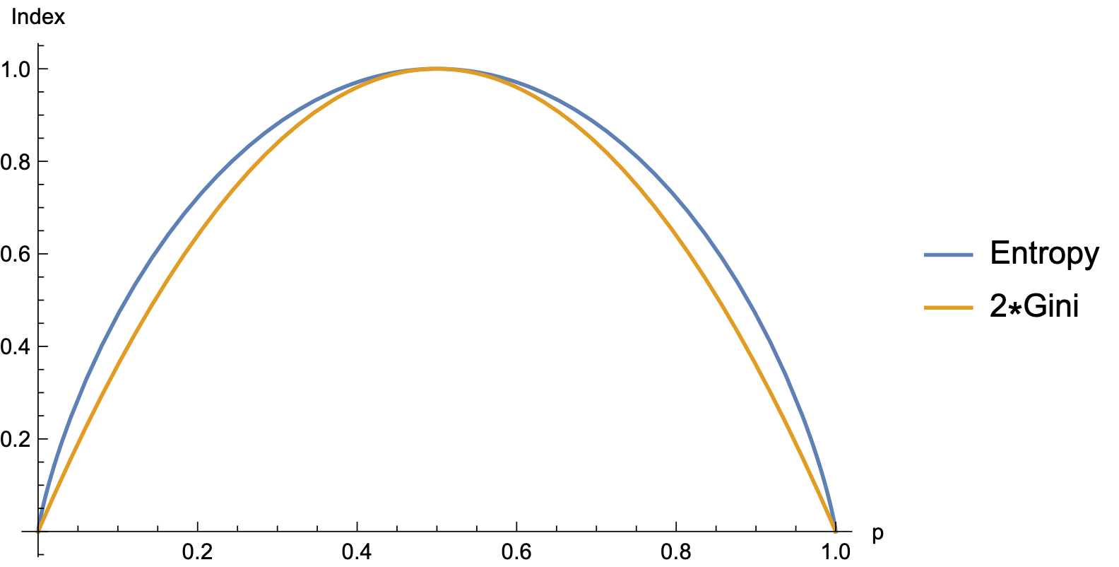
Measuring Purity
Assume two categories with proportions $p$ and $q$

Slide 8
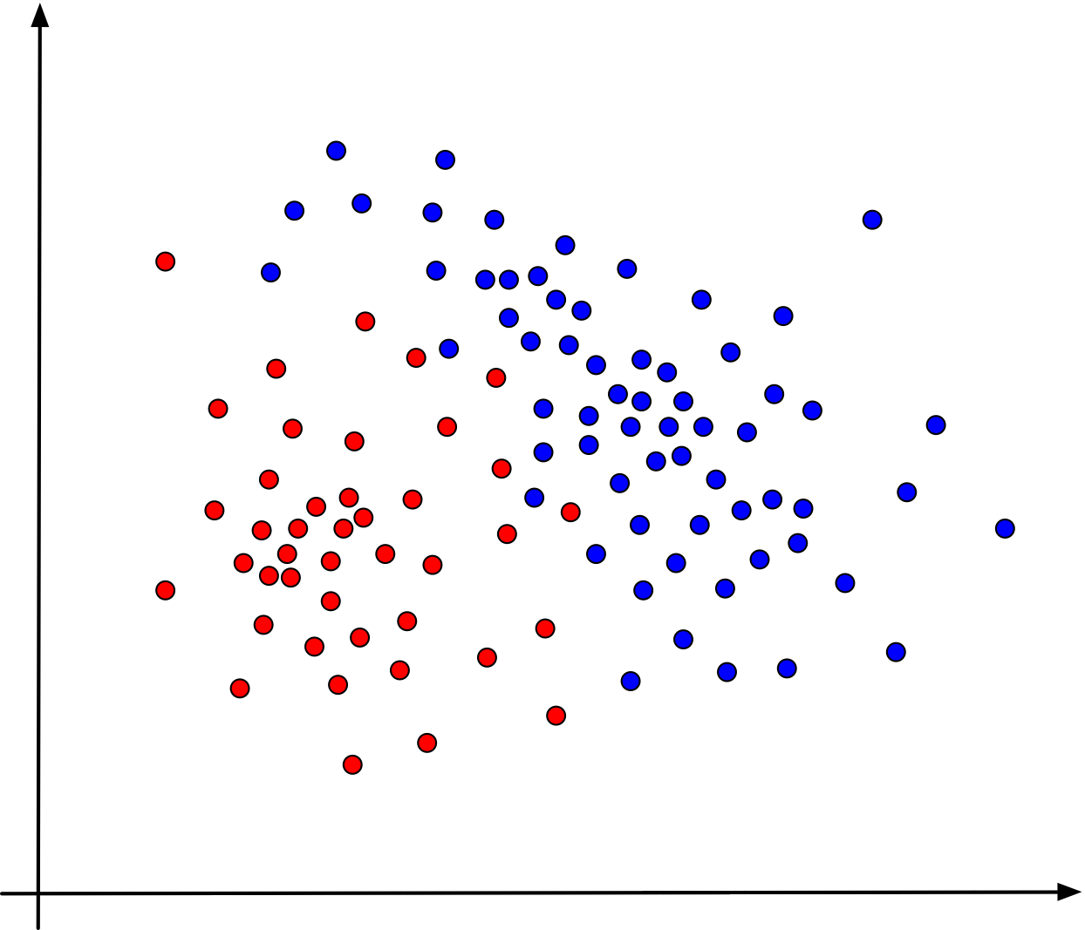
Building a Decision Tree
A decision tree
Can we predict the category (red vs blue) of the data from its coordinates?

Slide 9
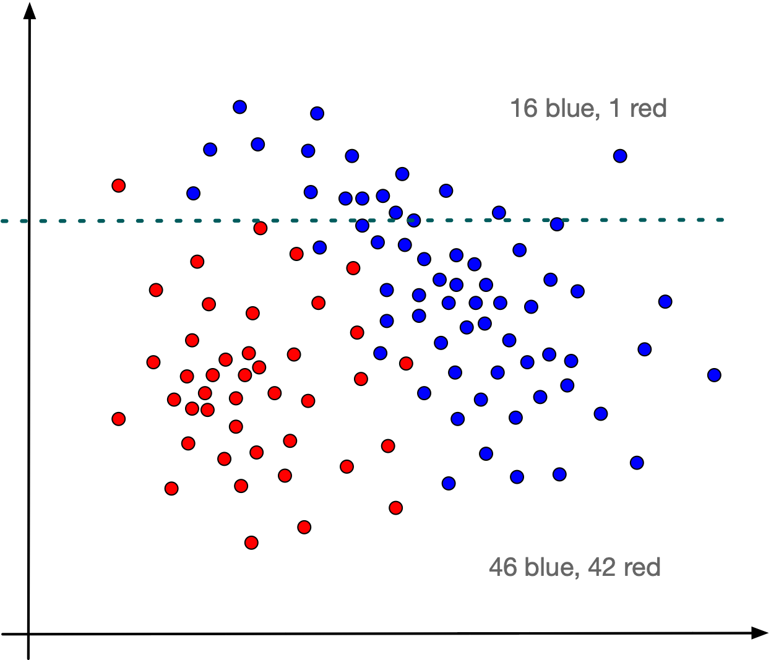
Building a Decision Tree
Introduce a single boundary
Almost all points above the line are blue

Slide 10
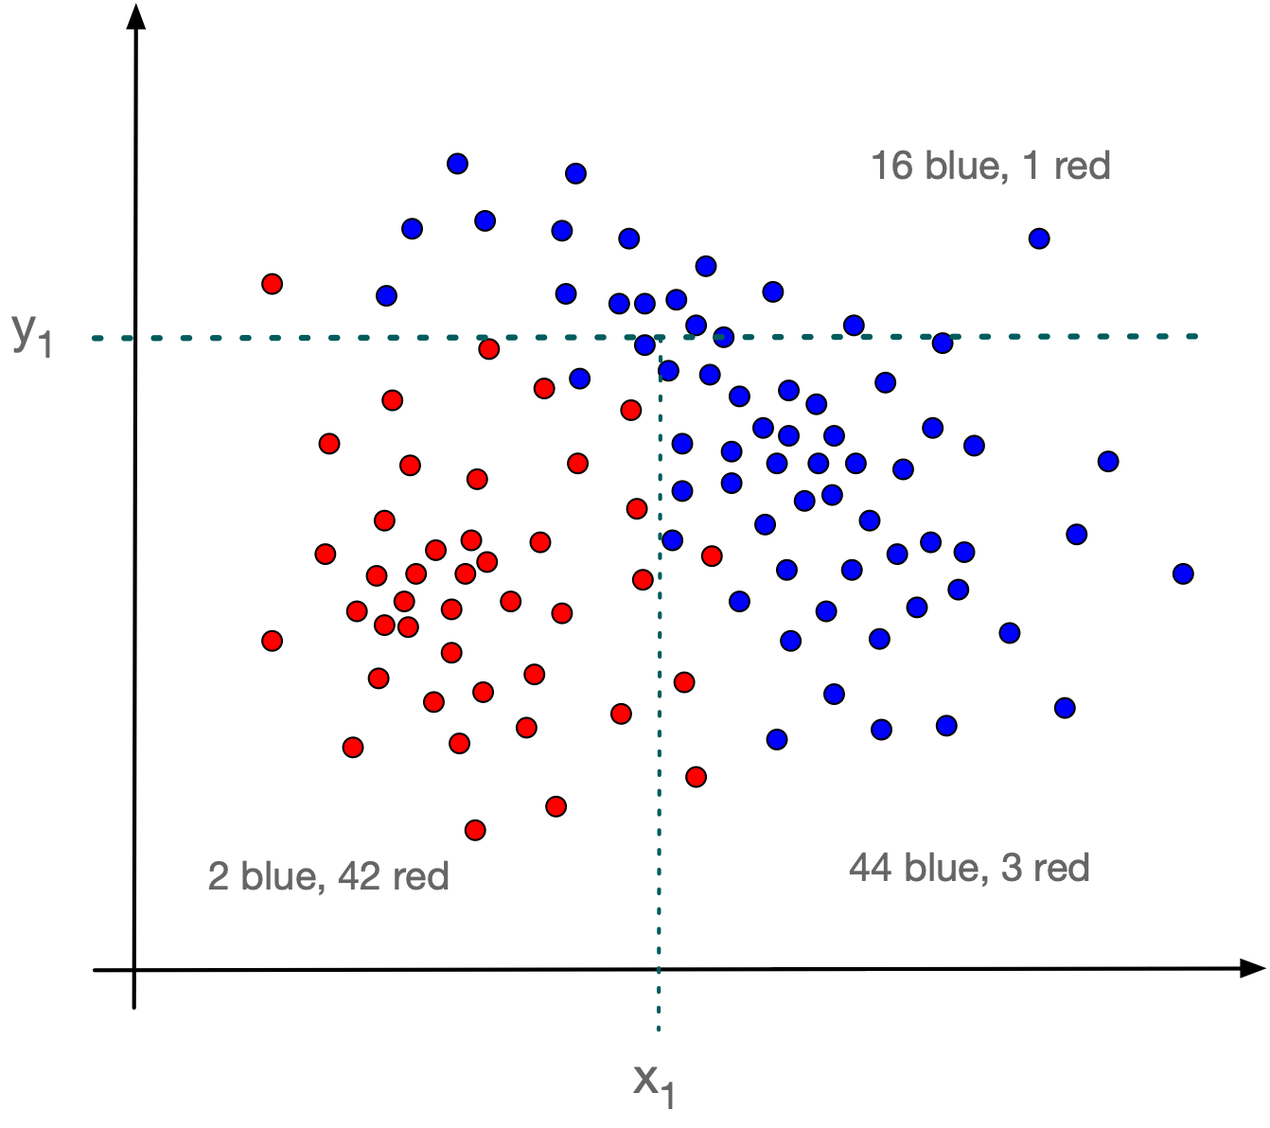
Building a Decision Tree
Subdivide the area below the line
Defines three almost homogeneous regions

Slide 11
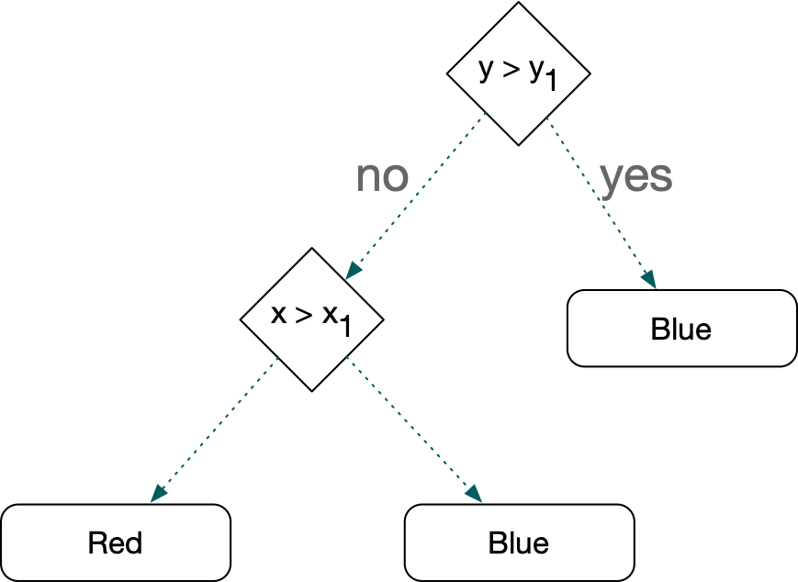
Building a Decision Tree
Express as a decision tree

Slide 12
Building a Decision Tree
Decision trees are easy to explain
Might more closely mirror human decision making
Can be displayed graphically and are easily interpreted by a non-expert
Can easily extend to non-numeric variables
Tend do not be as accurate as other simple methods
Non-robust: Small changes in data sets give rise to completely different final trees

Slide 13
Building a Decision Tree
If a new point with coordinates (x, y) is considered
Use the decision tree to predict the color of the point
Decision tree is not always correct even on the points used to develop it
But it is mostly right
If new points behave like the old ones
Expect the rules to be mostly correct

Slide 14
Building a Decision Tree
How do we build decision trees
Many algorithms were tried out and compared
First rule: Decisions should be simple, involving only one coordinate
Second rule: If decision rules are complex they are likely to not generalize
E.g.: the lone red point in the upper region is probably an outlier and not indicative of general behavior

Slide 15
Building a Decision Tree
How do we build decision trees
Third rule:
Don't get carried away
Prune trees to avoid overfitting

Slide 16
Building a Decision Tree
Algorithm for decision trees:
Find a simple rule:
Maximizes the information gain
Continue sub-diving the regions
Stop when a region is homogeneous or almost homogeneous
Stop when a region becomes too small

Slide 17
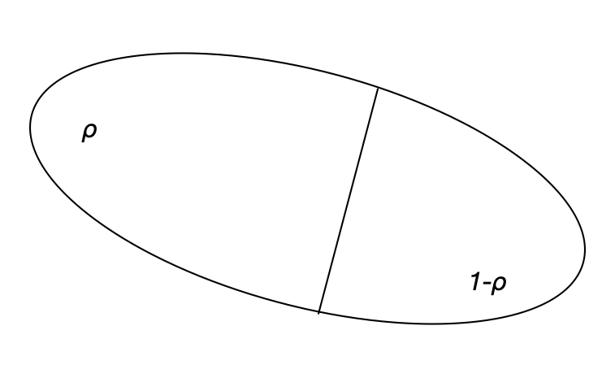
Building a Decision Tree
Information Gain from a split:
$μ$ information measure before
$μ_{1},μ_{2}$ information measures in the split parts
$$\text{Information gain}=μ-(ρμ_{1}+(1-ρ)μ_{2})$$

Slide 18
Processing Iris
Need to get the data:
make tuples of float
last element:
use numbers 0, 1, 2 to encode categories

Slide 19
def get_data():
""" opens up the Iris.csv file
"""
lista = []
with open("Iris.csv") as infile:
infile.readline() # remove first line
for line in infile:
values = line.strip().split(',')
if values[5] == "Iris-setosa":
cat = 1
elif values[5] == "Iris-versicolor":
cat = 2
else:
cat = 0
tupla = (float(values[1]),
float(values[2]),
float(values[3]),
float(values[4]),
cat)
lista.append(tupla)
return lista

Slide 20
Processing Iris
Let's count categories
def stats(lista):
counts = [0,0,0]
for element in lista:
counts[element[-1]] += 1
return counts

Slide 21
Processing Iris
Calculate the Gini index of a list
def gini(lista):
counts = stats(lista)
counts = [counts[0]/len(lista),
counts[1]/len(lista),
counts[2]/len(lista)]
return 1-counts[0]**2-counts[1]**2-counts[2]**2

Slide 22
Processing Iris
Calculate the entropy of a list
def entropy(lista):
counts = stats(lista)
proportions = [counts[0]/len(lista),
counts[1]/len(lista),
counts[2]/len(lista)]
entropy = 0
for prop in proportions:
if prop!=0:
entropy -= prop*math.log(prop,2)
return entropy

Slide 23
Processing Iris
Need to find all ways to split a list
First, let's have a helper function to remove doublettes
def unique(lista):
result = []
for value in lista:
if value not in result:
result.append(value)
return result

Slide 24
Processing Iris
Possible cutting points are the midpoints between values
def midpoints(lista, axis):
""" calculates the midpoints along the coordinate axis
"""
values = unique(sorted([pt[axis] for pt in lista]))
return [ round((values[i-1]+values[i])/2,3) for i in range(1, len(values))]

Slide 25
Processing Iris
Splitting happens along a coordinate (axis) and a value:
def split(lista, axis, value):
""" returns two lists, depending on pt[axis] < value or not
"""
left, right = [], []
for element in lista:
if element[axis] < value:
left.append(element)
else:
right.append(element)
return left, right

Slide 26
Processing Iris
Now we can find the axis and value that gives the maximum information gain
Set up frequently used values and the value to beat
best_split is going to contain axis and value
threshold does not look at splits that are too small
def best_split(lista, threshold = 3):
best_gain = 0
best_split = None
gini_total = gini(lista)
nr = len(lista)

Slide 27
Processing Iris
We need to try out all axes
def best_split(lista, threshold = 3):
best_gain = 0
best_split = None
gini_total = gini(lista)
nr = len(lista)
for axis in range(4):
for value in midpoints(lista, axis):
left, right = split(lista, axis, value)
if len(left) > threshold and len(right) > threshold:
gain = gini_total - len(left)/nr*gini(left)-len(right)/nr*gini(right)
if gain > best_gain:
best_gain = gain
best_split = (axis, value)
return best_split

Slide 28
Processing Iris
We need to try out all axes, and then all midpoints
def best_split(lista, threshold = 3):
best_gain = 0
best_split = None
gini_total = gini(lista)
nr = len(lista)
for axis in range(4):
for value in midpoints(lista, axis):
left, right = split(lista, axis, value)
if len(left) > threshold and len(right) > threshold:
gain = gini_total - len(left)/nr*gini(left)-len(right)/nr*gini(right)
if gain > best_gain:
best_gain = gain
best_split = (axis, value)
return best_split

Slide 29
Processing Iris
If the left and right side have more than threshold members, calculate the gain
def best_split(lista, threshold = 3):
best_gain = 0
best_split = None
gini_total = gini(lista)
nr = len(lista)
for axis in range(4):
for value in midpoints(lista, axis):
left, right = split(lista, axis, value)
if len(left) > threshold and len(right) > threshold:
gain = (gini_total - len(left)/nr*gini(left)
-len(right)/nr*gini(right))
if gain > best_gain:
best_gain = gain
best_split = (axis, value)
return best_split

Slide 30
Processing Iris
If the information gain is the best, we store it
def best_split(lista, threshold = 3):
best_gain = 0
best_split = None
gini_total = gini(lista)
nr = len(lista)
for axis in range(4):
for value in midpoints(lista, axis):
left, right = split(lista, axis, value)
if len(left) > threshold and len(right) > threshold:
gain = gini_total - len(left)/nr*gini(left)-len(right)/nr*gini(right)
if gain > best_gain:
best_gain = gain
best_split = (axis, value)
return best_split

Slide 31
Processing Iris
At the end, we return the best split point
def best_split(lista, threshold = 3):
best_gain = 0
best_split = None
gini_total = gini(lista)
nr = len(lista)
for axis in range(4):
for value in midpoints(lista, axis):
left, right = split(lista, axis, value)
if len(left) > threshold and len(right) > threshold:
gain = gini_total - len(left)/nr*gini(left)-len(right)/nr*gini(right)
if gain > best_gain:
best_gain = gain
best_split = (axis, value)
return best_split

Slide 32
Processing Iris
We could save the result of the best split seen so far
but splits are fast, so we do not bother

Slide 33
Processing Iris
We need to check how well our decision tree works
We split the data set into a training set and a test set
We use 80% - 20%, i.e. p=.80
def separate(lista, p):
train, test = [], []
for element in lista:
if random.random() < p:
train.append(element)
else:
test.append(element)
return train, test

Slide 34
Processing Iris
We build the decision tree by hand
First decision neatly separates Iris-versicolor from the rest
>>> best_split(train)
(2, 2.45)
>>> l, r = split(train, 2, 2.45)
>>> stats(l)
[0, 43, 0]
>>> stats(r)
[40, 0, 43]

Slide 35
Processing Iris
Now we look at the other set
This is almost an optimal split
rr should not be further subdivided
rl could work better
>>> best_split(r)
(3, 1.75)
>>> rl, rr = split(r,3,1.75)
>>> stats(rl)
[5, 0, 43]
>>> stats(rr)
[35, 0, 1]

Slide 36
Processing Iris
>>> best_split(rl)
(2, 4.95)
>>> rll, rlr = split(rl, 2, 4.95)
>>> stats(rll)
[1, 0, 41]
>>> stats(rll)
[4, 0, 2]

Slide 37
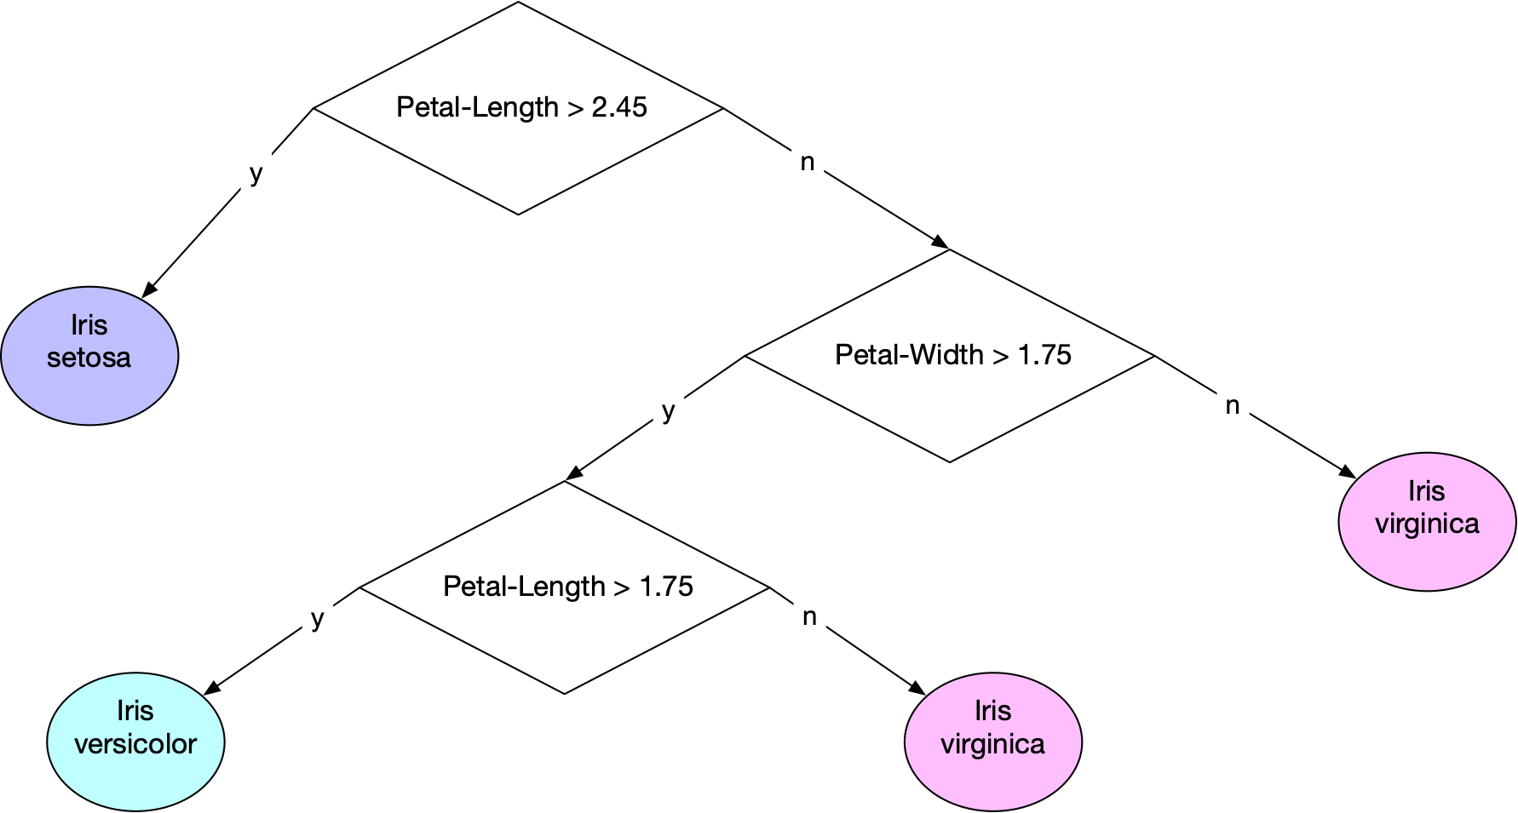
Processing Iris
Summary

Slide 38
Testing
Let's implement the decision tree:
def predict(element):
if element[2] < 2.45:
return 1
else:
if element[3] < 1.75:
if element[2] < 4.95:
return 2
else:
return 0
else:
return 0

Slide 39
Testing
And see how it works on the test data
One confused element or 1/36 error rate
Total:
Four confused elements out of 150

Slide 40
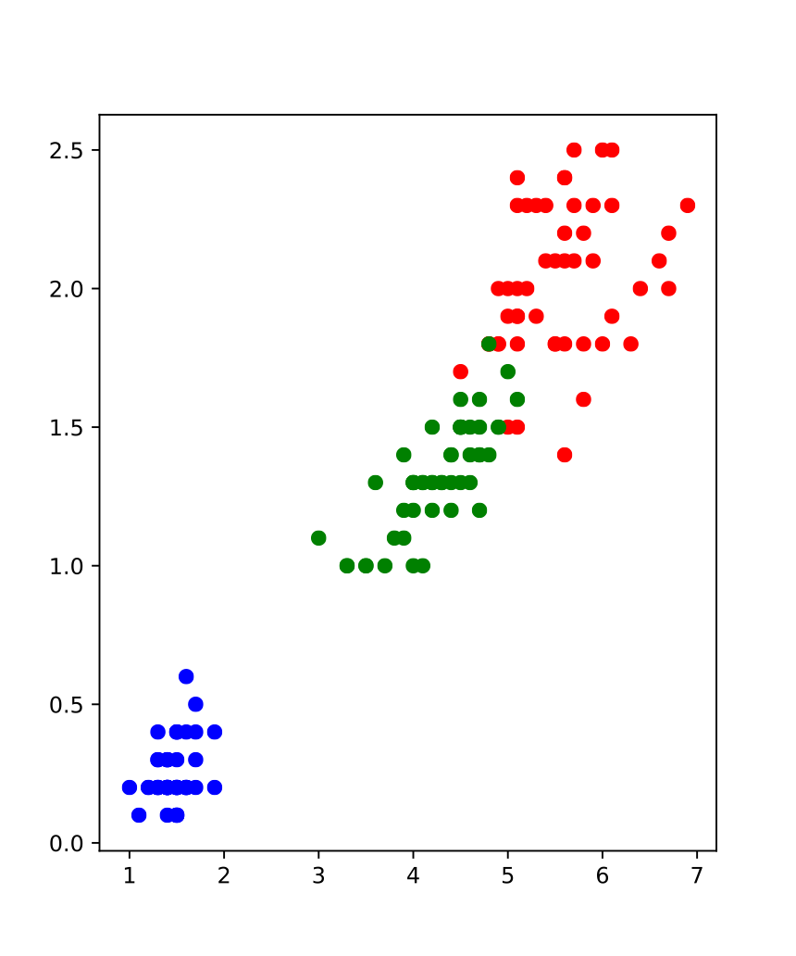
Result
Petal length and width are best at separating types
from matplotlib import pyplot as plt
plt.figure(figsize = (5,6))
plt.scatter( [el[2] for el in Iris if el[-1]==0],
[el[3] for el in Iris if el[-1]==0],
c='red' )
plt.scatter( [el[2] for el in Iris if el[-1]==1],
[el[3] for el in Iris if el[-1]==1],
c='blue' )
plt.scatter( [el[2] for el in Iris if el[-1]==2],
[el[3] for el in Iris if el[-1]==2],
c='green' )
plt.show()

