Slide 1
Python for Data Science
Overview of Python
Why Python
Installing Python
Installing Python Modules

Slide 2
Overview of the course
Assumptions:
We are here to learn some new skills
We learn new skills by doing
We work better with others
Python is important
It is a glue language
Need minimal python skills to use
It is interesting on its own
It's a modern language with interesting features
It's useful where-ever modules don't exist

Slide 3
Python
Python is an interpreted (scripting) language
Source code is compiled into a bytecode representation
Executed by Python virtual machine (usually implemented in C or Java)
If performance is needed:
Can call C-code from Python
Use PyPy with Just-In-Time compilation (JIT)

Slide 4
Python
Why Python:
Cool language
Extensible through modules
Statistics
Machine learning
Graphics

Slide 5
Python
Getting Python
Can use bundles (anaconda)
For the first half: get native Python from Python.org
Python 2.7 stable solution (built into MacOS)
Python 3.8.2 the version we need
Important : Allow automatic path adjustments on windows
This are the defaults

Slide 6
Python
Using Python:
We are going to use IDLE
Can create and safe scripts
Can interact directly in the IDE

Slide 7
Python 3 Modules
Python comes with many pre-installed modules
We need to install some modules
Use Pip
MacOS / Linus
In a shell:
Windows:
In a command window
thomasschwarz@Peter-Canisius Module1 % python3.8 -m pip install matplotlib
py -3.8 -m pip install matplotlib

Slide 8
Why Python
Universal, accessible language
Clear and simple syntax
Python philosophy: The frequent should be easy
Made for reading
Used for fast prototyping
Excellent support community
Help for beginners and experts is easily available

Slide 9
Why Python
Universal Language
Serves many different constituencies
Examples:
Gaming: AI engine is usually in Python
String processing: Basis for digital humanities and data wrangling
Many extension modules
With scypy or numpy, fast programs for scientific programming
Use pyplot for good quality graphics
…
Notebooks based on Python (Jupyter) integrate presentation, data, and programs

Slide 10
Why Python
Python in Data Science

Slide 11
Python Modules

Slide 12
Why Python
Example:
Time series data: closing prices of four stock indices
given as a cvs file
Use Pandas in order to deal with two dimensional data
Use matplotlib for graphics

Slide 13
Why Python? Time Series Example
Import the modules
Import the cvs file as a pandas dataframe
The first column should be the index, read as a date
import pandas as pd
import numpy as np
import matplotlib.pyplot as plt
raw_data = pd.read_csv('Index2018.csv')
values = raw_data.copy()
values.date = pd.to_datetime(values.date, dayfirst=True)
values.set_index("date", inplace = True)
print(values.describe())
print(values.head())

Slide 14
Why Python? Time Series Example
Fill in missing values and normalize to start at 100
Now display the US Standard & Poor and the German DAX
Now annotate the plot and show it
values.spx = values.spx.fillna(method = 'ffill')/values.spx['1994-01-07']*100.0
values.dax = values.dax.fillna(method = 'ffill')/values.dax['1994-01-07']*100.0
values.spx.plot(label='S&P')
values.dax.plot(label='DAX')
plt.title('S&P v DAX')
plt.xlabel('date')
plt.ylabel('Price')
plt.legend()
plt.show()

Slide 15
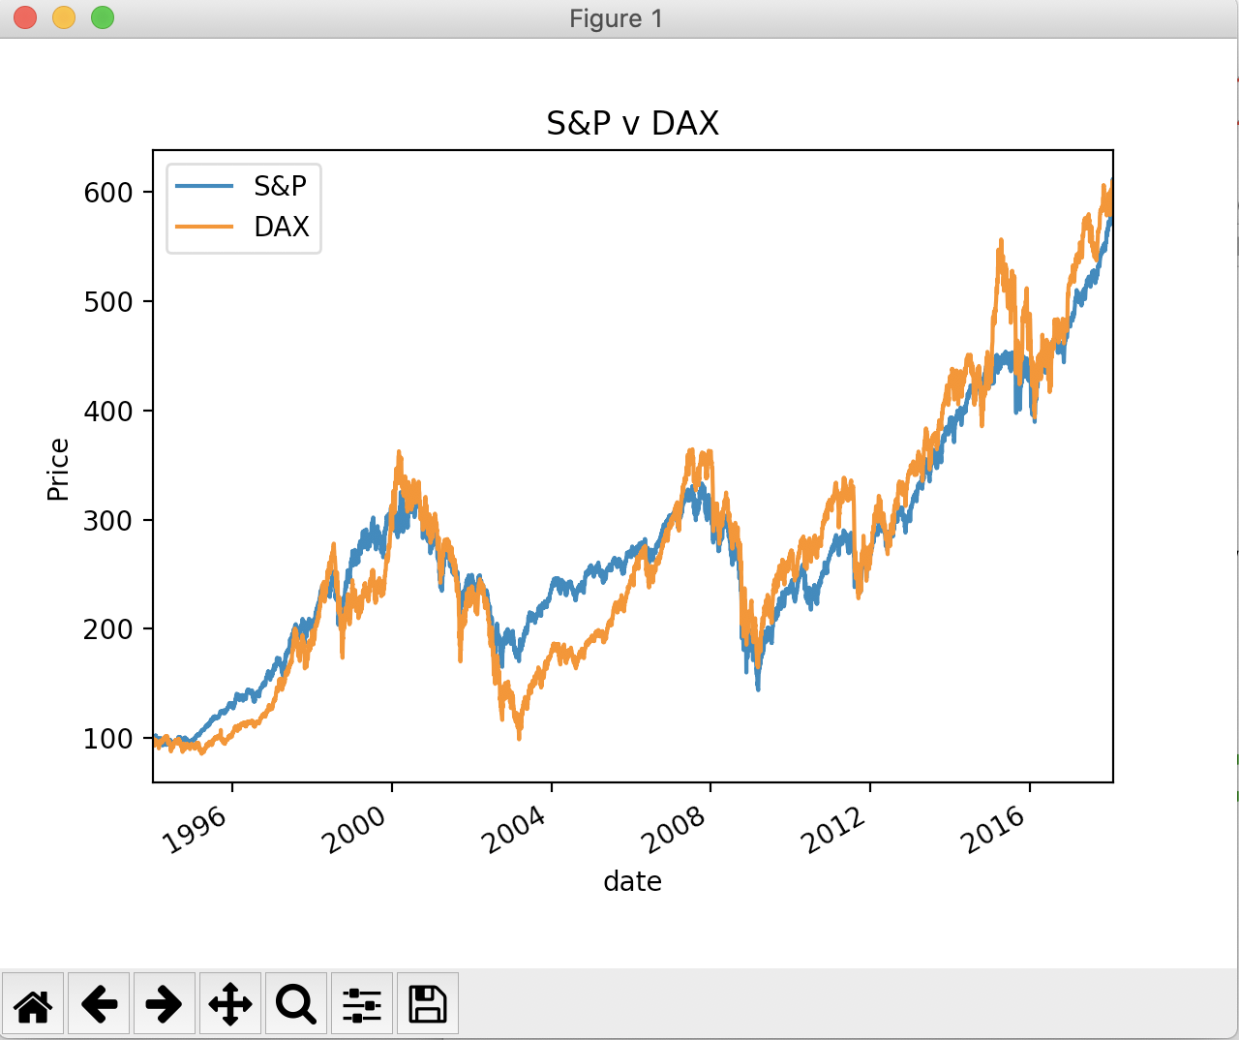
Why Python? Time Series Example
Result:

Slide 16
Why Python? Time Series Example

Slide 17
Why Python? Time Series Example

Slide 18
Why Python? Time Series Example

Slide 19
Why Python
Most of the programming was done for us
Needed to invoke powerful method
Majority of the code giving to small tweaks

Slide 20
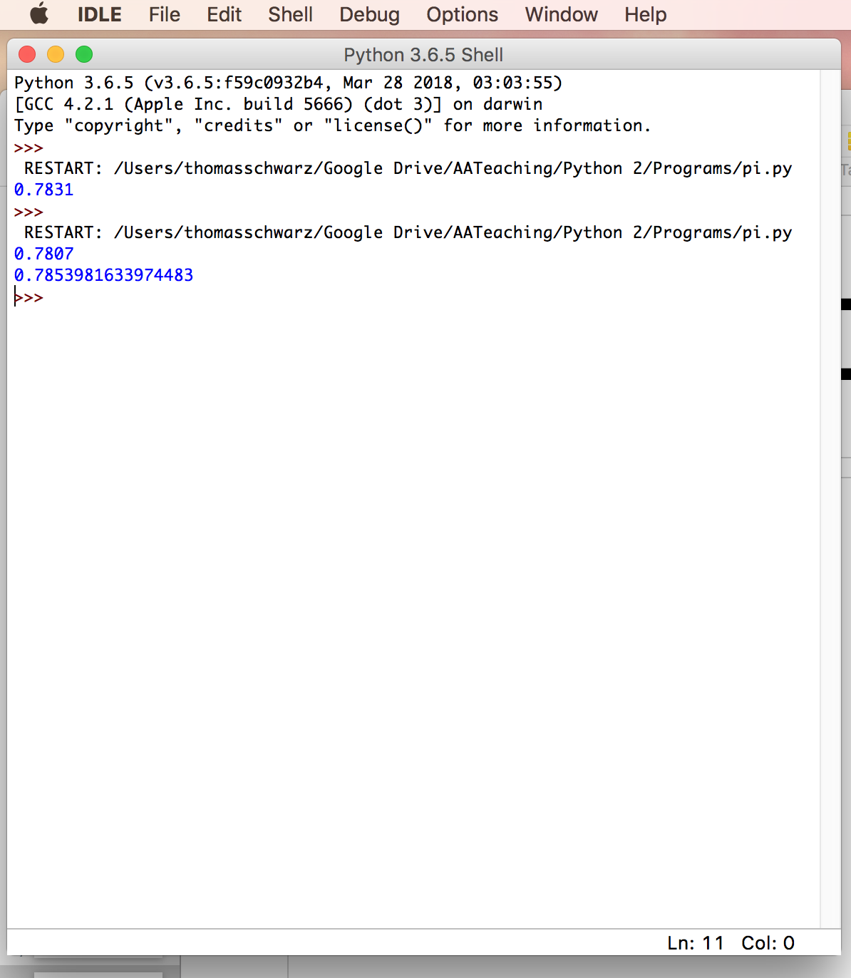
IDLE
IDLE is an interactive Python interpreter
Can be used as a desk calculator
Allows you to create new files

Slide 21
Variables and Types
All program languages specify how data in memory locations is modified
Python: A variable is a handle to a storage location
The storage location can store data of many types
Integers
Floating point numbers
Booleans
Strings

Slide 22
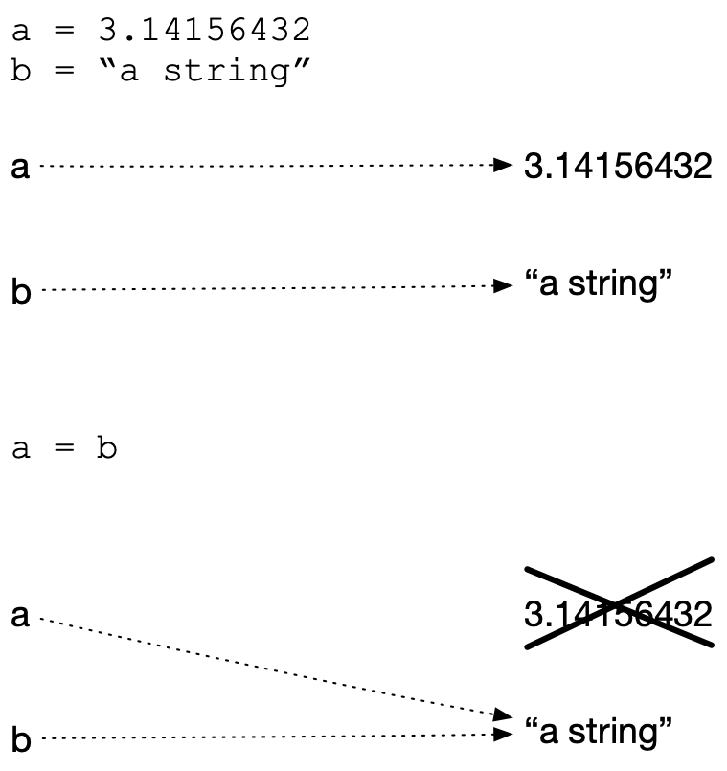
Variables and Types
Assignment operator = makes a variable name refer to a memory location
Variable names are not declared and can refer to any legitimate type
Create two variables and assign values to them
Variable a is of type floating point and variable b is of type string
After reassigning, both variable names refer to the same value
The floating point number is garbage collected

Slide 23
Expressions
Python builds expression from smaller components just as any other programming language
The type of operation expressed by the same symbol depends on the type of operands
Python follows the usual rules of precedence
and uses parentheses in order to express or clarify orders of precedence.

Slide 24
Expressions
Arithmetic Operations between integers / floating point numbers:
Negation (-), Addition (+), Subtraction (-), Multiplication (*), Division (/), Exponentiation (**)
Integer Division //
Remainder (modulo operator) (%)

Slide 25
Expressions
IF we use / between two integers, then we always get a floating point number
If we use // between two integers, then we always get an integer
a//b is the integer equal or just below a/b

Slide 26
Expressions
Strings are marked by using the single or double quotation marks
You can use the other quotation mark within the string
Some symbols are given as a combination of a forward slash with another symbol
Examples: \t for tab, \n for new line, \’ for apostrophe, \“ for double quotation mark, \\ for backward slash
We’ll get to know many more, but this is not the topic of today

Slide 27
Expressions
Strings can be concatenated with the +
They can be replicated by using an integer and the * sign
Examples:
“abc"+"def" —> 'abcdef'
‘abc\"'+'fg' —> 'abc"fg'
3*”Hi'" —> “Hi'Hi'Hi'"

Slide 28
Change of Type
Python allows you to convert the contents of a variable or expression to an expression with a different type but equivalent value
Be careful, type conversation does not always work
To change to an integer, use int( )
To change to a floating point, use float()
To change to a string, use str( )

Slide 29
Example
Input is done in Python by using the function input
Input has one variable, the prompt, which is a string
The result is a string, which might need to get processed by using a type conversion (aka cast)
The following prints out the double of the input (provided the user provided input is interpretable as an integer), first as a string and then as a number

Slide 30
Example
Python does not understand English (or Hindi) so giving it a number in other than symbolic form does not help
It can easily understand “123”
It does not complain about the expression having the same type.

Slide 31
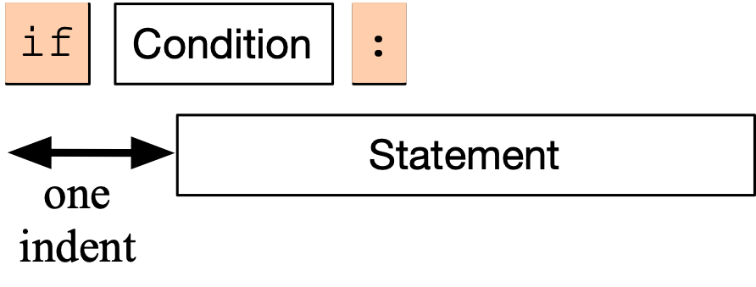
Conditional Statements
Sometimes a statement (or a block of statements) should only be executed if a condition is true.
Conditional execution is implemented with the if-statement
Form of the if-statement:

Slide 32
Conditional Statements
if — is a keyword
Condition: a Boolean, something that is either True or False
Statement: a single or block of statements, all indented
Indents are tricky, you can use white spaces or tabs, but not both. Many editors convert tabs to white spaces
The number of positions for the indent is between 3 and 8, depending on the style that you are using. Most important, keep it consistent.

Slide 33
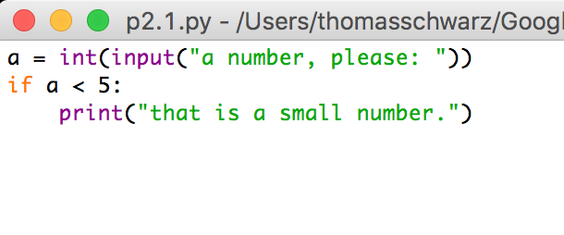
Example
First line asks user for integer input.
Second line checks whether user input is smaller than 5.
In this case only, the program comments on the number.

Slide 34
Example
Here we calculate the absolute value of the input.
The third line is indented.
The fourth line is not, it is always executed.

Slide 35
Example
Here, lines 3 and 4 are indented and are executed if the input is a negative integer.
The last line, line 5, is always executed since it is not part of the if-statement

Slide 36
Alternative statements
Very often, we use a condition to decide which one of several branches of execution to pursue.
The else-statement after the indented block of an if-statement creates an alternative route through the program.

Slide 37
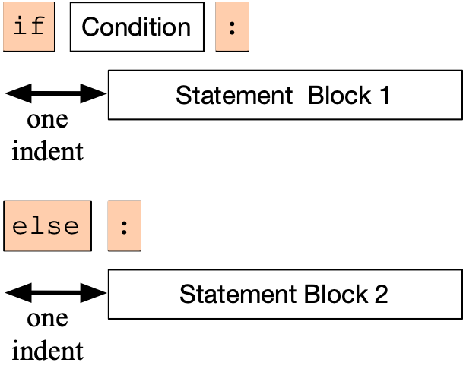
Alternative Statements
The if-else statement has the following form:
We add the keyword else, followed by a colon
Then add a second set of statements, indented once
If the condition is true, then Block 1 is executed, otherwise, Block 2.

Slide 38
Examples
I can test equality by using the double = sign.
To check whether a number n is even, I take the remainder modulo 2 and then compare with 0.

Slide 39
Alternative Statements
Often, we have more than two alternative streams of execution.
Instead of nesting if expressions, we can just use the keyword “elif”, a contraction of else if.

Slide 40
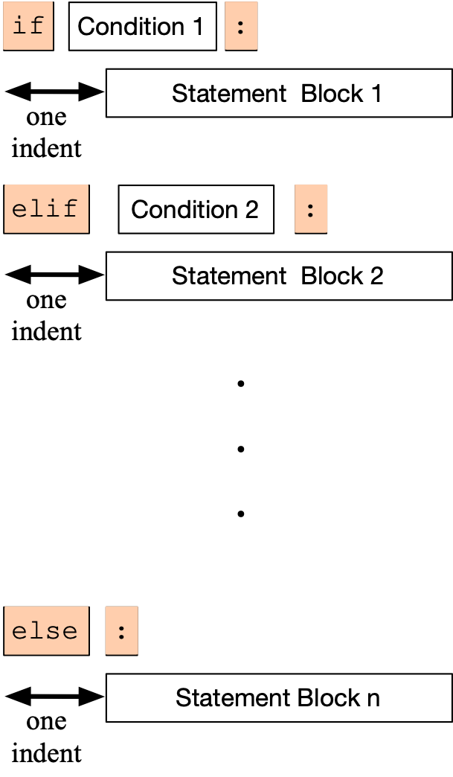
Alternative Statements
One of the statement blocks is going to be executed
The else block contains the default action, if none of the conditions are true

Slide 41
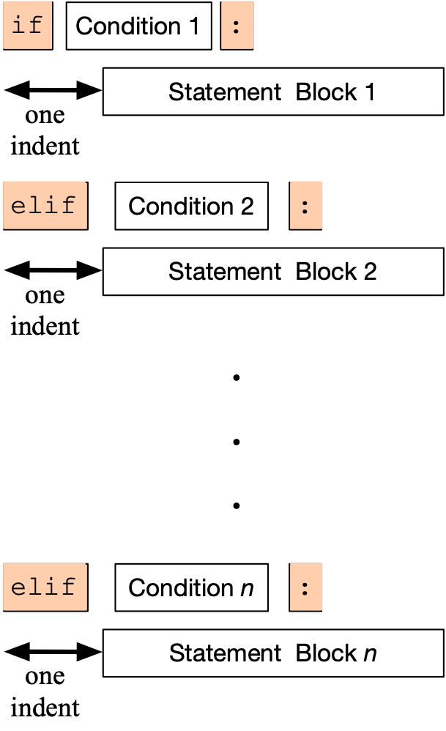
Alternative Statements
Here, there is no else statement, so it is possible that none of the blocks is executed.

Slide 42
Examples
Categorization of temperatures
if temperature < -25.0:
feeling = "arctic"
elif temperature < -10.0:
feeling = "Wisconsin in winter"
elif temperature < 0.0:
feeling = "freezing"
elif temperature < 15.0:
feeling = "cold"
elif temperature < 25.0:
feeling = "comfortable"
elif temperature < 35.0:
feeling = "hot"
elif temperature < 45.0:
feeling = "Ahmedabad in the summer"
else:
feeling = "hot as in hell"

Slide 43
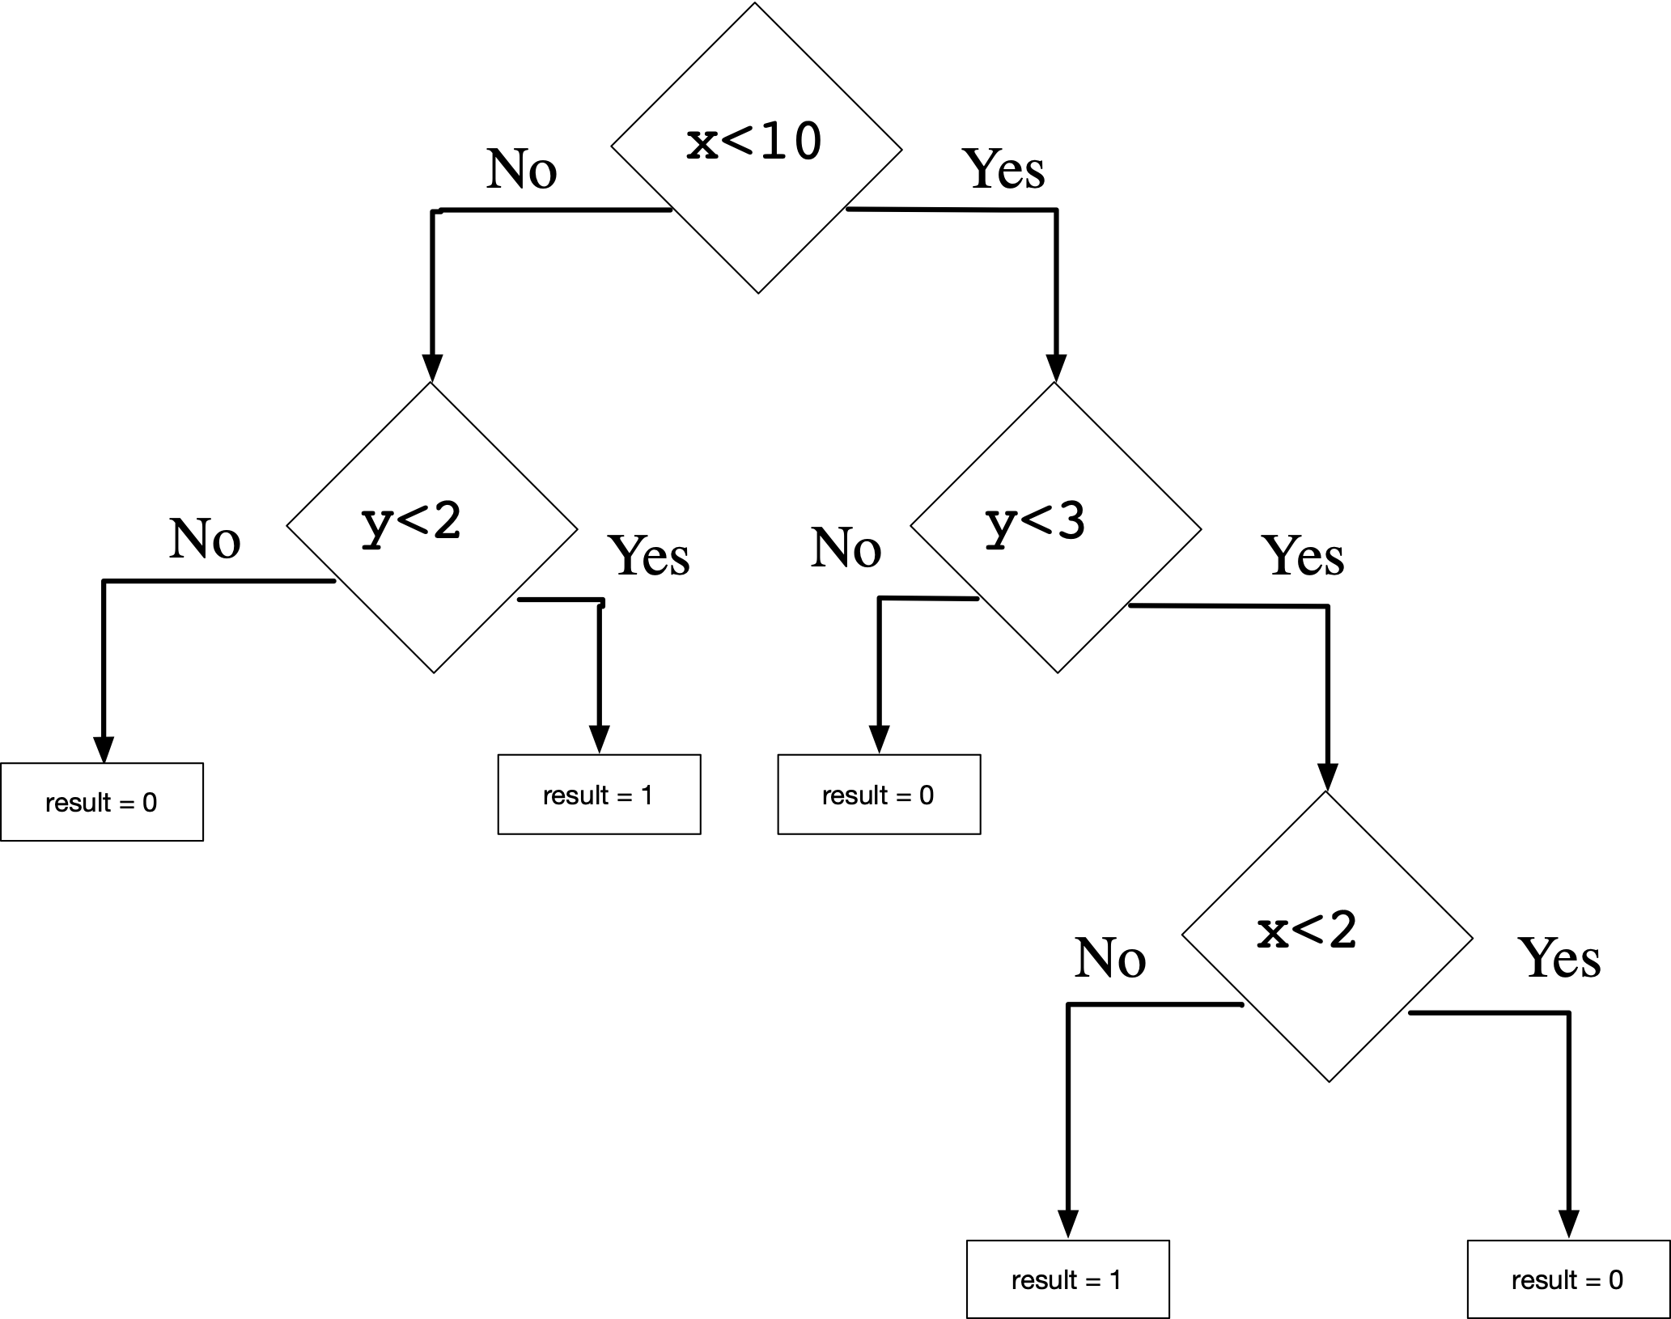
Boolean Expressions
Nested loops to implement decision tree:
if x<10:
if y<3:
if x<2:
result=0
else:
result=1
else:
result=0
else:
if y<2:
result=1
else result=0

